Slide 1
Impact of Covid on Employment in US
Team – Data Super-warriors

Slide 2

Project Proposal
We aim to analyze the impact of Covid across various industries and demographics across US.
Also, establish the correlation between Number of Covid Cases & Unemployment.
Correlation between Vaccination Rate and Employment Rate
Comparison of unemployment across states in Tristate area.
Focus on New Jersey (County wise analysis and correlation with Vaccination rate)
This Photo by Unknown Author is licensed under CC BY-NC-ND

Slide 3
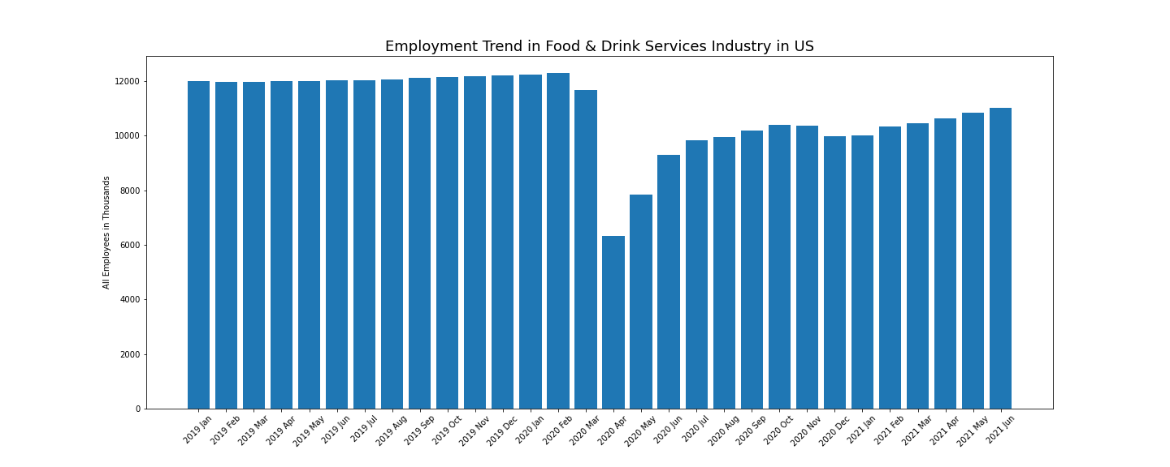
Analysis across Industries
Food & Drink Services
Education & Health Services
Government services
Goods Producing Industry
Information Industry
Leisure & Hospitality

Slide 4
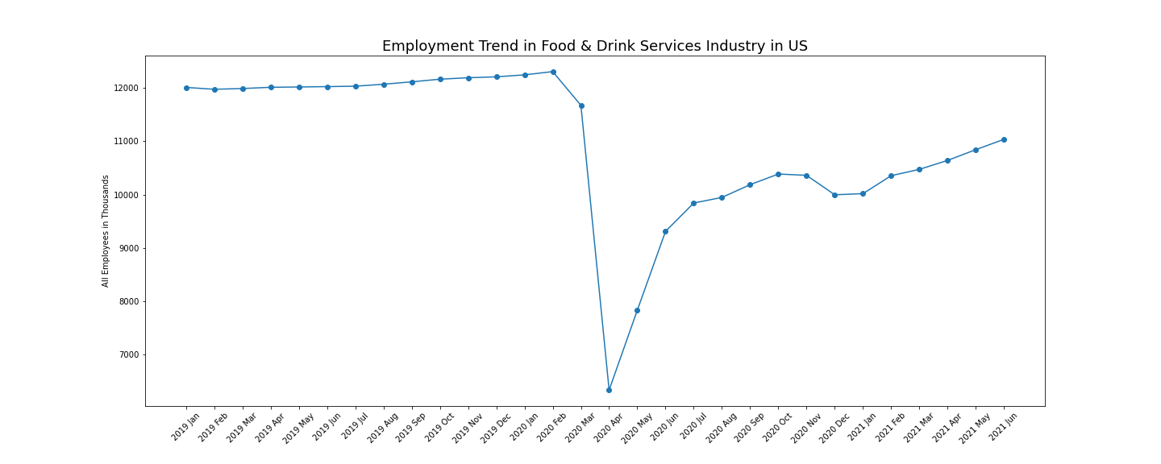
Analysis across Industries
Employment was hit the worst in Mar-April, 2020 when Covid started.

Slide 5
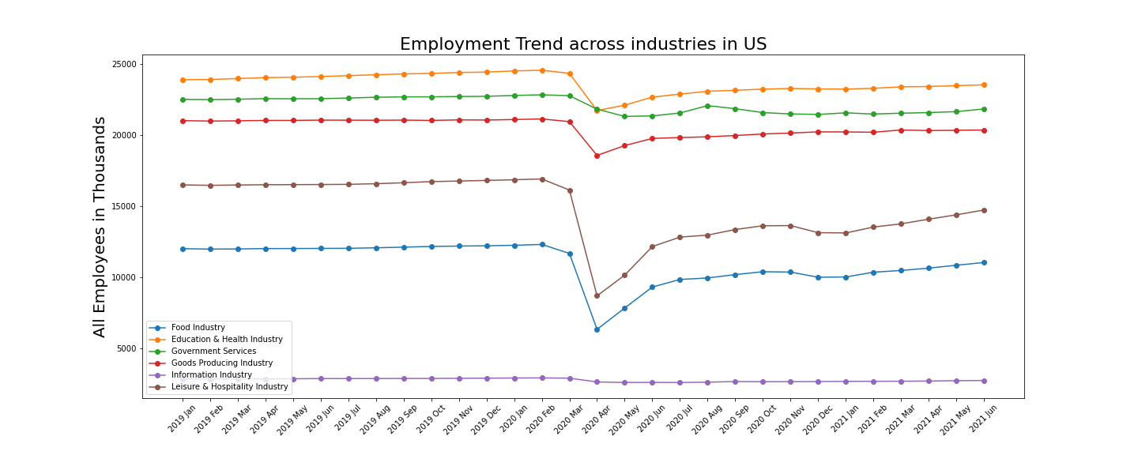
Analysis across Industries
Data Source:
U.S. Bureau of Labor Statistics (bls.gov)

Slide 6
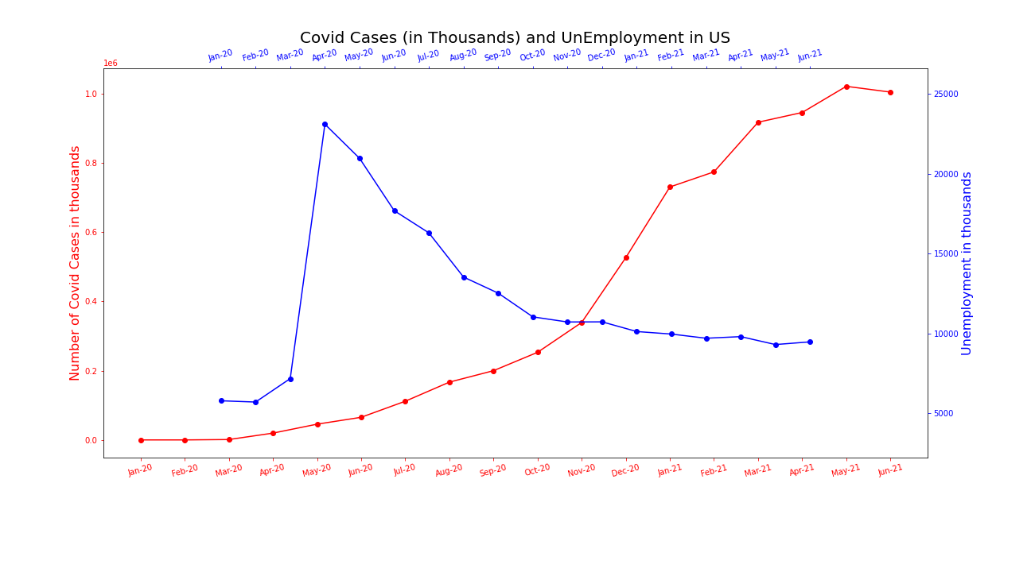
Number of Covid Cases Vs. Unemployment in US
Data for Covid Cases: https://github.com/nytimes/covid-19-data

Slide 7
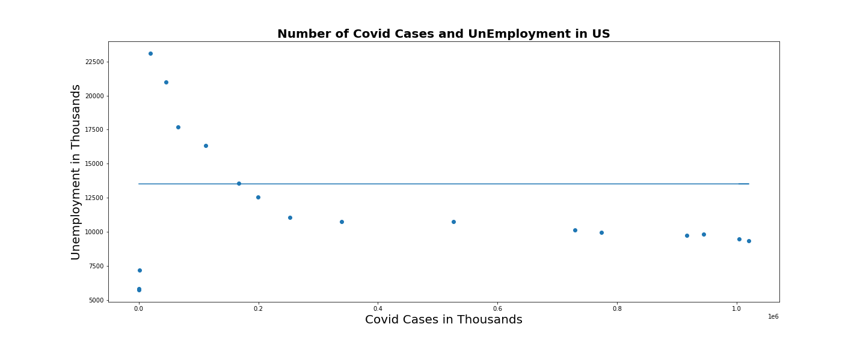
Correlation between Covid Cases & Unemployment in US
R-value = -0.34
P-value = 0.17

