Slide 1

Sports Equipment Management
Meet Mehta – B16CS016
Manvendra Kushwah – B16CS015

Slide 2







Key Features
Issue Equipment
Pay Dues
View all Outstanding
Student / Secretary
Student / Secretary
Secretary
Return Equipment
Check Dues of others
View all Available
Student / Secretary
Secretary
Secretary

Slide 3
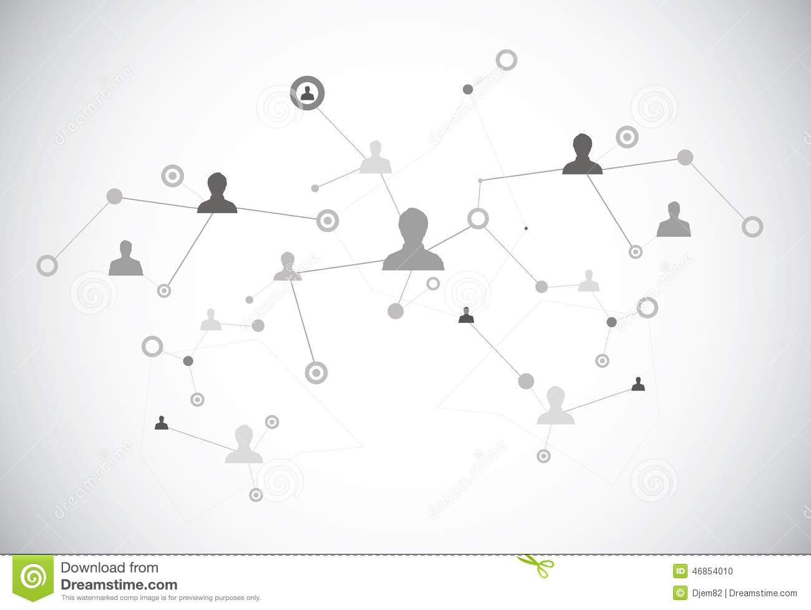
Use Cases
Login
Return Equipment
Issue Equipment
Check Availability
Guard Verification
Update Database
Check Dues
Pay Dues
01

Slide 4
Check Dues of other Student
Add Equipment
Get Valid ID
View Details
View all Outstanding
View all available
View by equipment category
02

Slide 5

Structure of Database
Available Equipments
Outstanding Equipments
MYSQL
Equipment Category
Equipment ID
Equipment Category
Equipment ID
Student Name
Roll Number
Issue Date
Return Date

Slide 6
Student
Total Equipments
MYSQL
Student Name
Roll number
Username
Password
Dues
Issecretary
Equipment Category
Equipment Price
Last issued id
Guard
Guard Name
Password

Slide 7

Things that could not be implemented
Database takes some time to fetch details and to go with the structure already decided it’s speed can’t be increased.
Automated testing was not done.
While issuing and returning equipment time of issue or return was not considered.
Was not able to hide password while user is entering.

Slide 8

Statistics of Unit Testing and System Testing
All the test cases were identified using unit and system testing.
All the major functions i.e. open function for all controller class were tested.
Any automated tool was not used.
Some of the test cases that were missed by us, identified by testing team are as follows :
While entering dues to be paid, string input were not handled.
Option 6 doesn’t work in secretary homepage.
Lowercase roll numbers doesn’t match.

Slide 9

Letter Dispatch Unit
Himanshu Dhankar - B16CS008
Ashutosh Yadav -

Slide 10




Use Cases
Add Letter
Post Letter
Generate Report
Complain
Check Letter Status
Update Letter Status
Add new users / update details
See all users

Slide 11




Statistics of Unit Testing
All functions added in the test report were verified.
Following were the main bugs identified :
Issues while changing username.
Segmentation fault is some cases.
Multiple complaints from same user.
Some cases of wrong input.

Slide 12
Conclusions
For developing any large application for multiple users C++ is not a good option.
Also development of large applications should be done in same ide if possible, as integration becomes easier.
Using a database like MYSQL or ORACLE is a quite better option than just using files like txt/csv.
Code modularization is highly important to make larger programs.

Slide 13
Thank You !
Notes:
Thank you

