Slide 1


Slide 2

Major Project-II (01CE0807)
Review 1 (01/03/2025)
Hospital Management System
Team ID: 8CE_INT026
Meet Khanesha (92100103180)(TC1)
Guided By
Internal Guide Name: Prof.Dhara joshi
External Guide Name: Dipali Dhandhukiya
Department of Computer Engineering, Faculty of Engineering & Technology

Slide 3
Outline
Overview of the company
Overview of Different Units
Achievements
Contact Info
Introduction
Abstract
System Analysis
Project Flowchart
Database
ER Diagrams
Use case diagrams
Tools & Technology
UI Design
Expected Outcomes

Slide 4

Overview of the Company
BitCoding Solutions, based in Surat, has been a leader in Web Development, App Development, AI/ML, and IT services since 2018.
We work with top companies and always deliver beyond our clients' expectations.
BitCoding Solutions was founded by Tushar Kachhadiya.
It is your trusted partner for innovative digital solutions, delivering excellent services for all businesses.

Slide 5
Overview of the Company
vision
At BitCoding Solutions, we aim to lead in technology by creating new standards in software development and IT services. Our goal is to help businesses grow with innovative and scalable solutions, making it easier for them to succeed in the digital world.
Mission
We provide high-quality, customized software and IT solutions to meet your specific needs. With our expertise and dedication, we help you work more efficiently and achieve success, becoming your trusted technology partner

Slide 6
Overview Of Different Units
AI/ML Development
Web Scraping
Android App Development
Python Development
Flutter Development
React.JS
Node.JS
Web Design
UI/UX Design

Slide 7




Achievements
🚀 We Are Growing & Driving Business Success
✔️ 100+ Satisfied Clients ✔️ 150+ Completed Projects
✔️ 80+ Skilled Experts ✔️ 590+ Media Posts

Slide 8
Contact Info
📍 Address 401, Vishvambhar Arcade, Near Yamuna Chowk, Mota Varachha, Surat - 394101
📧 Email info@bitcodingsolutions.com
⏰ Working Hours Monday - Friday: 09:00 AM - 06:00 PM
📞 Phone +91 90990 78077

Slide 9
Introduction
Hospitals and healthcare facilities require a digital system to manage patient records, appointments, and administrative tasks efficiently.
Our Hospital Management System (HMS) mobile application simplifies and streamlines hospital operations.
The app provides a user-friendly and secure platform for both patients and hospital staff
Patients can easily book appointments, access their medical records, and receive real-time updates.
The system is built using Firebase and Android technology.

Slide 10
Abstract
A doctor-patient interaction system is essential with the rapid growth of communication technology.
The App helps bridge time and distance gaps, enabling faster and more efficient medical services.
The system connects users with medical services, allowing easy access to patient data and consultations.
App platforms, App services, and databases have advanced, making it possible to develop an effective system.
The goal is to enhance patient care, improve doctor efficiency, and provide a seamless communication platform for healthcare services.

Slide 11
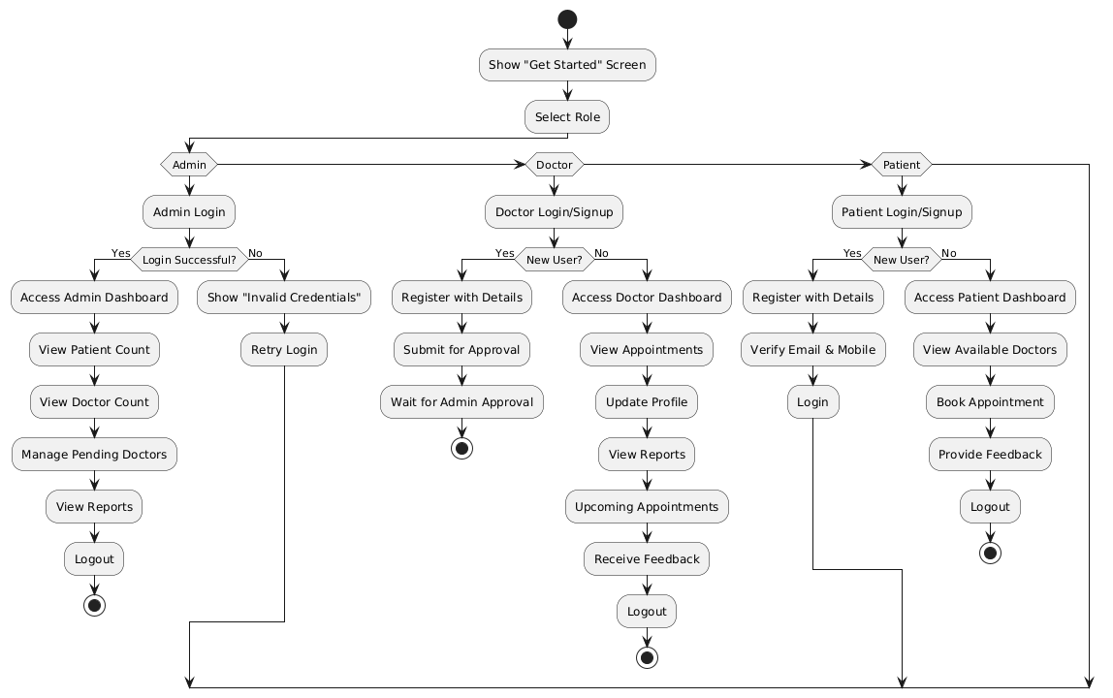
Flowchart

Slide 12
Database
Admin
Patient
Column Name | Data Type
admin_id | INT
email | VARCHAR(255)
password | VARCHAR(255)
Column Name | Data Type
patient_id | INT
name | VARCHAR(255)
gender | VARCHAR(50)
dob | DATE
email | VARCHAR(255)
phone | VARCHAR(20)
Doctor
Column Name | Data Type
doctor_id | INT
name | VARCHAR(255)
gender | VARCHAR(50)
dob | DATE
email | VARCHAR(255)
phone | VARCHAR(20)
specialization | VARCHAR(255)
experience | INT
Appointment
Column Name | Data Type
appointment_id | INT
doctor_id | INT
patient_id | INT
date | DATE
time | TIME
availability | VARCHAR(100)
Record
Feedback
Column Name | Data Type
record_id | INT
patient_id | INT
doctor_id | INT
treatment_plan | TEXT
created_at | DATE
Column Name | Data Type
feedback_id | INT
patient_id | INT
rating | INT
comments | TEXT

Slide 13
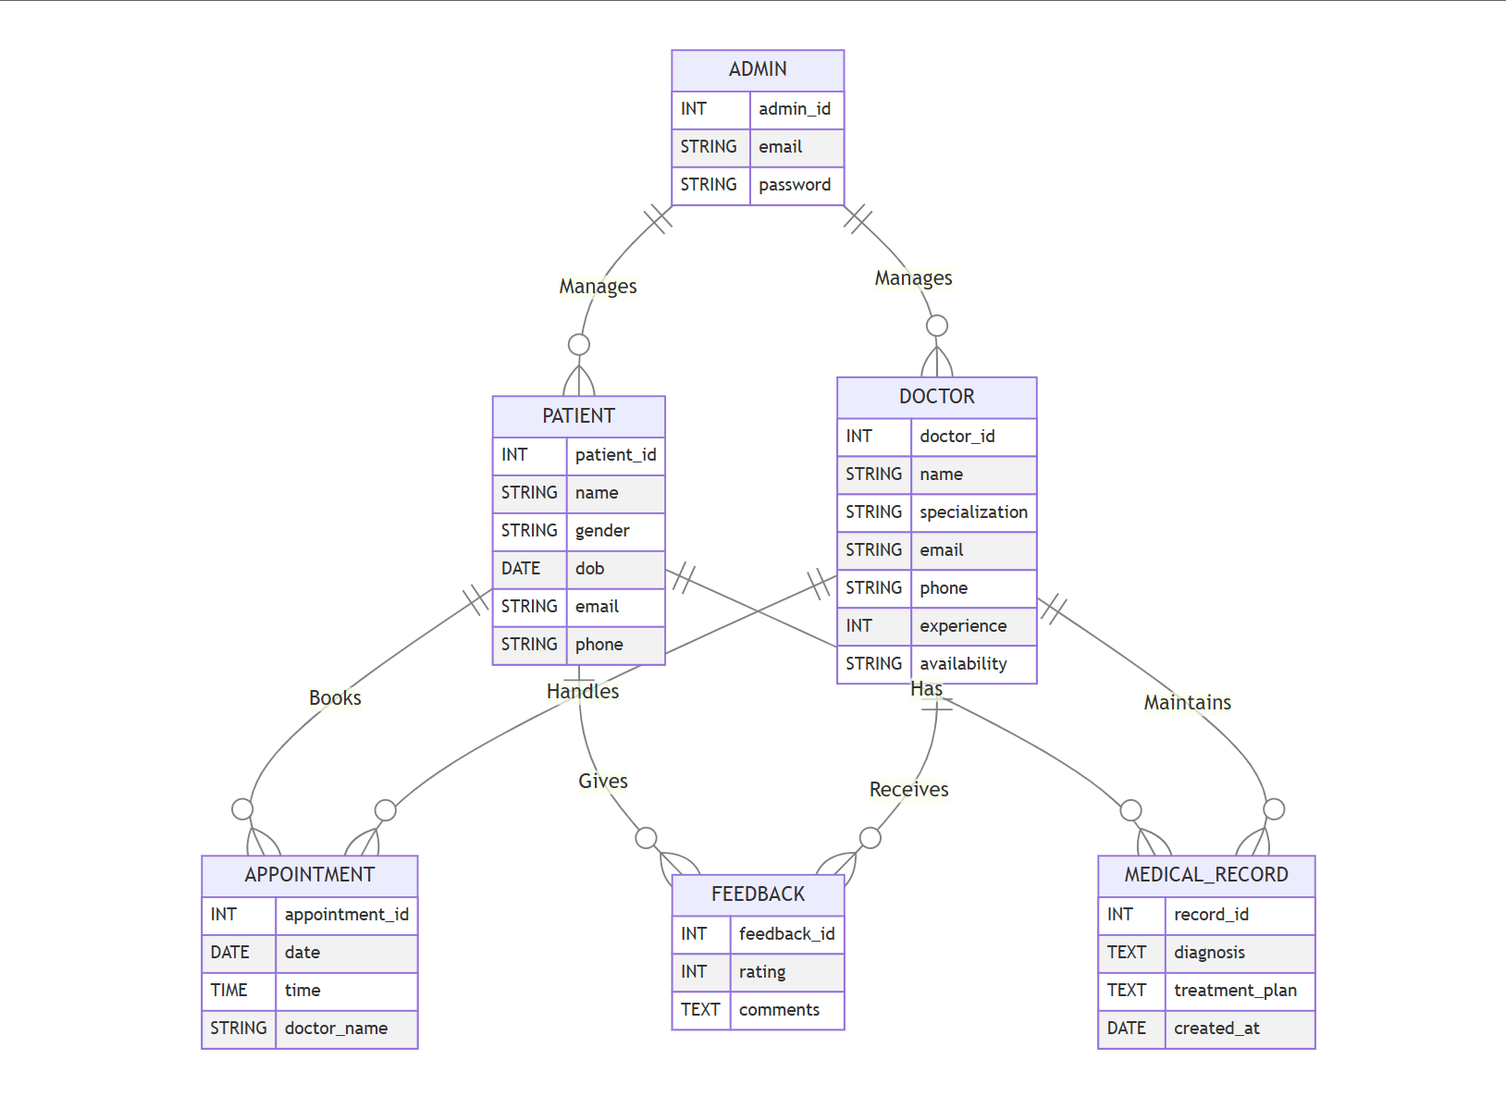
ER-Diagram

Slide 14
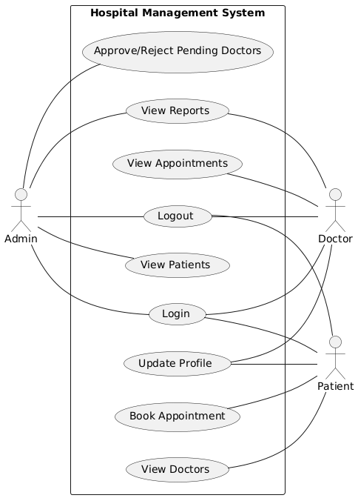
Use case Diagram

Slide 15
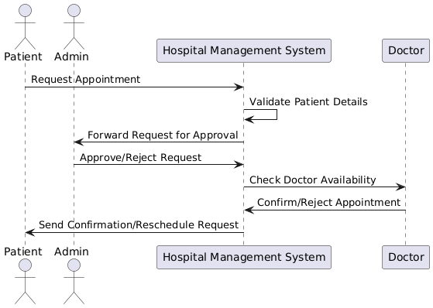
Sequence Diagram

Slide 16




Tools & Technology to be used
Tool
Android studio
Technology
Frontend
XML
Backend
Java
Firebase

Slide 17
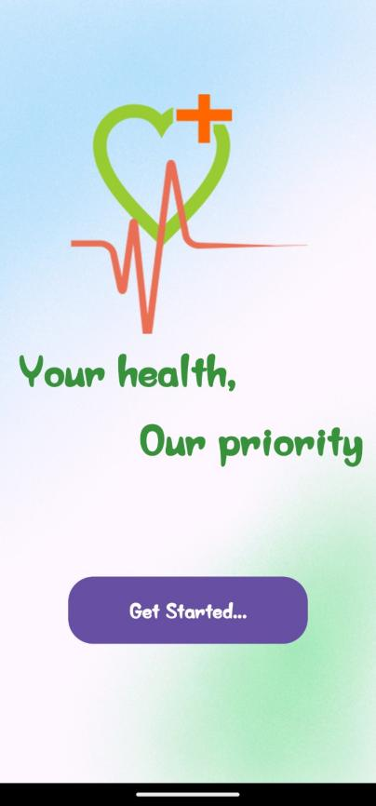
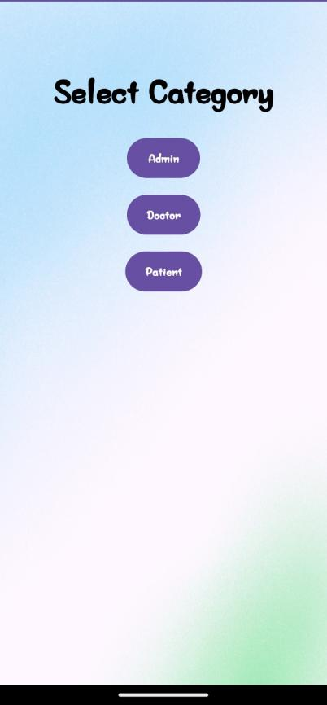
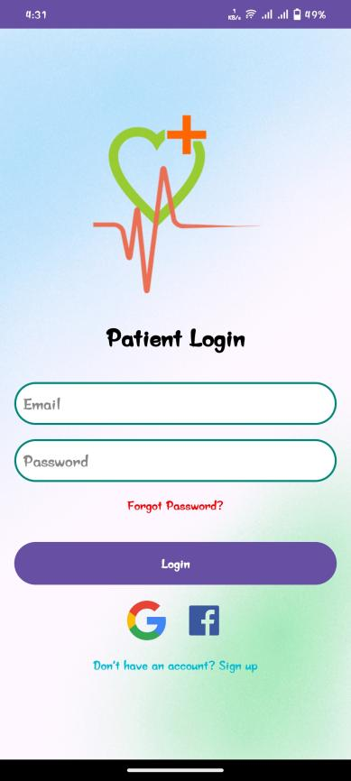
UI Design

Slide 18
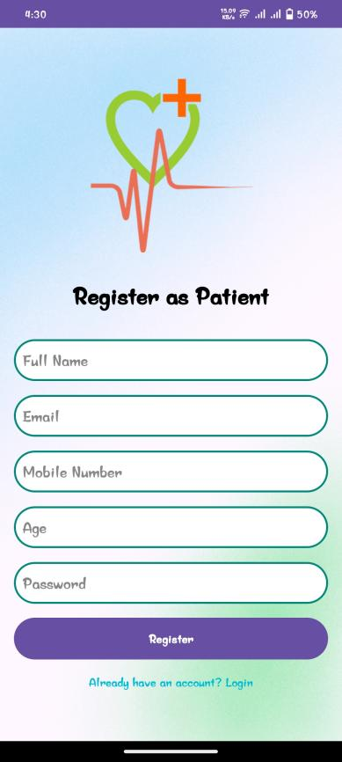
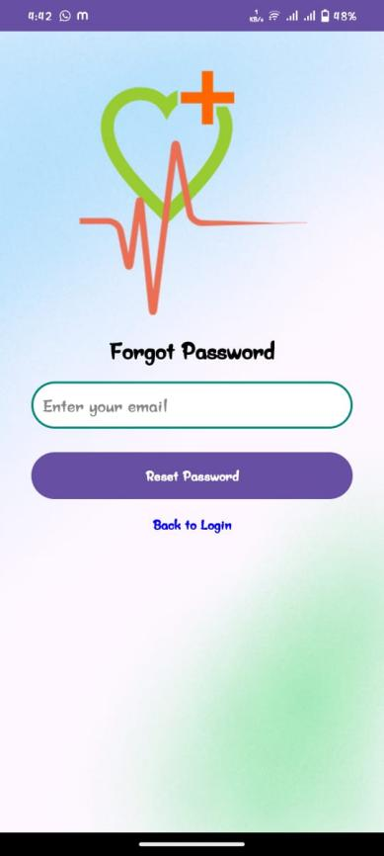
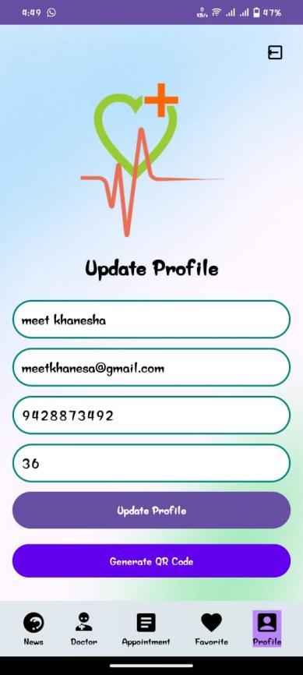
UI Design

Slide 19
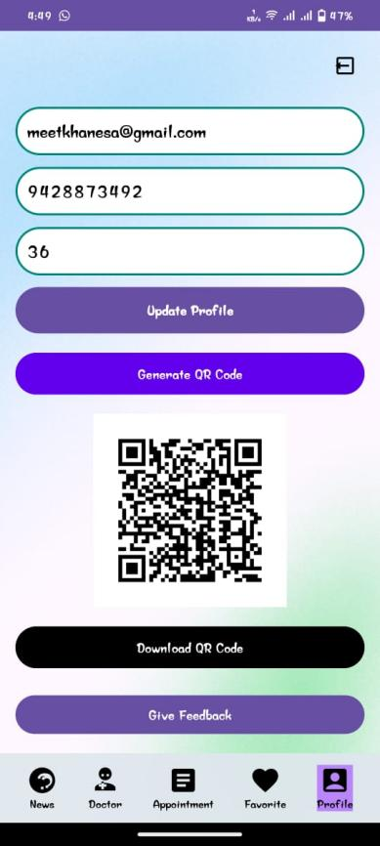
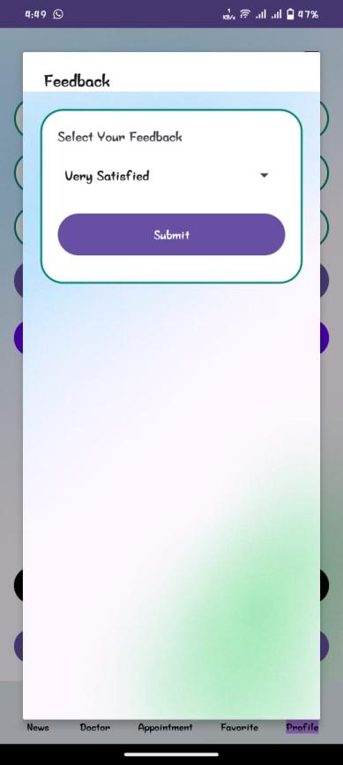
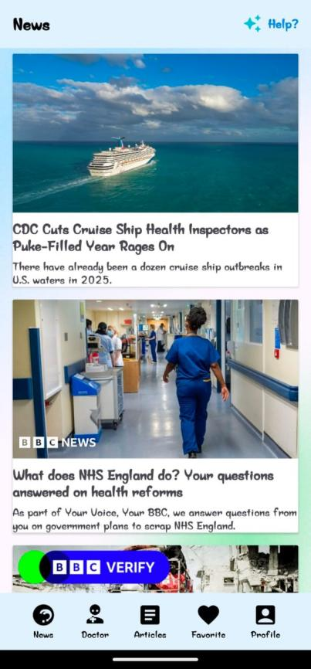
UI Design

Slide 20
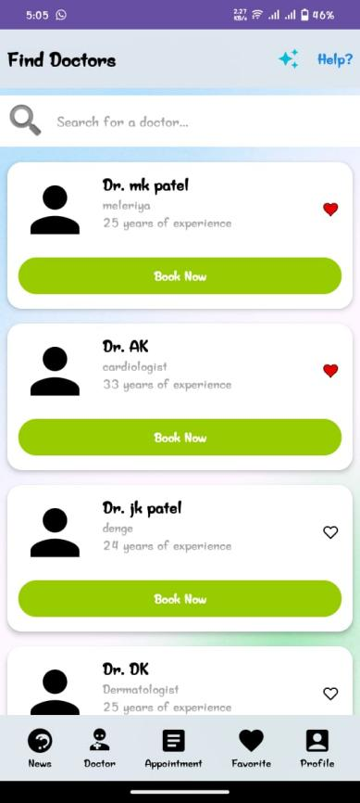
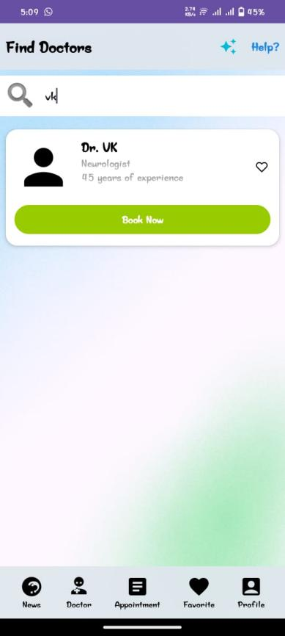
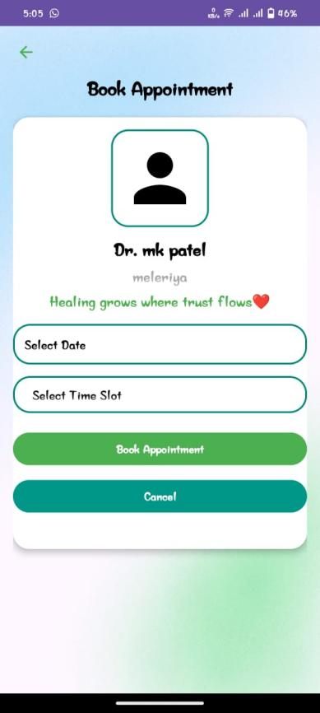
UI Design

Slide 21
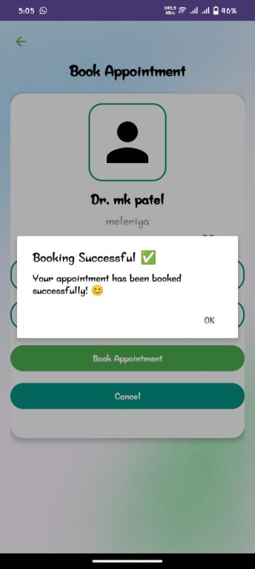
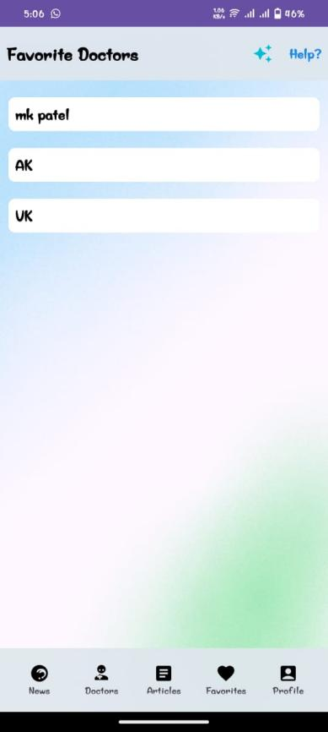
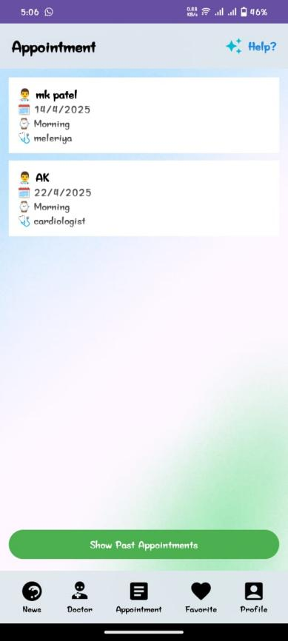
UI Design

Slide 22
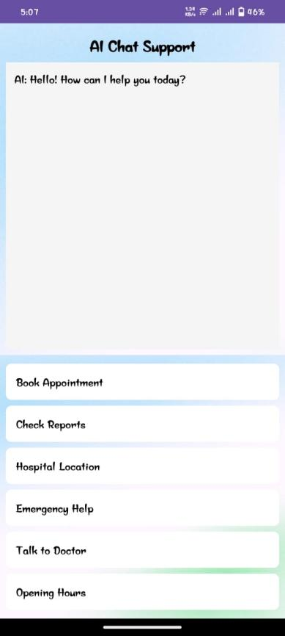
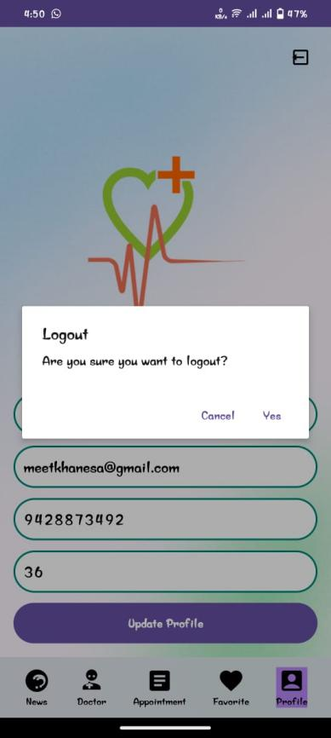
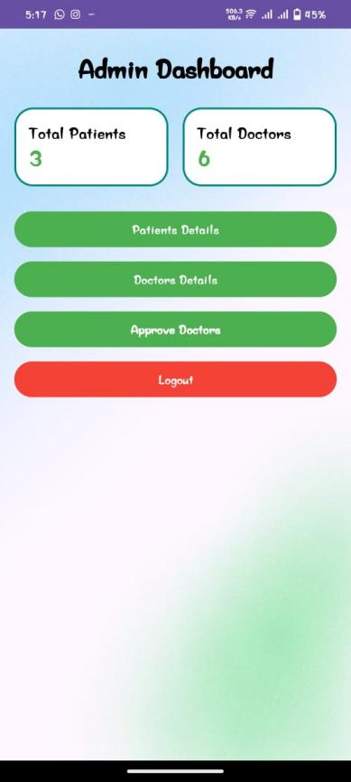
UI Design

Slide 23
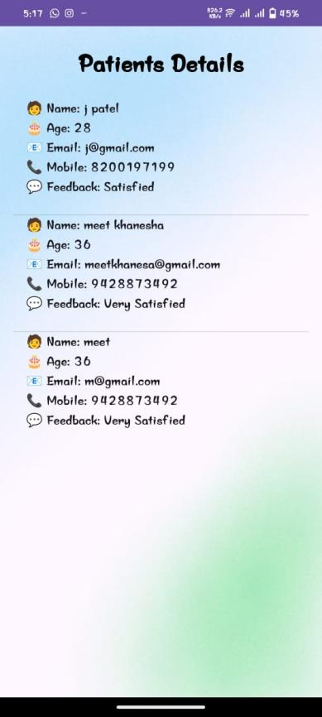
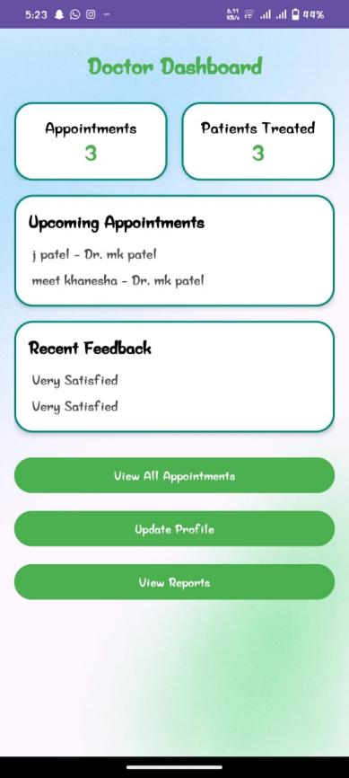
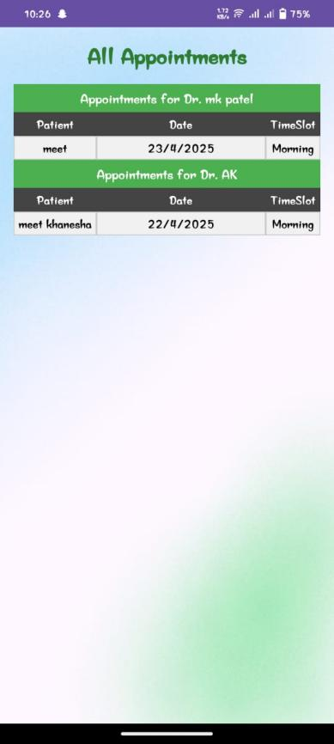
UI Design

Slide 24
Expected Outcomes
Improved Patient Experience – Patients can easily book appointments, access medical records, and receive real-time updates.
Efficient Hospital Management – Doctors and administrators can manage patient records, schedules, and appointments seamlessly.
Paperless & Digital Workflow – Reduces paperwork by storing and managing data digitally in Firebase.
Secure & Reliable System – Ensures data privacy and security using authentication and cloud storage.
Faster Medical Services – Reduces waiting times by streamlining appointment scheduling and patient data retrieval.
Remote Accessibility – The mobile app allows users to access hospital services anytime, anywhere.

Slide 25


