Slide 1
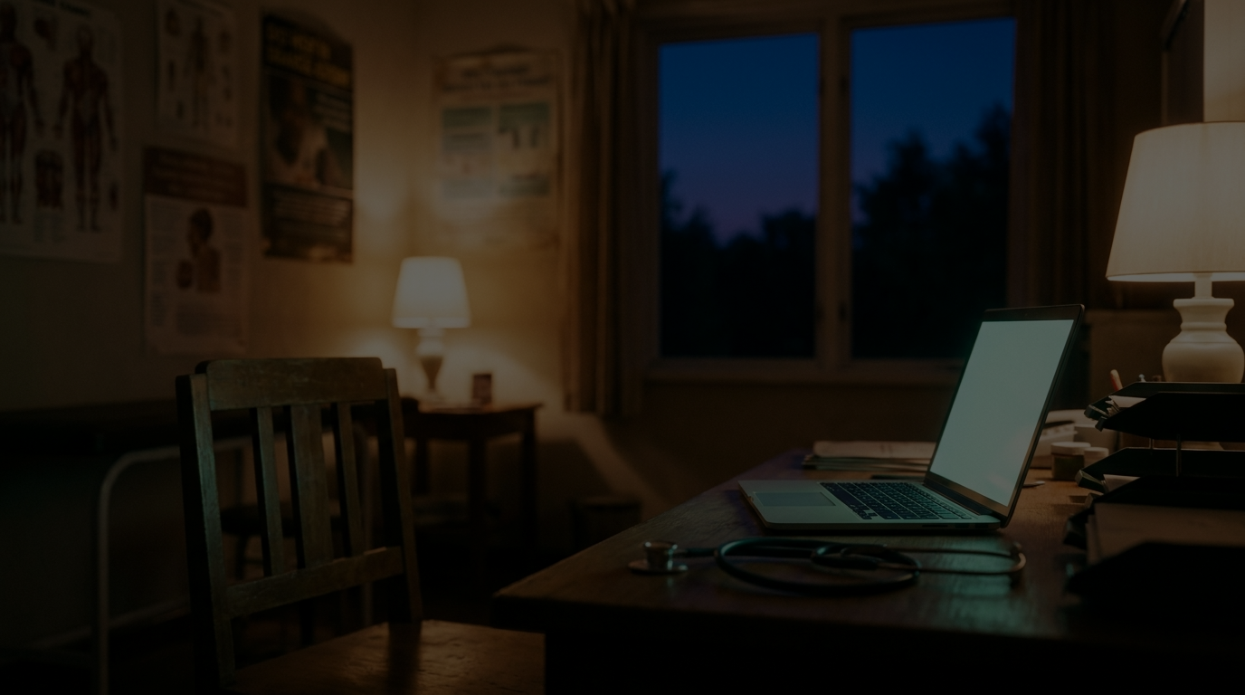
OBSCURA
Four tools. One laptop. Zero cloud.
Open-source AI for the clinics America runs on

Slide 2

2 hours at a desk
for every
1 hour with a patient.
That’s a doctor’s day now — and one in five say they intend to leave medicine within two years.
AMA time-motion study, Annals of Internal Medicine · intent-to-leave: Mayo Clinic Proceedings physician survey
2
OBSCURA

Slide 3
The clinics that need AI most
are the ones that can’t use it.
Cloud AI costs hundreds per doctor per month · won’t sign a HIPAA agreement · assumes an IT department
3
OBSCURA

Slide 4
The upload is the breach.
Sending a patient record to a cloud AI to ask “what’s sensitive?” is itself the disclosure.
4
OBSCURA

Slide 5
Open models changed everything.
Gemma 4 · Apache-2.0 · frontier reasoning on a stock laptop — no account, no fee, no network
5
OBSCURA

Slide 6
One engine. Four prongs.
Transcribe
The visit writes itself.
01
Redact
Share the record, not the patient.
02
Secure
A $0 IT department.
03
Organize
Files that name themselves.
04
AI proposes. A human approves. It verifies itself.
6
OBSCURA

Slide 7
Everything happens inside the laptop.
THE CLINIC'S LAPTOP — THE TRUST BOUNDARY
Signed note
Redacted PDF
Safety Score
Clean files
Visit audio
Documents
Messy files
SCAN
GEMMA 4
APPROVE
VERIFY
→
deterministic rules
regex · Luhn · collectors
→
one local model
reads · reasons · classifies
→
a human clicks
— always
→
attacks its own output
re-OCR · journal · undo
→
Network egress: 0 — pull the Wi-Fi and everything still works.
7
OBSCURA

Slide 8

It destroys data — and proves it.
0
recoverable characters after redaction
18
HIPAA Safe Harbor identifiers in the coverage panel
4
self-run verification checks on every export
Select-all · text-search · re-OCR · metadata audit — the tool attacks its own output before you trust it
8
OBSCURA

Slide 9
Free. Forever. For everyone.
Apache-2.0 · runs on the laptop the clinic already owns
Cloud AI scribes run $299–$1,512 per doctor, per month. Redaction suites, $279+/user. IT support, $150/user.
Obscura replaces that stack at $0 — for the clinics the $300M cloud-scribe market doesn’t serve.
9
OBSCURA

Slide 10

This is what the
time is for.
As fast as AI.
As private as a locked filing cabinet.
Open models made this inevitable. We just built it first.
OBSCURA
github.com/meetkpatel/Obscura
built on Gemma 4 · Apache-2.0

