Slide 1
ProteoML
Machine learning based Classification and Prediction of Intrinsically Disordered Proteins/Regions in Human Proteome
-Aishwarya Kanchi Ranganath
-Deep Pandya
-Mandhara Jayaram
-Meet Mukadam

Slide 2
Abstract
With applications in Genetics, Bioinformatics and Pharmacy, our model can be used for expediting research in the cure of neurodegenerative disorders like Alzheimer’s, Parkinson’s and cancers like Leukemia, Sarcoma, along with bypassing complex lab techniques, all in the field of Health Care.
The first protein structures and their sequence, after complex isolation and purification, were discovered and studied using crystallography methods initially and in more recent years, using spectroscopy. Until quite recently, proteins were thought to have fixed 3D structures. But recent advances have shown that some proteins (IDPs) and some regions of proteins (IDRs) also have a disordered structure that have both important functional and harmful implications. Their ability to transiently shift between phases, along with flexible multi-domain assemblies, have come to be known for important physiological functions as well as characteristic of certain diseased states.
Using DisProt as the database for IDPs and IDRs, which contains only a fraction of all proteins and regions of the human proteome whose data was obtained from UniProt - IDPs are ~800 in # and IDRs are ~2000 in number compared to the entire human proteome which is ~70000 in number - we have tried to predict which among the ~70000 might have the features for disorderly-ness, based on 11 characteristics. Prediction was done on the human proteome data set with an accuracy of ~82%. This model helps to obtain these characteristics of proteins in diseases much faster, thereby helping to build the IDP/IDR database.

Slide 3
Model Architecture
Random Forest Classifier
4000 estimators
Feature selection metric - Gini index
Pruning on depth - 11

Slide 4
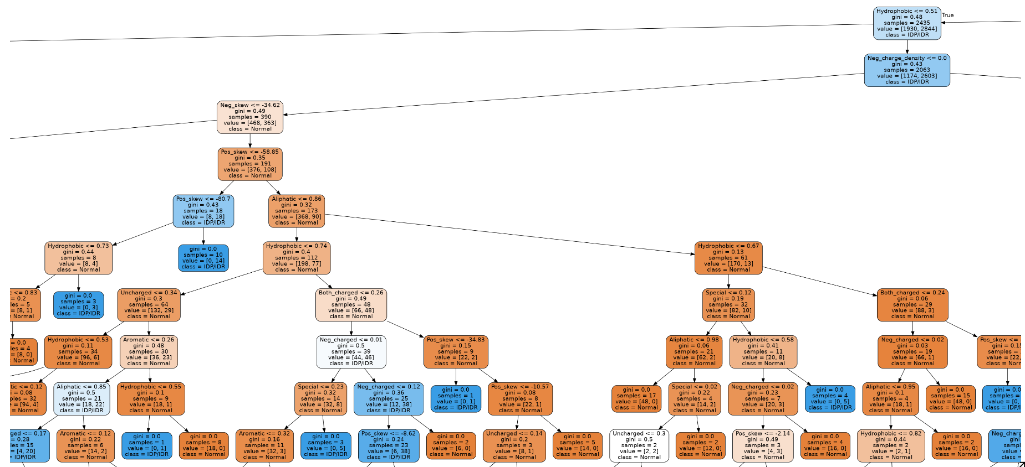

Slide 5
Results
Accuracy on test set = ~82%
Confusion Matrix:
Confusion Matrix | Predicted - disordered | Predicted - ordered
Actual - disordered | 562 | 169
Actual - ordered | 80 | 569

Slide 6
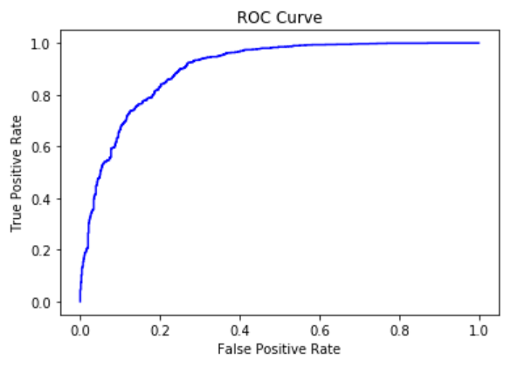
Results continued

Slide 7
Results continued
Sensitivity (true positive rate) - 0.88
Specificity (true negative rate) - 0.77
The Matthews Correlation Coefficient (MCC) has a range of -1 to 1 where -1 indicates a completely wrong binary classifier while 1 indicates a completely correct binary classifier. Using the MCC allows one to gauge how well their classification model/function is performing. Our model is showing an MCC of 0.65.

Slide 8
How did we validate our model?
Apart from statistical validations, we have conducted validations by comparing with results from lab experiments.

Slide 9
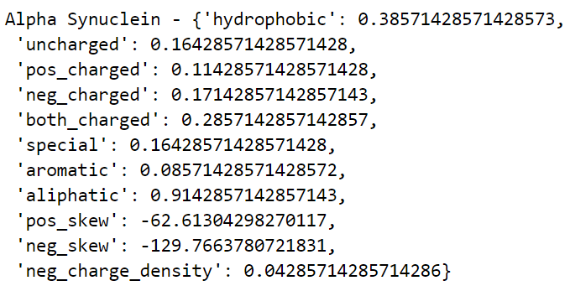
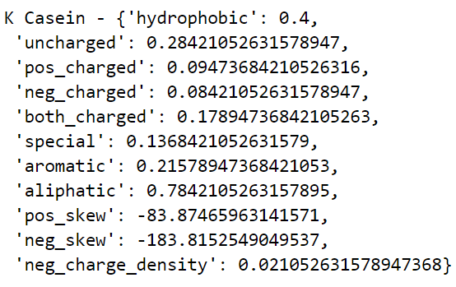
How do we tie the results?
We found some proteins linked to neurodegenerative diseases like Alzheimer's, Parkinson's, Huntington's, ALS (Lou Gehrig’s disease), Sarcoma and Leukemia.

Slide 10
What next?
We have extracted 8 biochemical and 3 sequential properties in our feature set.
Need more features based on structural information.
Need more IDPs/IDRs data.

