Slide 1
Chatbot
Design Engineering (3CP08)
21CP044 – Zil J. Rajwadi
22CP308 – Meet N. Mistry

Slide 2
Project Overview
Development of a Chatbot integrated with website management functionalities and speech-to-text recognition.
Leveraging the Botpress platform to serve both administrators and users.
Administrators can manage website data within the Botpress environment.
Users can access website information through natural language interactions.
Aiming to enhance website management efficiency and user engagement.

Slide 3
Technologies Used
Frontend:
HTML for structuring web pages.
CSS for styling and layout.
JavaScript for dynamic interactions and user interface enhancements.
Backend:
Python for server-side logic and integrations.
Botpress API for chatbot functionalities and managing conversational flows.

Slide 4
DESIGN CONSIDERATION FOR DETAIL DESIGN

Slide 5

Context Diagram

Slide 6
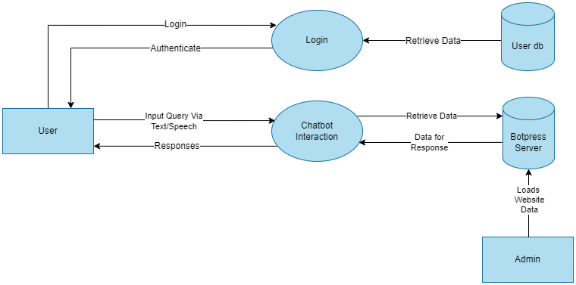
Data Flow Diagram(Level 1)

Slide 7
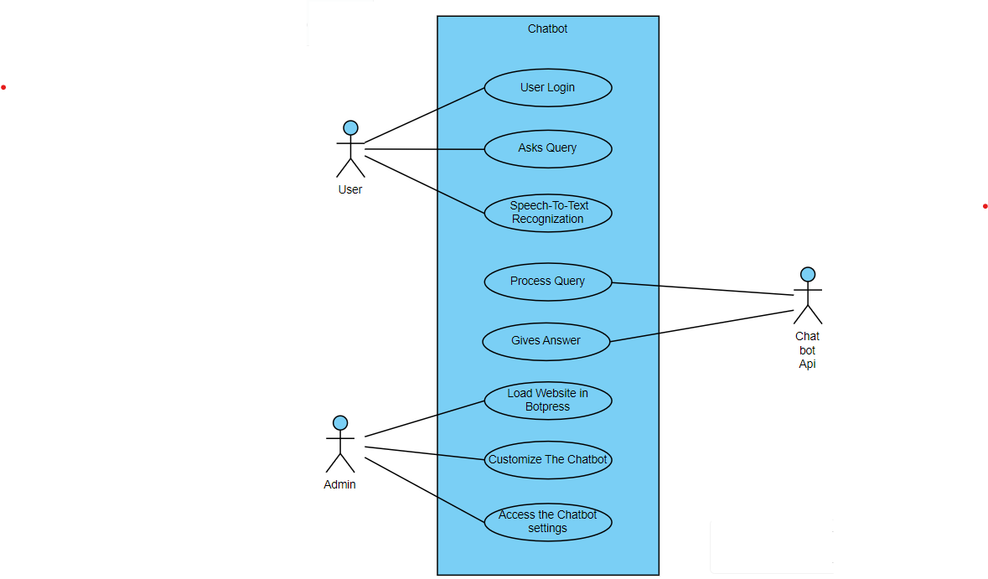
Use-case Diagram

Slide 8
CANVASES

Slide 9
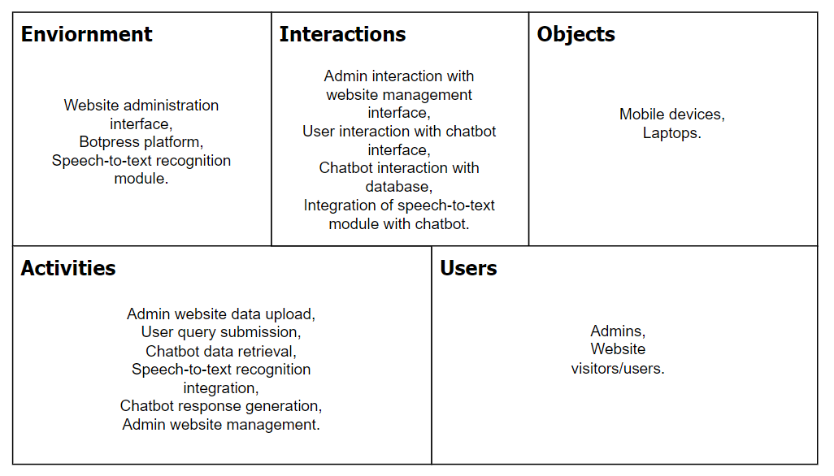
AEIOU Framework

Slide 10
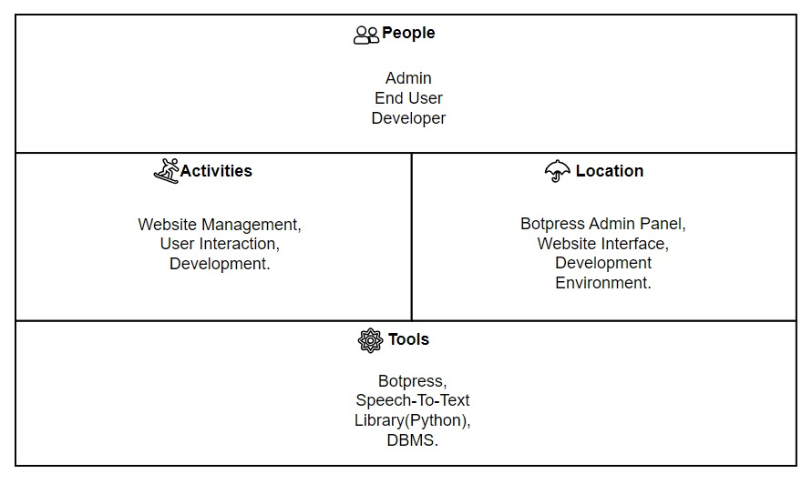
Ideation Canvas

Slide 11
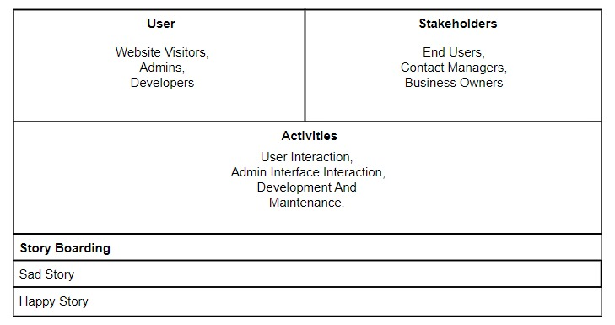
Empathy Canvas

Slide 12
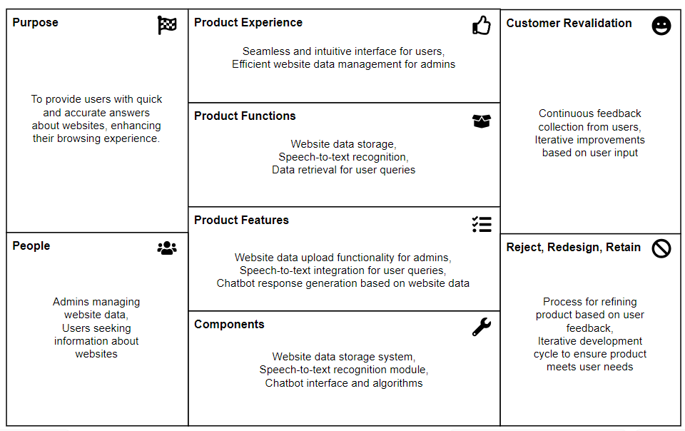
Product Development Canvas

Slide 13
IMPLEMENTATION

Slide 14
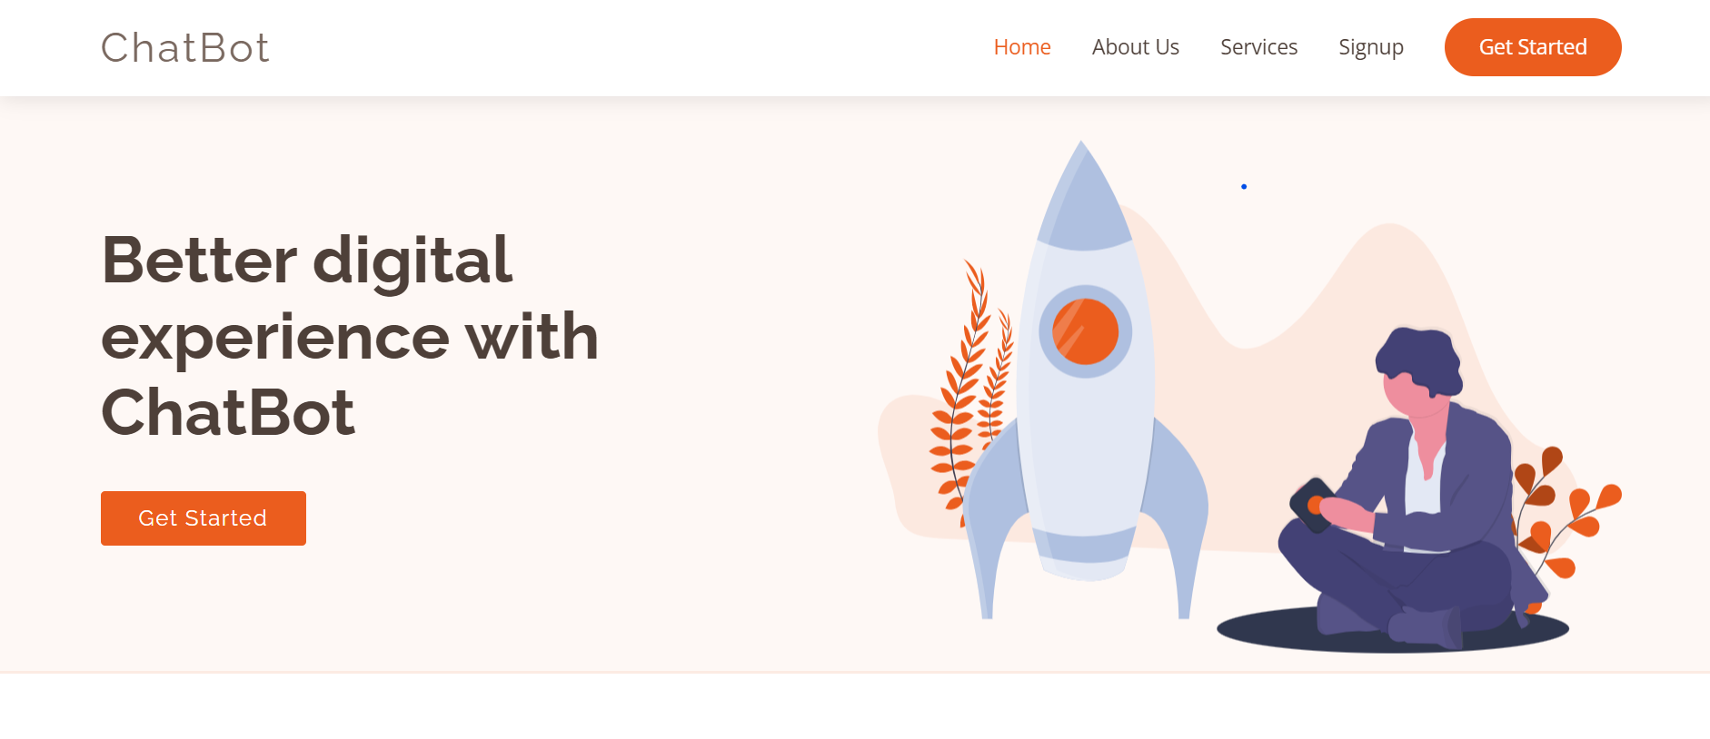
Home Page

Slide 15
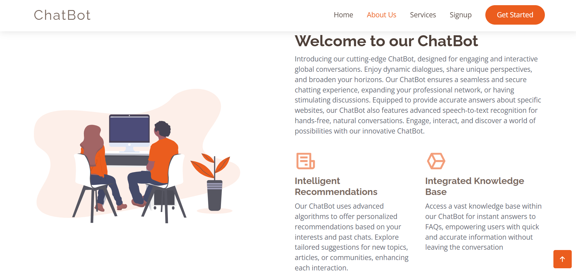
About-Us Page

Slide 16
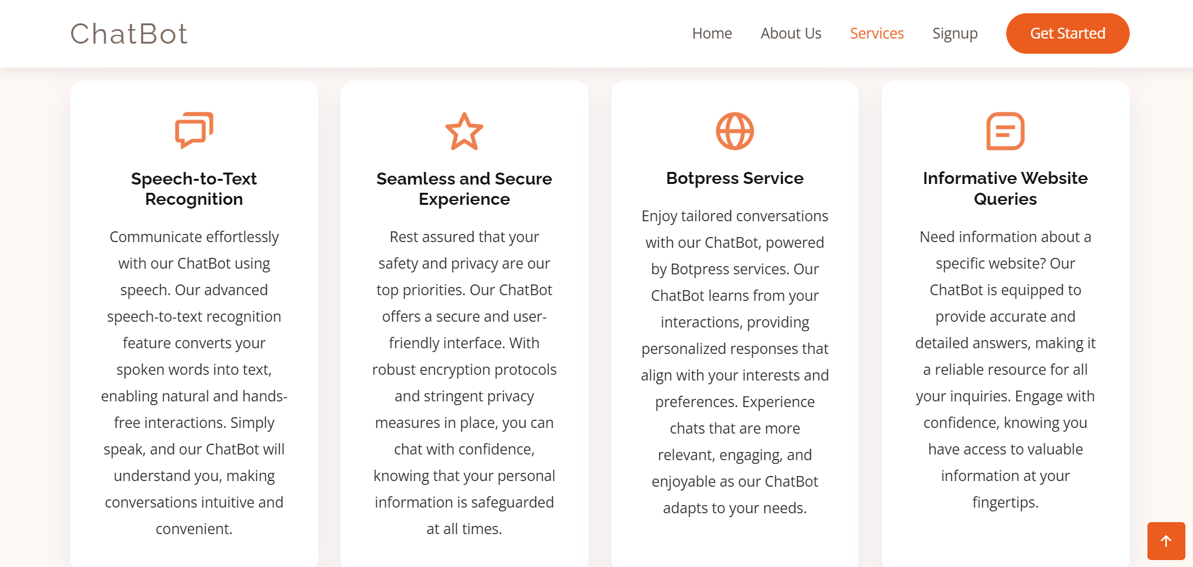
Services Page

Slide 17
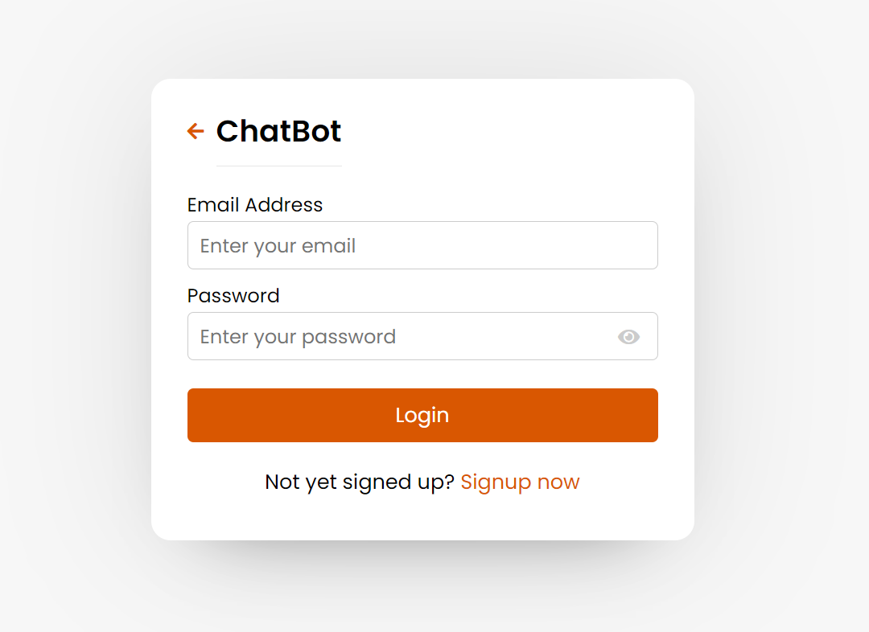
Login Page

Slide 18
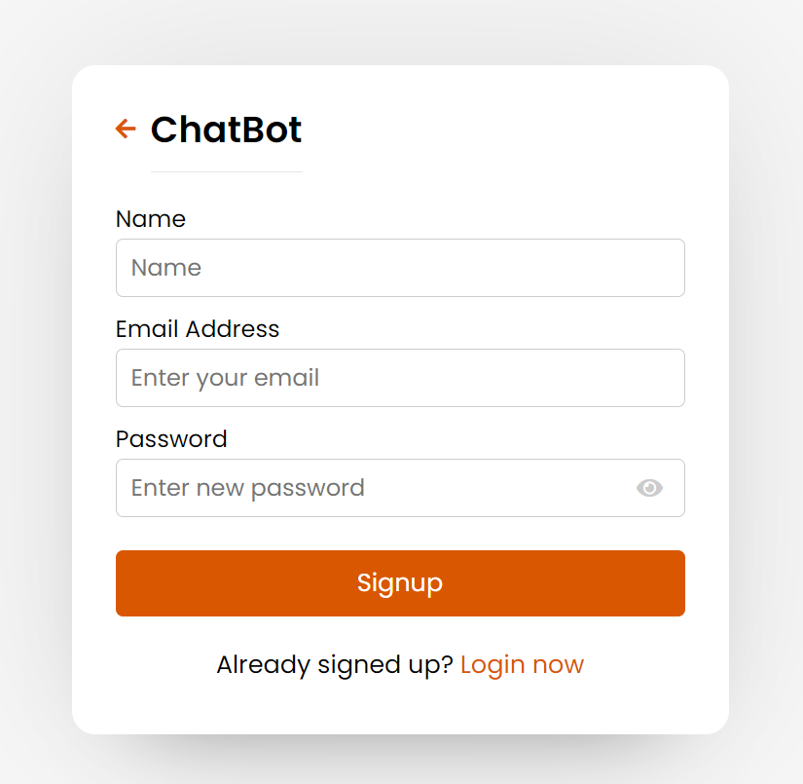
Signup Page

Slide 19
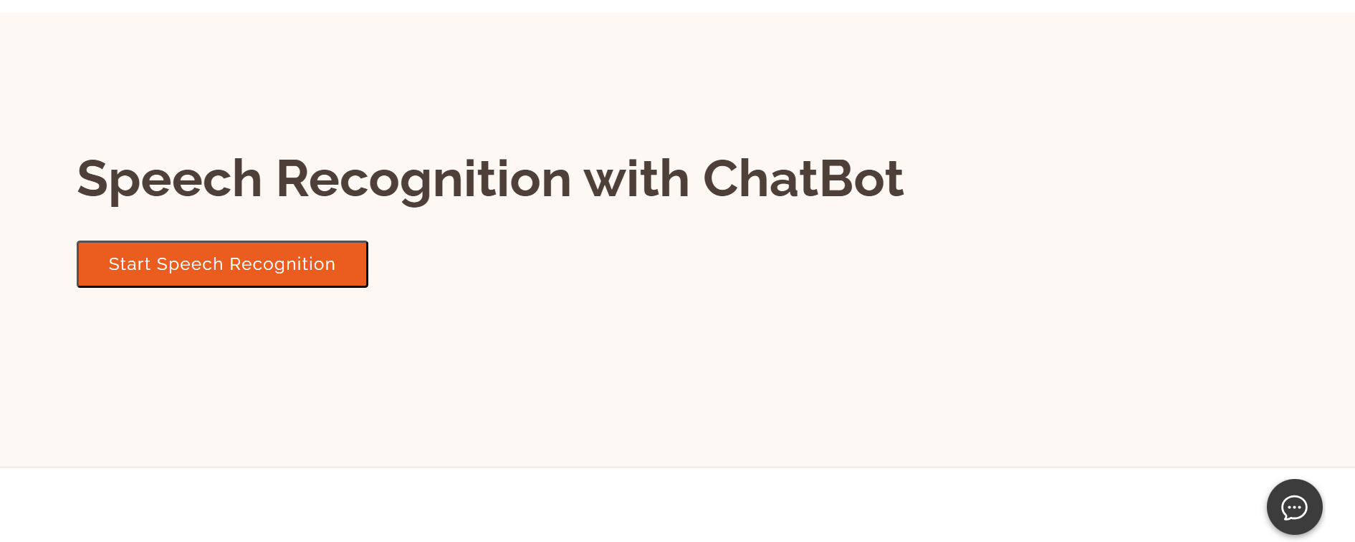
Speech Recognition and Chatbot

Slide 20
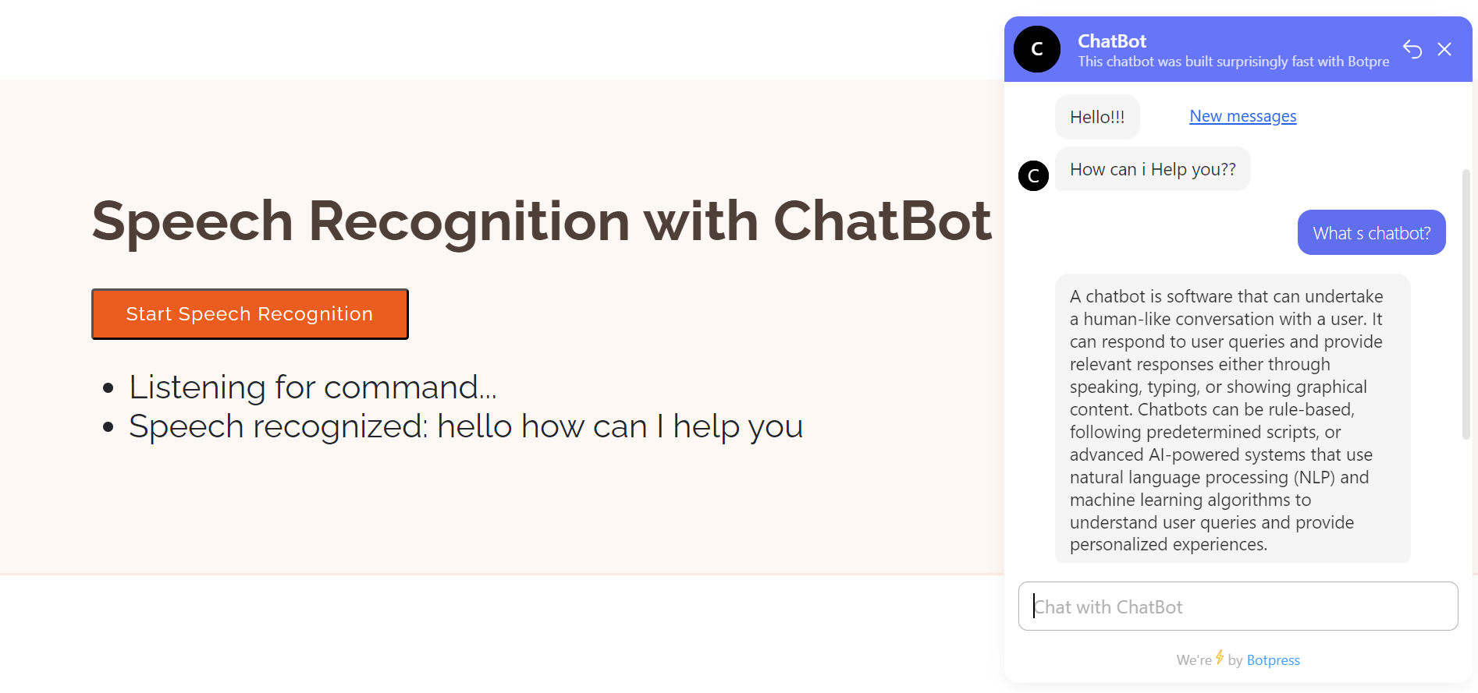
Showing the Chatbot

Slide 21
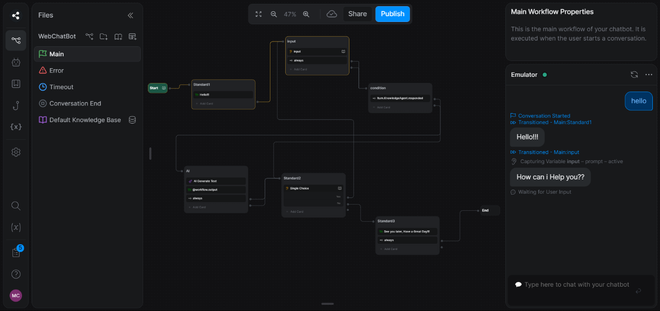
Botpress Studio and Rule-based Chatbot

Slide 22
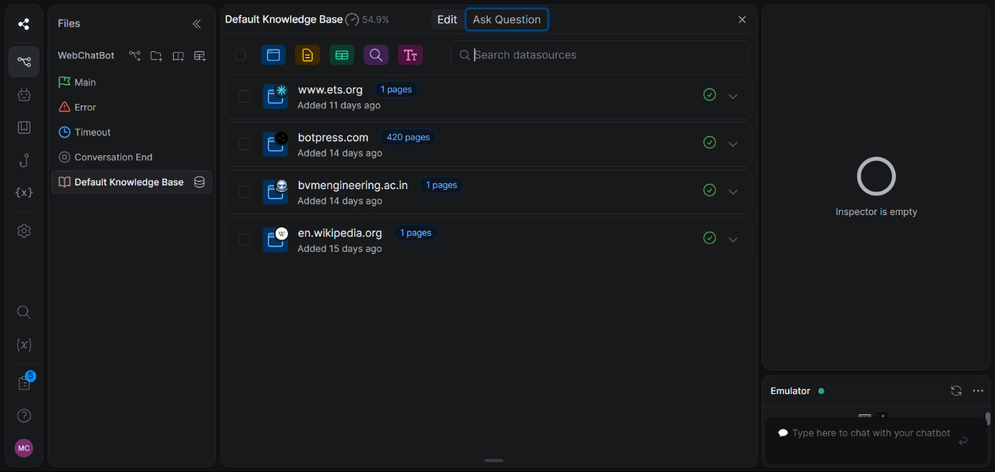
Knowledge Base in Botpress

Slide 23
REFERENCES

Slide 24
REFERENCES
Websites:
https://www.geeksforgeeks.org/connect-flask-to-a-database-with-flask-sqlalchemy/
https://botpress.com/docs/
Youtube Video Links:
https://www.youtube.com/playlist?list=PLlJHGGklthGlUVZlNhG5I0ZK8u1h6UfZ9
Entire implementation code for project is available in the following link:
https://github.com/meetm2003/ChatBot

Slide 25
Thank You

