Slide 1
Chatbot
Design Engineering (3CP08)
21CP044 – Zil J. Rajwadi
22CP308 – Meet N. Mistry

Slide 2
Project Overview
Development of a Chatbot integrated with website management functionalities and speech-to-text recognition.
Leveraging the Botpress platform to serve both administrators and users.
Administrators can manage website data within the Botpress environment.
Users can access website information through natural language interactions.
Aiming to enhance website management efficiency and user engagement.

Slide 3
Technologies Used
Frontend:
HTML for structuring web pages.
CSS for styling and layout.
JavaScript for dynamic interactions and user interface enhancements.
Backend:
Python for server-side logic and integrations.
Botpress API for chatbot functionalities and managing conversational flows.

Slide 4
DESIGN CONSIDERATION FOR DETAIL DESIGN

Slide 5

Context Diagram

Slide 6
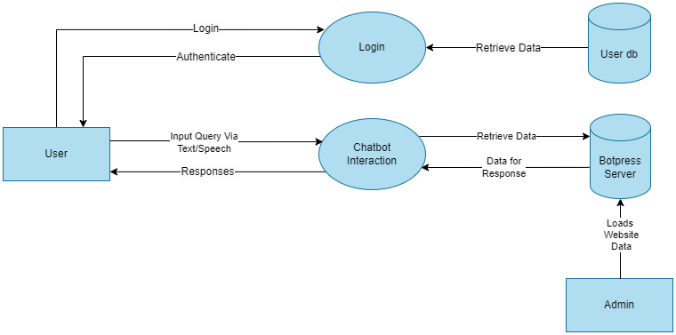
Data Flow Diagram(Level 1)

Slide 7
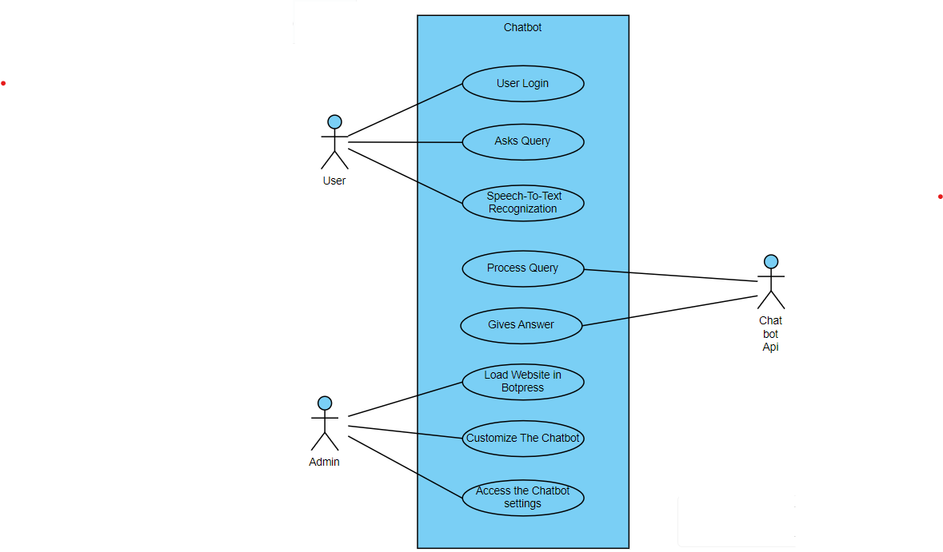
Use-case Diagram

Slide 8
IMPLEMENTATION

Slide 9
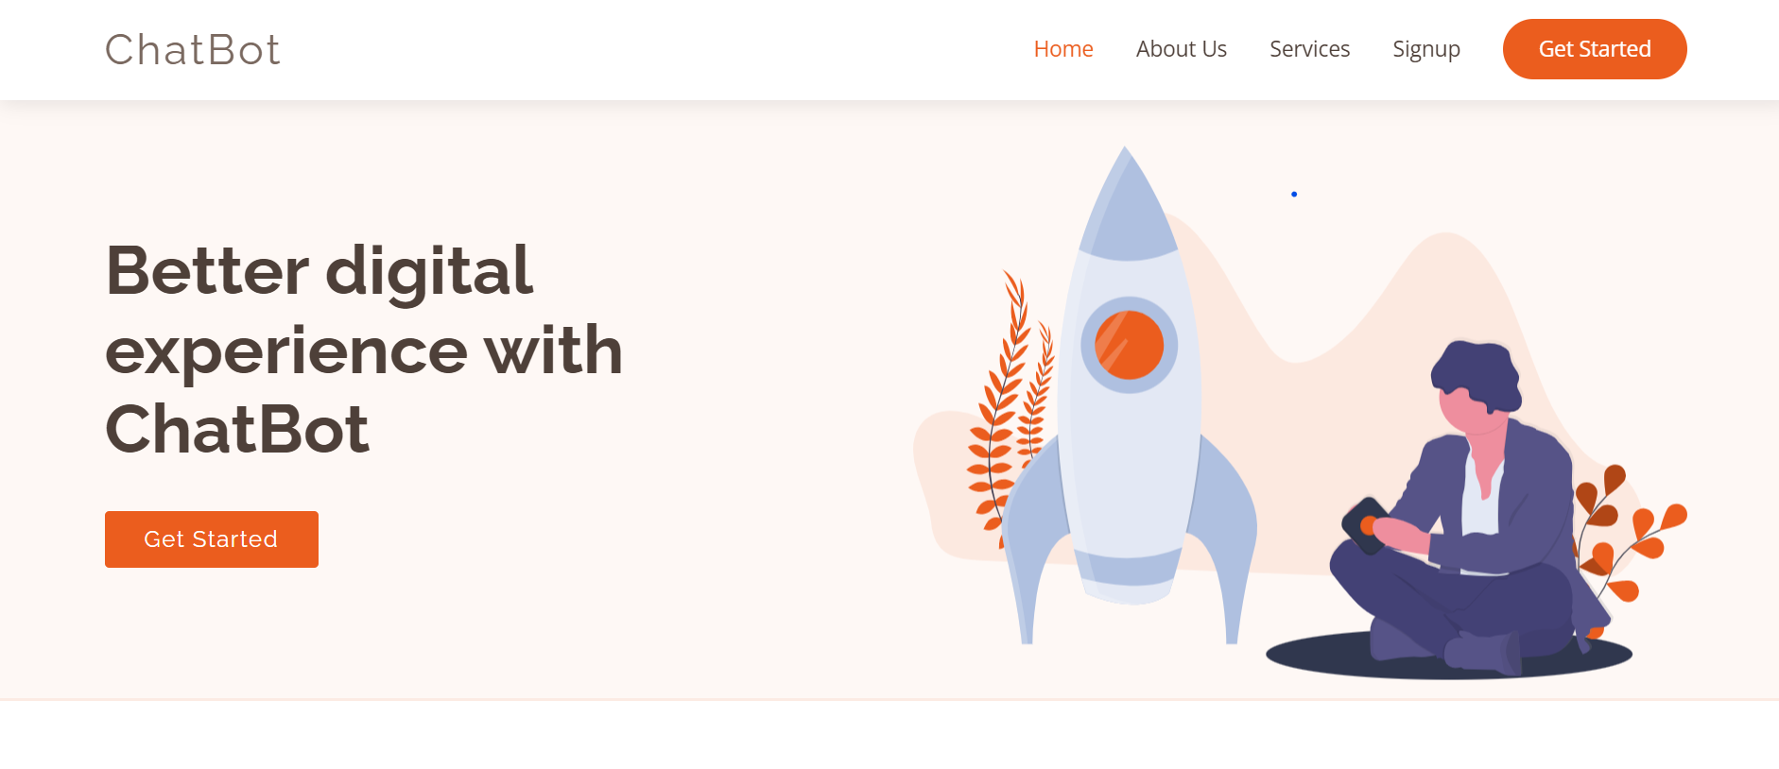
Home Page

Slide 10
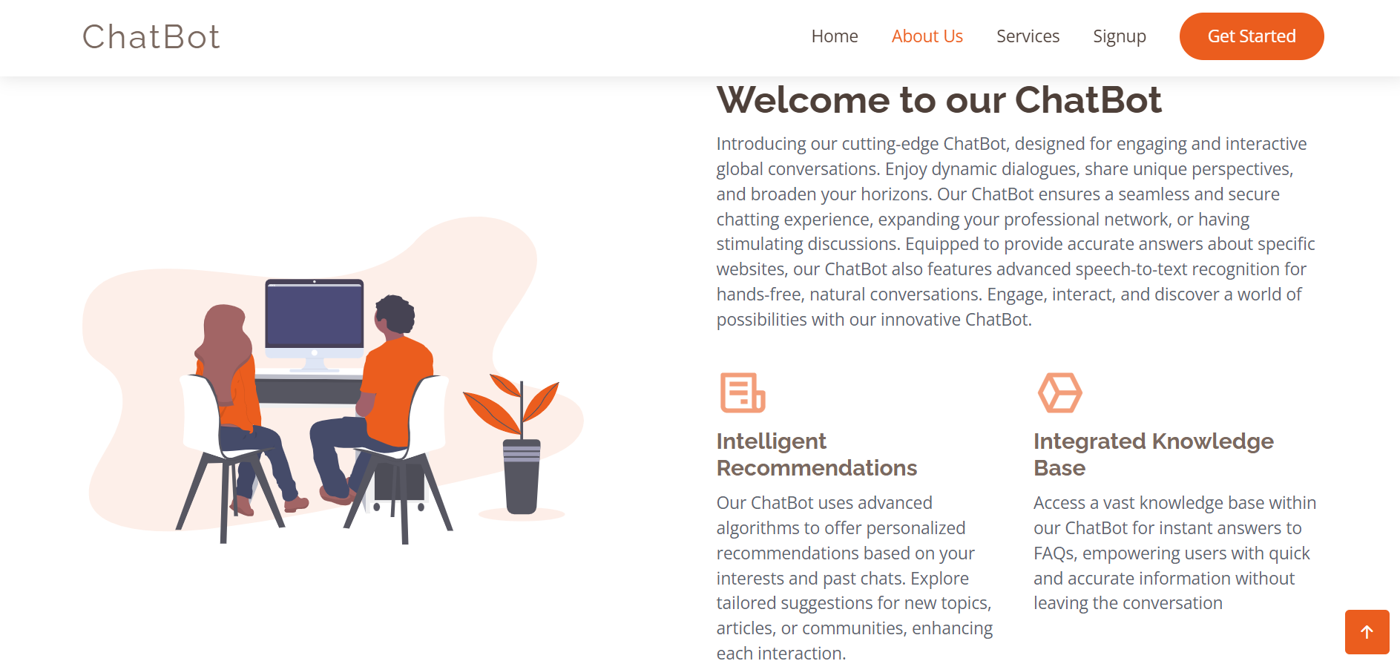
About-Us Page

Slide 11
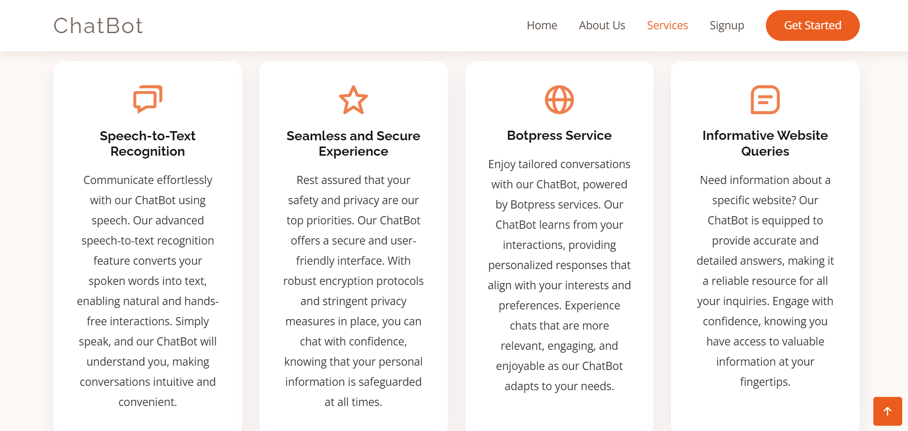
Services Page

Slide 12
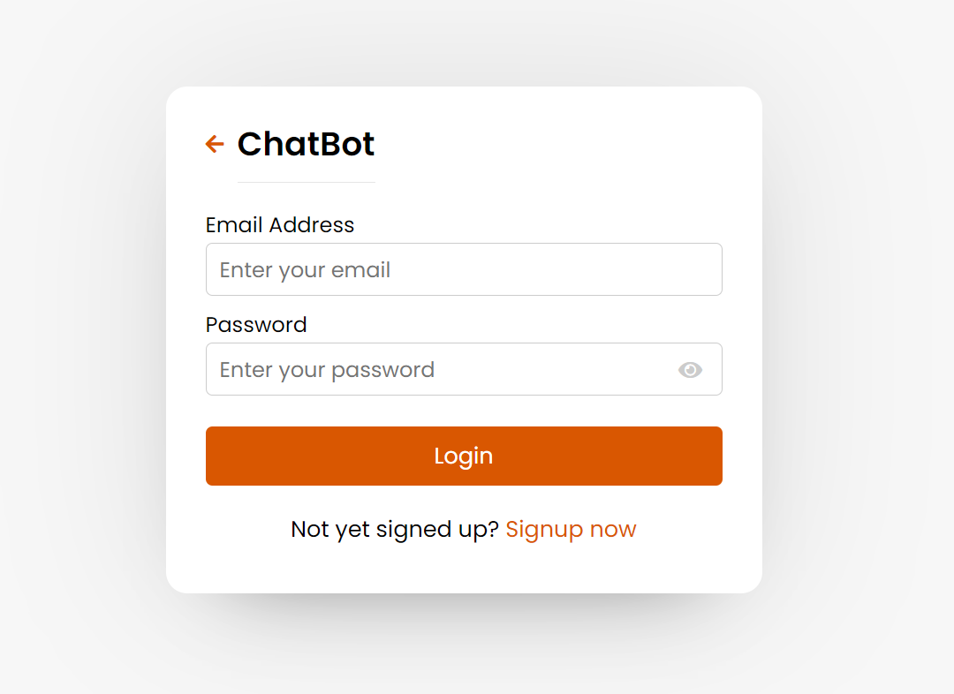
Login Page

Slide 13
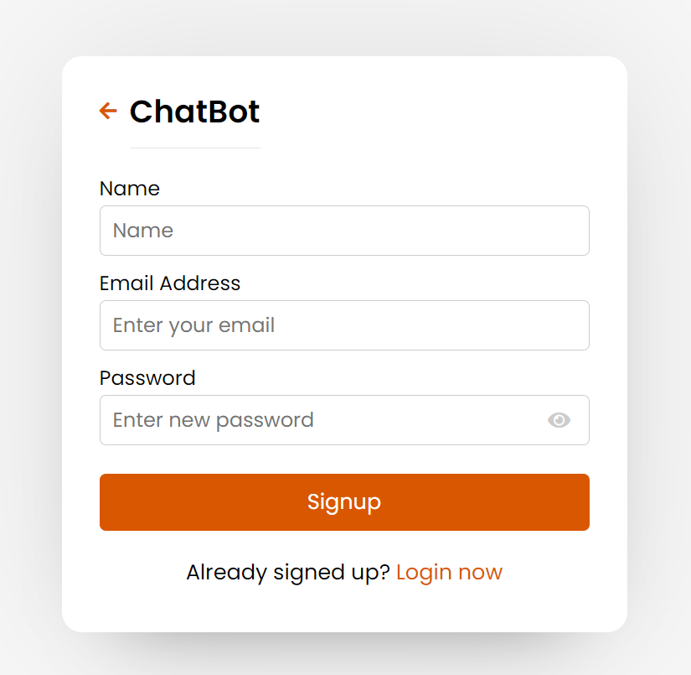
Signup Page

Slide 14
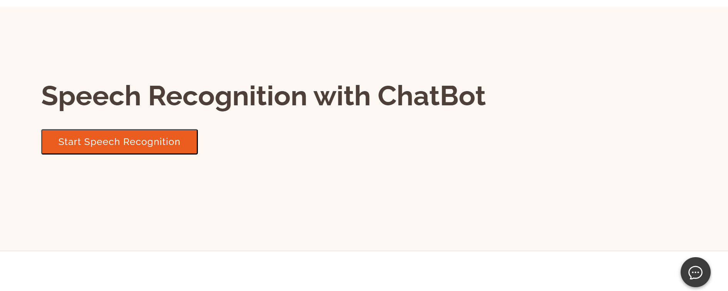
Speech Recognition and Chatbot

Slide 15
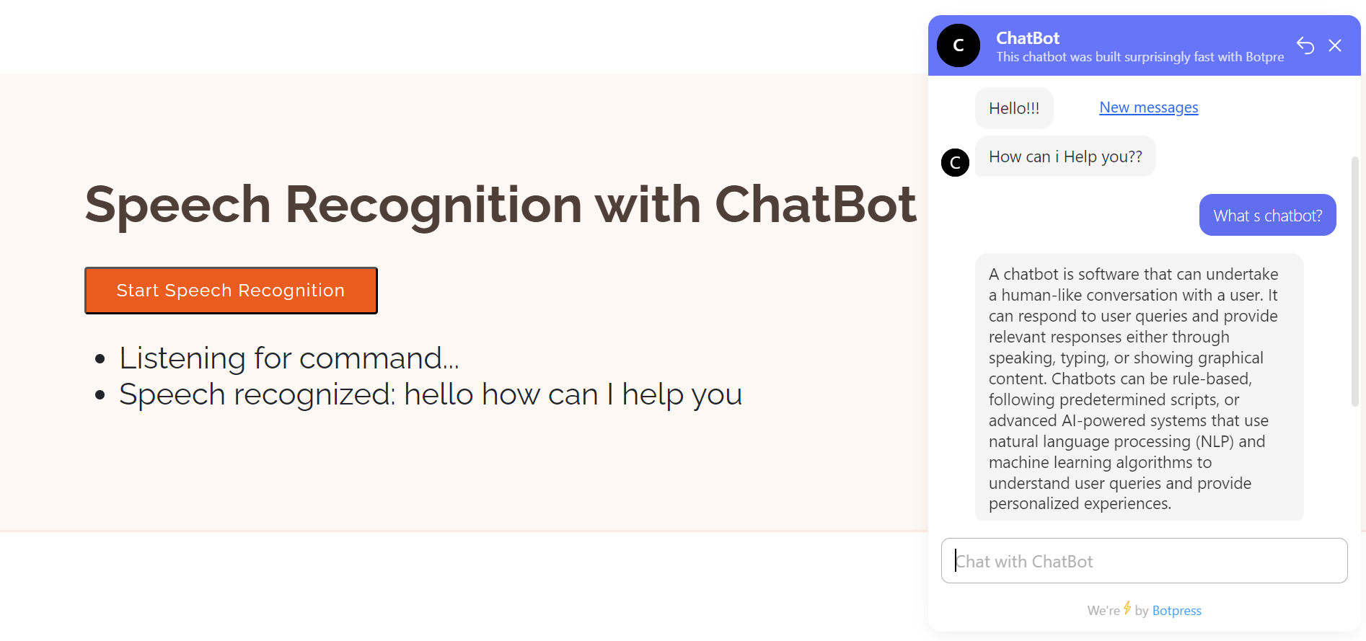
Showing the Chatbot

Slide 16
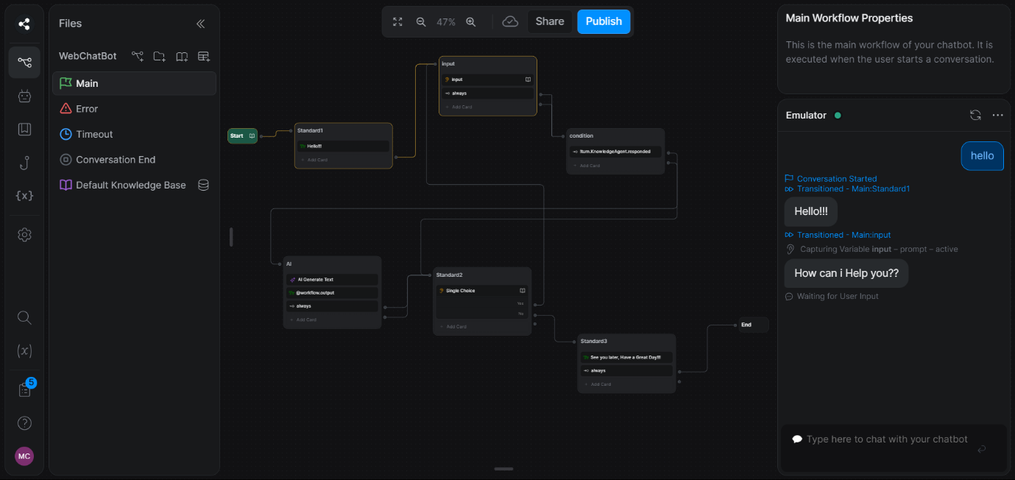
Botpress Studio and Rule-based Chatbot

Slide 17
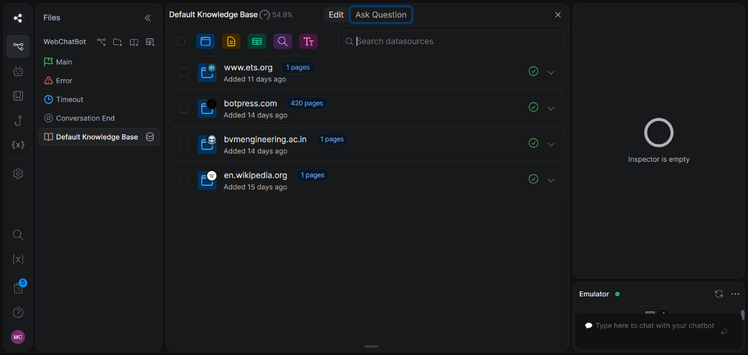
Knowledge Base in Botpress

Slide 18
Future Enhancements

Slide 19
Future Enhancements
Enhanced User Experience
Integration of Advanced Features
Expansion of Data Sources
Integration of Speech Recognition

Slide 20
REFERENCES

Slide 21
REFERENCES
Websites:
https://www.geeksforgeeks.org/connect-flask-to-a-database-with-flask-sqlalchemy/
https://botpress.com/docs/
https://www.youtube.com/playlist?list=PLlJHGGklthGlUVZlNhG5I0ZK8u1h6UfZ9

Slide 22
Thank You

