Slide 1
Mission Statement
The aim of our project is to design and implement a low-cost human-computer interface (HCI) which allows its user to control the computer cursor with eye movements.

Slide 2
Project Description
A wearable device that allows the user to control a computer cursor with eye movements
Images of the eye are captured with a digital camera
Images are processed, and mouse movement commands are sent to the computer wirelessly

Slide 3
Goals
Primary:
Locate the pupil, assign it to one of four quadrants, send movement commands to the computer, move the cursor
Identify blinking
Display images that the camera captures
Secondary:
Support the eye tracker interface with common computer applications
Display images that the camera captures with overlays that indicate how the images are being processed
Add more tracking regions for smoother control
Utilize blinking for operations such as clicking
Tertiary:
DSP algorithm appropriate for various kinds of lighting
Utilize glint for more accurate tracking

Slide 4
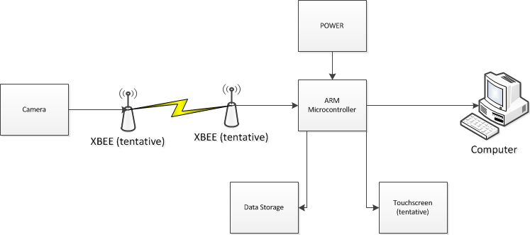
System Block Diagram

Slide 5
ARM
Several Processors to choose from
VFP (Vector Floating Point)
Needed for image processing
Popular outside of school
Same processors used in Visions Lab (Sam Siebert)

Slide 6
ARM vs DSP Chip
Previous teams have used a DSP chip from TI (Rapid Fire)
Use of ARM over that because of bad memory controller on DSP chip
ARM allows external storage more readily
ARM has all of the facilities that the DSP chip provides in one package

Slide 7
Beagle Bone
ARM Cortex A8
600 MHz Dual Core
VFP
Minimal peripherals -> Maximum customizability

Slide 8
Risks
No experience with ARM
One of the reasons we want to use the ARM
Me killing Arielle
High speed signals if we make our own board for an ARM
High speed ARMs are difficult to find
a

Slide 9
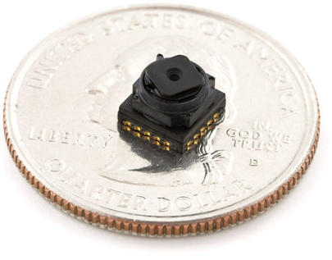
Camera
Purpose
Used to record movements of the eye
Resolution minimal 640x480
Tentative Camera
CMOS Camera TCM8230MD
640x480 Pixel Resolution
Data Output 8-bit Parallel (YUV or RGB)
Command I/O I2C
Max Frame Rate 30fps
Picture Size: VGA
Note Small Size (Ideal for wearable device)
Retailer: Sparkfun
Price: $9.99
Data Output Rate 144kbps
Image Courtesy of Sparkfun

Slide 10
Camera to Microcontroller Interface
Camera control across I2C (uC GPIO)
Synchronization
Glue Logic Solution
CPLD
Data Output 8-bit Parallel
Buffer
Hardware Solution
Shift Registers -> Serial
Latch -> Storage Management
Read from buffer into uC
Additional Microcontroller Solution
Use uC to provide 8-bit Parallel Interface (GPIO Expensive) and other synchronization signals and command

Slide 11
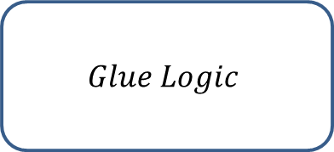
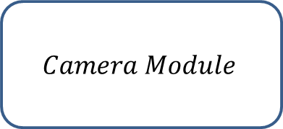
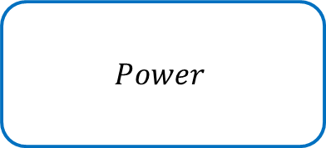

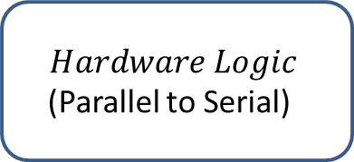


Camera Block Diagram
SDA
$$Camera Module$$
VD
SCL
HD
DCLK
I2C Command
Synchronization Signals
8-Bit
Parallel Data
$$Glue Logic$$
$$μC$$
$$Hardware Logic$$
(Parallel to Serial)
Enable
and Write
8-Bit Serial Data
$$Power$$
$$FIFO Buffer$$
$$FIFO to USB$$
$$for Computer$$

Slide 12
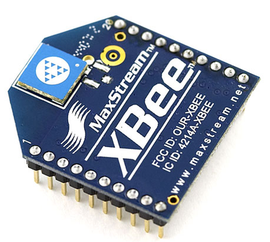
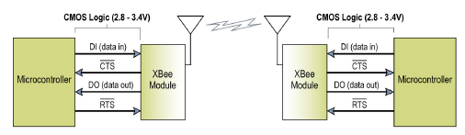
Wireless
Purpose
User ‘mobility’
Transmit Cursor Control Commands to Target PC
Tentative Transceiver
Xbee Series 1 Chip Antenna 1mW
Supply Voltage 2.8 – 3.4V
Range 100m
RF Data Rate 250kbps
Serial Data Rate 1200bps- 250kbps
Retailer: Sparkfun
Price: $22.95
Image Courtesy of Sparkfun
XBee Explorer USB (Quick development)
Programming
Retailer: Sparkfun
Price: $24.95

Slide 13
Wireless Block Diagram

Slide 14
Risk
RF Exposure (Time and Distance)
1mW Wireless
Power

Slide 15
Tentative Power
Powered by 120Vac
Use AC-DC converter
DC-DC converters
Use DC-DC converters for large step down voltages
Linear Regulators
Linear Regulators for smaller step down voltages
Isolation of power lines from all components

Slide 16

Tentative Power
Tentative DC-DC Converters
Buck Converter
Covers constant DC input voltages
Step down 15V to 3.3V
More efficient than Buck-Boost Converter

Slide 17

Tentative Power
Tentative DC-DC Converters
Buck-Boost Converter
Covers variable DC input voltages
Suitable for batteries
Step down 3.3V – 4.3V to 1.2V

Slide 18
Tentative Power
Camera (2.8V and 1.5V)
ARM CORTEX R4 (1.2V and 3.3V)
ARM CORTEX M4 (1.8V – 3.6V)
IRLED (1.6V)

Slide 19
Lighting Configuration
Method 1: Infrared lighting configuration
Use IR emitter attached to glasses to illuminate the eye
Can achieve “dark pupil” and “light pupil” effect for pupil contrast
Can experiment with blocking out ambient light or not
Method 2: Ambient lighting configuration
More difficult but more rewarding
Challenge: reflections can easily confuse pupil detection algorithms
Possible Solution: Black felt to control reflections

Slide 20
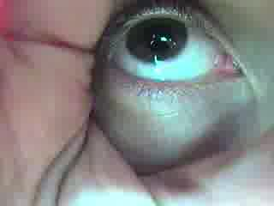
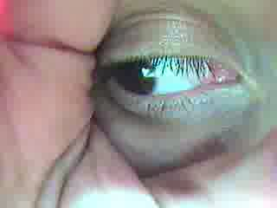
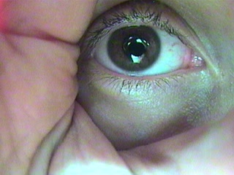
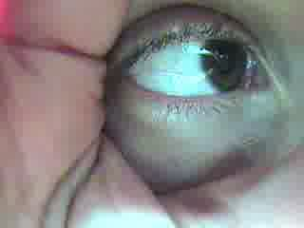
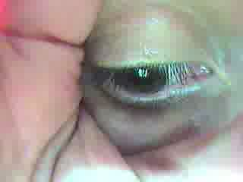
Sample Images with Ambient Lighting

Slide 21
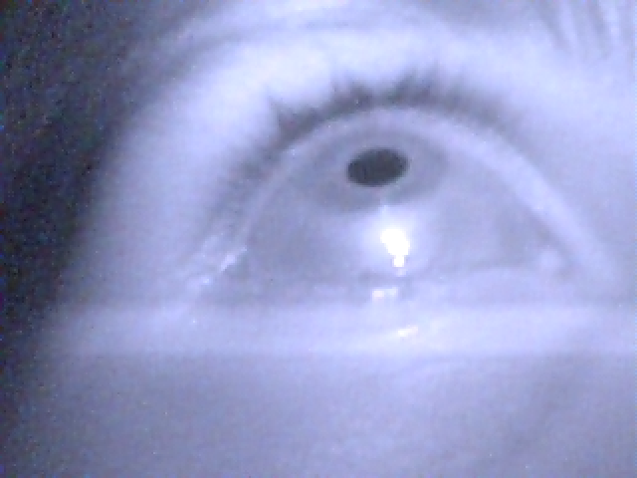
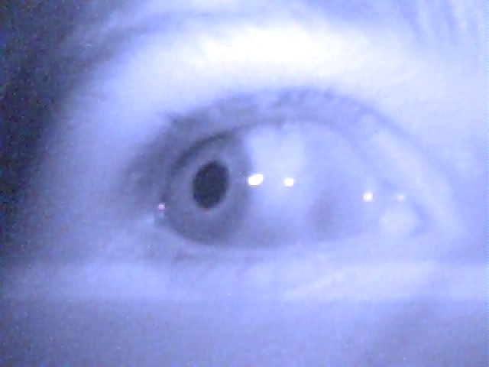
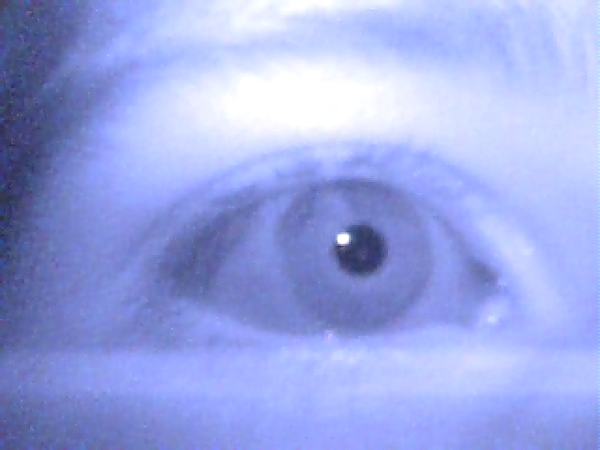
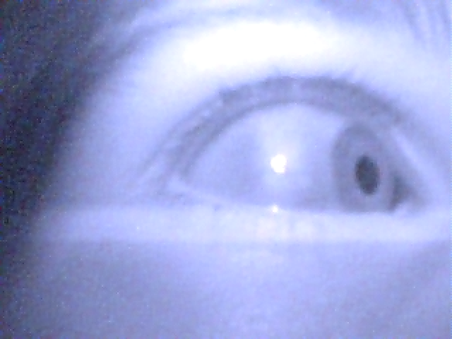
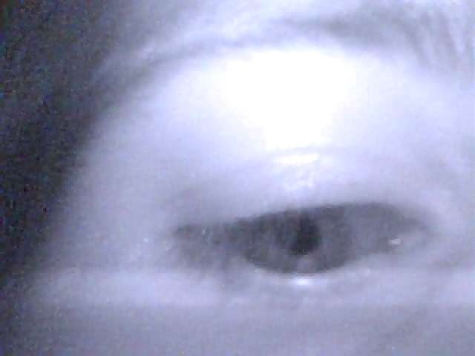
Sample Images with IR Lighting

Slide 22
Risks
Digital Signal Processing:
Risks:
Precision of pupil centroid calculation.
Inconsistency between pupil and direction of gaze
Processing time
Solution:
Process fewer frames for more thorough processing algorithms.
Tune via calibration
Optimize and simplify code as much as possible
Lighting
Risks:
Inconsistency in lighting through sequence of images
Ambient light creating reflections
Solution:
Have a controlled lighting environment
Experiment

Slide 23
Main Software Flow
Start
Initialization
Control Loop
No
Frame?
Frame Interrupt Handler
Yes

Slide 24
Interrupt Handler
Get Frame
Yes
Blinking?
No
Find pupil center
Comparing center with reference center
End Interrupt
Move computer cursor

Slide 25
Initialization
No
Calibration Complete?
Yes
Send Instruction
Capture Frame
End Calibration
Frame Valid?
Compute Calibration Value
No
Yes
List of Calibration Values:
Center position
Region of interest
Skin tone
Eye to eyelid ratio

Slide 26
Effects of IRLED on eyes
ANSI Z136 – Safe Use of Lasers
Potential Hazards
Infrared A (780-1400 nm)
Retinal Burns
Cataract
Infrared B (1400 – 3000 nm)
Corneal Burn
Aqueous Flare
IR Cataract
Infrared C (3000 – 1 million nm)
Corneal Burn
http://www.microscopyu.com/print/articles/fluorescence/lasersafety-print.html

Slide 27
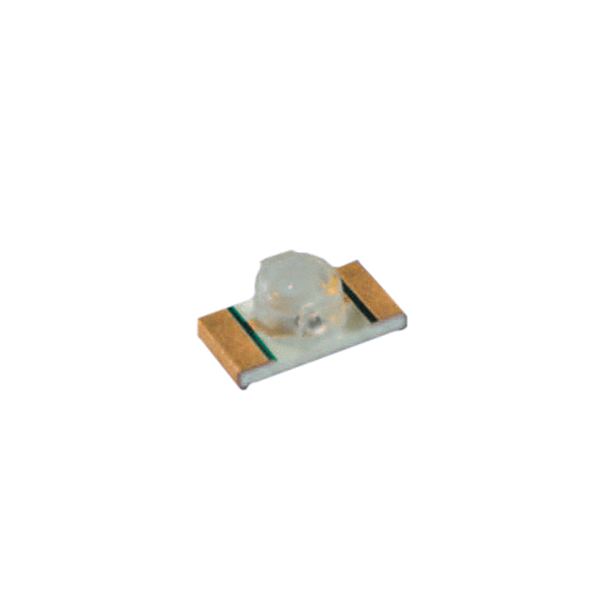
Effects of IRLED on eyes
IEC 62471 – Photobiological safety of lamps and lamp systems
For exposure times of t > 1000 s
Max Exposure limit at 20°C is 200 W/m²
Max Exposure limit at 25°C is 100 W/m²
E_{e} = I_{e} / d²
E_{e} is irradiance
I_{e} is radiant intensity
d² is distance
Predicted E_{e} = 4 W/m²
SFH 4058 IRLED (Tentative)
Eye Safety of IREDs used in Lamp Applications, Claus Jager, 2010

Slide 28
Effects of IRLED on eyes
IEC 62471 – Photobiological safety of lamps and lamp systems
4 W/m²
SFH 4058 IRLED (Tentative)
Exposure times of t > 1000 s
4 W/m² < 200 W/m² at 20°C
4 W/m² < 100 W/m² at 25°C
Eye Safety of IREDs used in Lamp Applications; Claus, Jager, 2010

Slide 29
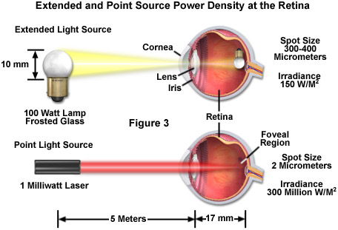
Effects of IRLED on eyes
Comparison of Lamp versus Laser
http://www.microscopyu.com/print/articles/fluorescence/lasersafety-print.html

Slide 30
Division of Labor
Tasks | Armeen Taeb | Nick Bertrand | Arielle Blum | Mike Mozingo | Khashi Xiong | Bruce Chen
Software Computer Interface | S | P
Lighting/Camera | P | S
Pupil Detection Algorithm | P | S
Code Optimization | S | P
Camera Module |  |  | P | S
Wireless Communication |  |  | S |  | P
Physical Setup |  |  | S |  | P
Firmware/Drivers |  |  | P | S
Power |  |  |  | S | P
PCB Layout |  |  |  | P | S
Documentation
Mascot/Cheerleader |  |  |  |  |  | P,S,T

