Slide 1

Team eyeCU
Nick Bertrand
Arielle Blum
Mike Mozingo
Armeen Taeb
Khashi Xiong
Notes:
Armeen

Slide 2
Mission Statement
The aim of our project is to design and implement a low-cost human-computer interface (HCI) which allows its user to control the computer cursor with eye movements.
Notes:
Armeen

Slide 3
Project Description
A wearable device that allows the user to control a computer cursor with eye movements
Images of the eye are captured with a digital camera
Images are processed, and mouse movement commands are sent to the computer wirelessly
Notes:
Armeen

Slide 4
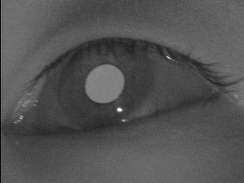
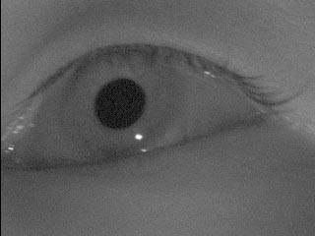
Where Did the User Look?
Video Eye tracking commonly uses one of two methods:
Pupil Tracking: (we will focus on this method)
Glint-Pupil Vector tracking
A: Bright Pupil, B: Dark Pupil, C: Corneal Reflection (glint)
A
B
C
http://www.sciencedirect.com/science/article/pii/S0262885699000530
Notes:
If the illumination is coaxial with the optical path, then the eye acts as a retroreflector as the light reflects of the retina creating a bright pupil effect. If the illumination source is offset from the optical path, then the pupil appears dark because the retroreflection from the retina is directed away from the camera.
Armeen

Slide 5
Goals
Primary:
Locate the pupil, assign it to one of four quadrants, send movement commands to the computer, move the cursor
Identify blinking
Display images that the camera captures
Secondary:
Support the eye tracker interface with common computer applications
Display images that the camera captures with overlays that indicate how the images are being processed
Add more tracking regions for smoother control
Utilize blinking for operations such as clicking
Tertiary:
DSP algorithm appropriate for various kinds of lighting
Utilize glint for more accurate tracking
Notes:
Armeen

Slide 6
System Block Diagram
Notes:
Nick

Slide 7
DSP Software Flow
Notes:
Nick

Slide 8
Interrupt Handler
Notes:
Nick

Slide 9
Initialization
List of Calibration Values:
Center Position
Region of Interest
Skin Tone
Eye to Eyelid Ratio
Notes:
Nick

Slide 10
Lighting Configuration
Method 1: Infrared lighting configuration
Use IR emitter attached to glasses to illuminate the eye
Can achieve “dark pupil” and “light pupil” effect for pupil contrast
Can experiment with blocking out ambient light or not
Method 2: Ambient lighting configuration
More difficult but more rewarding
Challenge: reflections can easily confuse pupil detection algorithms
Possible Solution: Black felt to control reflections
Notes:
Nick

Slide 11
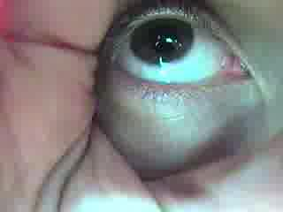
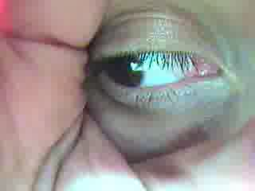
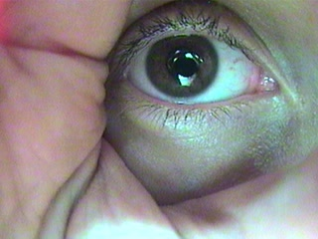
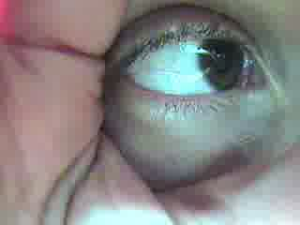
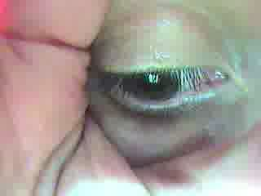
Sample Images with Ambient Lighting
Notes:
Nick

Slide 12
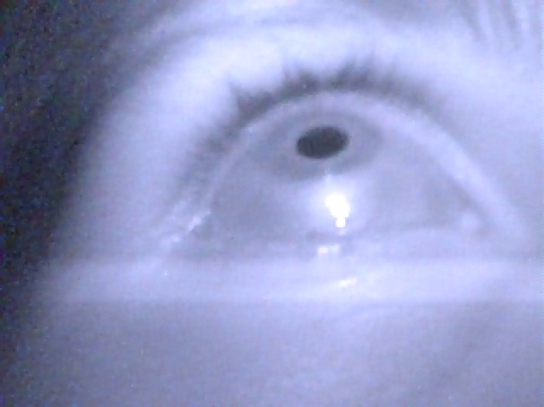
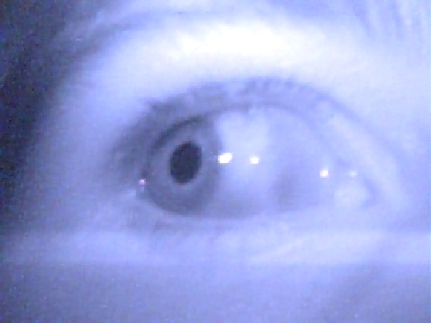
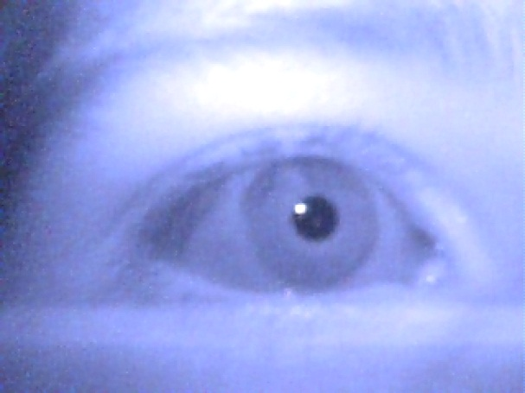
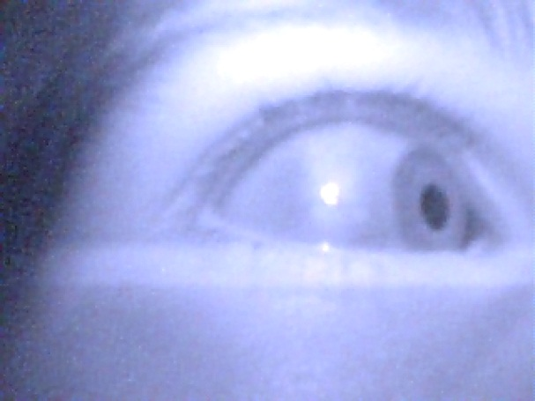
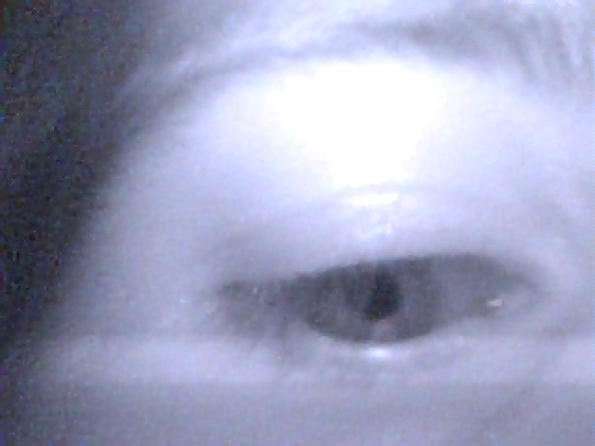
Sample Images with Infrared Lighting (Dark Pupil)
Notes:
Nick

Slide 13
Risks
Digital Signal Processing
Risks
Precision of pupil centroid calculation
Inconsistency between pupil and direction of gaze
Processing time
Solution
Process fewer frames for more thorough processing algorithms
Tune via calibration
Optimize and simplify code as much as possible
Lighting
Risks
Inconsistency in lighting through sequence of images
Ambient light creating reflections
Solution
Have a controlled lighting environment
Experiment
Notes:
Nick

Slide 14
Effects of IRLED on Eyes
ANSI Z136 – Safe Use of Lasers
Potential Hazards
Infrared A (780nm – 1400 nm)
Retinal Burns
Cataract
Infrared B (1400nm – 3000 nm)
Corneal Burn
Aqueous Flare
IR Cataract
Infrared C (3000nm – 1 million nm)
Corneal Burn
http://www.microscopyu.com/print/articles/fluorescence/lasersafety-print.html
Notes:
Khashi

Slide 15
Effects of IRLED on Eyes
IEC 62471 – Photobiological safety of lamps and lamp systems
For exposure times of t > 1000s
Max exposure limit is 200 W/m² at 20°C
Max exposure limit is 100 W/m² at 25°C
E_{e} = I_{e}/d²
E_{e} is irradiance
I_{e} is radiant intensity
d is distance from IRLED to eye
Predicted E_{e} = 312mW/m²
SFH 484 IRLED (Tentative)
Eye Safety of IREDs used in Lamp Applications, Claus Jager, 2010
Notes:
Khashi

Slide 16
Effects of IRLED on Eyes
IEC 62471 – Photobiological safety of lamps and lamp systems
312mW/m²
SFH 484 IRLED (Tentative)
For exposure times of t > 1000s
312mW/m² < 200 W/m² at 20°C
312mW/m² < 100 W/m² at 25°C
Eye Safety of IREDs used in Lamp Applications, Claus Jager, 2010
Notes:
Khashi

Slide 17
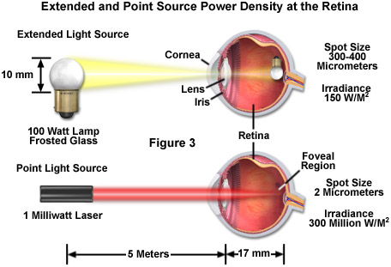
Effects of IRLED on Eyes
Lamp vs Laser
http://www.microscopyu.com/print/articles/fluorescence/lasersafety-print.html
Notes:
Khashi

Slide 18
System Block Diagram
Notes:
Khashi

Slide 19
Power
Powered by 120 Vac
Use AC-DC converter
DC-DC converters
Use DC-DC converters for larger voltage step downs
Linear Regulators
Linear Regulators for smaller voltage step downs
Isolation of power lines from all components
Notes:
Khashi

Slide 20

Power
Tentative DC-DC Converters
Buck Converter
Efficient with constant DC input voltages
Ideal for 15V to 3.3V step down
More efficient than Buck-Boost Converter
Notes:
Khashi

Slide 21

Power
Tentative DC-DC Converters
Buck-Boost Converter
Ideal for variable DC input voltages (batteries)
Step down 3.3V – 4.3V to 1.2V
Notes:
Khashi

Slide 22
Power
Camera
2.8V and 1.5V
ARM CORTEX R4
1.2V and 3.3V
ARM CORTEX M4
1.8V to 3.6V
IRLED
1.6V
XBEE
2.8V to 3.4V
Notes:
Khashi

Slide 23
Risk
Power
Risk
Surge from AC-DC converter, potentially destroying components or shocking user
Solution
Fuse the AC-DC converter so a power surge does cause damage
Notes:
Khashi

Slide 24
System Block Diagram
Notes:
Mike
-- describe glasses + camera
-- talk about camera board + XBEE
-- follow data through ARM, talk about DSP here.
-- Mention data storage for debugging help
-- Interface to computer
-- program on host computer to intercept control signals and control the cursor

Slide 25


ARM
VFP (Vector Floating Point)
Popular outside of school
Gain good experience
Same processors used in Visions Lab
Sam Siewert as a great resource
Wide Range of processors
Cortex M4, Cortex R4, Cortex A8*
*Cortex A8 is the processor used on the BEAGLE boards
Notes:
Mike
-- Our DSP will need some sort of floating point or fixed point (integer calculations not sufficient)

Slide 26
ARM vs DSP Chip
Previous teams have used a DSP chip from TI
Rapid Fire used a DSP chip
Use of ARM over that because of difficult memory controller on DSP chip
ARM will allow external storage more readily
ARM has all of the facilities that the DSP chip provides in one package
Fewer components to worry about
Notes:
Mike
-- DSP chip that rapid fire used had a clock of 300MHz
-- only for high speed memory (data storage)
-- fewer components in that we will have only the ARM, instead of a microcontoller + DSP chip.
-- does not include supporting components
-- Cortex R4 (200 MHz) VFP unit provides 320 DMIPS
-- DMIPS + Dhrystone MIPS

Slide 27
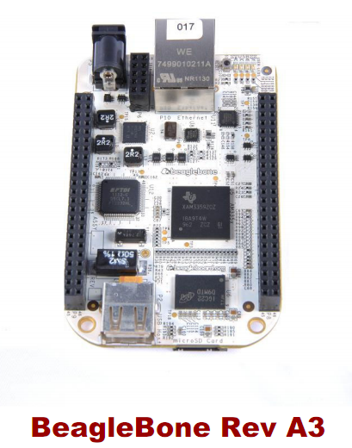
Beagle Board
3 boards to chose from
BEAGLE, XM, Bone
Using the BEAGLE bone
Fewer included components
USB and Ethernet
Use as main board
Build interface to the board
As fallback plan
Layout our own ARM board, and if we can’t get it to work, utilize the BEAGLE
Notes:
Mike
-- uses cortex A8 processor
-- speed of 600MHz

Slide 28
Risks
No experience with ARM
An opportunity to gain experience
High speed signals if our team designs our own board for the ARM
Signal Integrity
Finding a high speed arm that is not a BGA
Notes:
Mike
-- cortex M4 ~180 MHz
-- cortex R4 ~200 MHz

Slide 29
System Block Diagram
Notes:
Arielle

Slide 30
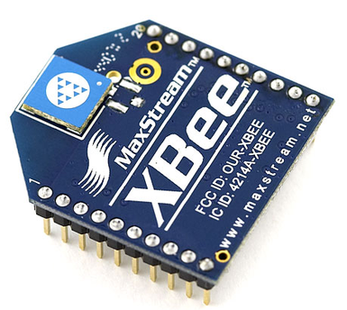
Wireless
Transmit camera data to host controller
Xbee Series 1 Chip
Range 100m
RF Data Rate 250 kbps
Serial Data Rate 1200 bps – 250 kbps
Xbee Explorer USB
Quick Development
Notes:
Arielle
-- from SparkFun
-- two points of interest
-- range = plenty enough
-- speed -> based on calculation of maximun data output from camera
we do not exceed 250 kbps so the XBEE will be able to
transmit all of the images with no slowing

Slide 31
Wireless Block Diagram
Notes:
Mike

Slide 32
Risk
Insufficient transmit speed
RF Exposure (Time and Distance)
1mW Wireless
Notes:
Mike
-- like mentioned before based on the quick calculation we did we should have sufficient bandwidth to
transmit all of the images
-- low power, consider cell phones which have power ratings around 1 Watt

Slide 33
System Block Diagram
Notes:
Arielle

Slide 34
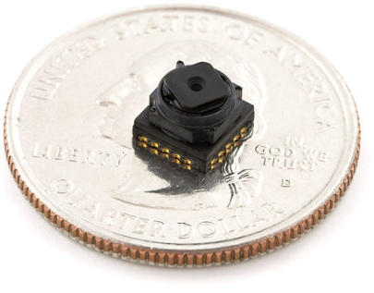
Camera
Used to record movements of the eye
Tentative Camera
TCM8230MD CMOS Camera
Small, ideal for a wearable device
640 x 480 Pixel Resolution (VGA)
30 FPS (Frames Per Second)
Command I/O 12C
Data Output 8-bit Parallel (YUV or RGB)
Data Output Rate 144kbps
Notes:
Arielle

Slide 35
Camera
Controlled across I2C (uC GPIO)
Synchronization
Data Output 8-bit
Buffer
Hardware Solution
Shift Registers -> Serial
Latch -> Storage Management
Read from buffer into uC
Additional Microcontroller Solution
Use uC to provide 8-bit Parallel Interface with other synchronization signals and command
Notes:
Arielle

Slide 36
Camera Block Diagram
Notes:
Arielle

Slide 37
Project Expenses
Section | Component | Quantity | Cost ($)
Wireless
 | XBee | 2 | 22.95
 | USB XBee Explorer | 1 | 24.95
 | XBee Breakout Board | 2 | 2.95
Processing
 | BeagleBone Evaluation Board | 1 | 89
 | I/O Board | 1 | 33
 | XBee Microcontroller (ARM) | 1 | 1
 | SDRAM | 1 | 10
Mechanical
 | Lensless Glasses | 1 | 5.99
Camera
 | 640x480 CMOS Camera | 1 | 9.99
 | Test Cameras | 3 | Donated
 | FTDI to USB | 1 | 10
 | Glue Logic CPLD | 1 | 2
 | Hardware Buffer | 2 | 1.5
 | IR LEDS | 4 | 0.95
Manufacturing
 | PCB Fabrications (3 at 4 layer, 2 at 2 layer) | 5 | 264
Presentation | Poster | 1 | 55
Misc. |  |  | 200
Total Cost |  |  | 735.16
Notes:
Arielle

Slide 38
Sustainability and Environmental Concerns
RoHS

Slide 39
Division of Labor
Tasks | Armeen Taeb | Nick Bertrand | Arielle Blum | Mike Mozingo | Khashi Xiong | Bruce Chen
Computer Applications | S | P
Lighting | P | S
DSP | P | S
Code Optimization | S | P
Camera Module |  |  | P | S
Wireless Communication |  |  | S |  | P
Physical Setup |  |  | S |  | P
Firmware/Drivers |  |  | P | S
Power |  |  |  | S | P
PCB Layout |  |  |  | P | S
Mascot/Cheerleader |  |  |  |  |  | P,S,T
Primary | Secondary
Notes:
Arielle

Slide 40
Questions?
Notes:
Arielle

