Slide 1

Fling
Don’t Just Fly, Teleport

Slide 2
Requirements

Slide 3
Application Requirements:
Python 2.7+
Additional Python Libraries:
Flask
WTForms
MySQLdb
passlib
Deployment tool (Optional)

Slide 4
User Requirements:
HTML5 Supported Browser
Chrome 67 +
Firefox 60 +
Safari 11.2 +
Edge 18 +

Slide 5
Data Flow Diagram

Slide 6
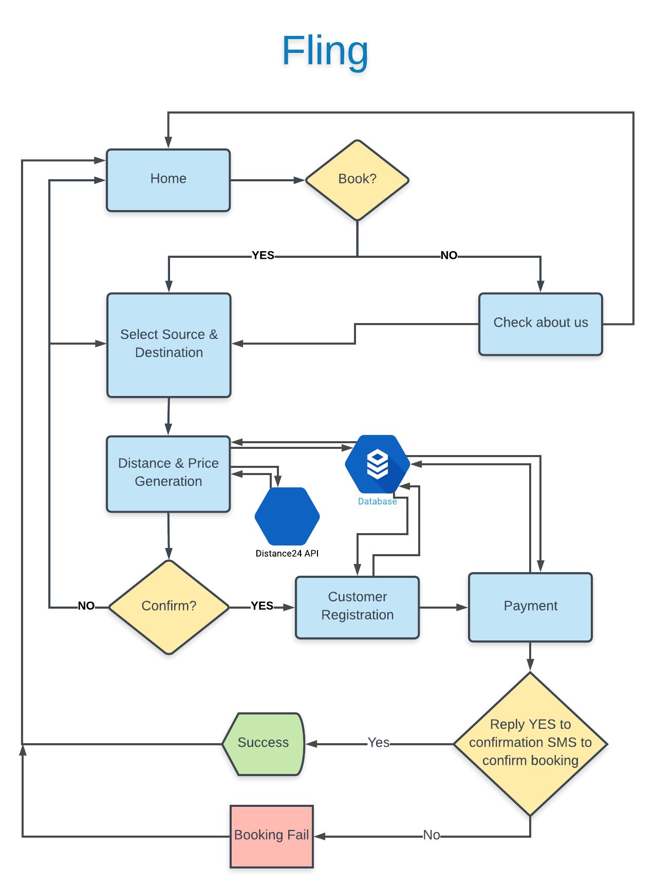
DFD
www.lucidchart.com

Slide 7
Concept
This flight service provides 3 main routes which are classified according to the hemispheres.
For booking a seat successfully; source & destination selection, registration, crypto-card details and SMS verification is required.
After that an email will be sent to the customer for successful booking.

Slide 8
Seats
Seats are not divided into classes, which prevents creating major differences between & among customers.
All seats in Fling planes are same, with same features & aesthetics, with no differences.
This results in same cost of the seats, saving time & cost of selection & management respectively.

Slide 9
Cost Calculation
The source & destination selected by the user is sent as arguments to a free Distance API, known as Distance24 API, which returns a JSON file with all the information stored in the form of dictionaries, one of them being a straight line distance.
This distance and current standard flying rate is considered to calculate the total flying cost.
Other additional packages & features are added to the final cost if the customer decides to include in their final flight package.

Slide 10
Payment
For payment, there are plenty of options to be included some of the most common ones being:
PayPal
Crypto
Paytm

Slide 11
ER Diagram

Slide 12
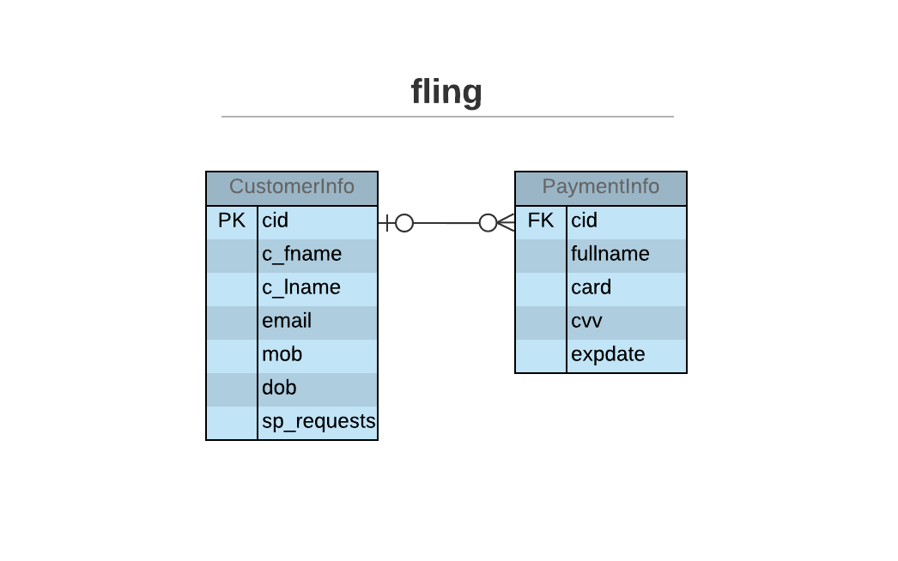
ER Diagram
www.lucidchart.com

Slide 13
DB Structure

Slide 14
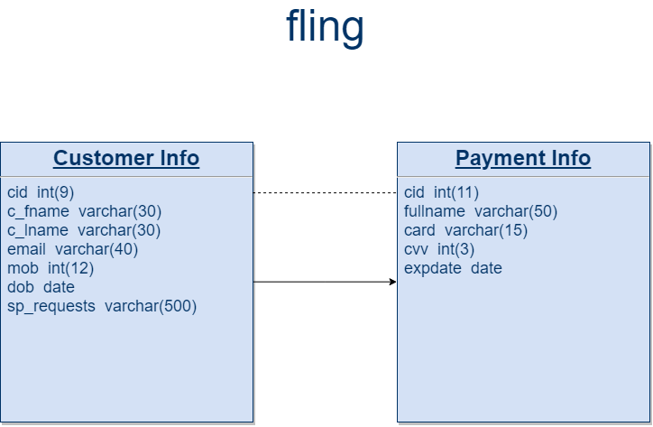
DB www.draw.io
Notes:
DB

Slide 15
Screen Layouts

Slide 16
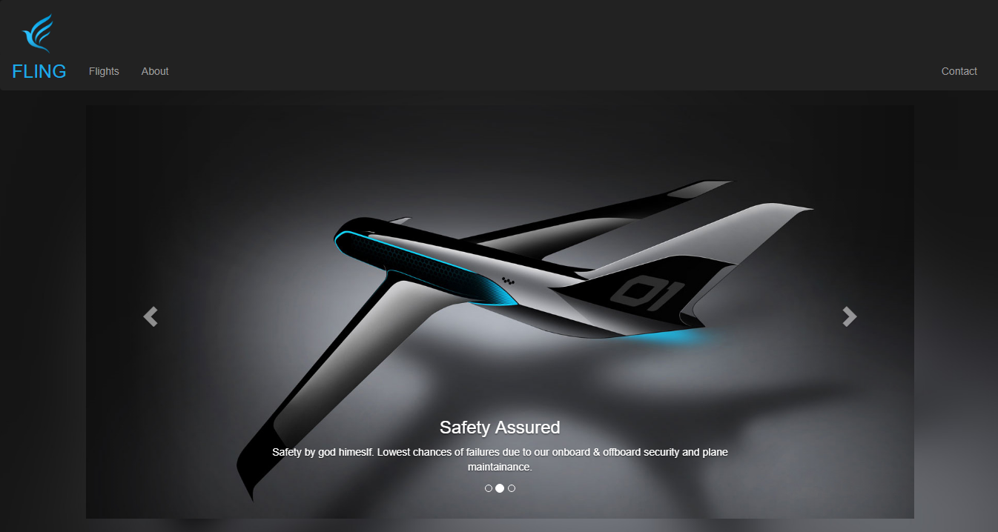
Home

Slide 17
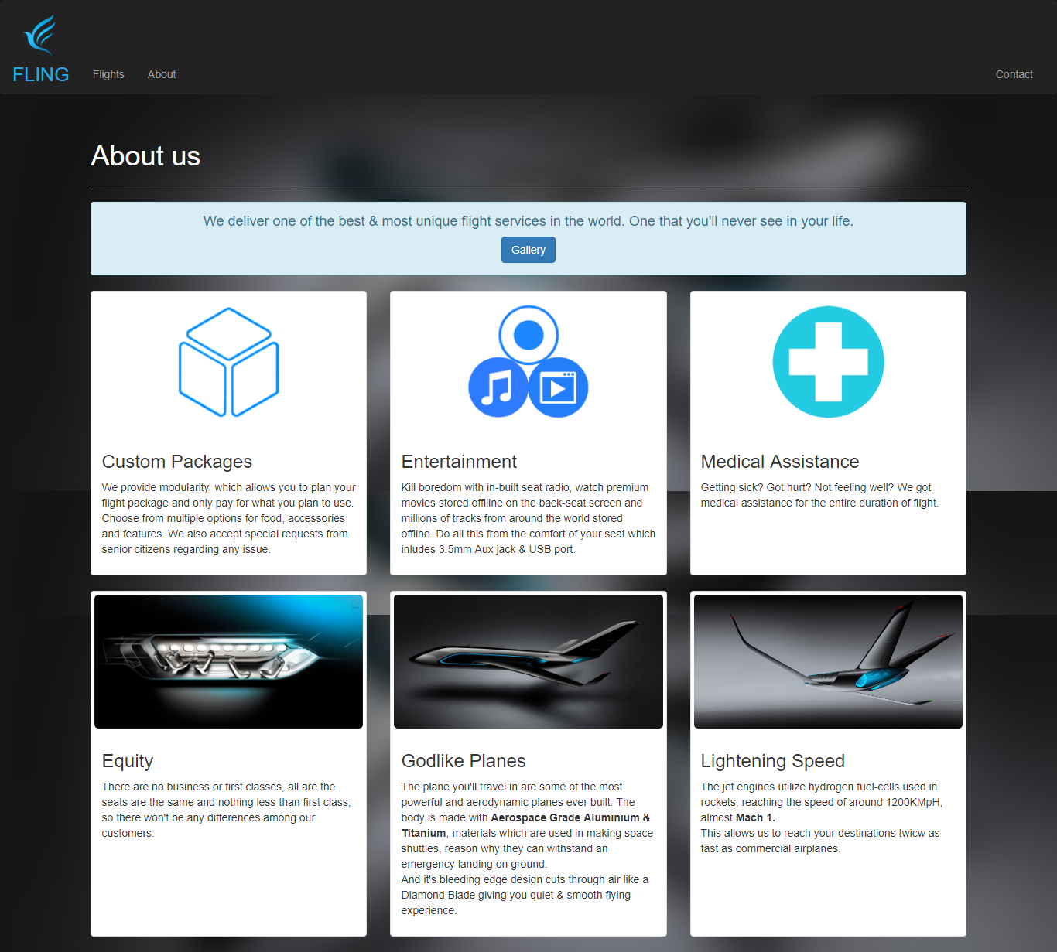
About

Slide 18
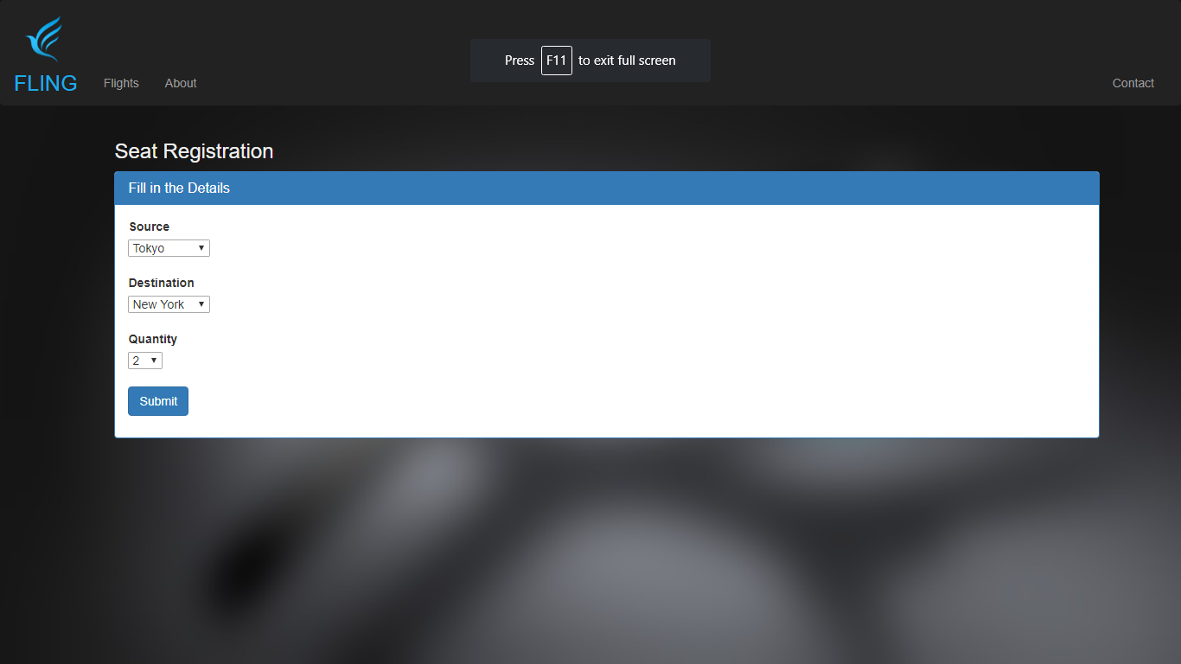
Source & Destination Selection

Slide 19
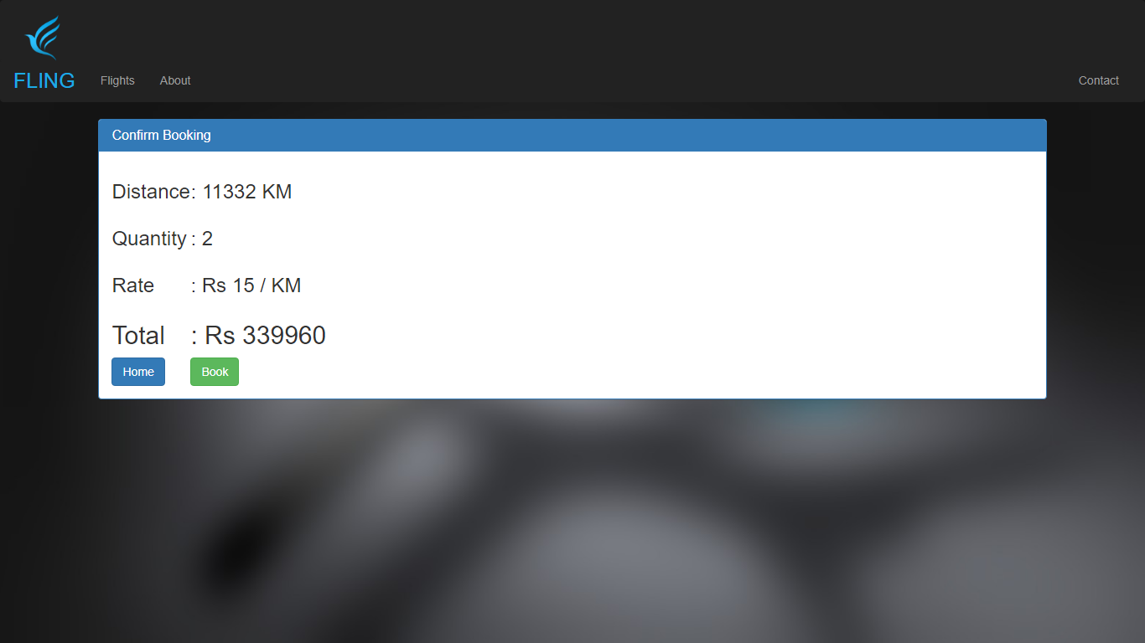
Flight Summary

Slide 20
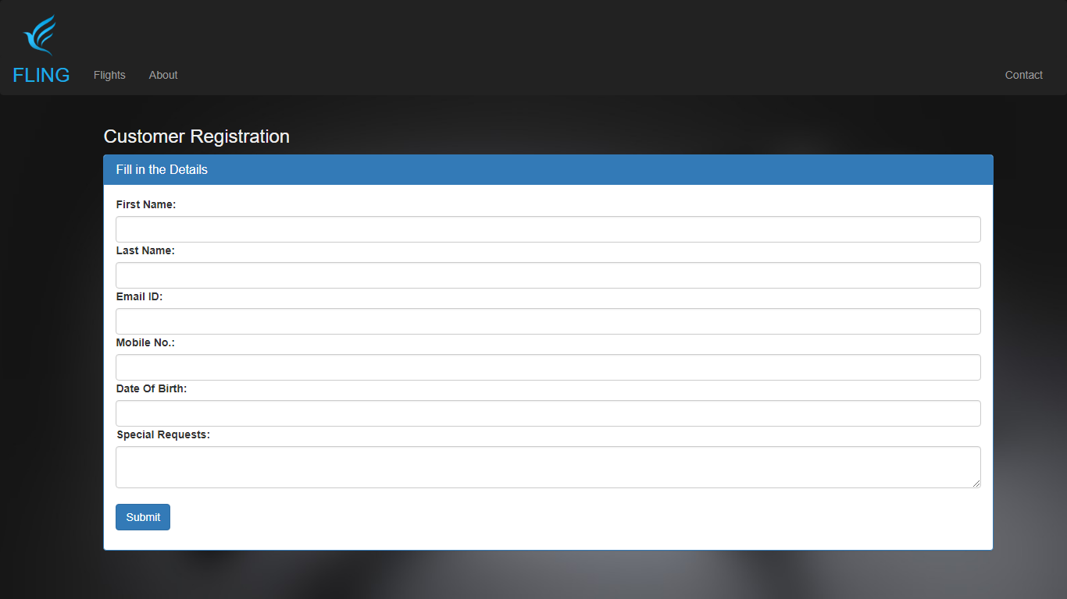
Registration

Slide 21
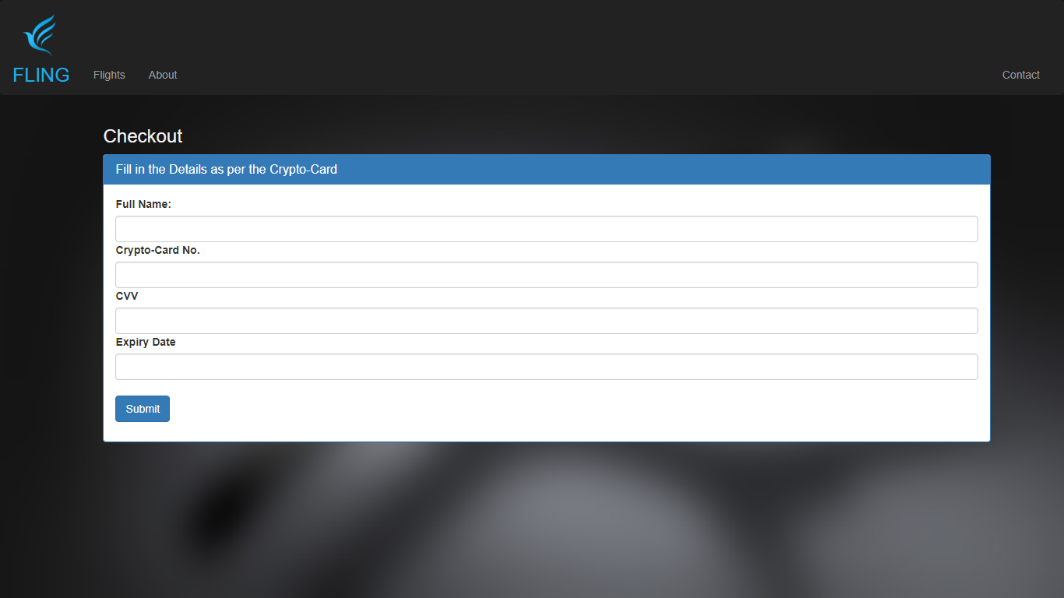
Payment (temp.)
Payment

Slide 22
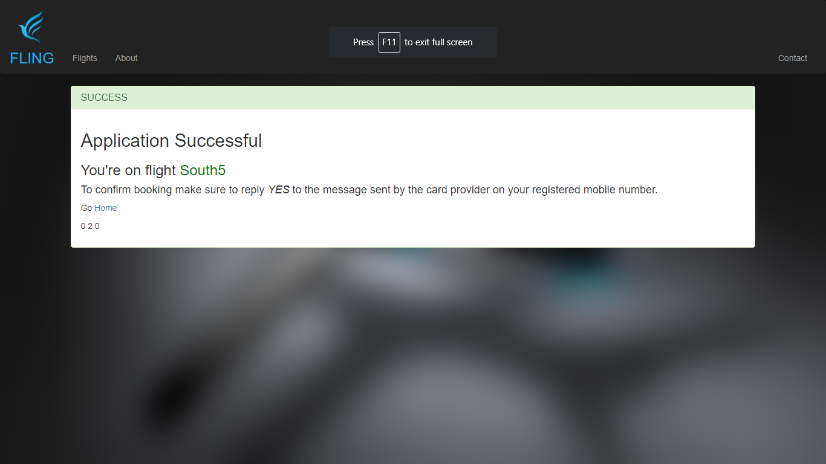

Booking Successful

Slide 23
Don’t Just Fly
Teleport

