Slide 1
Nature Inspired Computing
TY B.Tech Honours

Slide 2
Unit | Description | Duration
1 | Introduction to Natural Computing From nature to natural computing, sample idea, Philosophy of natural computing, Natural computing approaches, Natural Phenomena, Models, and Metaphors, From Nature to Computing and Back Again, General Concepts – Individuals, Entities, Agents; Parallelism and Distributivity; Interactivity; Adaptation; Feedback; Self-Organization; Bottom-Up Vs Top-Down | 05
2 | Artificial Neural Networks Biological Nervous Systems, Artificial Neural Networks, Neuron Models, Architectures, Supervised learning: Perceptron algorithm, Back Propagation Algorithm, Unsupervised learning: Self-organizing maps, ART, Reinforcement learning | 06
3 | Evolutionary Computing – Genetic Algorithms Basic Principles of Genetics, Fitness Function; Selection: Selective Pressure, Random Selection, Proportional Selection, Tournament Selection, Rank-Based Selection, Boltzmann Selection, Elitism; Reproduction Operators: Crossover operator, Mutation; Application: Pattern Recognition, Numerical Function Optimization. | 08
4 | Swarm Intelligence: Particle Swarm Optimization: Basic Particle Swarm Optimization: Global Best PSO, Local Best PSO, Velocity Components; Basic PSO parameters, Single Solution Particle Swarm Optimization: Guaranteed Convergence PSO, Social-Based Particle Swarm Optimization, Hybrid Algorithms, Sub-Swarm Based PSO, Multi-Start PSO Algorithms, Repelling Methods, Binary PSO; Application | 08
5 | Ant Algorithm: Simple Ant Colony Optimization, Ant Colony Optimization Meta-Heuristic, Cemetery Organization and Brood Care, Division of Labor, Application: Travelling Salesman Problem | 06
6 | Artificial Immune Models: Natural Immune System: Classical view, Antibodies and Antigens, White Cells, Immunity types, Network Theory, Danger Theory; Artificial Immune Models: Artificial Immune system algorithm, classical view models, Clonal Selection Theory: CLONALG; Network Theory Models; Danger Theory Models; Application: Intrusion Detection | 06

Slide 3
Books Recommended:
Text Books:
L. N. de Castro, “Fundamentals of Natural Computing: Basic Concepts, Algorithms and Applications”, 2006, CRC Press, ISBN-13: 978-1584886433
Andries P. Engelbrecht, “Computational Intelligence an Introduction”, Wiley, 2nd Edition
Tom Mitchell, Machine Learning, McGraw Hill, 1997, 0-07-042807-7
Reference Books:
D. Floreano and C. Mattiussi, “Bio-Inspired Artificial Intelligence: Theories, Methods, and Technologies”, 2008, MIT Press, ISBN-13: 978-0262062718
Russell C. Eberhart, Yuhui Shi, James Kennedy, “Swarm Intelligence: The Morgan Kaufmann Series in Evolutionary Computation”, 1st Edition, ISBN-13: 978- 1558605954
Sam Jones (Editor), “Bio Inspired Computing-Recent Innovations and Applications”, Clanrye International; 2nd edition (2 January 2015), ISBN-10: 1632400812
Yang Xiao (Editor), “Bio-Inspired Computing and Networking”, CRC Press,

Slide 4
Unit 1: Introduction to Natural Computing
Journey of Human – from using natural resources to learning from nature
Observing Physical, chemical and biological phenomena and patterns in nature
Laws of motion and gravity – designing aircrafts
Understanding basic principles of life – creating transgenic food and medicines to control diseases
Source of inspiration to imitate nature to create solutions in various domains ranging from engineering to biology
Simulate and emulate natural phenomenas

Slide 5
Unit 1: Introduction to Natural Computing
Natural computing: is the computational version of this process of extracting ideas from nature to develop ‘artificial’ (computational) systems, or using natural media (e.g., molecules) to perform computation
Branches of Natural Computing:
Computing inspired by nature:
makes use of nature as inspiration for the development of problem solving techniques
to develop computational tools (algorithms) by taking inspiration from nature for the solution of complex problems
The simulation and emulation of natural phenomena in computers:
a synthetic process aimed at creating patterns, forms, behaviors, and organisms that (do not necessarily) resemble ‘life-as-we-know-it’.
Its products can be used to mimic various natural phenomena,
Increasing our understanding of nature and insights about computer models.
Computing with natural materials:
it corresponds to the use of natural materials to perform computation
constituting a true novel computing paradigm that comes to substitute or supplement the current silicon based computers.

Slide 6
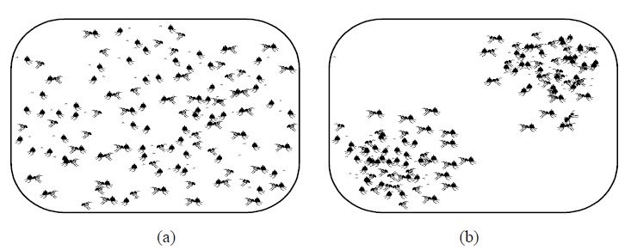
Some Examples
a. Initial distribution of ants
b. Clustering of dead ants
Pick up rule: if an ant finds a dead body, it picks it up and wanders around the arena until it finds another dead body. The probability or likelihood that an ant picks up a dead body is inversely proportional to the number of items in that portion of the arena; that is, the more dead bodies around, the smaller the probability it is picked up, and vice-versa.
Dropping rule: while wandering around, the loaded ant eventually finds more dead bodies in its way. The more dead bodies are found in a given region of the arena, the higher the probability the ant drops the dead body it is carrying at that location of the arena, and vice-versa.
As a result of these very simple behavioral rules, all dead items will eventually be brought together into a single group, depending on the initial configuration of the arena and how the rules are set up.
Question 1: what kind of problem could be solved inspired by this simple model of a natural phenomenon?
Question 2: how would you use these ideas to develop a computing tool (e.g., an algorithm) for solving the problem you specified above?

Slide 7
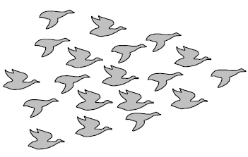
Some Examples
Flock of Birds
Follow the leader: When we see birds flocking in the sky, it is most natural to assume that the birds ‘follow a leader’; in this picture, the one in front of the flock.
No Global rule: There is no ‘global rule’ that can be defined so as to simulate a bird flock. It is possible, however, to generate scripts for each bird in a simulated flock so as to create a more realistic group behavior (for example, in a computer simulation).
Question 1: describe (some of) these behavioral rules that, when applied to each bird in the flock, result in an emergent group behavior that is not specifically defined by the individual rules
Question 2: can you extend these rules to herds of land animals and schools of fish? That is, is there a significant qualitative difference between these various types of group behavior?

Slide 8
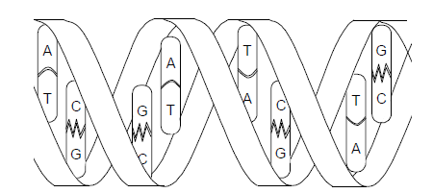
Some Examples
Double strand of DNA
Strands of DNA: The DNA molecules contain the genetic information of all living beings on earth. It is known that this genetic
information, together with the environmental influences, determines the phenotype (expressed physical characteristics) of an individual.
Genetic engineering techniques can nowadays be used to artificially manipulate DNA so as to alter the genetic information encoded in these molecules. For instance, DNA molecules can be denatured (separated into single strands), annealed (single strands can be ‘glued’ together to form double strands of DNA), shortened (reduced in length), cut (separated in two), multiplied (copied), modified (e.g., new sequences inserted),
Question 1: Based on your knowledge of how standard computers (PCs) work, propose a new model of computer based on DNA strands and suggest a number of DNA manipulation techniques that can be used to compute with molecules
Question 2: what would be the advantages and disadvantages of your proposed DNA computer over the standard computers?

Slide 9
Natural computing could be used when:
• The problem to be solved is complex, i.e., involves a large number of variables or potential solutions, is highly dynamic, nonlinear, etc.
• It is not possible to guarantee that a potential solution found is optimal (in the sense that there is no better solution), but it is possible to find a quality measure that allows the comparison of solutions among themselves.
• The problem to be solved cannot be (suitably) modeled, such as pattern recognition and classification (e.g., vision) tasks. In some cases, although it is not possible to model the problem, there are examples (samples) available that can be used to ‘teach’ the system how to solve the problem, and the system is somehow capable of ‘learning from examples’.
• A single solution is not good enough; that is, when diversity is important. Most standard problem-solving techniques are able to provide a single solution to a given problem, but are not capable of providing more than one solution. One reason for that is because most standard techniques are deterministic, i.e., always use the same sequence of steps to find the solution, and natural computing is, in its majority, composed of probabilistic methods.
• Biological, physical, and chemical systems and processes have to be simulated or emulated with realism. Euclidean geometry is very good and efficient to create man-made forms, but has difficulty in reproducing natural patterns. This is because nature is fractal, and only fractal geometry provides the appropriate tools with which to model nature.
• Life behaviors and phenomena have to be synthesized in artificial media. No matter the artificial media (e.g., a computer or a robot), the essence of a given natural behavior or pattern is extracted and synthesized in a, usually,
much simpler form in artificial life systems.
• The limits of current technology are reached or new computing materials have to be sought. Nature abounds with information storage and processing systems, and the scientific and engineering aspects of how to use these natural materials to compute are the main challenges of the third branch of natural computing: computing with natural materials

Slide 10
Natural Phenomena, Models, and Metaphors
Natural phenomena:

