Slide 1
One-Click Kubernetes Deployment
Full Overview Presentation

Slide 2
Problem Statement
- Manual deployments are slow and error-prone.
- Security risks from ad-hoc operations.
- Lack of auditability and reproducibility.

Slide 3
Solution Overview
- Terraform provisions cloud infrastructure.
- Kubernetes orchestrates containerized workloads.
- GitHub Actions automates deployments and scans.

Slide 4
Workflow Summary
1. Optional: Run Security Scan.
2. Provision infrastructure with Terraform (apply/destroy/refresh).
3. Deploy applications (Node.js, NGINX, k8sGPT).
4. Deletion workflow with dry run + confirm safety checks.

Slide 5
Key Parameters
- environment: dev/test
- action: apply / destroy / refresh
- provider: google / openai
- run_security_scan: true/false
- run_terraform: true/false
- run_application_deployment: true/false
- dry_run & confirm (delete workflow)

Slide 6
Safety Features
- Dry run and confirm required for deletions.
- Secrets stored in GitHub Secrets.
- RBAC restrictions and least privilege.
- Full audit logs for infra and apps.

Slide 7
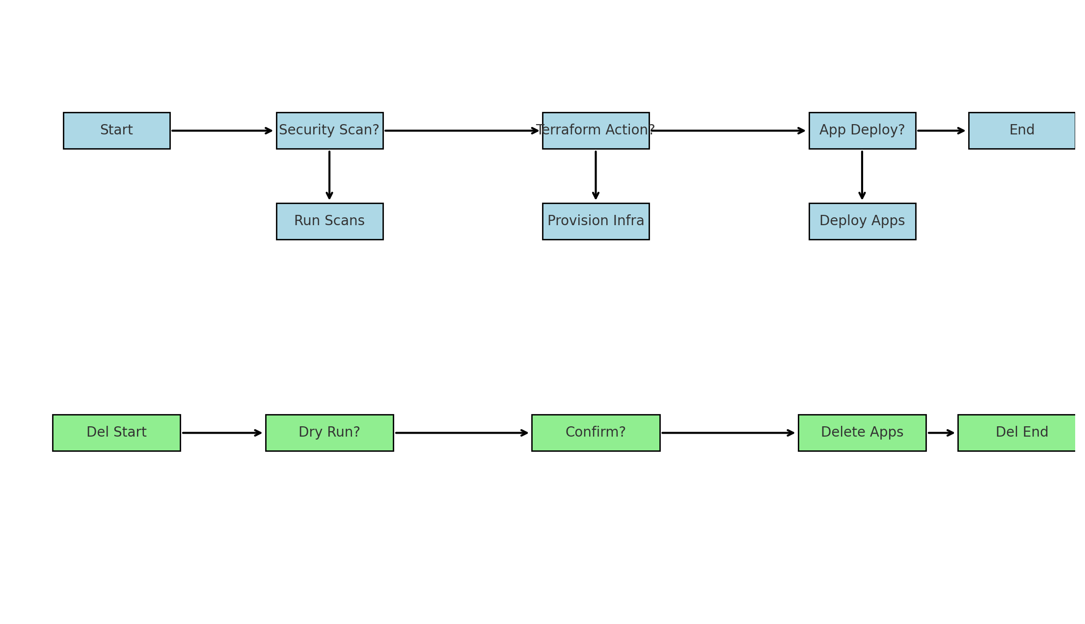
Deployment + Deletion Workflows

Slide 8
Best Practices
- Security: Secrets, RBAC, image scanning.
- Scalability: Separate environments, autoscaling, ingress.
- Extensibility: GitOps, Helm, observability.
- Cost Optimization: Spot instances, destroy unused envs.
- Governance: Audit logs, policy as code, approvals.

Slide 9
Conclusion & Benefits
- Speed: One-click deployments reduce setup time.
- Reliability: Declarative infra ensures consistency.
- Security: Integrated scans and guardrails.
- Cost Savings: Temporary environments on demand.
- Flexibility: Multiple use cases with one workflow.

