Slide 1

Linear Regression with Gradient Descent
California Housing Price Dataset
DASC 5133 Introduction to Data Science
Instructor : Dr. Ahmed Abukmail
Final Term Project presentation
April 21 , 2025
By : Meet Patel [ 2334908 ]

Slide 2
Agenda
Introduction
Understanding of Algorithm
Model Optimization
Gradient Descent
Normalization vs Standardization
Implementation
Comparison of Data Visualisation

Slide 3
Introduction
Implementing Linear Regression with gradient descent
What is algorithm ?
Data
What is LinearRegression Algorithm ?
ML Algorithm
Equation : Y = mX + c
Above equation is for 1 independent variable or feature.

Slide 4
What if we have more than 1 independent feature for target Y variable ?
For that we need to use Multiple Linear Regression
Equation : b0 + b1X1 + b2X2 + . . . . . . + bnXn

Slide 5
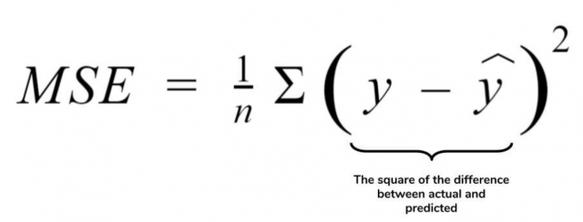
Loss Function : - It measures how far the estimated value is from its true value.
It helps us to determine which model and parameter are better.
It also consider as error function or MSE [ Mean Square Error ]

Slide 6
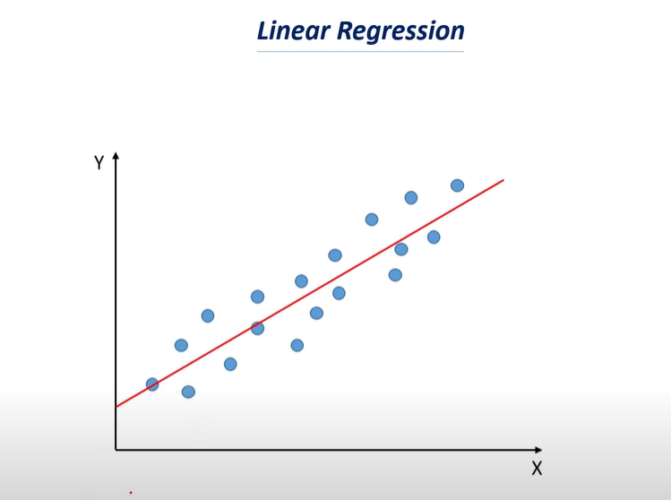
The lower loss function value the higher accuracy of model.

Slide 7
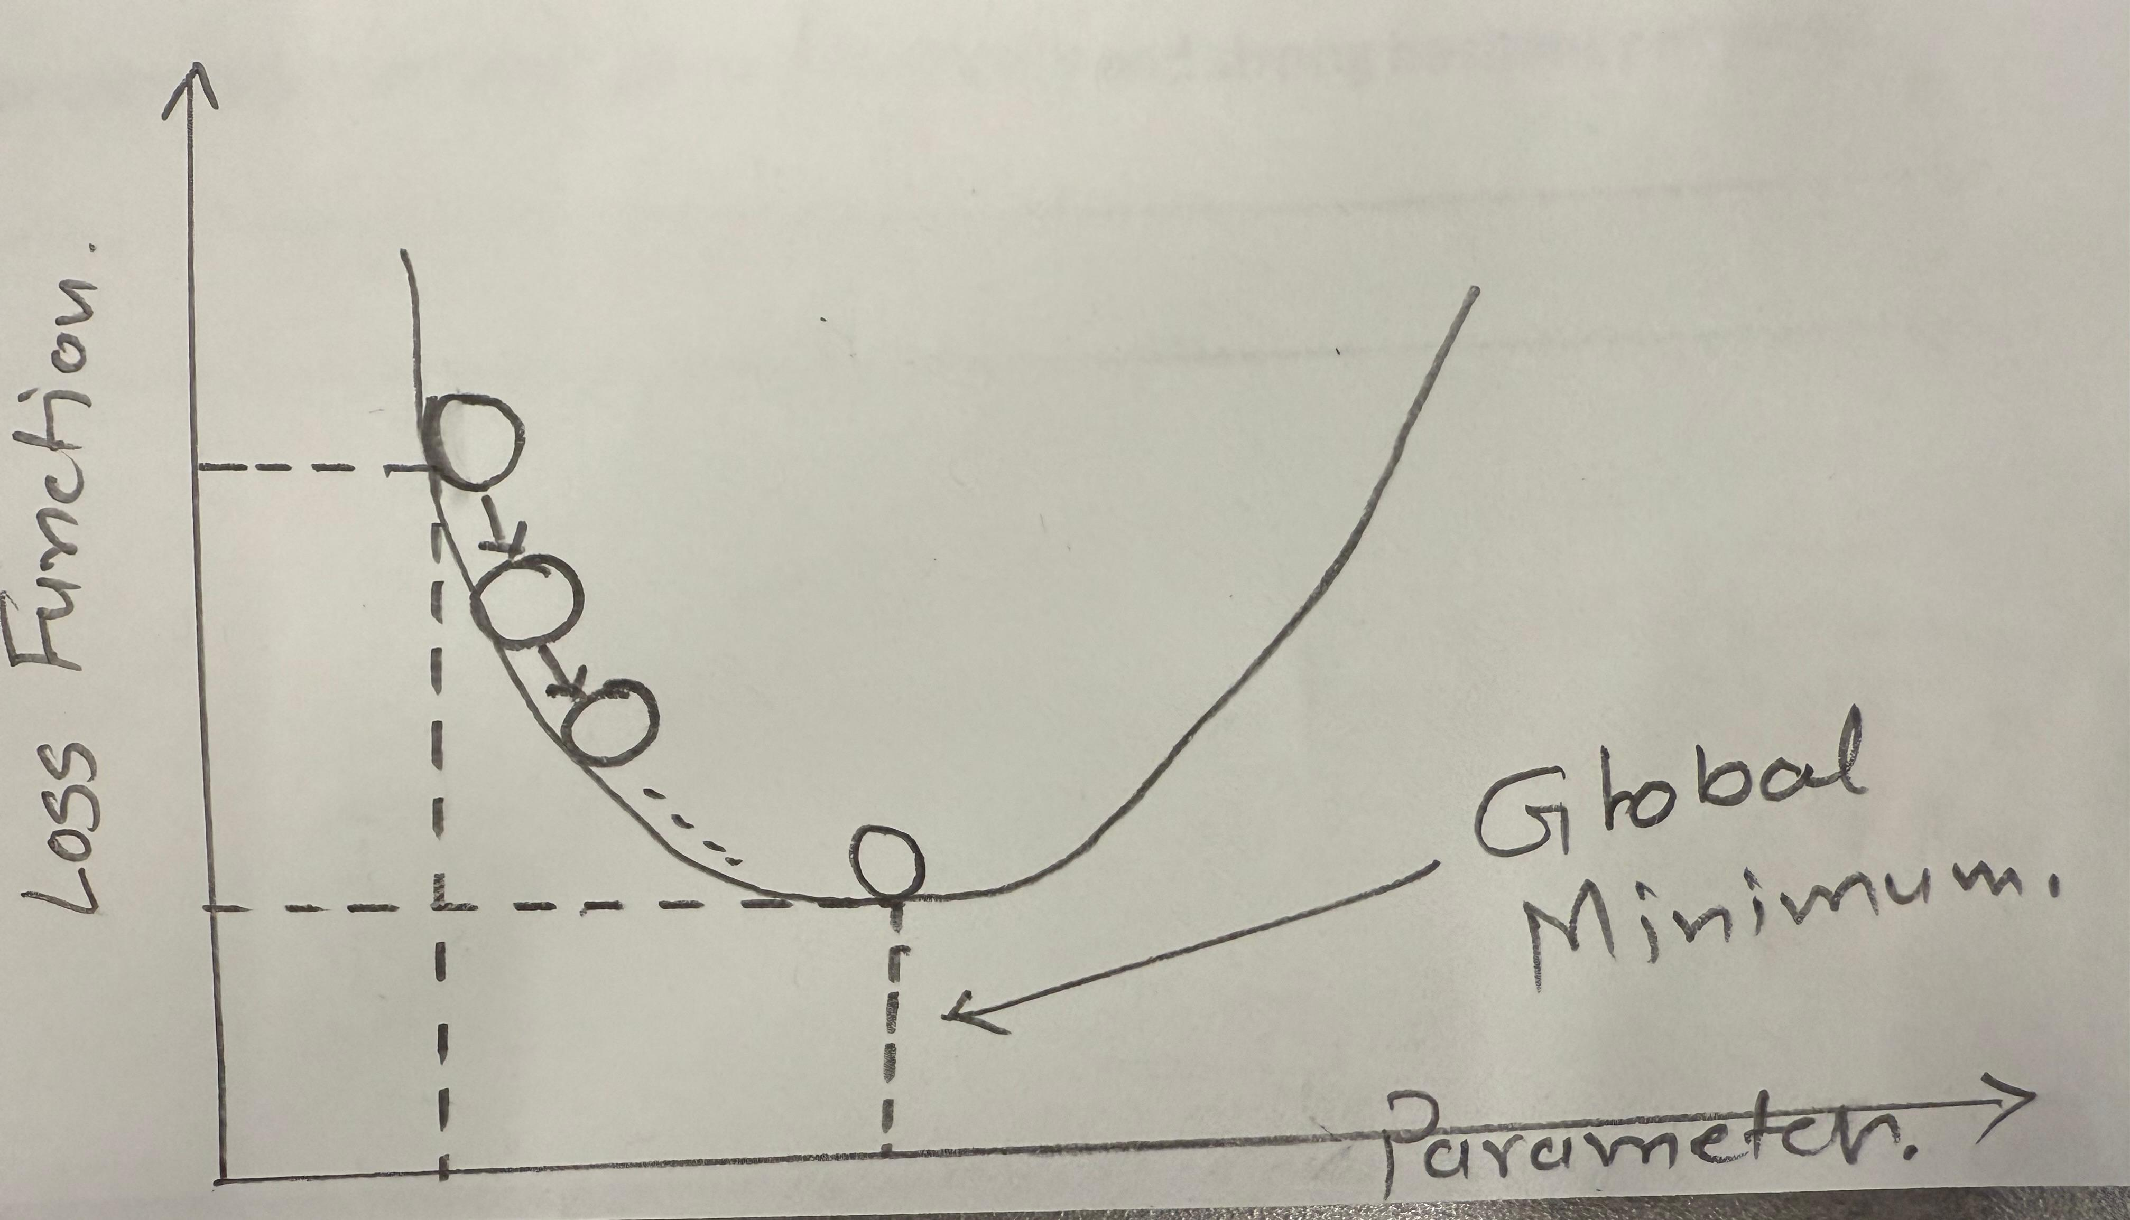
Gradient Descent : -
It is the technique of model optimization for better choosing of Parameter.

Slide 8
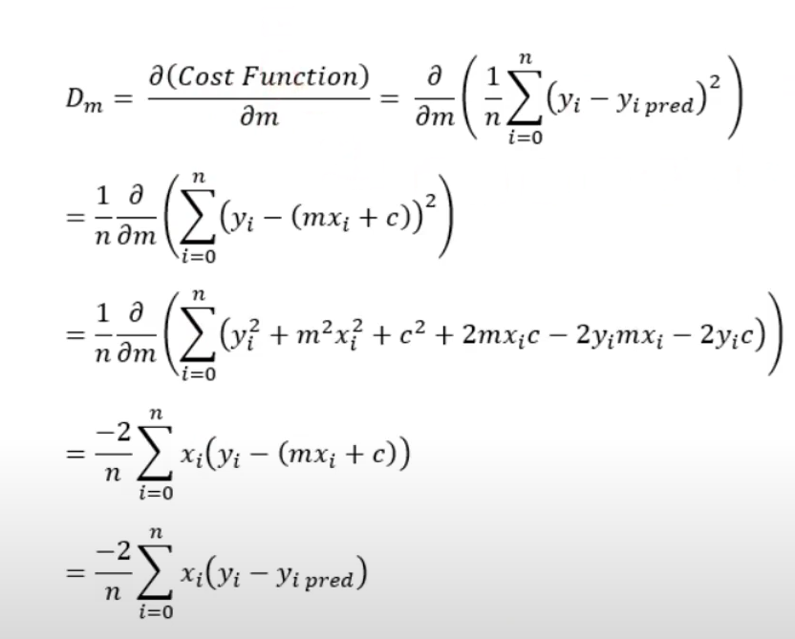
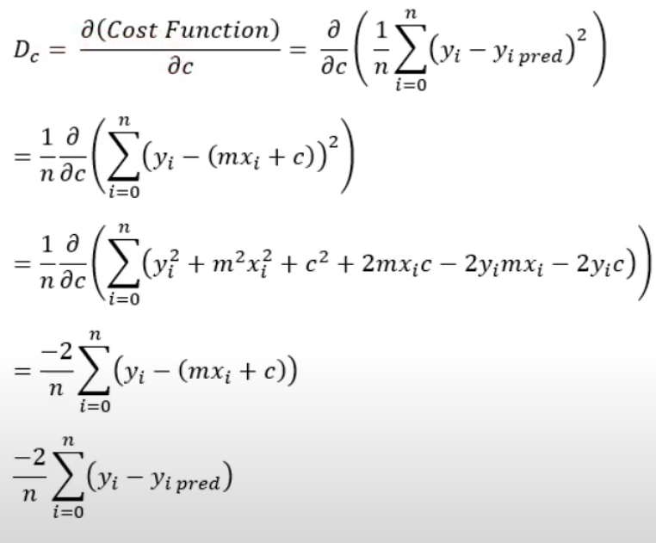
Gradient Descent : -
Equation : - w = w – α * dw and b = b - α * db
Where , α = Leaning Rate

Slide 9
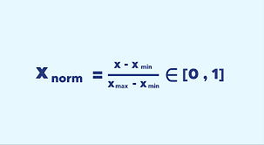
Normalisation VS Standerization : -
What is Normalisation ?
It basically scalled down the feature value to [0,1]
What is Standerization ?
It basically scalled down the feature value to “Standard Normal Distribution “.
It basically means Mean = 0 , Std = 1.
Formula for Normalisation

Slide 10
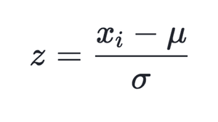
Normalisation VS Standerization : -
What is Standerization ?
It basically scalled down the feature value to “Standard Normal Distribution “.
It basically means Mean = 0 , Std = 1.
Formula for Standerization
Xi = Feature Data , µ = Mean Value , ó = Standard Deviation.

Slide 11
Dataset Overview
It has around 20,000+ rows
With 9 columns
I took the subset having 5000 rows for implementation
Dataset Preprocessing
Handles the null values in it
Get rid of any string data type column
Get rid of any outlier

Slide 12
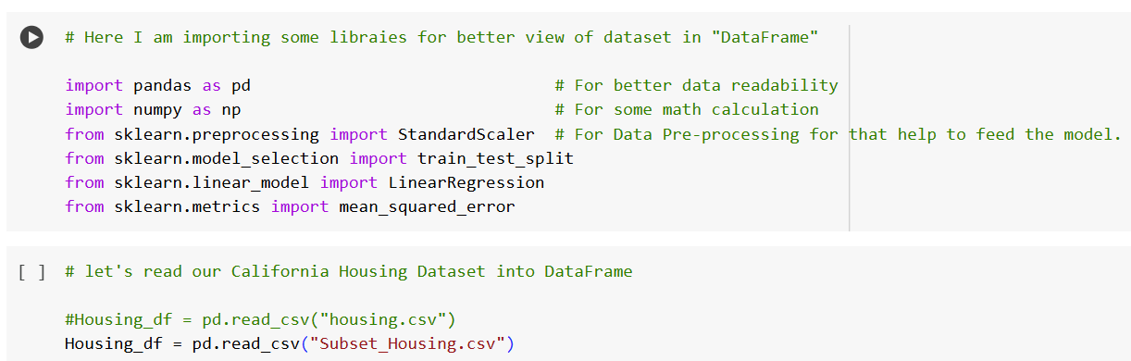
Dataset Cleaning Part
Loading Some libraries and Dataset.

Slide 13
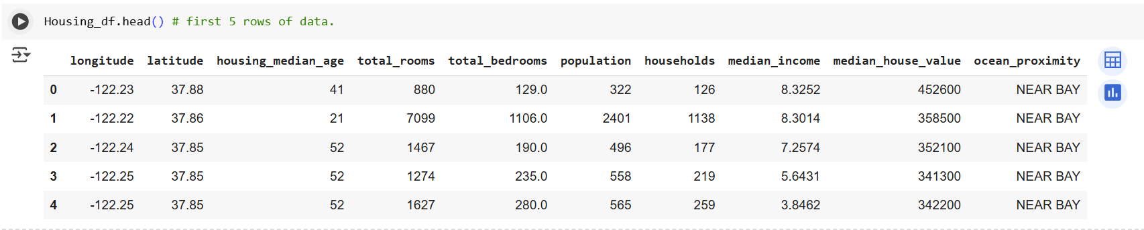
Dataset Cleaning Part
First 5 rows of Dataset .

Slide 14
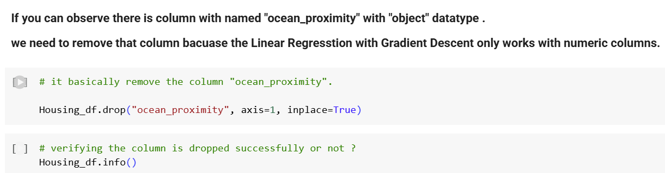
Dataset Cleaning Part
Removing “String” type column

Slide 15
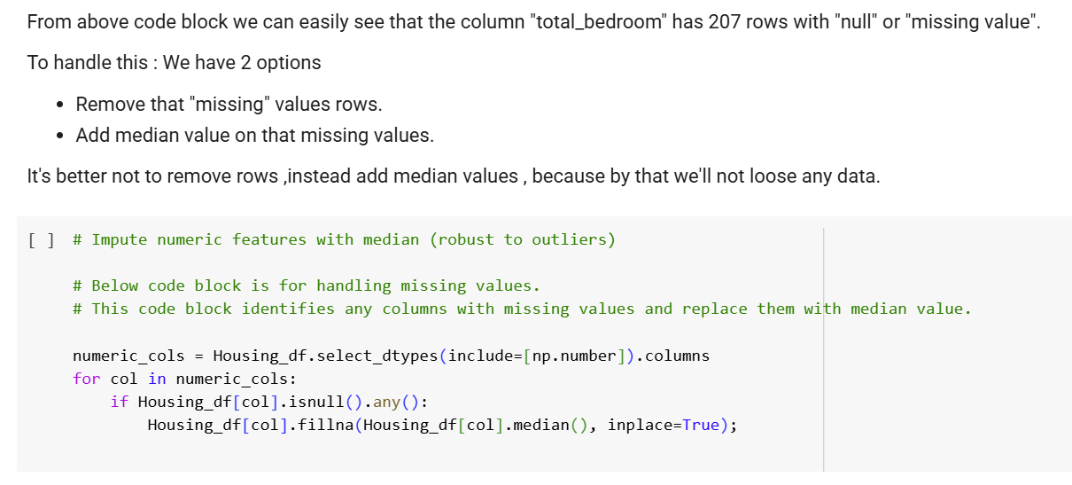
Dataset Cleaning Part
Handaling missing data

Slide 16
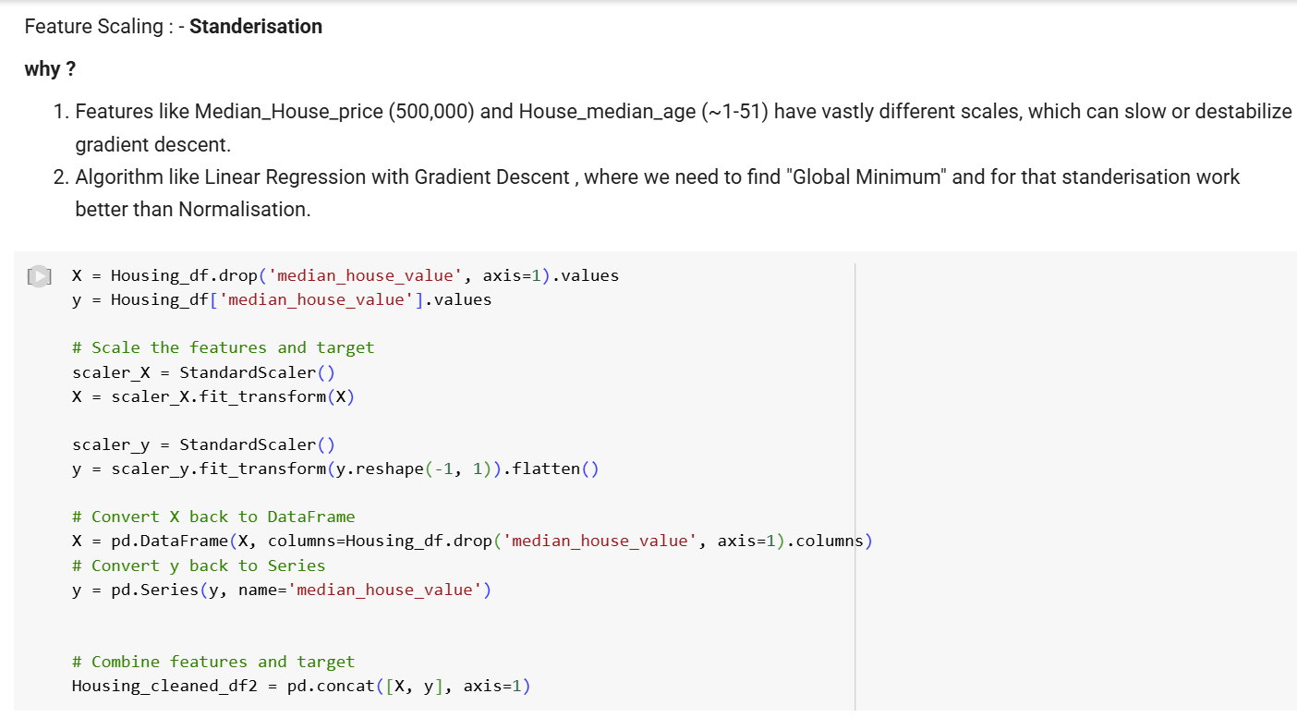
Dataset Cleaning Part
Standerization

Slide 17
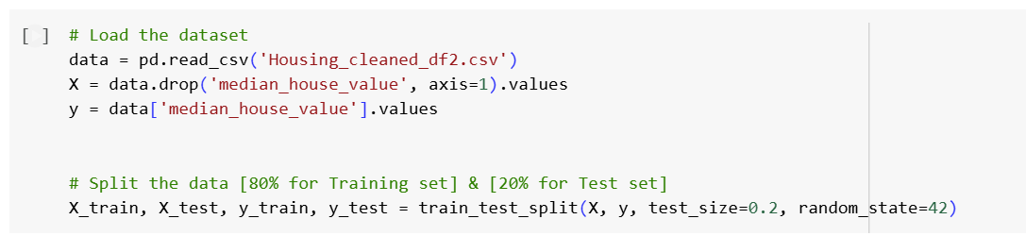
Implementation Part
Spliting data into 80%[ Training ] & 20% [ Testing ]

Slide 18
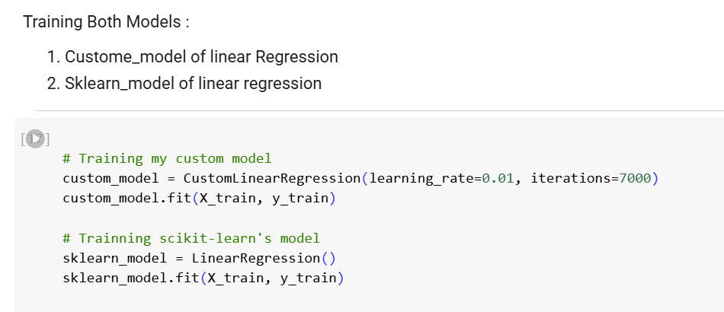
Implementation Part
Training Both Models

Slide 19
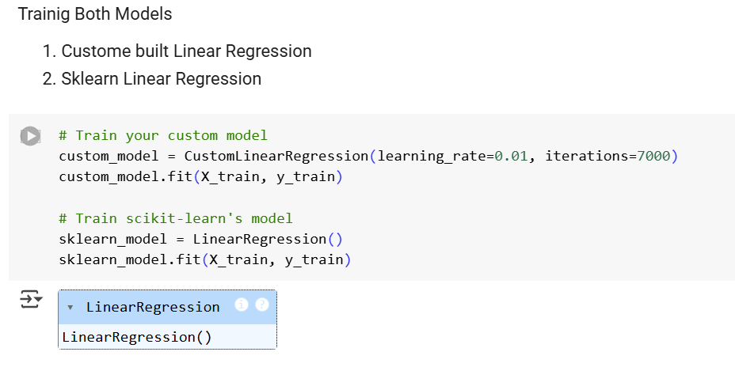
Implementation Part
Training Both Models

Slide 20
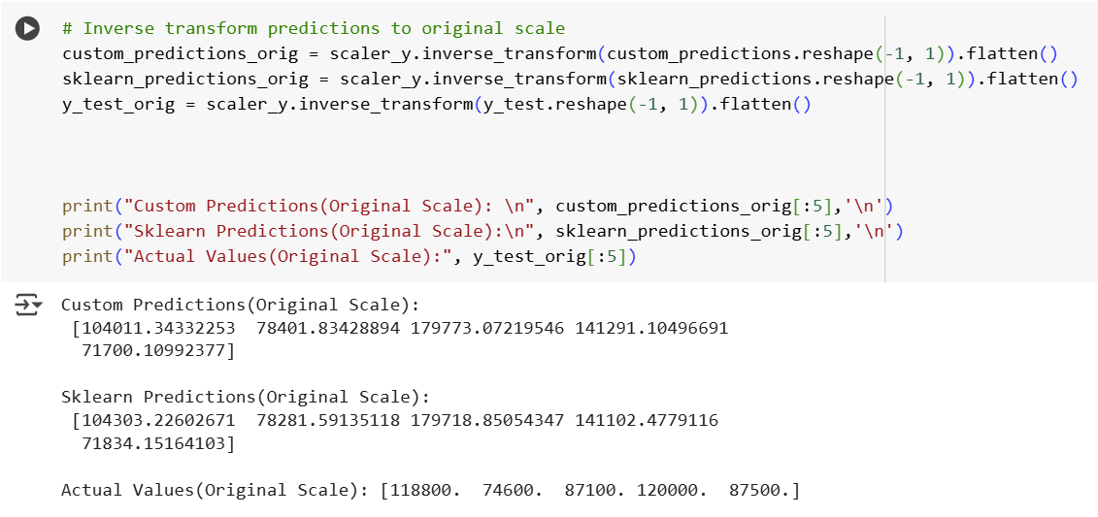
Implementation Part
Converting to original scale

Slide 21
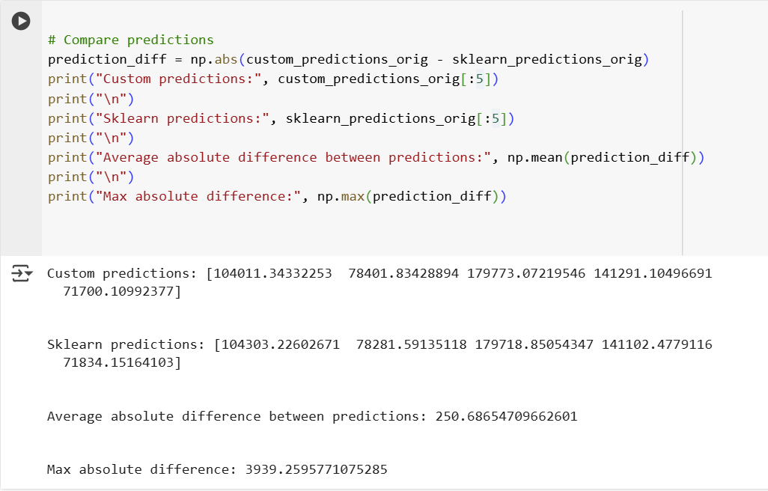
Implementation Part
Comparing the Prediction with Sklearn Model

Slide 22
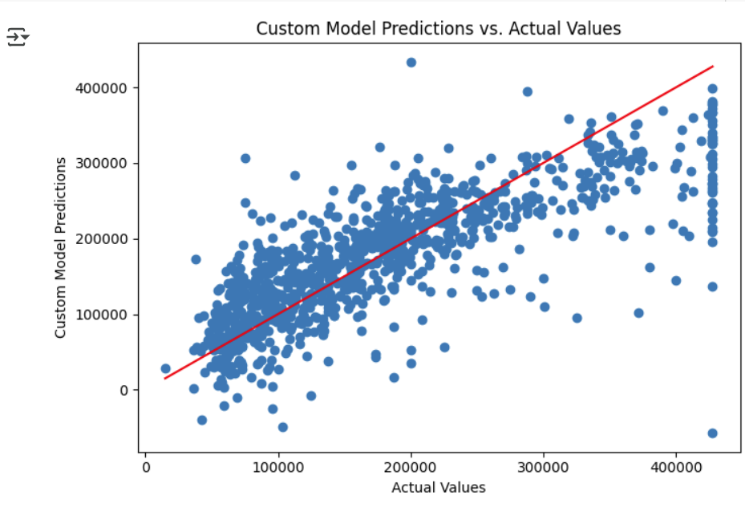
Data Visualisation Part
Comparing the figures for both models.

Slide 23
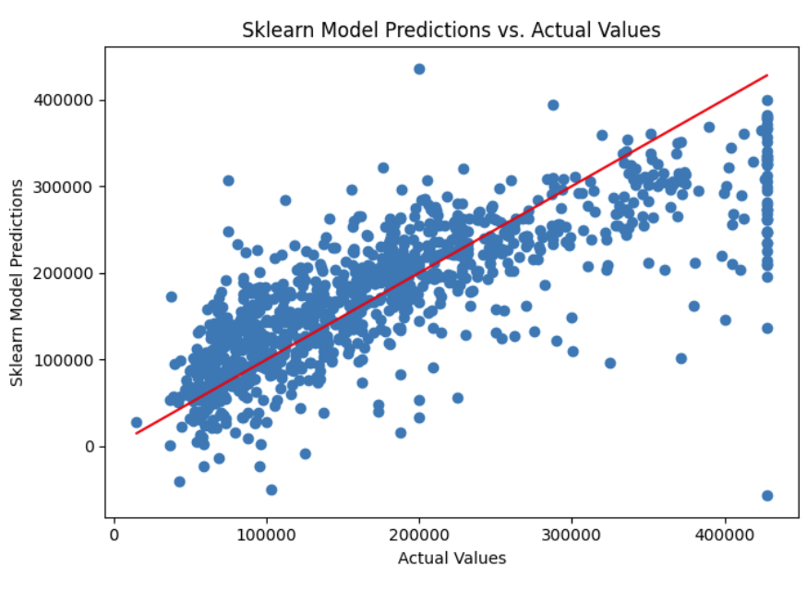
Data Visualisation Part
Comparing the figures for both models.

Slide 24
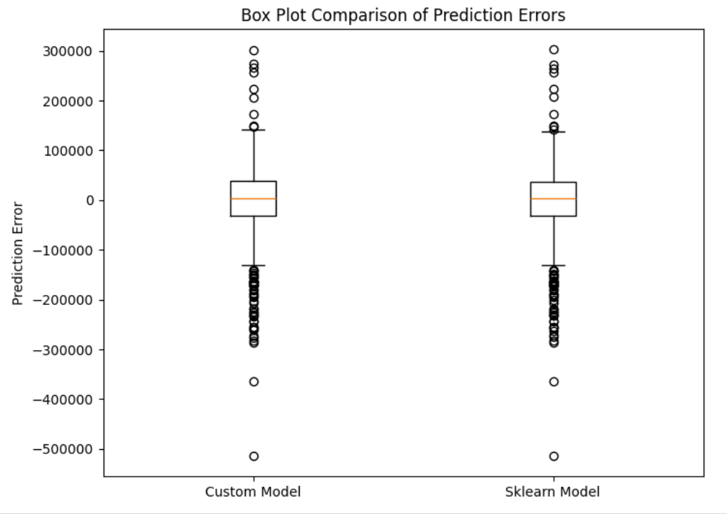
Data Visualisation Part
Comparing the figures for both models.

Slide 25
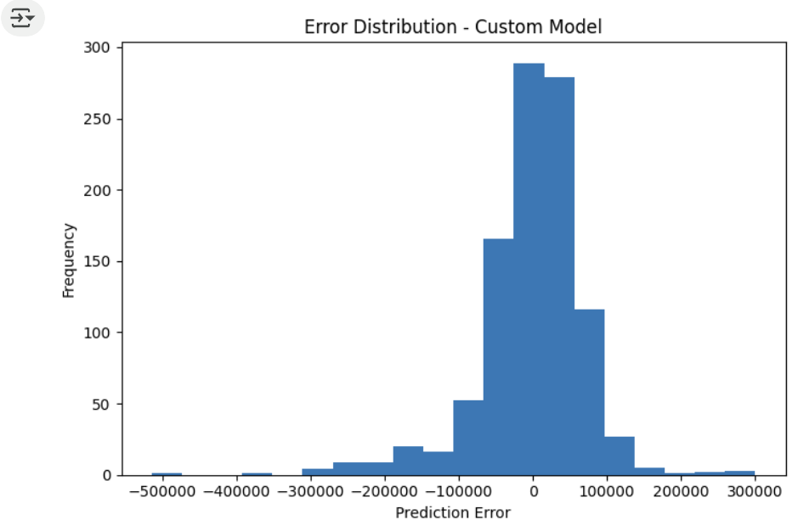
Data Visualisation Part
Comparing the figures for both models.

Slide 26
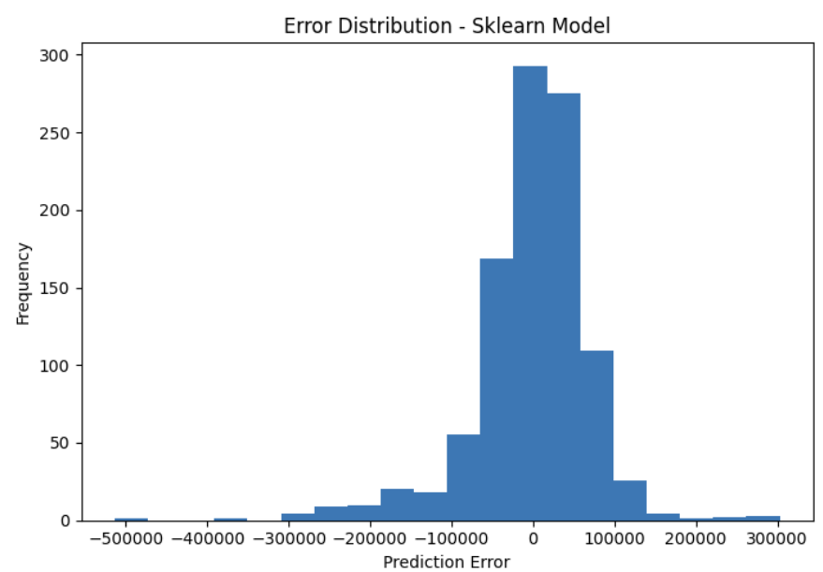
Data Visualisation Part
Comparing the figures for both models.

Slide 27
Comparison Matrics
Comparing values for both models.
Custome Predicted values : - [113948.795498 89178.81907181 183526.9499726 150386.32290458 86226.73883732]
Sklearn Predicted values : - [114444.14942017 89054.55089451 183486.59765956 150198.07831986 86505.6797085 ]

Slide 28

Thank you & Q&A

