Slide 1
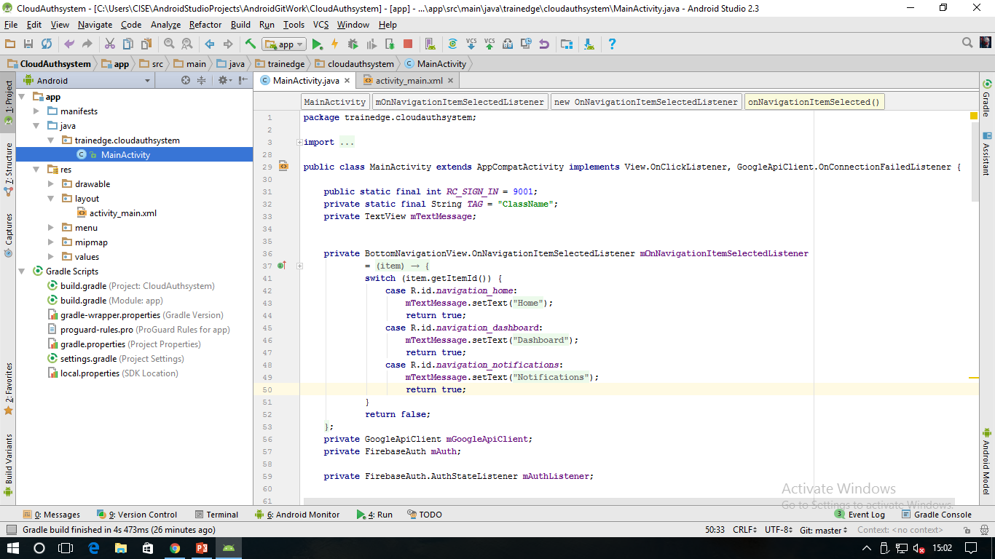
Cloud Authentication
Firebase
f
G
t
Android Studio

Slide 2
Download github desktop
Login to github using your account
Go to browser
Inside it goto Github.com
`search zaid-kamil
Select open in desktop
Select clone
Select AndroidGitworks

Slide 3
Go to Android studio
Open project > by selecting project folder’s >build.gradle file
Sync project
Add root for vcs on popup
Test run the app

