Slide 1
Download github desktop
Login to github using your account
Go to browser
Inside it goto Github.com
`search zaid-kamil
Select open in desktop
Select clone
Select AndroidGitworks

Slide 2
Go to Android studio
Open project > by selecting project folder’s >build.gradle file
Sync project
Add root for vcs on popup
Test run the app

Slide 3
Step to enable firebase in a android project
Create an android project
Goto Tools menu > Firebase
After the firebase assistant panel opens, you can choose any option
Click on connect to Firebase button
On the dialog window , change name and press continue
Then click on add dependency button, and press ok on the dialog popup

Slide 4
Authentication system in android
After connection, we can make our app to be authorized via Firebase
Go to https://firebase.google.com
Then to docs > android > get started
Also login into firebase with your Google account
After login go to console
Where you may [or may not] find your project you created on firebase
If present, click on it to go to the project dashboard and move to authentication
There you have to enable different login setups, like G+, Facebook,etc

Slide 5
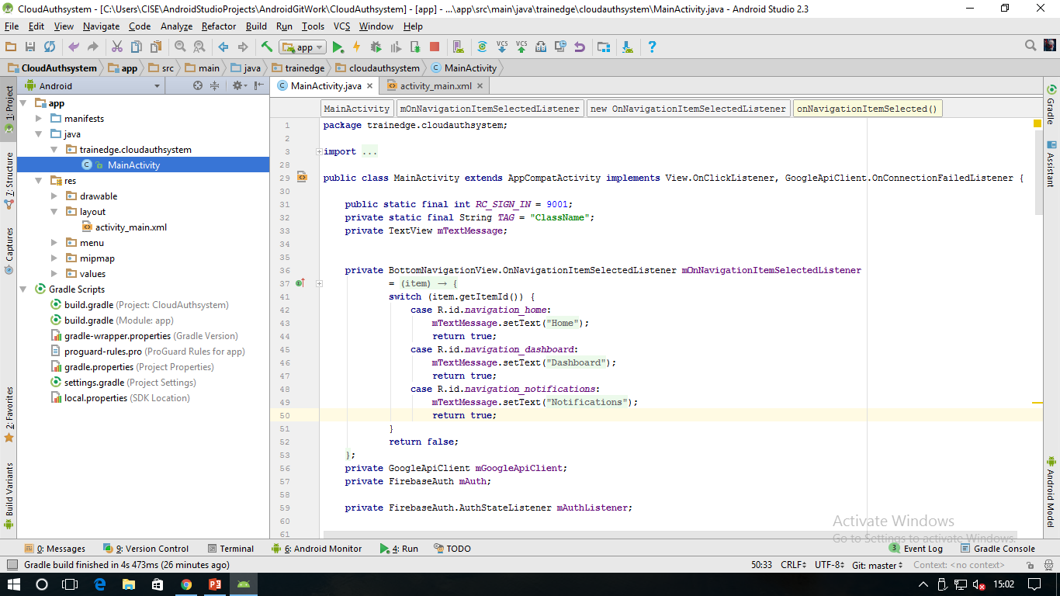
Cloud Authentication
Firebase
f
G
t
Android Studio

