Slide 1
Windows Phone MVVM and Unit Testing Step by Step
WPH208
Andy Wigley
Windows Phone Development MVP, Mobile Software Consultant
APPA Mundi Ltd

Slide 2

About Me
Andy Wigley
Mobile Solutions Consultant and Trainer
MVP since 2002, currently Windows Phone Development MVP
Author, regular speaker
Founder partner of APPA Mundi Ltd (www.appamundi.com)
Email: andy.wigley@appamundi.com
Blog
http://mobileworld.appamundi.com/blogs/andywigley
Twitter
#andy_wigley

Slide 3
About You…
You have done some Windows Phone dev
You’d like to do it better
You understand the value of unit testing or you wouldn’t be here
You want to know what it takes to make Windows Phone projects testable and how to go about it

Slide 4
Outline
What is Unit Testing?
How to build software that is hard to test
Separation of Concerns
The goodness of MVVM
Creating Testable Classes
Building testable objects by connecting them through dependency injection
Unit Testing Windows Phone XAML applications
Windows Phone 7 and Windows Phone 8

Slide 5
What is Unit Testing?

Slide 6
What is Unit Testing?
Goal is to test separately the individual business objects or units
It’s not about…
Integration testing
User interface automating
User Experience verification
Rationale: if each unit works perfectly in isolation, the application as a whole is more likely to function correctly
Key message: You need to construct your application from testable units

Slide 7
Unit Tests are Important
Tests are important assets
Attach equal importance to your test code and your application code
Invest in your product for the long term
Well tested products are inherently well factored and well structured
Less brittle and can ‘embrace change’
Less likely to introduce problems with a new release
Consider test-driven development

Slide 8

Cost of Bug Detection

Slide 9
Windows Phone Project that is NOT testable
demo

Slide 10
MVVM Goodness
The Benefits of Separation of Concerns

Slide 11

Model – View - ViewModel
Test!
Presentation
Business Logic
Data
View
ViewModel
Test!
Model
View
ViewModel
Test!
View
ViewModel

Slide 12
Road to Effective Unit Testing Step 1: Use Databinding
Simplest way to display data in UI controls is to program them directly to get and set properties of controls
e.g. textBox1.Text = "Hello, world";
In complex applications, such code quickly becomes unwieldy and error prone, and prevents effective unit testing
Use Silverlight data binding to link your Views to your ViewModels
ViewModels expose the data that is the source for data binding
UI controls can get their display values automatically from properties of the ViewModel class
Changing the property, updates the display
User input can automatically update the bound property of the ViewModel class

Slide 13
Data Binding in XAML
<TextBlock x:Name="ContentText" Text="{Binding LineThree, Mode=OneWay}"/>
Properties of controls can be bound to a public property of a data object
In the example above, the Text property of the TextBlock is bound to the LineThree property of some data source
Define the data source by setting:
The DataContext property of any containing FrameworkElement-derived class (a containing control, the page, or the frame), or
The ItemsSource property of a List control

Slide 14
Data Binding Modes
<TextBlock x:Name="ContentText" Text="{Binding LineThree, Mode=OneWay}"/>
The Mode property determines how changes are synchronized between the target control and data source
OneTime – Control property is set once to the data value and any subsequent changes are ignored
OneWay – Changes in the data object are synchronized to the control property, but changes in the control are not synchronized back to the data object
TwoWay – Changes in the data object are synchronized to the control property and vice-versa

Slide 15
INotifyPropertyChanged
ViewModels implement INotifyPropertyChanged
public class ItemViewModel : INotifyPropertyChanged
{
private string lineOne;
public string LineOne
{
get { return lineOne; }
set {
if (value != lineOne)
{
lineOne = value;
NotifyPropertyChanged("LineOne");
}
}
}
public event PropertyChangedEventHandler PropertyChanged;
private void NotifyPropertyChanged(String propertyName)
{
if (null != PropertyChanged)
PropertyChanged(this, new PropertyChangedEventArgs(propertyName));
}
}

Slide 16
MVVM and DataBinding
demo

Slide 17
Advanced MVVM
Exposing data through bindable properties of your VM is only part of the answer
The ViewModel needs to do more than simply manage data properties
What about logic executed as a result of user action such as clicking a button?
How can I perform navigation from my VMs?

Slide 18
Road to Effective Unit Testing Step 2: Use Commanding to Handle User Actions
View.xaml
View.xaml.cs
ViewModel
Events
Event Handlers
Commanding

Slide 19
Commanding Bind Events to RelayCommand or RelayCommand<T>
For controls that extend ButtonBase, use the Command attribute to bind the Click event to a RelayCommand property on your VM
For other controls and/or events, use Blend InvokeCommandAction
<Button Content="Press this" Height="72" Margin="90,464,0,0" Name="button1" Width="300"
Command="{Binding HelloCommand}"/>
<ListBox Height="100" x:Name="listBox1" >
<i:Interaction.Triggers>
<i:EventTrigger EventName="SelectionChanged">
<i:InvokeCommandAction Command="{Binding SelectionChanged}"
CommandParameter="{Binding ElementName=listBox1, Path=SelectedIndex}"/>
</i:EventTrigger>
</i:Interaction.Triggers>
</ListBox>

Slide 20
Commanding RelayCommand Implements Logic to Execute
public class MainViewModel : ViewModelBase
{
...
// Note that RelayCommand is NOT in the Silverlight class libraries. This RelayCommand object
// comes from the MVVMLight framework. You could create your own implementation – it must implement
// the Silverlight ICommand interface.
private RelayCommand _myHelloCommand;
/// <summary>
/// Gets the HelloCommand.
/// </summary>
public RelayCommand HelloCommand
{
get
{
return _myHelloCommand
?? (_myHelloCommand = new RelayCommand( () =>
{
this.WelcomeTitle = "You changed the Title!";
}));
}
}
}

Slide 21
The Need for a Navigation Service
The Problem: ViewModels need to control navigation between pages
But the System.Windows.Navigation.NavigationService is accessible only through
the NavigationService property of each page
or by calling methods on the PhoneApplicationFrame for the application
And ViewModels are not allowed to call any methods in any View
The Answer: Implement a NavigationService
Handles navigation tasks on behalf of the ViewModels
Maintains the purity of our ViewModels
Allows us to mock the Navigation Service when we write unit tests

Slide 22
Road to Effective Unit Testing Step 3: Move Common Logic into Services
Frame
View1.xaml
ViewModel1
View2.xaml
ViewModel2
o
NavigationService
Navigate
GoBack
?

Slide 23
NavigationService Implementation
public class NavigationService : INavigationService
{
public void NavigateTo(Uri pageUri)
{
var _mainFrame = Application.Current.RootVisual as PhoneApplicationFrame;
_mainFrame.Navigate(pageUri);
}
public void GoBack()
{
var _mainFrame = Application.Current.RootVisual as PhoneApplicationFrame;
if (_mainFrame.CanGoBack)
{
_mainFrame.GoBack();
}
}
}

Slide 24
Services are Good :)
Get used to creating Services for logic that ‘lives’ outside of the Views and their ViewModels
Many Benefits:
Encapsulates logic for a particular function in a separate class
Lifetime can extend across many different pages
Examples:
DataService: Service that exposes the Model data to the ViewModels
StateService: Service to store the current state or context across multiple pages

Slide 25
MVVM and Commanding
demo

Slide 26
The Story So Far…
Step 1: Using Databinding to connect Views to ViewModels
Step 2: Using Commanding to handle User actions
Step 3: Move Common Logic into Service classes
Result: Our ViewModel encapsulates all our business logic, and our View is concerned solely with Presentation
…but we’re not quite there yet
The ViewModel can still be hard to test because it has dependencies on the state of other, connected objects
☹

Slide 27
Dependency injection
Creating Testable Objects by Removing Dependencies on Other Objects

Slide 28
How Dependencies Make Testing Difficult
public class MainViewModel
{
private DataService dataSvc;
public MainViewModel()
{
dataSvc= new DataService();
}
public void XYZmethod()
{
var theCar = dataSvc.Car;
...
NavigationService.Instance.GoBack();
}
...
}
DataService
DataService
DataService
DataService
NavigationService

Slide 29
Inject Dependencies To Allow Mocking
public class MainViewModel
{
private IDataService dataSvc;
private INavigationService navSvc;
public MainViewModel(IDataService data, INavigationService nav)
{
dataSvc= data;
navSvc = nav;
}
public void XYZmethod()
{
var theCar = dataSvc.Car;
...
navSvc.GoBack();
}
...
}
DataService : IDataService
MockDataService : IDataService
MockNavigationService : INavigationService
NavigationService : INavigationService

Slide 30
Dependency Injection Container
public class ViewModelLocator
{
static ViewModelLocator()
{
ServiceLocator.SetLocatorProvider(() => SimpleIoc.Default); // Using SimpleIOC
// Register Services
if (ViewModelBase.IsInDesignModeStatic)
SimpleIoc.Default.Register<IDataService, Design.DesignDataService>();
else
SimpleIoc.Default.Register<IDataService, DataService>();
SimpleIoc.Default.Register<INavigationService, NavigationService>();
// Register ViewModels
SimpleIoc.Default.Register<MainViewModel>();
}
// Following property returns an instance of MainViewModel, with dependencies injected
public MainViewModel Main
{
get { return ServiceLocator.Current.GetInstance<MainViewModel>(); }
}
}

Slide 31
Dependency Injection
demo

Slide 32
Unit Testing Windows Phone XAML applications
Using the Silverlight Windows Phone Unit Testing Framework

Slide 33
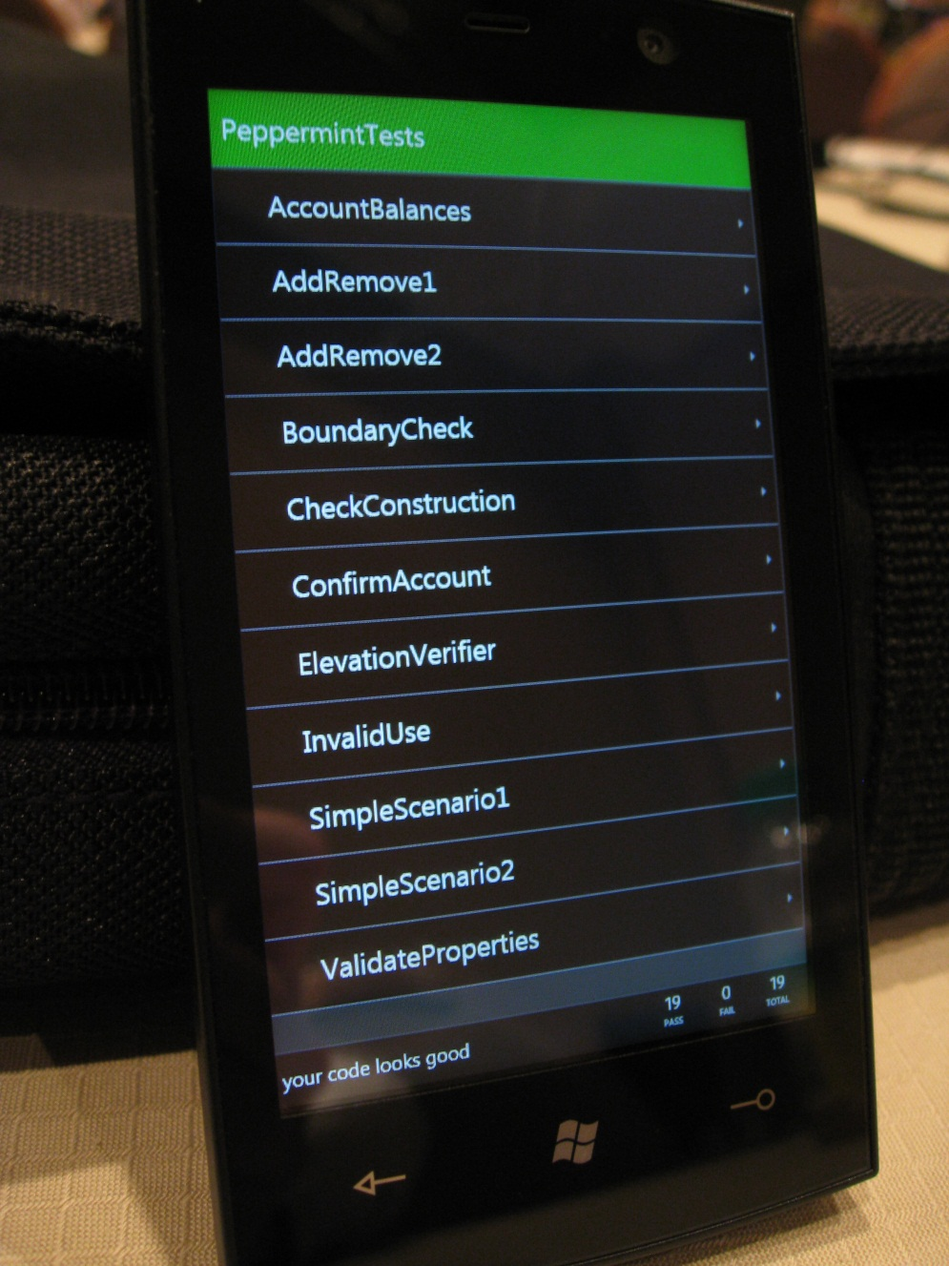
Windows Phone Testing

Slide 34
Unit Test Metadata
Attributes
[TestClass]
[TestMethod]
[Tag("SubsetTag ")]
[ExpectedException(…)]
[Priority(0)]
Assertions
Assert.IsTrue
Assert.IsNotNull
Assert.IsInstanceOfType
StringAssert.Contains

Slide 35
Unit Test Example
/// <summary>
/// Tests that the Initialize method takes a copy of the 'main' car
/// NOTE uses the Mock Datastore to test the VM in isolation
/// </summary>
[TestMethod]
public void InitializeCopiesCar()
{
var mDS = new MockDataService();
var carDetailsVM = new CarDetailsViewModel(mDS, new MockNavigationService());
var origName = mDS.Car.Name;
var origOdo = mDS.Car.InitialOdometerReading;
// Call method to test
carDetailsVM.Initialize();
Assert.AreEqual(origName, carDetailsVM.Car.Name, "Name of car not copied");
Assert.AreEqual(origOdo, carDetailsVM.Car.InitialOdometerReading, “Odo not copied");
}

Slide 36
Unit Testing
demo

Slide 37
In Summary: The Road to Effective Unit Testing
Step 1: Use Databinding to connect Views to ViewModels
Step 2: Use Commanding to handle User actions
Step 3: Move Common Logic into Services
Step 4: Use Dependency Injection and Mocking

Slide 38


Further Reading
Blog: Cheat Sheet for Unit Testing on Windows Phone 7 http://bit.ly/9Jwf9w
Microsoft patterns & practices: Building Testable Windows Phone Apps http://bit.ly/M8D4rw
Microsoft patterns & practices: Developing a Windows Phone App using the MVVM Pattern http://bit.ly/L4sQWh
Windows Phone 7 Continuous Integration Testing Framework http://wp7ci.codeplex.com

Slide 39
MVVM Frameworks for Windows Phone
MVVMLight http://mvvmlight.codeplex.com/
Caliburn Micro http://caliburnmicro.codeplex.com/
Simple MVVM Toolkit http://simplemvvmtoolkit.codeplex.com/
Catel http://catel.codeplex.com/
nRoute http://nroute.codeplex.com/
UltraLight.mvvm http://ultralightmvvm.codeplex.com/

Slide 40
Related Content
WPH207 Windows Phone: Building Enterprise Apps
AAP401 Real World Developer Testing with Visual Studio 2012
Windows Phone for Developers – TLC – Hall 1
Find Me Later At TLC After This Session 11:45 – 12:45

Slide 41
Windows Phone Sessions
Tuesday
Thursday
12:00 | G105 | WPH201 | What's New
14:45 | G105 | WPH203 | Build Apps and Games for WP 7.5
16:30 | E107 | WPH202 | Collaborate Through Exchange, SharePoint, Lync and Office 365
08:30 | G105 | WPH205 | Device and App Management
12:00 | G105 | WPH301 | Tiles and Notifications
14:45 | G105 | WPH207 | Building Enterprise Apps
16:30 | D201 | WPH302 | Localization and Globalization
Wednesday
Friday
12:00 | E104 | WPH204 | Application UI Design Principles
14:45 | D201 | WPH304 | Security Deep Dive
17:00 | G105 | WPH206 | How to Make Money with your Applications and Games
08:30 | G105 | WPH303 | Windows Phone: Optimizing Application Performance
10:15 | G105 | WPH208 | Windows Phone: MVVM and Unit Testing Step by Step

Slide 42



Resources
Learning
Connect. Share. Discuss.
Microsoft Certification & Training Resources
http://europe.msteched.com
www.microsoft.com/learning
TechNet
Resources for IT Professionals
Resources for Developers
http://microsoft.com/technet
http://microsoft.com/msdn

Slide 43
Submit your evals online
Evaluations
http://europe.msteched.com/sessions

Slide 44
Questions?

Slide 45
© 2012 Microsoft Corporation. All rights reserved. Microsoft, Windows, Windows Vista and other product names are or may be registered trademarks and/or trademarks in the U.S. and/or other countries.
The information herein is for informational purposes only and represents the current view of Microsoft Corporation as of the date of this presentation. Because Microsoft must respond to changing market conditions, it should not be interpreted to be a commitment on the part of Microsoft, and Microsoft cannot guarantee the accuracy of any information provided after the date of this presentation. MICROSOFT MAKES NO WARRANTIES, EXPRESS, IMPLIED OR STATUTORY, AS TO THE INFORMATION IN THIS PRESENTATION.

