Slide 1
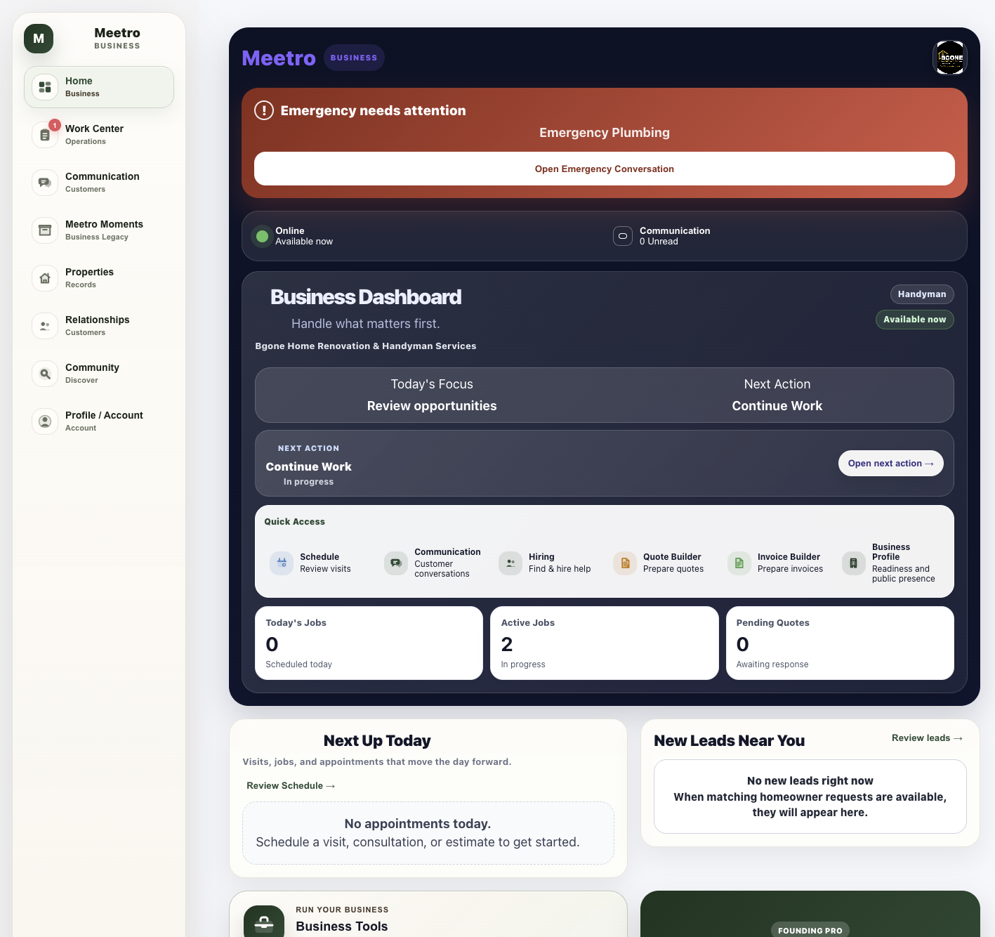
YOUR BUSINESS.
ONE CLEAR VIEW.
Meetro Community brings opportunities,
active work, communication, scheduling, and
business tools into one connected operating view.

