Slide 1

Process Control Daemon
For Embedded Linux Platforms
Technical Training Presentation
Hai Shalom
March 2010 (v.9)

Slide 2
Licensing
This work is licensed under the Creative Commons Attribution-Share Alike 3.0 United States License.
To view a copy of this license, visit http://creativecommons.org/licenses/by-sa/3.0/us/ or send a letter to Creative Commons, 171 Second Street, Suite 300, San Francisco, California, 94105, USA.
Contributors to this document:
  Copyright © 2010 Texas Instruments Incorporated - http://www.ti.com/
  Copyright © 2010 Hai Shalom – http://www.rt-embedded.com

Slide 3
Licensing
The PCD project is licensed under the GNU Lesser General Public License version 2.1, as published by the Free Software Foundation.
To view a copy of this license, visit http://www.gnu.org/licenses/lgpl-2.1.html#SEC1 or send a letter to the Free Software Foundation, Inc., 51 Franklin Street, Fifth Floor, Boston, MA 02110-1301, USA

Slide 4
Agenda
Introduction to PCD
Description of a system without PCD
Advantages of a system with PCD
PCD Configuration file
PCD Parser utility
PCD API
PCD Options
Information message
System requirements

Slide 5
What is PCD?
PCD – Process Control Daemon is a light-weight system level process manager for Embedded-Linux based projects (consumer electronics, network devices, etc.).
PCD starts, stops and monitors all the user space processes in the system, in a synchronized manner, using a textual configuration file.
PCD recovers the system in case of errors and provides useful and detailed debug information.

Slide 6
Why do we need PCD?
What is missing in our system?

Slide 7
In a system without PCD:
System boot is done by scripts (init.d/rcS, others)
  Scripts may not have the means to verify that the started process, service or driver was successful.
  No well defined dependency and synchronization between processes. Sometimes, adding non-deterministic delays between them which somehow workaround these issues.
  Scripts don’t know when is the best time to start a process.
  Scripts can not start high priority services.

Slide 8
In a system without PCD:
What happens in case of a crash?
  Without a process monitor, a crashing program just exits, usually after printing “Segmentation Fault”. This message is usually not noticed in the flood of system logs, leaving the system unstable and unusable.
  Even with a signal handler, the system is unusable because there is no entity that restarts the process or synchronize it with other processes.
  Without a process monitor, the product remains on, yet unusable, until the user power-cycles it!

Slide 9
In a system without PCD:
No, or minimal field debugging capabilities
  Crashes are not logged or saved.
  Usually, there is no debug information provided when a process crashes in the field (No GDB is available there…).
  Even if some basic debug information is provided, it is usually insufficient for understanding what happened.

Slide 10
How can PCD contribute?
What are the advantages of products with PCD?

Slide 11
Enhanced system startup
System startup is configured and synchronized as a set of rules:
  Each process, service or driver has a designated rule.
  Each rule is initiated in the right time, when a start condition has been satisfied:
    Another rule or set of rules have completed successfully.
    A resource has been created (Network device, file, IPC).
  PCD can be configured to verify that a rule was successful by validating its end condition.
    Correct exit status.
    Process ready signal.
    Resource creation
    Simple delay.

Slide 12
Reduced boot up time
Speed up system startup
  Rules are started as soon as their start condition is satisfied.
  No need for non-deterministic delays between starting processes.
  Dependencies between processes are well defined.
  Rules without inter-dependency are started in parallel.

Slide 13
Enhanced stability and robustness
Enhanced monitoring on critical processes, and action in case of failure.
  PCD can be configured to take various action in case a rule fails:
    Restart the rule: Usually for non-critical services such web server, telnet server, etc. or processes that can recover by restarting themselves.
    Reboot the system: In case of a fatal, non-recoverable error.
    Execute a recovery rule.
Improve system stability and robustness.
  Catch all the errors early during unit-tests or validation cycles. Provide all the detailed debug information to the development team immediately.

Slide 14
Enhanced field debugging capabilities
Enhance debug capabilities of faulty processes.
  PCD’s default exception handlers will catch potential failures, and display useful information about each failure:
    Process name and id
    A detailed description about the exception, including date and time, signal description, origin and id.
    Last known errno.
    Fault address (The address which caused the crash).
    Detailed register dump.
    Detailed map file (all accessible address spaces).
  Error logs can be saved in non-volatile memory for offline post-mortem analysis.

Slide 15
Standard API for PCD services
The PCD exports API for the following actions:
  Start a process (with optional parameters).
  Terminate a process normally (activate its termination handler).
  Kill a process (brutally).
  Send a “process ready” event to PCD (Used by the process to inform the PCD that it has finished initializing and it is ready).
  Signal a process.
  Register to PCD default exception handlers.
  Find another instance of a process.
  Reboot the system (with logged a reason).

Slide 16
Dependency graph generation
The PCD can generate a dependency graph script which shows all rules and their dependencies.
The graph can display all rules, active rules only, or inactive rules only.
The generated graph allows the development and architecture teams to examine and understand the dependency between each rule in the system, and fix it in case of mistakes.

Slide 17
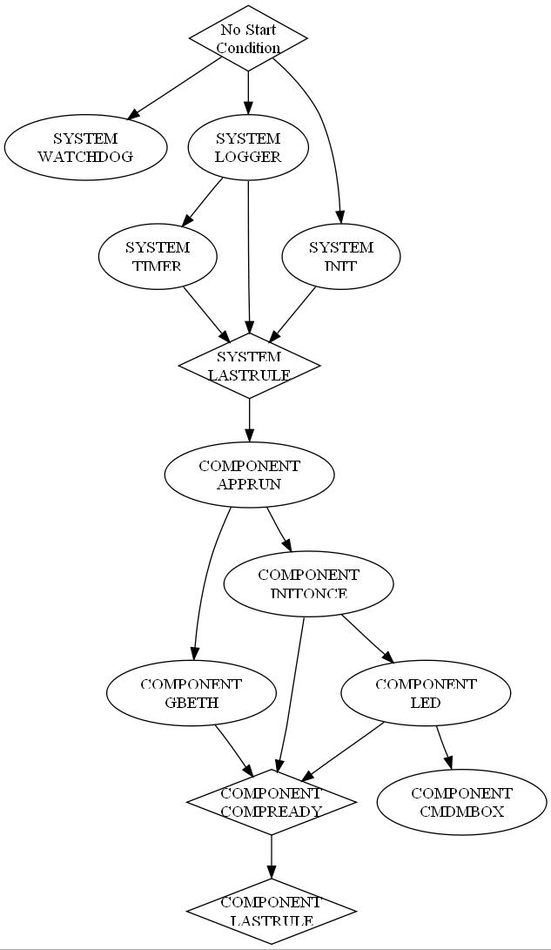
Dependency graph generation
Here is a generated example.
The example shows a very basic system configuration.
We can see the PCD starts the watchdog, init and logger in parallel.
Then, the timer starts (depends on the logger).
When all system services are up, a pseudo rule (SYSTEM_LASTRULE) marks the end of the system init.
Then, the components are started accordingly.

Slide 18
PCD Software modules

Slide 19
PCD Software modules
The PCD is composed of the following software modules:
  Main: Performs the initializations and the main loop.
  Rule Parser: Reads and parses the textual rules.
  Rules DB: Stores all the rules as binary records.
  Process: Starts, stops and monitors the processes
  Timer: Provides the ticks for the pcd.
  Condition check: Checks if a condition is satisfied.
  Failure action: Performs failure/recovery actions.
  Exception: Implements the detailed exception handlers.
  API: The PCD API interface.

Slide 20
PCD functional blocks
Textual configuration file with rules
Rule Info
PARSER
Add Rule
RULES
DB
OK/Fail
Parse Rules File
OK/Fail
Activate Rules
MAIN
Check Messages
PCD API
Application
Activate /
Stop
Enqueue /
Dequeue
Rule
IPC
Tick
Crashed
Iterate
COND
CHECK
Check
Condition
TIMER
Enqueue
Rule
PROCESS
EXCEPT
OK / NOK
Enqueue Process
Activate Rule
Activate failure action
Stopped / Signaled / Exited
Spawn / Signal /
Monitor
FAILURE
ACTION
Process
Activate failure action
* Refer to PCD Design document for more details.

Slide 21
PCD Configuration file
Structure and syntax

Slide 22
PCD Configuration file
A textual file, similar to shell script syntax.
Contains a list of “Rule Blocks”.
A Rule block is defined per process.
Inclusion of PCD configuration files is allowed (Configuration files can be divided to logical or functional blocks).

Slide 23
PCD Configuration file
Parser Module
Process Control Module
Rules Database
Add Rule
Started, Stopped, Monitored
Read
Rule
Associated
Process
PCD Script
Rule
Rule
Rule
…
Rule
Depends
Rule
Associated
Process
Started, Stopped, Monitored
Depends
Rule
Associated
Process
Started, Stopped, Monitored

Slide 24
PCD Rule block
Each Rule Block defines the following:
  Rule name
  A process and its parameters
  Start condition
  End condition with timeout
  Process priority
  Daemon flag
  Failure/recovery action

Slide 25
PCD Rule block – Rule name
The Rule name is used to identify the rule in a human readable form.
The Rule name is the identifier used by the software to communicate with the PCD.
The Rule name is used by the PCD to report the status of the rule.
The Rule name is composed of:
  Component/Group name (max 16 characters).
  Rule identifier name (max 16 characters).

Slide 26
PCD Rule block – Rule name: Indexed rules
Indexed rules allow run time creation of rules based on a single Rule template.
  Required when multiple copies of the same process are required to be run.
Indexed rules are marked with a dollar sign ($) in the end of the rule name.
  E.g: MYGROUP_INDEXEDRULE$
The software can activate multiple copies of an indexed rule by appending an index id to the rule name (replacing the dollar sign) in the rule id.

Slide 27
PCD Rule block – Process and parameters
This section defines what is the process name (full path) and its parameters.
If “NONE” is specified, no process is spawned. This could be used as a “synchronization rule”.

Slide 28
PCD Rule block – Process and parameters
It is possible to start a process which is associated with a rule, with different optional parameters (dynamic parameters).
Rules also accept parameters from variables, where variable name starts with a $ sign.
The variable name is replaced with the contents of the variable and removed if variable doesn’t exists.
Variable contents is either taken from U-Boot environment variables, or from the file: /tmp/[variable name]

Slide 29
PCD Rule block – Start condition
Start condition defines what is the condition to activate the process.
The following start conditions are supported:
  NONE - No start condition, application is spawned immediately
  FILE filename - The existence of a file
  RULE_COMPLETED id - Rule id completed successfully
  NETDEVICE netdev - The existence of a networking device
  IPC_OWNER owner - The existence of an IPC destination point
  ENV_VAR name, value - Value of an environment variable

Slide 30
PCD Rule block – End condition w/ timeout
End condition defines what is the condition to determine that the process is ready or started ok.
The following end conditions are supported:
  NONE - No monitor on the result, just spawn application and continue.
  FILE filename - The existence of a file
  EXIT status - The application exited with status. Other statuses are considered failure
  NETDEVICE netdev - The existence of a networking device
  IPC_OWNER owner - The existence of an IPC destination point
  PROCESS_READY - The process sent a READY event through PCD API.
  WAIT msecs - Delay, ignore END_COND_TIMEOUT

Slide 31
PCD Rule block – End condition w/ timeout
It is possible to define timeout for the end condition to be satisfied.
The timeout is defined in milliseconds.
The timer is stared only after the rule starts.
If no timeout is required, use “-1”.

Slide 32
PCD Rule block - Process priority
It is possible to create a process with a specific priority:
  NICE value – Use normal priority scheduling with the value of value, where the range of value is -20 (highest) to 19 (lowest).
  FIFO value – Use FIFO priority scheduling the value of value, where the range of value is 0 (lowest) to 99 (highest).
FIFO lowest priority is higher than NICE highest priority.

Slide 33
PCD Rule block – Daemon flag
Daemon flag is used to mark processes which remain in the background and never exit.
If such a process ends, the PCD will treat it as a failure and activate a failure action.

Slide 34
PCD Rule block – Failure action
Failure actions take place when either:
  A daemon process has exited
  An end condition was failed to be satisfied and a timeout occurred.
The following failure actions are supported:
  NONE – Do not take any action
  REBOOT - Reboot the system
  RESTART - Restart the rule
  EXEC_RULE id - Execute a rule

Slide 35
PCD Rule block – Active flag
Active flag defines if the Rule is active or not.
Active rules are automatically started whenever their start condition is satisfied.
Non-active rules are “sleeping” until a start process command is sent using the PCD API, and are not part of the automated system startup.

Slide 36
PCD Rule block - Example
#################################################################
# Index of the rule
RULE = SYSTEM_LOGGER
# Condition to start rule
START_COND = RULE_COMPLETED,SYSTEM_INIT
# Command with parameters
COMMAND = /usr/sbin/logger $logger_params
# Scheduling (priority) of the process
SCHED = NICE,0
# Daemon flag - Process must not end
DAEMON = YES
# Condition to end rule
END_COND = PROCESS_READY
# Timeout for end condition. Fail if timeout expires
END_COND_TIMEOUT = -1
# Action upon failure
FAILURE_ACTION = RESTART
# Active
ACTIVE = YES

Slide 37
PCD Parser utility
Features and parameters

Slide 38
PCD Configuration file syntax checking
The PCD provides an offline parser which runs on the host.
The parser provides an easy way to check that the configuration file does not contain syntax errors without running on the target.
Use the –f option to specify a PCD script filename.
Use the –v option to display all parsed rules.
The parser is activated using:
# ./pcdparser [-f filename] -v

Slide 39
Automatic PCD header generation
The PCD parser program can generate a header file with definitions for Group name and Rule names for each group.
The parser also generates a macro to easily define a rule ID variable, required for PCD API.
E.g.: GROUP_DECLARE_PCD_RULEID( ruleId, RULE_NAME )
Use the –o option (along with required file path) to generate the header file.

Slide 40
Automatic PCD header generation
/**************************************************************************/
/* FILE: system_pcd.h
/* PURPOSE: PCD definitions file (auto generated).
/**************************************************************************/
#ifndef _SYSTEM_PCD_H_
#define _SYSTEM_PCD_H_
#include "pcdapi.h"
/*! \def PCD_GROUP_NAME_SYSTEM
* \brief Define group ID string for SYSTEM
*/
#define PCD_GROUP_NAME_SYSTEM "SYSTEM"
#define PCD_RULE_SYSTEM_APPRUN "APPRUN"
#define PCD_RULE_SYSTEM_GBETH “GBETH"
#define PCD_RULE_SYSTEM_INITONCE "INITONCE"
#define PCD_RULE_SYSTEM_LED "LED"
#define PCD_RULE_SYSTEM_LASTRULE "LASTRULE"
/*! \def SYSTEM_DECLARE_PCD_RULEID()
* \brief Define a ruleId easily when calling PCD API
*/
#define DECLARE_PCD_SYSTEM_RULEID( ruleId, RULE_NAME ) \
PCD_DECLARE_RULEID( ruleId, PCD_GROUP_NAME_SYSTEM, RULE_NAME )
#endif

Slide 41
Automatic dependency graph generation
The PCD parser program can generate a dependency graph script which shows all rules and their dependencies.
The graph can display all rules, active rules only, or inactive rules only (Default is active only).
Use the –g option (along with required file path) to generate the graph file.
Use the –d option to specify display level:
  0: Active rules only
  1: Full display
  2: Inactive rules only

Slide 42
Automatic dependency graph generation
The script graph file uses the DOT language syntax:
http://graphviz.org/doc/info/lang.html
The script is converted to graphical layout using the Graphviz tool (Available for Windows/Linux): http://graphviz.org/Download.php
Graph nodes:
  Rules are marked with ellipses.
  Synchronization Rules are marked with diamonds.

Slide 43
Automatic dependency graph generation

Slide 44
PCD API
API which is exported to the software

Slide 45
PCD API
The PCD exports API for the following actions:
  Start a process (with optional parameters).
  Terminate a process normally (activate its termination handler if exists).
  Kill a process (brutally).
  Send a “process ready” event to PCD (Used by the process to mark the PCD that it finished initializing and it is ready). This event must be coupled with PROCESS_READY end condition.
  Signal a process
  Register to PCD default exception handlers
  Find another instance of a process.

Slide 46
PCD API – Starting a process
The API starts a process associated with a specific rule.
There is an option to start the process with an optional set of parameters.
If optional parameters are not specified, the PCD uses the default parameters as defined in the configuration file.
STATUS PCD_api_start_process( const struct ruleId_t *ruleId, const Char *optionalParams );

Slide 47
PCD API – Signaling a process
The API signals a process associated with a specific rule.
The only signals allowed are SIGUSR1 and SIGUSR2.
Other signals are considered failures signals generated only by the system.
STATUS PCD_api_signal_process( const struct ruleId_t *ruleId, Int32 sig );

Slide 48
PCD API – Terminating a process
The API terminates a process associated with a specific rule.
The PCD sends a SIGTERM to the process, allowing it to cleanup correctly.
STATUS PCD_api_terminate_process( const struct ruleId_t *ruleId );

Slide 49
PCD API – Killing a process
The API kills a process associated with a specific rule.
The PCD sends a SIGKILL to the process and kills it brutally and immediately.
STATUS PCD_api_kill_process( const struct ruleId_t *ruleId );

Slide 50
PCD API – Get rule state
The API returns the current state of the specified rule.
  PCD_API_RULE_IDLE: Rule is idle, never been run.
  PCD_API_RULE_RUNNING: Rule is running; waiting for start or end condition.
  PCD_API_RULE_COMPLETED_PROCESS_RUNNING: Rule completed successfully, process is running (daemon).
  PCD_API_RULE_COMPLETED_PROCESS_EXITED: Rule completed successfully, process exited.
  PCD_API_RULE_NOT_COMPLETED: Rule failed due to timeout, failure in end condition.
  PCD_API_RULE_FAILED: Rule failed due to process unexpected failure (exit, signal or crash).
STATUS PCD_api_get_rule_state( const struct ruleId_t *ruleId, pcdApiRuleState_e *ruleState );

Slide 51
PCD API – Send process ready event
The API sends a “Process Ready” event to the PCD.
The event should be sent by a monitored process right after it has finished to initialize all its resources and it is ready to provide service.
It must be coupled with the process PROCESS_READY end condition, or else it will be ignored.
STATUS PCD_api_send_process_ready( void );

Slide 52
PCD API - Default exception handlers
The API registers all the fault exceptions to a default PCD handler.
The default handler will display a detailed log upon catching an exception, including some useful debugging information.
The calling process may specify a cleanup callback function.
STATUS PCD_api_register_exception_handlers( Char *name, Cleanup_func cleanup );
PCD_API_REGISTER_EXCEPTION_HANDLERS();

Slide 53
PCD API – Exception example
Planting a malicious code in the logger:
Uint8 *killme = (Uint8 *)0xdeadbeef;
*killme = (Uint8)0xbd;

Slide 54
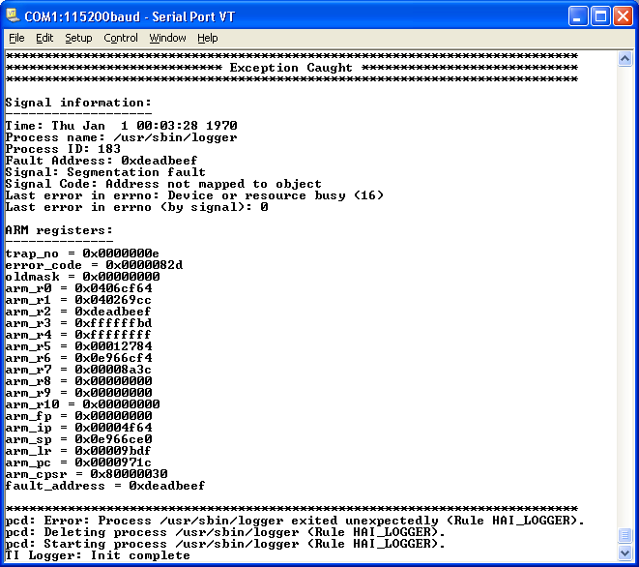
PCD API – Exception example

Slide 55
PCD API – Exception example
The exception information contains:
  Date and time of exception
  Process name and ID
  Signal information and code
  Last known ERRNO
  Fault address
  ARM registers
    arm_pc – Last execution address; can point to the faulty command (use objdump to find it in the source).
    arm_lr – Return address
    Others

Slide 56
PCD API – Find process ID
The API searches for a process name, and returns its PID if found.
Useful for daemons which do not allow more than one instance running. If the function returns non-zero result, it means that another copy of the daemon is already running.
pid_t PCD_api_find_process_id( Char *name );
PCD_API_FIND_PROCESS_ID();

Slide 57
PCD API - Reboot
The API can be used to reboot the system.
Each reboot request will be logged, with optinal reason provided by the caller.
A wrapper macro can be used for a constant reason string, which states the function name and line.
void PCD_api_reboot( const Char *reason, Bool force );
PCD_API_REBOOT() ;

Slide 58
PCD options
The daemon’s parameters and options

Slide 59
PCD Non-Volatile error logger (postmortem analysis)
The PCD daemon can log all error messages and caught exceptions in the NVRAM.
The log file can be used later for “postmortem” analysis.
The maximum file size is around 4KB.
The log file works like a FIFO.

Slide 60
PCD Debug mode
The PCD supports debug mode.
In debug mode, the system is not rebooted in case of a “REBOOT” failure actions.
The system is left in the state which caused the failure for failure analysis.
Can be used in conjunction with the error logger.
Use the –d flag to enable debug mode.

Slide 61
PCD Timer tick
The PCD allows to fine tune the timer ticks.
The timer ticks drive the PCD actions:
  Checking start and end conditions
  Starting and stopping processes.
The default timer tick is 20ms.
Use the –t tick option to change the timer tick value.

Slide 62
PCD Verbose mode
The PCD can be configured to display rule status:
  Started
  Failed
  Finished successfully
  Etc.
Use the –v option to enable verbose information display.

Slide 63
PCD Daemon Command line parameters summary
The PCD supports the following command line parameters:
  -f FILE, --file=FILE : Specify PCD rules file.
  -v, --verbose : Verbose display.
  -p, --print : Print parsed configuration.
  -t tick, --timer-tick=tick : Setup timer ticks in ms (default 100ms).
  -e FILE, --errlog=FILE: Specify error log filename.
  -d, --debug: Debug mode, do not reboot the system
  -h, --help : Print a help message and exit.

Slide 64
Information messages
Normal operation messages, error messages, warning messages

Slide 65
PCD Startup messages
PCD Startup:
  The following messages are displayed during the PCD startup.
  Shows how many rules were parsed.
  Informs that the PCD initialization is completed.
TI Process Control Daemon v1.0.1
Copyright (C) 2010 Texas Instruments Incorporated
pcd: Loaded XX rules.
pcd: Initialization complete.

Slide 66
PCD Startup messages (Errors)
Failure during PCD script parsing, will result in error messages which will inform about the error.
It is recommended to use the pcdparser utility prior to loading an updated PCD script to the target.
pcd: Error: Missing input: expected "COMMAND" but found "END_COND" at line# 19.
pcd: Error: Unable to parse PROCESS_READY.
pcd: Error: Handling the keyword END_COND.
pcd: Error: Input file did not have complete information, premature termination.
pcd: Error: Reading the input configuration.
pcd: Error: Error in generating configuration.

Slide 67
PCD Startup messages (Errors)
The PCD might fail during its subsystems initialization (Unlikely).
  An appropriate error message will be displayed.
The PCD allows only a single instance running at any time.
pcd: Another copy of PCD is already running, aborting.

Slide 68
PCD Daemon messages
In case a reboot is required, a message from PCD will be displayed.
Reboot may occur if:
  A reboot was requested
  A fatal error has occurred which activated a system reboot (Failure action).
  An exception in PCD itself.
All processes started by PCD are terminated (Except in debug mode).
pcd: Terminating PCD, rebooting system...

Slide 69
PCD Daemon messages
In case an exception has occurred in the PCD itself, the PCD will:
  Dump the exception information in: /nvram/pcd_self_exception.txt
  Display the following messages:
  In debug mode, the system will NOT be rebooted:
pcd: Caught fault signal.
pcd: Wrote exception information in NVRAM.
pcd: Reboot disabled in debug mode, exiting.

Slide 70
Process cycle message
Process Cycle:
  The “Starting” messages are displayed per each activation of a rule.
  The “Success” messages are displayed per each rule which was started correctly and passed its end condition.
pcd: Starting process proc_name (Rule GROUP_RULENAME).
...
...
pcd: Rule GROUP_RULENAME : Success.

Slide 71
Process cycle message
Processes may be terminated or killed during their life, a message will displayed:
pcd: Terminating process proc_name (pid) (Rule GROUP_RULENAME)
pcd: Killing process proc_name (pid) (Rule GROUP_RULENAME)

Slide 72
Process cycle message (Errors)
Rules may fail during their end conditions.
  In case of timeout:
pcd: Error: Rule GROUP_RULENAME : Timeout.

Slide 73
Process cycle message (Errors)
Rules may fail due to various process failures:
  A daemon process has exited (and should not):
  A process has exited with error:
  An exception caused a process to stop (Either handled or unhandled):
pcd: Error: process proc_name exited unexpectedly(pid)
(Rule GROUP_RULENAME).
pcd: Error: process proc_name(pid)exited with result code X
(Rule GROUP_RULENAME).
pcd: Error: Exception X (ex_code) caused process proc_name (pid) to stop (Rule GROUP_RULENAME).
pcd: Error: Unhandled exception X (ex_code) in process proc_name (pid) (Rule GROUP_RULENAME).

Slide 74
Warnings
Trying to signal a process which is not running:
Trying to start a process which is already running:
Trying to stop a process which is not running:
pcd: Warning: Cannot signal process, process proc_name is not running (Rule GROUP_RULENAME)
pcd: Warning : Cannot start process, process proc_name (pid) already running (Rule GROUP_RULENAME)
pcd: Warning : Cannot stop process, process proc_name is not running (Rule GROUP_RULENAME)

Slide 75
PCD memory requirements
RAM/Flash footprint

Slide 76
Memory requirements
PCD Code: 28KB
PCD Data section: 4KB
PCD Heap: 36KB (Typical).
PCD Stack (Watermark): 84KB (Typical).

Slide 77
PCD Resources
PCD Home page: http://www.rt-embedded.com/pcd
The PCD Project is managed and maintained at SourceForge: http://sourceforge.net/projects/pcd/
New software engineers are welcomed to join the project and contribute.

Slide 78
Thank you!
Written by Hai Shalom: mailto:hai@rt-embedded.com

