Slide 1

Process Control Daemon
For Embedded Linux Platforms
Hai Shalom
July 2010 (v.11)

Slide 2
Licensing
This work is licensed under the Creative Commons Attribution-Share Alike 3.0 United States License.
To view a copy of this license, visit http://creativecommons.org/licenses/by-sa/3.0/us/ or send a letter to Creative Commons, 171 Second Street, Suite 300, San Francisco, California, 94105, USA.
Contributors to this document:
  Copyright © 2010 Texas Instruments Incorporated - http://www.ti.com/
  Copyright © 2010 Hai Shalom – http://www.rt-embedded.com

Slide 3
Licensing
The PCD project is licensed under the GNU Lesser General Public License version 2.1, as published by the Free Software Foundation.
To view a copy of this license, visit http://www.gnu.org/licenses/lgpl-2.1.html#SEC1 or send a letter to the Free Software Foundation, Inc., 51 Franklin Street, Fifth Floor, Boston, MA 02110-1301, USA

Slide 4
Agenda
Introduction to PCD
Description of a system without PCD
Advantages of a system with PCD
PCD high level technical information
System requirements

Slide 5
What is PCD?
PCD – Process Control Daemon is a light-weight system level process manager for Embedded-Linux based projects (consumer electronics, network devices, etc.).
PCD starts, stops and monitors all the user space processes, daemons and services in the system, in a synchronized manner, using a textual configuration file.
PCD recovers the system in case of errors and provides useful and detailed debug information.

Slide 6
Why do we need PCD?
What is missing in our system?

Slide 7
In a system without PCD:
System boot is done by scripts (init.d/rcS, others)
  Scripts may not have the means to verify that the started process, service or driver was successful.
  No well defined dependency and synchronization between processes. Sometimes, adding non-deterministic delays between them which somehow workaround these issues.
  Scripts don’t know when is the best time to start a process.
  Scripts can not start high priority services.

Slide 8
In a system without PCD:
What happens in case of a crash?
  Without a process monitor, a crashing program just exits, usually after printing “Segmentation Fault”. This message is usually not noticed in the flood of system logs, leaving the system unstable and unusable.
  Even with a signal handler, the system is unusable because there is no entity that restarts the process or synchronize it with other processes.
  Without a process monitor, the product remains on, yet unusable, until the user power-cycles it!

Slide 9
In a system without PCD:
No, or minimal field debugging capabilities
  Crashes are not logged or saved.
  Usually, there is no debug information provided when a process crashes in the field (No GDB is available there…).
  Even if some basic debug information is provided, it is usually insufficient for understanding what happened.

Slide 10
How can PCD contribute?
What are the advantages of products with PCD?

Slide 11
Enhanced system startup
System startup is configured and synchronized as a set of rules:
Each process, service or driver has a designated rule.
Rule 1
Process 1
Rule 2
Process 2
Rule 3
Process 3

Slide 12
Enhanced system startup
Each Rule tells the PCD about a process:
  What is the command?
  What are the parameters?
  What is the required priority?
  Is it a daemon?
  When to start it?
  What is the trigger for completion?
  How much time to wait for it to complete?
  What to do in case of a crash?
A rule can be active (started by the PCD) or passive (started manually).

Slide 13
Enhanced system startup
Each rule is initiated in the right time, when a start condition has been satisfied:
  Another rule or set of rules have completed successfully.
  A resource has been created (Network device, file).
Rule Completed
External Events
Start Rule
PCD Logic
Resource Created
Rule
Start Immediately

Slide 14
Enhanced system startup
PCD can be configured to verify that a rule was successful by validating its end condition:
  The process has exited with the correct status.
  The process sent a “Process ready” signal.
  The process has created a resource.
  Don’t check anything, just wait.
Rule Events
Rule Completed
External Events
Start Next Rule
PCD Logic
Rule
Resource Created
Exit Status

Slide 15
Dependency graph generation
The PCD can generate a dependency graph script which shows all rules and their dependencies.
The graph can display all rules, active rules only, or inactive rules only.
The generated graph allows the development and architecture teams to examine and understand the dependency between each rule in the system, and fix it in case of mistakes.

Slide 16
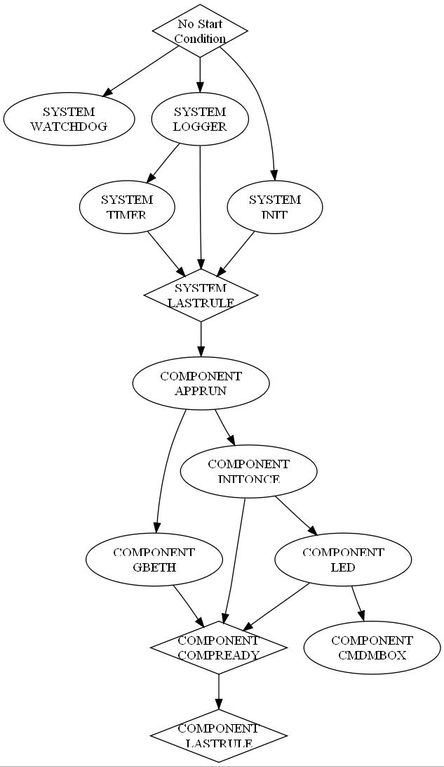
Dependency graph generation
Here is a generated example.
The example shows a very basic system configuration.
We can see the PCD starts the watchdog, init and logger in parallel.
Then, the timer starts (depends on the logger).
When all system services are up, a pseudo rule (SYSTEM_LASTRULE) marks the end of the system init.
Then, the components are started accordingly.

Slide 17
Reduced boot up time
Speed up system startup
  Rules are started as soon as their start condition is satisfied.
  No need for non-deterministic delays between starting processes.
  Dependencies between processes are well defined.
  Rules without inter-dependency are started in parallel.

Slide 18
Enhanced stability and robustness
Enhanced monitoring on critical processes, and action in case of failure.
  PCD can be configured to take various action in case a rule fails:
    Restart the rule: Usually for non-critical services such web server, telnet server, etc. or processes that can recover by restarting themselves.
    Reboot the system: In case of a fatal, non-recoverable error.
    Execute a recovery rule.
Restart
Crash
Reboot
Rule
Recover

Slide 19
Enhanced stability and robustness
Improve system stability and robustness.
  Catch all the errors early during unit-tests or validation cycles. Provide all the detailed debug information to the development team immediately.

Slide 20
Enhanced field debugging capabilities
PCD’s default exception handlers will catch potential failures, and display useful information about each failure:
    Process name and id
    Signal description, date and time, origin and id.
    Last known errno.
    Fault address (The address which caused the crash).
    Detailed register dump.
    Detailed map file (all accessible address spaces).
Detailed
Exception
Information
Rule
Crash

Slide 21
Enhanced field debugging capabilities
Error logs can be saved in non-volatile memory for offline post-mortem analysis.
Rule
Crash
Log in
NVRAM

Slide 22
PCD Exception handler in action (ARM)
pcd: Starting process /usr/sbin/segv (Rule TEST_SIGSEGV).
pcd: Rule TEST_SIGSEGV: Success (Process /usr/sbin/segv (204)).
**************************************************************************
**************************** Exception Caught ****************************
**************************************************************************
Signal information:
Time: Thu Jan 1 00:00:12 1970
Process name: /usr/sbin/segv
PID: 204
Fault Address: 0x00008590
Signal: Segmentation fault
Signal Code: Invalid permissions for mapped object
Last error: Success (0)
Last error (by signal): 0
ARM registers:
trap_no=0x0000000e
error_code=0x0000081f
oldmask=0x00000000
r0=0x00008590
r1=0x0ecf4ba4
r2=0x00000000
r3=0x00000052
r4=0x00010690
r5=0x00000000
r6=0x0000846c

Slide 23
PCD Exception handler in action (ARM)
r7=0x00008418
r8=0x00000000
r9=0x00000000
r10=0x00000000
fp=0x00000000
ip=0x00000000
sp=0x0ecf4cf0
lr=0x0000856c
pc=0x00008548
cpsr=0x40000010
fault_address=0x00008590
Maps file:
00008000-00009000 r-xp 00000000 1f:07 59 /usr/sbin/segv
00010000-00011000 rw-p 00000000 1f:07 59 /usr/sbin/segv
04000000-04005000 r-xp 00000000 1f:06 231 /lib/ld-uClibc-0.9.29.so
04005000-04007000 rw-p 04005000 00:00 0
0400c000-0400d000 r--p 00004000 1f:06 231 /lib/ld-uClibc-0.9.29.so
0400d000-0400e000 rw-p 00005000 1f:06 231 /lib/ld-uClibc-0.9.29.so
0400e000-04023000 r-xp 00000000 1f:06 175 /lib/libticc.so
04023000-0402a000 ---p 04023000 00:00 0
0402a000-0402c000 rw-p 00014000 1f:06 175 /lib/libticc.so
0402c000-04067000 r-xp 00000000 1f:06 200 /lib/libuClibc-0.9.29.so
04067000-0406e000 ---p 04067000 00:00 0
0406e000-0406f000 r--p 0003a000 1f:06 200 /lib/libuClibc-0.9.29.so
0406f000-04070000 rw-p 0003b000 1f:06 200 /lib/libuClibc-0.9.29.so
0ece0000-0ecf5000 rwxp 0ece0000 00:00 0 [stack]
**************************************************************************

Slide 24
Standard API for PCD services
Every application can request services from the PCD, using the PCD API:
  Start a process (with optional parameters).
  Terminate a process normally (activate its termination handler).
  Kill a process (brutally).
  Send a “process ready” event to PCD (Used by the process to inform the PCD that it has finished initializing and it is ready).
  Signal a process.
  Register to PCD default exception handlers.
  Find another instance of a process.
  Reboot the system (with logged a reason).

Slide 25
PCD High level technical info
PCD high level modules, script syntax checking, header generation, graph generation.

Slide 26
PCD Software modules
The PCD is composed of the following software modules:
  Main: Performs the initializations and the main loop.
  Rule Parser: Reads and parses the textual rules.
  Rules DB: Stores all the rules as binary records.
  Process: Starts, stops and monitors the processes
  Timer: Provides the ticks for the pcd.
  Condition check: Checks if a condition is satisfied.
  Failure action: Performs failure/recovery actions.
  Exception: Implements the detailed exception handlers.
  API: The PCD API interface.

Slide 27
PCD functional blocks
Textual configuration file with rules
Rule Info
PARSER
Add Rule
RULES
DB
OK/Fail
Parse Rules File
OK/Fail
Activate Rules
MAIN
Check Messages
PCD API
Application
Activate /
Stop
Enqueue /
Dequeue
Rule
IPC
Tick
Crashed
Iterate
COND
CHECK
Check
Condition
TIMER
Enqueue
Rule
PROCESS
EXCEPT
OK / NOK
Enqueue Process
Activate Rule
Activate failure action
Stopped / Signaled / Exited
Spawn / Signal /
Monitor
FAILURE
ACTION
Process
Activate failure action
* Refer to PCD Design document for more details.

Slide 28
PCD Configuration file
A textual file, similar to shell script syntax.
Contains a list of “Rule Blocks”.
A Rule block is defined per process.
Inclusion of PCD configuration files is allowed (Configuration files can be divided to logical or functional blocks).

Slide 29
PCD Configuration file
Parser Module
Process Control Module
Rules Database
Add Rule
Started, Stopped, Monitored
Read
Rule
Associated
Process
PCD Script
Rule
Rule
Rule
…
Rule
Depends
Rule
Associated
Process
Started, Stopped, Monitored
Depends
Rule
Associated
Process
Started, Stopped, Monitored

Slide 30
PCD Rule block - Example
#################################################################
# The name of the rule, COMPONENT_MODULENAME
RULE = SYSTEM_LOGGER
# Condition to start rule
START_COND = RULE_COMPLETED,SYSTEM_INIT
# Command with parameters
COMMAND = /usr/sbin/logger –s -t
# Scheduling (priority) of the process (NICE -19:19, FIFO 1:99)
SCHED = NICE,0
# Daemon flag – Process must never exit?
DAEMON = YES
# Condition to end rule
END_COND = PROCESS_READY
# Timeout for end condition. Fail if timeout expires
END_COND_TIMEOUT = -1
# Action upon failure: Restart, reboot, exec another rule?
FAILURE_ACTION = RESTART
# Active: Rule is started by PCD, passive: Rule is started manually
ACTIVE = YES

Slide 31
Configuration file syntax checking
The PCD provides an offline parser which runs on the host.
The parser provides an easy way to verify that your configuration file does not contain syntax errors, similarly to compilation process.
The parser allows to fix the configuration files on the host, without the need to run them on the target, and rebuilding an image in case of an error.

Slide 32
PCD header generation
The PCD parser host program can generate a header file with definitions for Group name and Rule names for each group.
The generated header provides an easy and error free means to communicate with the PCD API.

Slide 33
PCD header generation example
/**************************************************************************/
/* FILE: system_pcd.h
/* PURPOSE: PCD definitions file (auto generated).
/**************************************************************************/
#ifndef _SYSTEM_PCD_H_
#define _SYSTEM_PCD_H_
#include "pcdapi.h"
/*! \def PCD_GROUP_NAME_SYSTEM
* \brief Define group ID string for SYSTEM
*/
#define PCD_GROUP_NAME_SYSTEM "SYSTEM"
#define PCD_RULE_SYSTEM_APPRUN "APPRUN"
#define PCD_RULE_SYSTEM_GBETH “GBETH"
#define PCD_RULE_SYSTEM_INITONCE "INITONCE"
#define PCD_RULE_SYSTEM_LED "LED"
#define PCD_RULE_SYSTEM_LASTRULE "LASTRULE"
/*! \def SYSTEM_DECLARE_PCD_RULEID()
* \brief Define a ruleId easily when calling PCD API
*/
#define DECLARE_PCD_SYSTEM_RULEID( ruleId, RULE_NAME ) \
PCD_DECLARE_RULEID( ruleId, PCD_GROUP_NAME_SYSTEM, RULE_NAME )
#endif

Slide 34
Dependency graph generation
The script graph file uses the DOT language syntax:
http://graphviz.org/doc/info/lang.html
The script is converted to graphical layout using the Graphviz tool (Available for Windows/Linux): http://graphviz.org/Download.php
Graph nodes:
  Rules are marked with ellipses.
  Synchronization Rules are marked with diamonds.

Slide 35
PCD Exception handler
Each process can register to the PCD’s default exception handlers using the PCD API.
The PCD performs as a “crash daemon” which listens on a dedicated socket.
In case of an exception in a process, the exception handlers will gather all the crash information in a safe way and send it to the PCD.
The PCD will format the data, display it on the screen and log it in the non-volatile storage.
Note that many functions are not allowed to be used by a process during exception (also printf!)

Slide 36
PCD Exception handler
Rule
Crash
Signal
PCD
API
PCD Logic
Prepare and send exception info
Detailed
Exception
Information
Log in
NVRAM

Slide 37
PCD memory requirements
RAM/Flash footprint

Slide 38
Memory requirements
PCD Code: 28KB
PCD Data section: 4KB
PCD Heap: 36KB (Typical).
PCD Stack (Watermark): 84KB (Typical).

Slide 39
PCD Resources
PCD Home page: http://www.rt-embedded.com/pcd
The PCD Project is managed and maintained at SourceForge: http://sourceforge.net/projects/pcd/
New software engineers are welcomed to join the project and contribute.

Slide 40
Thank you!
Written by Hai Shalom: mailto:hai@rt-embedded.com

