Slide 1
Building a Simple Question Answering System
Mark A. Greenwood
Natural Language Processing Group
Department of Computer Science
University of Sheffield, UK

Slide 2
Overview
What is Question Answering?
Question Types
Evaluating Question Answering Systems
A Generic Question Answering Framework
The Standard Approach
A Simplified Approach
  Results and Evaluation
  Problems with this Approach
  Possible Extensions
Question Answering from your Desktop

Slide 3
What is Question Answering?
The main aim of QA is to present the user with a short answer to a question rather than a list of possibly relevant documents.
As it becomes more and more difficult to find answers on the WWW using standard search engines, question answering technology will become increasingly important.
Answering questions using the web is already enough of a problem for it to appear in fiction (Marshall, 2002):
  “I like the Internet. Really, I do. Any time I need a piece of shareware or I want to find out the weather in Bogotá… I’m the first guy to get the modem humming. But as a source of information, it sucks. You got a billion pieces of data, struggling to be heard and seen and downloaded, and anything I want to know seems to get trampled underfoot in the crowd.”

Slide 4
Question Types
Clearly there are many different types of questions:
  When was Mozart born?
    Question requires a single fact as an answer.
    Answer may be found verbatim in text i.e. “Mozart was born in 1756”.
  How did Socrates die?
    Finding an answer may require reasoning.
    In this example die has to be linked with drinking poisoned wine.
  How do I assemble a bike?
    The full answer may require fusing information from many different sources.
    The complexity can range from simple lists to script-based answers.
  Is the Earth flat?
    Requires a simple yes/no answer.
The systems outlined in this presentation attempt to answer the first two types of question.

Slide 5
Evaluating QA Systems
The biggest independent evaluations of question answering systems have been carried out at TREC (Text Retrieval Conference) over the past five years.
  Five hundred factoid questions are provided and the groups taking part have a week in which to process the questions and return one answer per question.
  No changes are allowed to your system between the time you receive the questions and the time you submit the answers.
Not only do these annual evaluations give groups a chance to see how their systems perform against those from other institutions but more importantly it is slowly building an invaluable collection of resources, including questions and their associated answers, which can be used for further development and testing.
Different metrics have been used over the years but the current metric is simply the percentage of questions correctly answered.

Slide 6
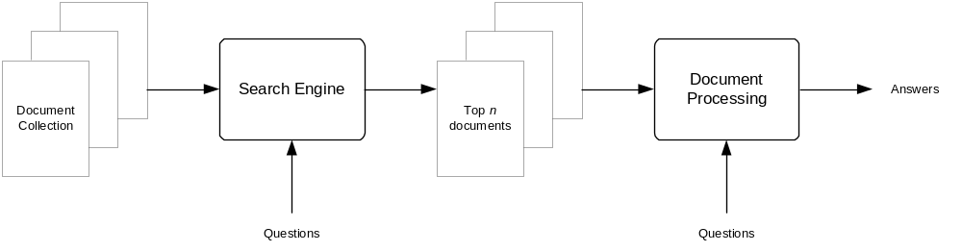
A Generic QA Framework
A search engine is used to find the n most relevant documents in the document collection.
These documents are then processed with respect to the question to produce a set of answers which are passed back to the user.
Most of the differences between question answering systems are centred around the document processing stage.

Slide 7
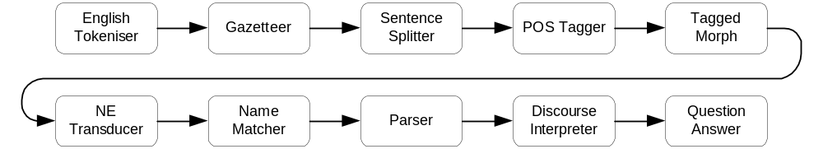
The Standard Approach
Obviously different systems use different techniques for processing the relevant documents.
Most systems, however, use a pipeline of modules similar to that shown above, including our standard system, known as QA-LaSIE.
Clearly this leads to a complicated system in which it is often difficult to see exactly how an answer is arrived at.
This approach can work – some groups report that they can answer approximately 87% of TREC style factoid questions (Moldovan et al, 2002).
QA-LaSIE on the other hand answers approximately 20% of the TREC style factoid questions (Greenwood et al, 2002).
Notes:
Make sure you tell them what each of the different modules does, as not everyone in the audience will know (although some will so make sure you get it right!).

Slide 8
A Simplified Approach
The answers to the majority of factoid questions are easily recognised named entities, such as
    countries
    cities
    dates
    peoples names
    company names…
The relatively simple techniques of gazetteer lists and named entity recognisers allow us to locate these entities within the relevant documents – the most frequent of which can be returned as the answer.
This leaves just one issue that needs solving – how do we know, for a specific question, what the type of the answer should be.
Notes:
Give good details on what gazetteer lists and named entity recognisers do and roughly how they work.

Slide 9
A Simplified Approach
The simplest way to determine the expected type of an answer is to look at the words which make up the question:
    who – suggests a person
    when – suggests a date
    where – suggests a location
Clearly this division does not account for every question but it is easy to add more complex rules:
    country – suggests a location
    how much and ticket – suggests an amount of money
    author – suggests a person
    birthday – suggests a date
    college – suggests an organization
These rules can be easily extended as we think of more questions to ask.

Slide 10
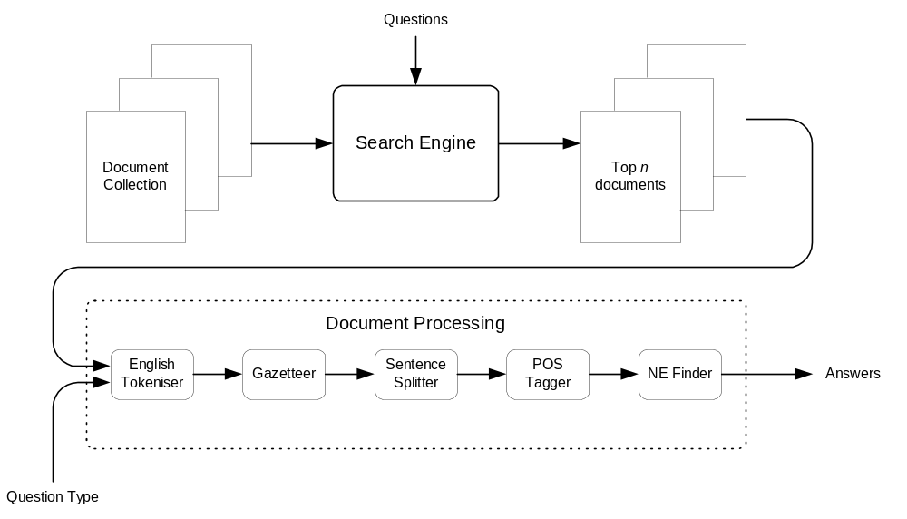
A Simplified Approach

Slide 11
Results and Evaluation
The system was tested over the 500 factoid questions used in TREC 11 (Voorhees, 2002):
Results for the question typing stage were as follows:
  16.8% (84/500) of the questions were of an unknown type and hence could never be answered correctly.
  1.44% (6/416) of those questions which were typed were given the wrong type and hence could never be answered correctly.
  Therefore the maximum attainable score of the entire system, irrespective of any future processing, is 82% (410/500).
Results for the information retrieval stage were as follows:
  At least one relevant document was found for 256 of the of the correctly typed questions.
  Therefore the maximum attainable score of the entire system, irrespective of further processing, is 51.2% (256/500).

Slide 12
Results and Evaluation
Results for the question answering stage were as follows:
  25.6% (128/500) questions were correctly answered by the system using this approach. This is compared to the 22.2% (111/500) of the questions which were correctly answered by QA-LasIE and 87.4% (437/500) correctly answered by the best system evaluated at TREC 2002 (Moldovan et al, 2002).
Users of web search engines are, however, used to looking at a set of relevant documents and so would probably be happy looking at a handful of short answers.
  If we examine the top five answers returned for each question then the system correctly answers 35.8% (179/500) of the questions which is 69.9% (179/256) of the maximum attainable score.
  If we examine all the answers returned for each question then 38.6% (193/500) of the questions are correctly answered which is 75.4% (193/256) of the maximum attainable score, but this involves displaying over 20 answers per question.

Slide 13
Problems with this Approach
The gazetteer lists and named entity recognisers are unlikely to cover every type of named entity that may be asked about:
  Even those types that are covered may well not be complete.
  It is of course relatively easy to build new lists, e.g. birthstones.
The most frequently occurring instance of the right type might not be the correct answer.
  For example if you are asking when someone was born, it maybe that their death was more notable and hence will appear more often (e.g. John F Kennedy’s assination).
There are many questions for which correct answers are not named entities:
  How did Patsy Cline die? – in a place crash

Slide 14
Possible Extensions
A possible extension to this approach is to include answer extraction patterns (Greenwood and Gaizauskas, 2003).
  These are basically enhanced regular expressions in which certain tags will match multi-word terms.
  For example questions such as “What does CPR stand for?” generate patterns such as “NounChunK ( X )” where CPR is substituted for X to select a noun chunk that will be suggested as a possible answer.
  Often using these patterns will allow us to determine when the answer is not present in the relevant documents (i.e. if none of the patterns match then we can assume the answer is not there).

Slide 15
Possible Extensions
Advantages of using these patterns alongside the simple approach:
  The answer extraction patterns can be easily incorporated as they become available.
  These patterns are not constrained to only postulating named entities as answers but also single words (of any type), noun/verb chunks or any other sentence constituent we can recognise.
  Even questions which can be successfully answered by the simple approach may benefit from answer extraction patterns.
    The patterns for questions of the form “When was X born?” include
    “X ( DatE –” which will extract the correct answer from text such as “Mozart (1756-1791) was a musical genius” correctly ignoring the year of death.

Slide 16

QA from your Desktop
Question answering may be an interesting research topic but what is needed is an application that is as simple to use as a modern web search engine.
The ideas outlined in this talk have been implemented in an application called AnswerFinder.
Hopefully this application will allow average computer users access to question answering technology.

Slide 17
Any Questions?
Copies of these slides can be found at:
http://www.dcs.shef.ac.uk/~mark/phd/work/

Slide 18
Bibliography
Mark A. Greenwood and Robert Gaizauskas. Using a Named Entity Tagger to Generalise Surface Matching Text Patterns for Question Answering. In Proceedings of the Workshop on Natural Language Processing for Question Answering (EACL03), pages 29–34, Budapest, Hungary, April 14, 2003.
Mark A. Greenwood, Ian Roberts, and Robert Gaizauskas. The University of Sheffield TREC 2002 Q&A System. In Proceedings of the 11th Text REtrieval Conference, 2002.
M. Marshall. The Straw Men. HarperCollins Publishers, 2002.
Dan Moldovan, Sanda Harabagiu, Roxana Girju, Paul Morarescu, Finley Lacatusu, Adrian Novischi, Adriana Badulescu, and Orest Bolohan. LCC Tools for Question Answering. In Proceedings of the 11th Text REtrieval Conference, 2002.
Ellen M. Voorhees. Overview of the TREC 2002 Question Answering Track. In Proceedings of the 11th Text REtrieval Conference, 2002.

