Slide 1

INFO 6068 Capstone Project
Testing Ewheelz Web Application
Professor:
Kim Gariepy
Members:
Daniel Gilbert
Mrinal Chopra
Lyan Joy Limjap
Francisco Gomez
Ralph Anonuevo
Rose Maria George

Slide 2
Agenda
01
Introduction
02
Timeline , Roles and Responsibilities
03
Testing Overview
04
Test Data
05
Test Tool and environment

Slide 3
Team Pro-Test: Who We Are
We are a Top-Tier
Professional Software Testing Team
We have a strong commitment to the proper evaluation of software quality. We seek to improve any software product we test by achieving defect prevention and usability problems using functional and non functional testing approaches. We guarantee the best performing products that fulfill all the requirements of our customers.

Slide 4
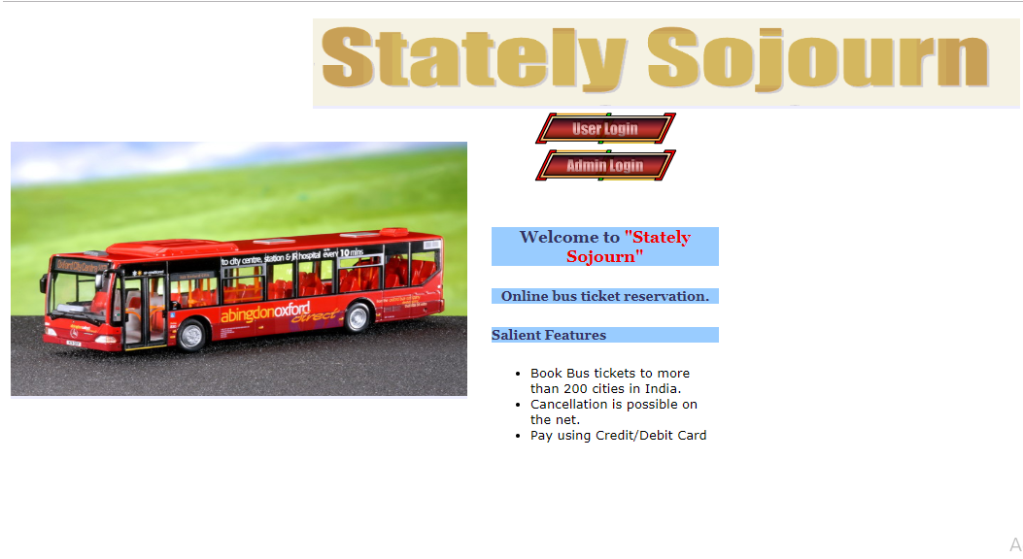
Introduction
This project we have undertaken is the testing of the Ewheelz Webb Application for Stately Sojourn Bus Services. The team will conduct functional and non-functional testing of all components within the Ewheelz application to ensure customer satisfaction with the use of the system.

Slide 5
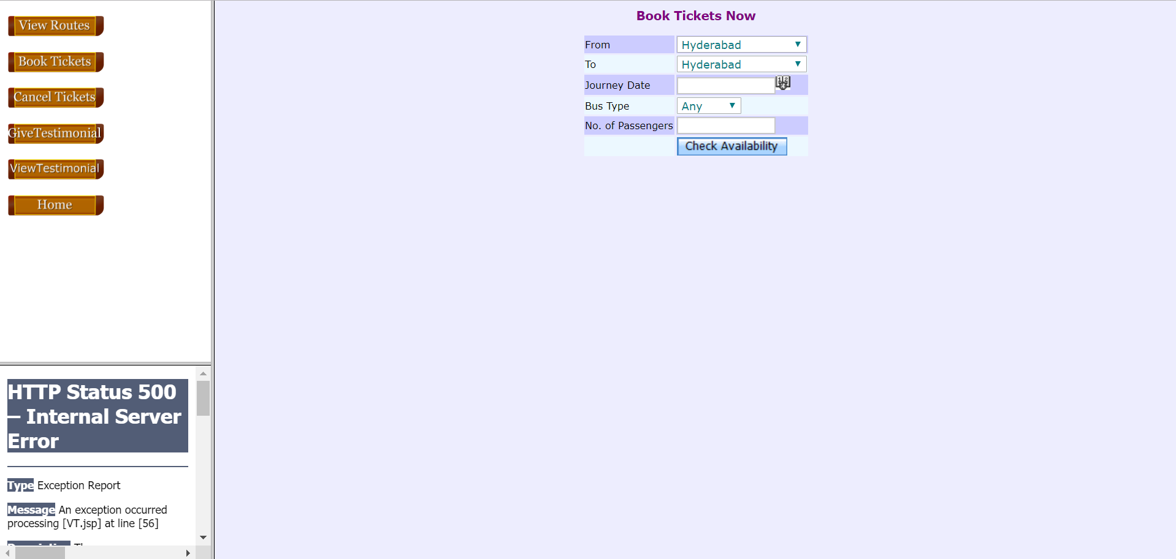

Slide 6
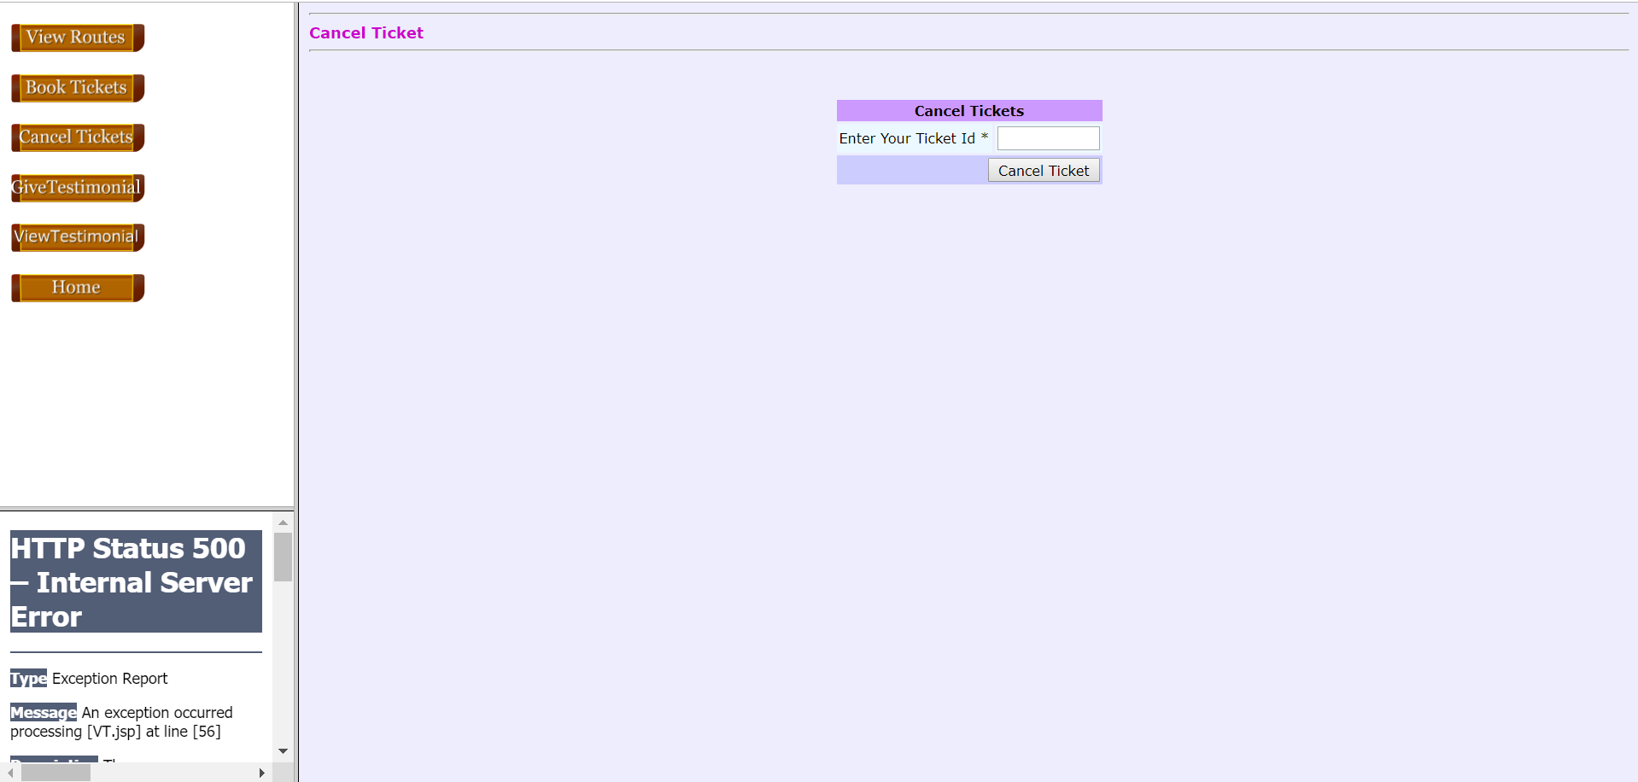

Slide 7
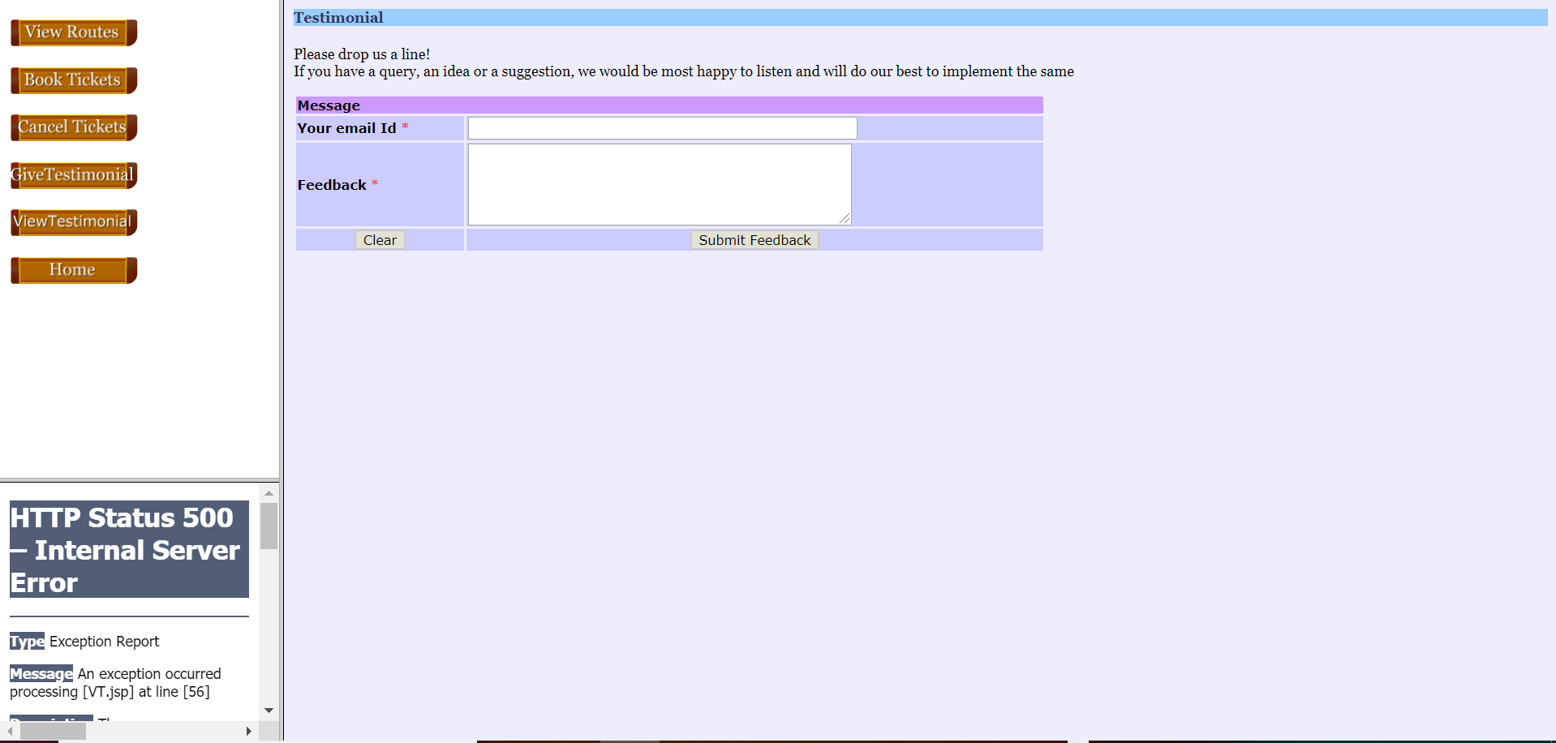

Slide 8
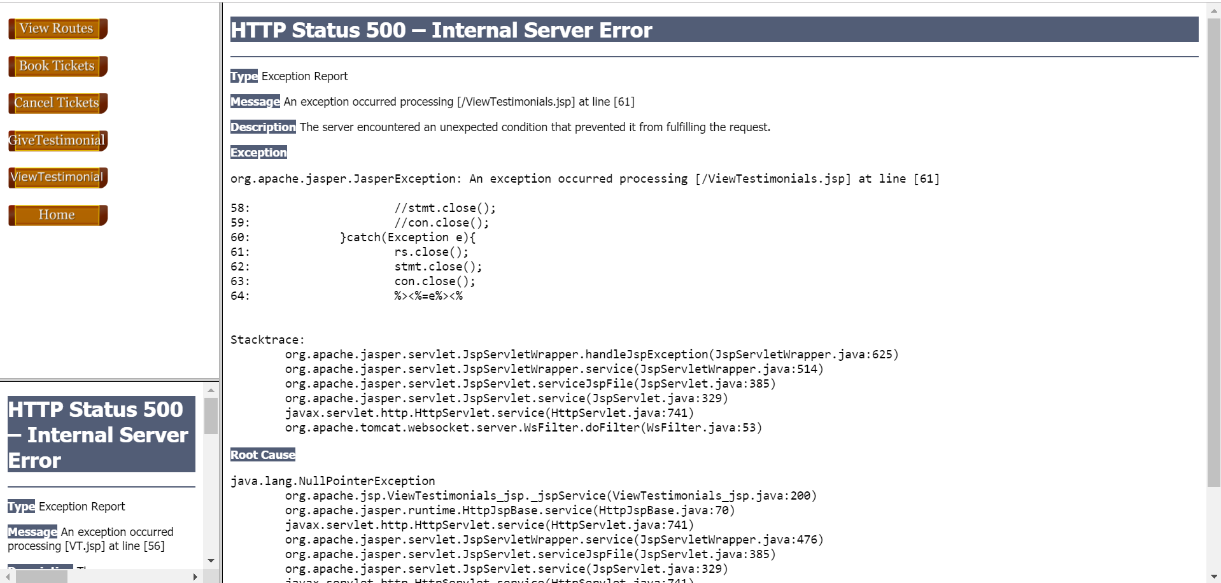

Slide 9
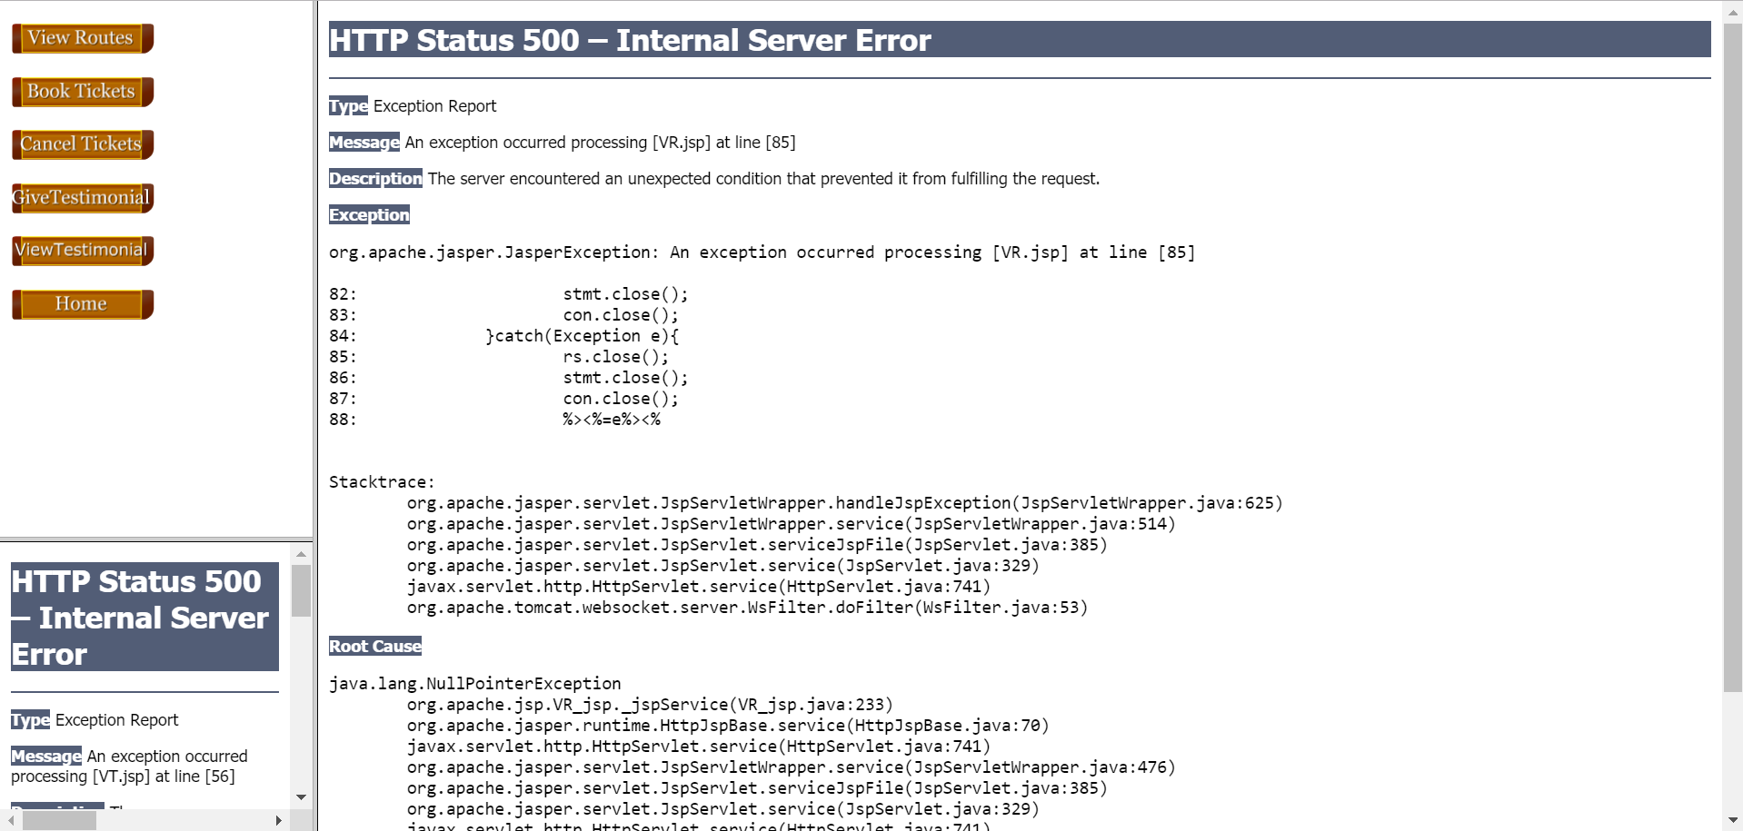

Slide 10
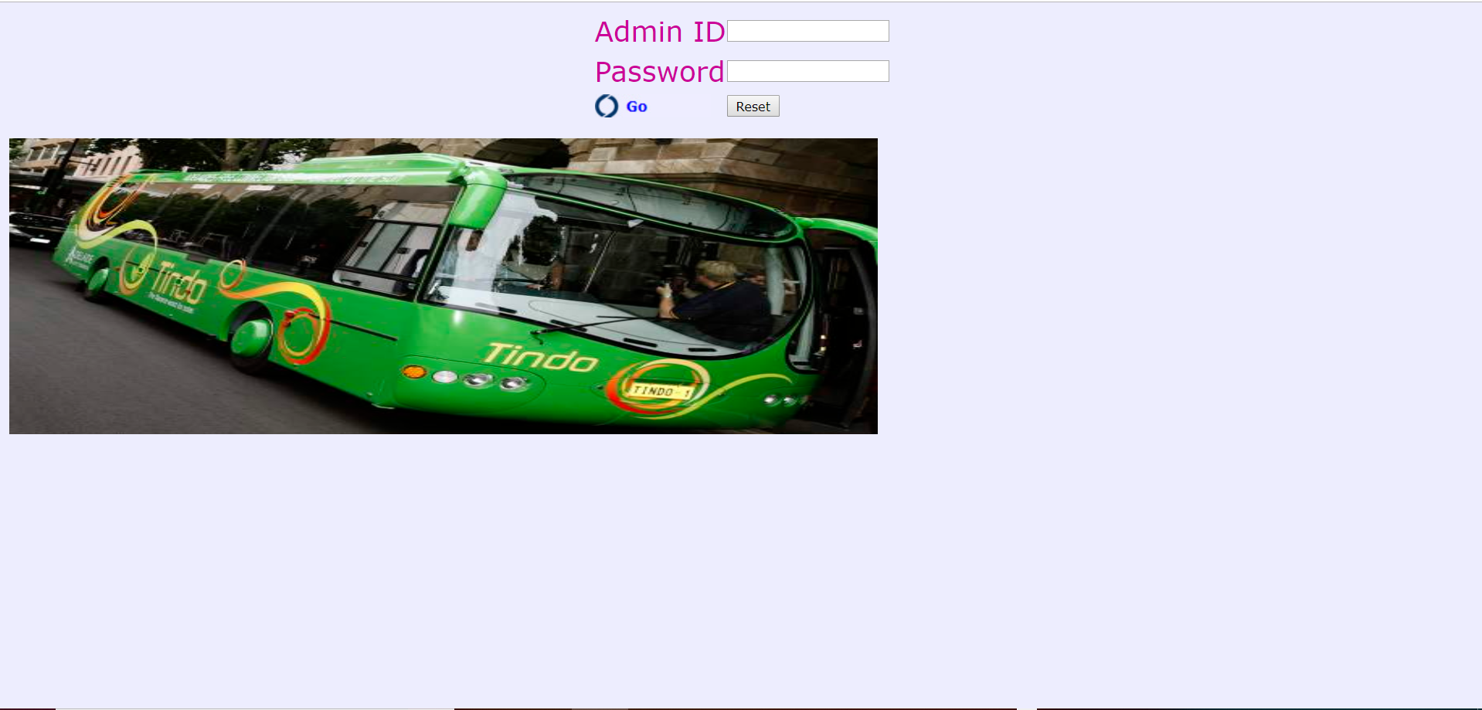

Slide 11
Agenda
02
Time line , Roles and Responsibilities

Slide 12
Timeline project
Week 1
Week
2-3
Week 4-6
Week 5-7
Week 8-9
Week
9
Week 10
Initiation
Create Test Cases
Final Reporting /Project Closure
Create Team
Assign Roles and Responsibilities Conduct Preliminary Research
Test Execution
Define tests that cover all conceivable use cases
Identify Key Conclusions of Project
Report key findings to Stake Holders
Create Test Scenarios/Scripts
Conduct Testing
Functional Testing
Usability Testing
Automated Testing
Two Phases
Planning
Define Scope
Create Test Plan
Create Test Strategy
Create Persons to represent key user bases
Create Scenarios that represent bulk of usage
Create Scripts to structure testing
Execution Reporting
Analyze and Synthesize results of testing

Slide 13

Roles And responsibilities
Project Manager
Responsible for conducting project meetings, update the project status to the professor and ensuring the project moves forward as per the project plan. This role will be rotated weekly
report
Technical lead
Responsible for installation and setup of the test environment, maintaining all the tools and ensuring they are working properly
Ewheelz App
Quality Analyst
Input
conclusion
Responsible for ensuring standards of every milestone through the project and verification of every document created. This role will be rotated for each milestone.
Test Analyst
Responsible for designing, implementing and executing test cases, scenarios and scripts. This role will be taken on by all members of the team in conjunction.
output
Scribe / Workshop session
Responsible for taking down the meeting minutes, meeting agenda, submissions and maintaining the IAD log. This role will be rotated weekly

Slide 14
Test Execution Roles
Daniel Gilbert, Mrinal Chopra and Anand Baby will be head of Functional Testing. Functional Testing will be conducted first to ensure system is functional enough to stand up to other forms of testing. Functional testing will occur during both phases of testing.
Francisco Gomez and Rose George will be head of automated testing. Automated Testing will be done in the first phase provided the system is functional enough to handle it. If not, automated testing will have to be conducted in phase two. The Smoke Test will help determine this.
Ralph Anonuevo and Lyan Limjap will be head of Usability Testing. Usability Testing will be conducted only in the second phase of testing once the system has been made functional enough for users to test.

Slide 15
Agenda
03
Testing Overview

Slide 16
Testing Overview
Water fall model
Development Lifecycle
The team will utilize a Waterfall Software Development Lifecycle approach for our testing.
Waterfall makes the most sense for this project because the testing team does not have the opportunity to work in conjunction with the development team
the team is being given all the components at once rather than each component individually as it is developed
Planning
Analysis
Design
Implementation

Slide 17
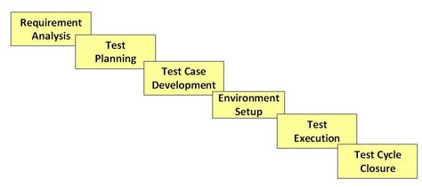
Testing Overview
Testing Lifecycle
Software Testing Lifecycle Phases
The team will utilize a standard testing life cycle
First the team will assess the requirements,
then plan the tests to match these requirements as well as the defined strategy and identified risks,
then test cases will be developed to match the plan,
then the testing environment will be set up for testing,
then the test execution will be conducted,
and then the results will be analysed and changes will be made according to these results.
Picture1 - Picture taken from: STLC - Software Testing Life Cycle Phases & Entry, Exit Criteria. (2019). Retrieved from https://www.guru99.com/software-testing-life-cycle.html

Slide 18



Preliminary Steps
To start the testing process the team will first review all Functional and Non-functional Requirements
The team will then proceed with Smoke Testing which is a series of non-exhaustive tests the ensure the most important functions work and that the system is stable enough to proceed with further testing

Slide 19
Test Execution / Types of Testing
Functional Testing
Boundary Value Analysis and Equivalence Partitioning for entries within menus
Component, Integration, System and Acceptance Testing
Regression Testing for second phase, after update
Automated Testing
F
AT
Automated Testing will be done to test that the system is meeting performance criteria (System handles 3500 users at a time and renders a page in under 3 seconds).
Jmeter and Selenium will be used for automated testing.
Listeners will be created to test all the menus and facilities of the app.
Usability Testing
Morville`s Honeycomb Model will be utilized to structure a Heuristic Evaluation for Usability Testing
Scenarios representing most frequent use cases will be created
Personas will be created to identify key user base to select testers
Ten people matching persona criteria will be selected for usability testing
U
S
Security Testing
Wireshark will be utilized to test network security
BSQL Hacker will be utilized to test SQL database security
.

Slide 20
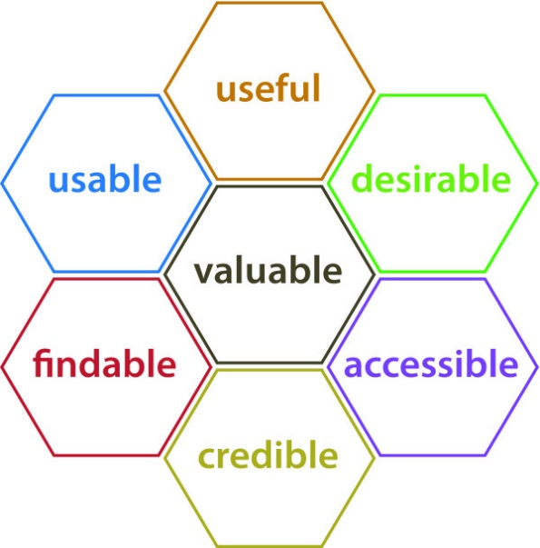
Heuristic Evaluation: Morville’s Honeycomb Model
Morville’s Honeycomb Model was chosen for the Usability Testing of this system as it covers all the major bases of the User Experience and applies well to web applications like Ewheelz
Useful: The product should fulfill a need. Usable: The product should be easy to use. The product should help the user accomplish their desired goal.
Desirable: The visual appearance of the product should be enjoyable. The design should be minimal and to the point.
Findable: Content should be navigable and locatable. The navigational structure of the website should make sense.
Accessible: The product should be designed in such a way that those with disabilities can have an equally positive experience
Credible: The product needs to be trustworthy and reliable.
Picture 2 - Picture taken from: Rosenbaum, Sarah & Glenton, Claire & Cracknell, Jane. (2008).
User experiences of evidence-based online resources for health professionals: User testing of The Cochrane Library. BMC medical informatics and decision making. 8. 34. 10.1186/1472-6947-8-34.

Slide 21
Entry and Exit Criteria
Type of Test | Entry Criteria 1 | Entry Criteria 2 | Entry Criteria 3 | Exit Criteria 1 | Exit Criteria 2 | Exit Criteria 3
Functional | Business and technical Requirements defined | Environment Set up | Test Cases and Test Plan defined | All Test cases executed | All defects documented and reported | Severity Codes assigned
Usability Testing | Metrics defines | Scenarios and Personas created | Testers selected and scripts written | All testers complete tasks and questionnaires | All relevant information consolidated and analyzed | Severity Codes assigned
Automated Testing | All automatable test cases identified | Jmeter and Junit scripts created | Required parameters defined (3500 users at a time, load page in under 3 seconds) | 100% of test cases executed and results recorded | Output reports generated by automation tools and analyzed | Severity Codes assigned
Security Testing | Security Standards established | Security Risks identified | Security Testing Tools and Protocols Selected | Vulnerabilities identified and addressed | Minimum security standards met and exceeded | Security risks mitigated

Slide 22
Agenda
04
Test Data

Slide 23
Test Data
Test Type | Source of Test Data
Functional Testing | Manually generated using boundary value analysis and equivalence partitioning. Exception cases will also be manually identified
Automated Testing | Ranges of values will be provided to the automated testing tools.
Usability Testing | Scenarios and scripts will be created to organize the usability testing process Post-task and Post-Test Questionnaires will be used to record testing results
Security Testing | Known Vulnerabilities, Penetration Testing, Ethical Hacking, Risk Assesment, Known Threats
U
AT
F
S

Slide 24
Agenda
05
Test Tool and environment

Slide 25




Test Tools
Selenium IDE
SQL scripting
For running automated functional testing of large quantities of data.
For load testing with large quantities of data as well as database sanitization
JMeter
Wireshark/BSQL Hacker
For testing performance of the system.
Emulating large quantities of users in different scenarios. .
Security Testing Tools for monitoring network security and database security respectively

Slide 26




Test Management Tools
Microsoft Project
Microsoft Word
For managing Test Plan, monitoring progress on deliverables, displaying connections and creating a Gantt Chart
For managing Test Strategy Document as well as Scripts, Scenarios, Personas and Questionnaires for testing
Excel
Google Drive
For managing test cases and results as well as IAD log, team roles and the CSV documents produced by automation tools
Used for document versión control and keeping all team members up to date

Slide 27
Testing Environment
Minimum Hardware Requirement for All Team Members:
• Processor: 64 bit Multicore Intel® w/ Intel-VT or 64 bit Multicore AMD with AMD-V support
• Memory: 8GB Minimum
• Optical Drive: DVD Multi Dual Layer or external USB Optical Drive (Optional)
• Operating System: Microsoft Windows 10 Enterprise, Pro, or Education
• Hard Disk Drive: 750GB or greater HDD with external USB Storage Drive
• Display: 14" XGA (1024x768), DirectX11 and OpenGL 4.0 (or higher) compatible or better
• Communication devices:
• Wireless (802.11a/b/g/n compliant)
• Ethernet 10/100/1000 Mbps with standard RJ45 jack
• USB Ports: 2 x USB 3.0 ports
Software Environment Requirements:
Apache Tomcat
Java Runtime Environment 1.8
SQL 5.7.27
Adobe Flash
Web Browsers: Chrome, Internet Explorer, Firefox

Slide 28
Test Results Capture
For functional testing and security testing, tests will be manually conducted and results will be recorded in a testing spreadsheet created in excel.
Usability Testing results will be recorded using post-task and post-test questionnaires. Results will then be tabulated and analysed to identify frequent concerns.
Automated Testing results will be recorded using Jmeter and Selenium. Output reports will be generated by these automation tools in CSV format. Results will be manually reviewed and analysed.

Slide 29
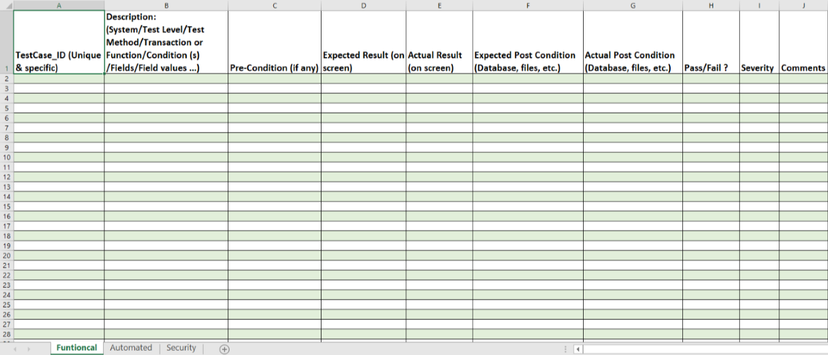
Test Results Capture

Slide 30
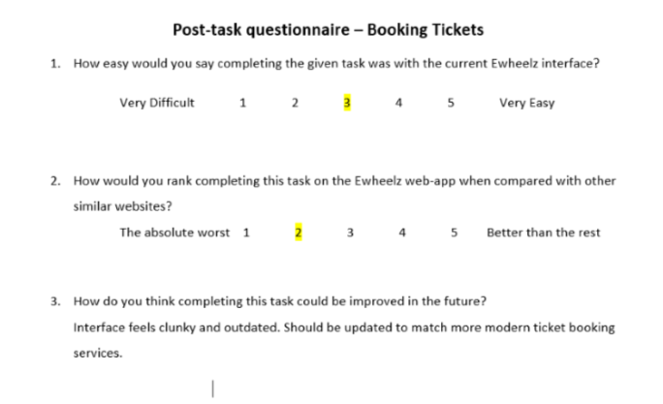
Test Results Capture

Slide 31
References
Dustini, E (2009) Implementing Automated Software Testing ,
.
STLC - Software Testing Life Cycle Phases & Entry, Exit Criteria Retrieved from: https://www.guru99.com/software-testing-life-cycle.html
Pexel. [Photograph]. (2019) Work photos. Retrieved from
https://www.pexels.com/search/work/
Rosenbaum, Sarah & Glenton, Claire & Cracknell, Jane. (2008).
User experiences of evidence-based online resources for health professionals: User testing of The Cochrane Library. BMC medical informatics and decision making. 8. 34. 10.1186/1472-6947-8-34.

Slide 32
Thank You

