Slide 1
Crowd Sourcing
Component 2

Slide 2
What is Crowdsourcing?
Crowdsourcing is a specific sourcing model in which individuals or organizations use contributions from Internet users to obtain needed services or ideas.
Provides a Platform for freelance testers
Crowdsourcing is the form of idea competitions and a platform to offer the services.

Slide 3
Different Types of Crowd Sourcing
Crowdsource Design
Crowdfunding
Microtasks
Open Innovation

Slide 4
Pros
Better quality results
Quicker Results
Financially helpful

Slide 5
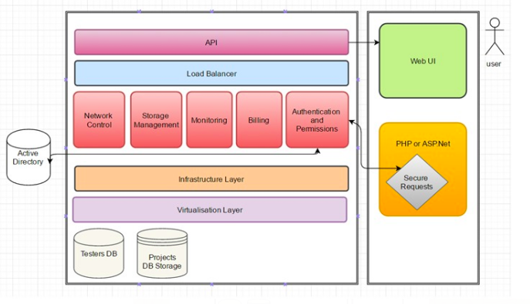
System Architecture

Slide 6
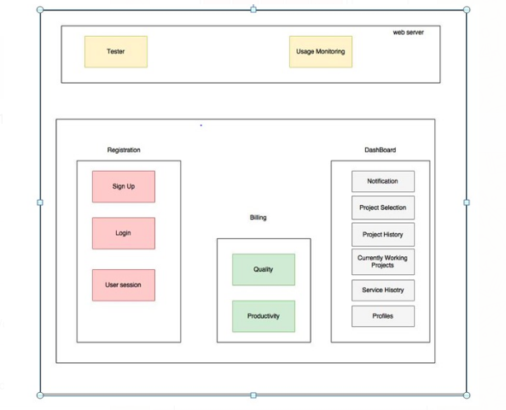

Slide 7
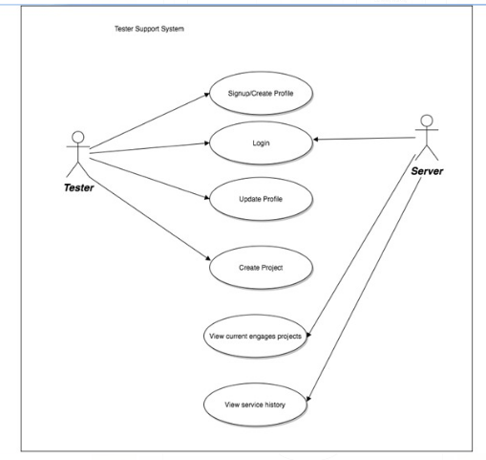
Tester Support System

Slide 8
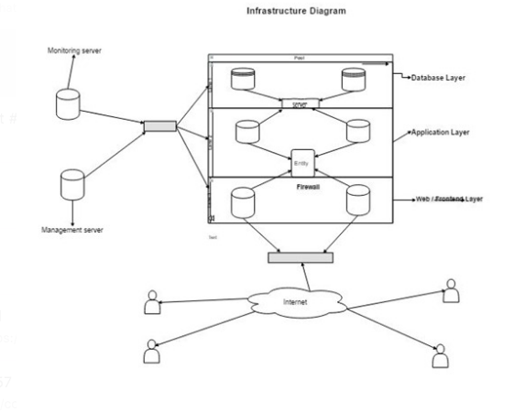
Infrastructure diagram for Tester Support

Slide 9
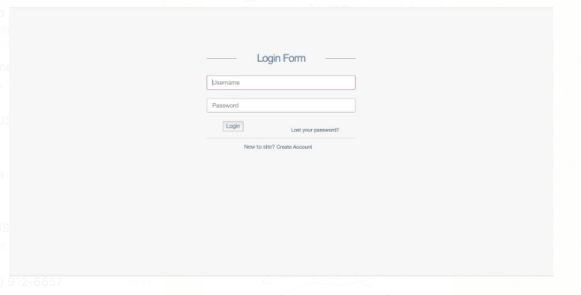
Working

Slide 10
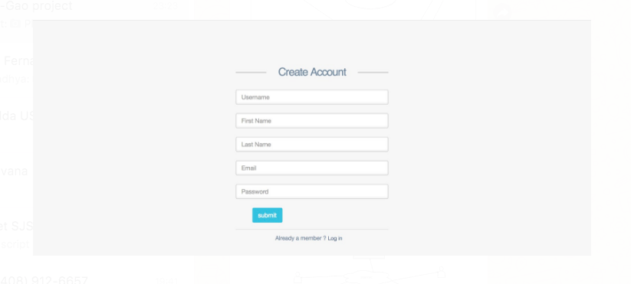

Slide 11
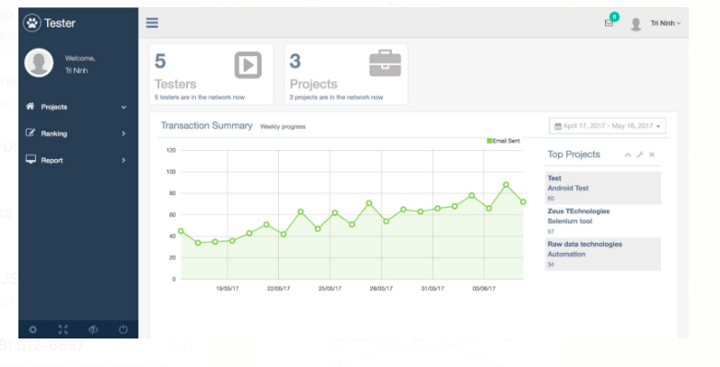

Slide 12
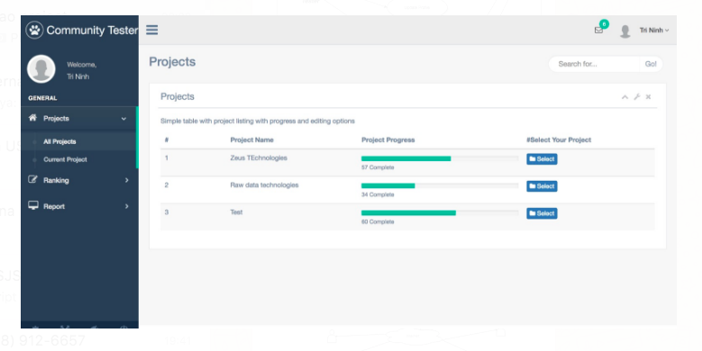

Slide 13
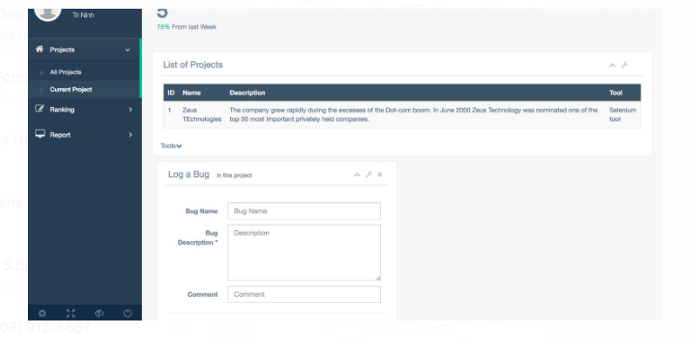

Slide 14
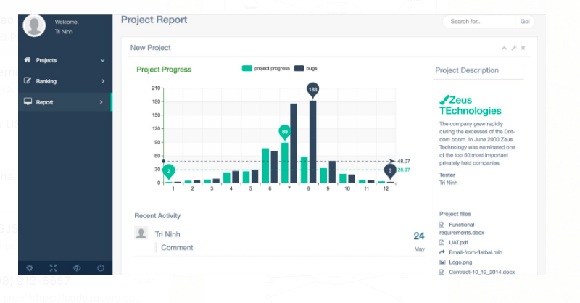

Slide 15
Thank You

