Slide 1


Group: 03
Stadium Seat Booking Management System
Meet Sheladiya : 19BIT076
Renish Jagani : 19BIT108
Rishit Samariya : 19BIT109
Rishabh Patel : 19BIT141
Ujash Thakkar : 19BIT142
Ananya Khandelwal : 19BIT144

Slide 2
Features
1. Number of Seats: The details related to the seats in our database is mentioned properly .
2. Seat Availability: The people will be to check the availability of the seats in the stadium for a particular
match just at one click.
3. Temperature: The people will have to be checked their body temperature due to COVID concern.
4. Updates of Different matches: The details of the upcoming matches should be also present in the
application which will provide the exact date of the match.
5. Stadiums: The matches that take place in different stadiums must be mentioned properly and should be
updated on regular basis.
6. Category: The seats in the stadium can be categorized based on prize.

Slide 3
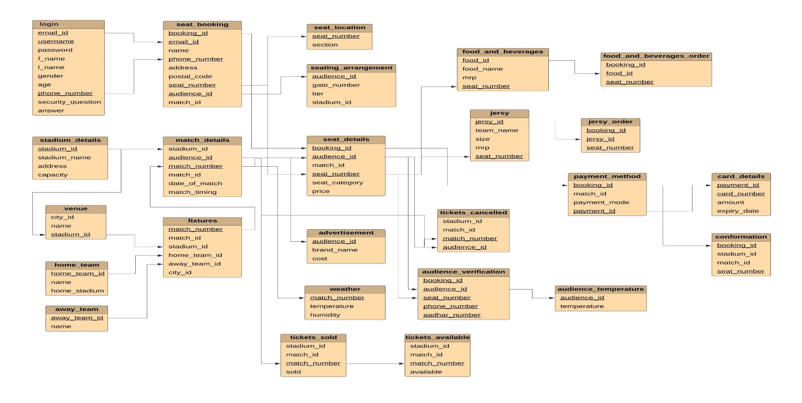
Relational Model for Stadium Seat Booking Management System

Slide 4
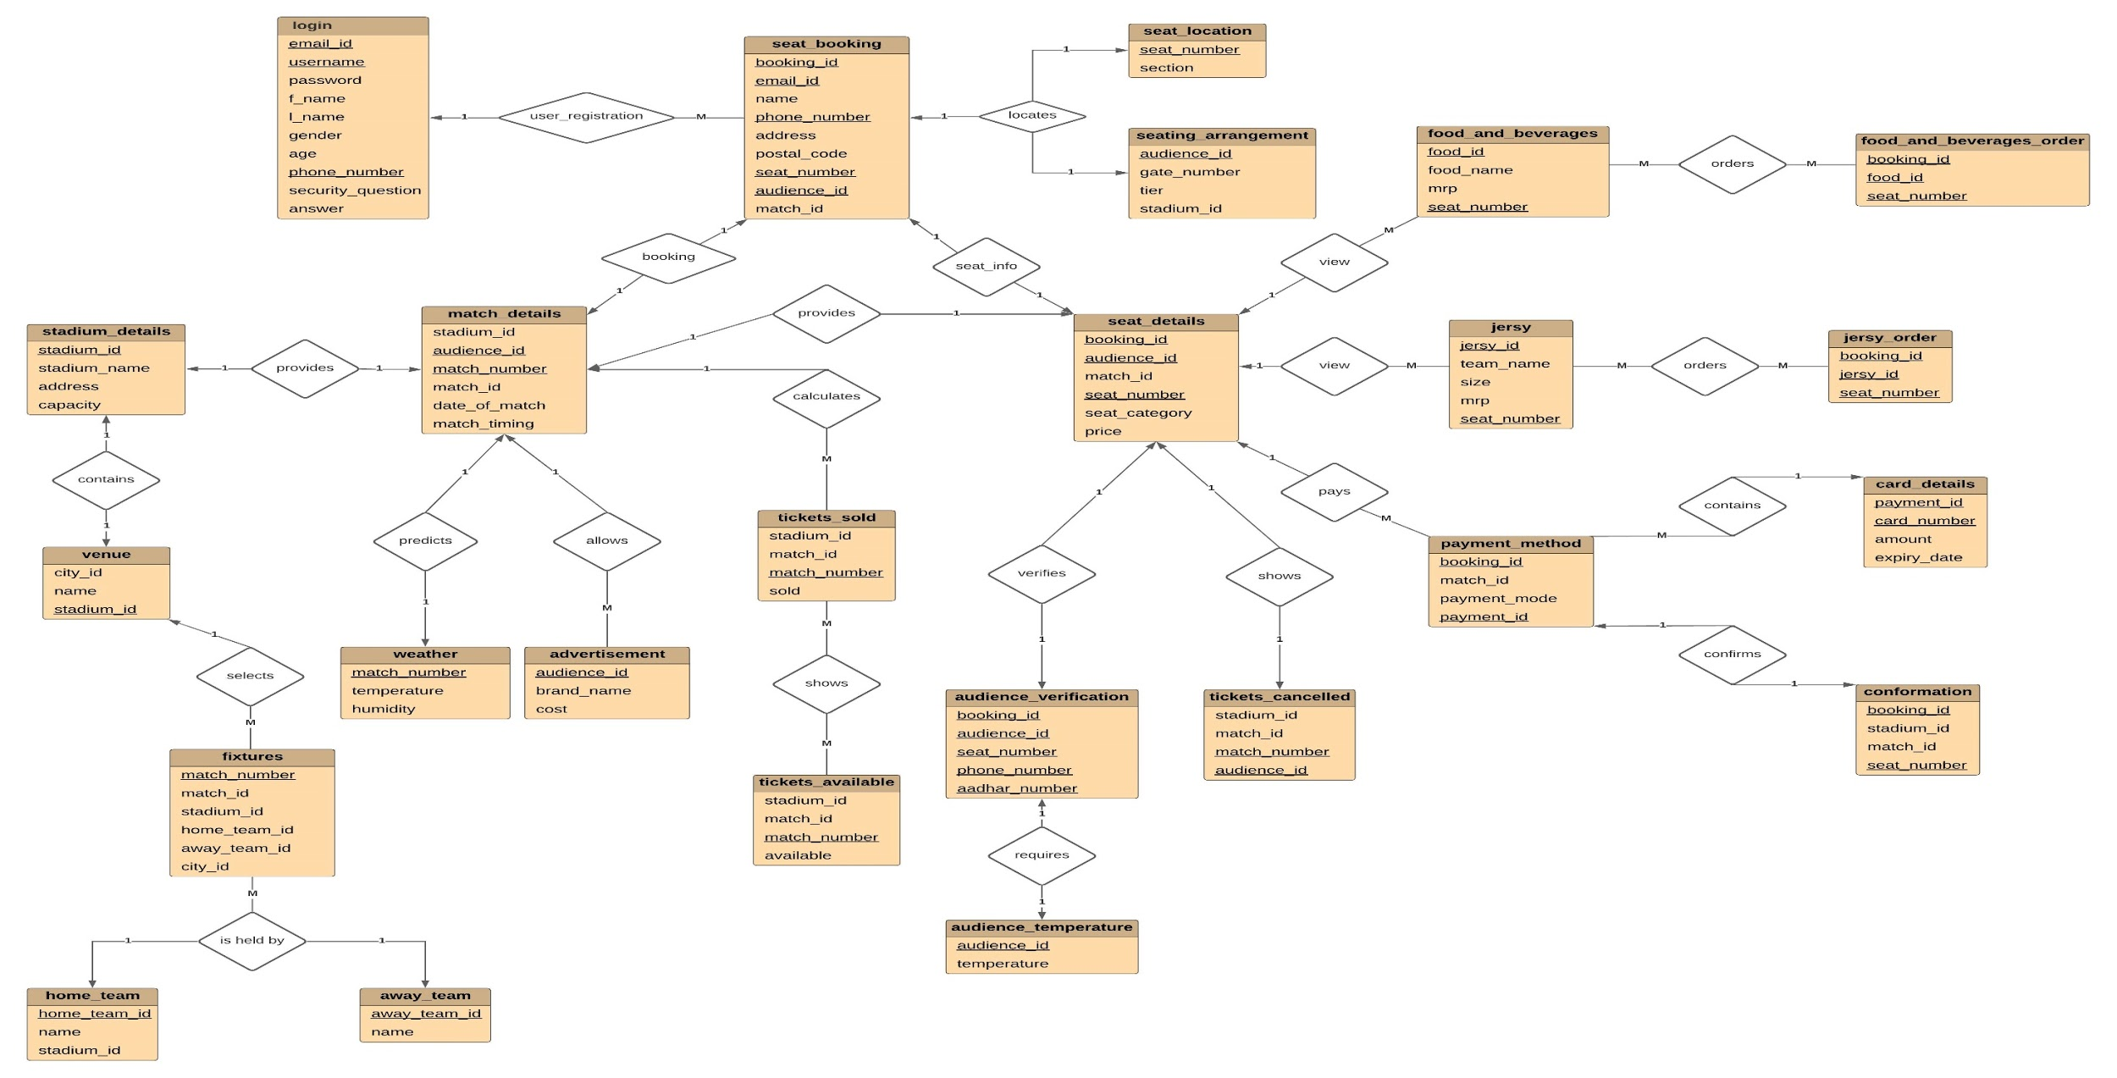
Entity Relational Model for Stadium Seat Booking Management System

