Slide 1

Zipfile
File compression

Slide 2
Prepared by…………
Meet Sheth(19DCE134)
Under the guidance of……….
Pro. Aishwariya Budhrani
Submited to……………
Devang Patel Institute of Advance Technology and Research (DEPSTAR)
DEPARTMENT OF COMPUTER ENGINEERING,
CHARUSAT At: Changa, Dist: Anand, Pin: 388421
October,2020

Slide 3
What is zipfile?
easy to keep related files together
make transporting, e-mailing, downloading and storing data
software faster
more efficient

Slide 4
Why zipfile?
compress data and therefore save time and space and make downloading software and transferring e-mail attachments faster
Distributing files on the Internet: Only one download is required to obtain all related files, and file transfer is quicker
Sending a group of related files to an associate: When you distribute a collection of files as a single Zip file,
Saving disk space: If you have large files that are important but seldom used, such as large data files, simply compress the files into a Zip file and then unzip (or "extract") them only when needed.

Slide 5

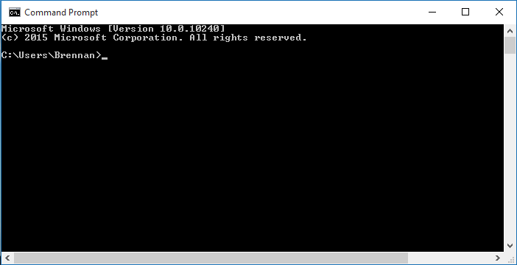
Software requiredment
JRE(Java Runtime Environment)
CMD
(Command Prompt)

Slide 6
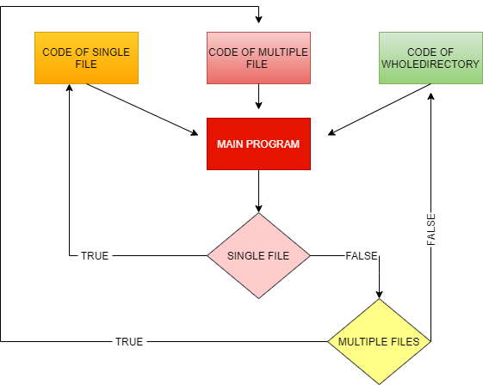
workflow

Slide 7
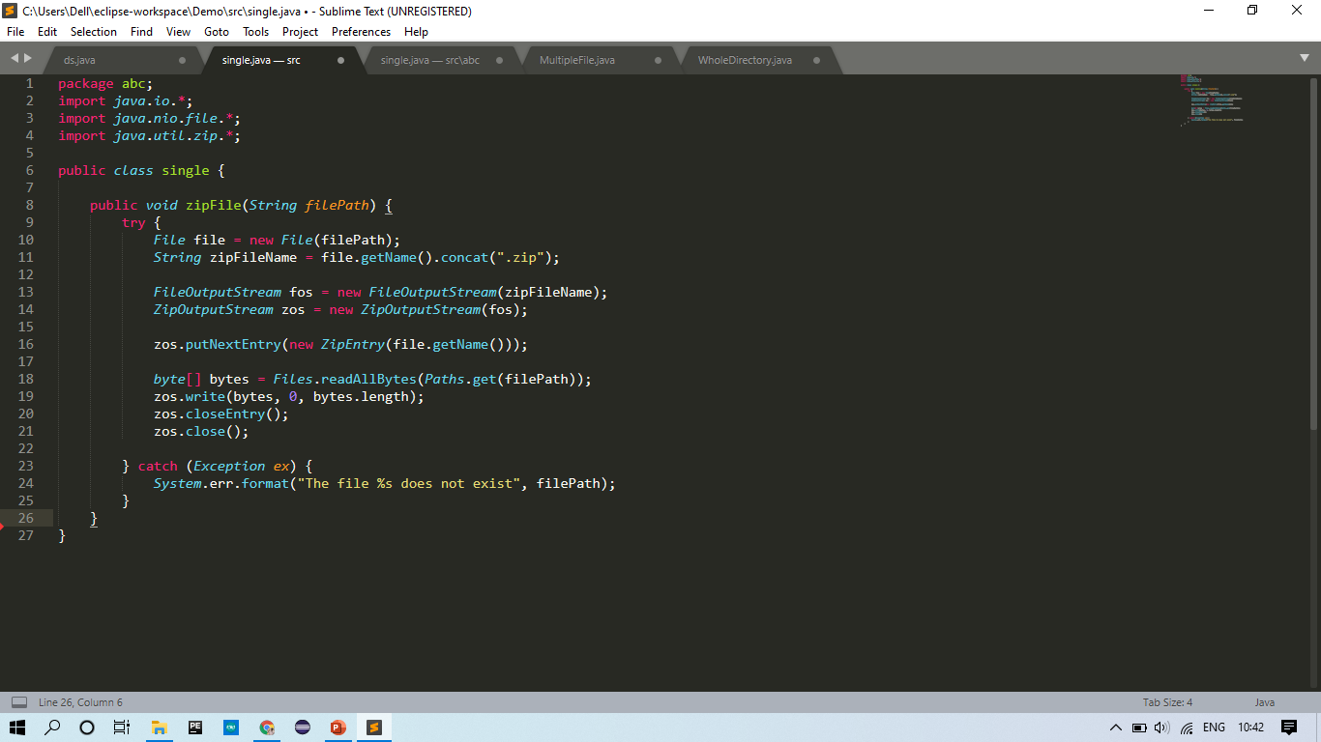
S
I
N
G
L
E
Z
I
P
P
I
N
G
C
O
D
E

Slide 8
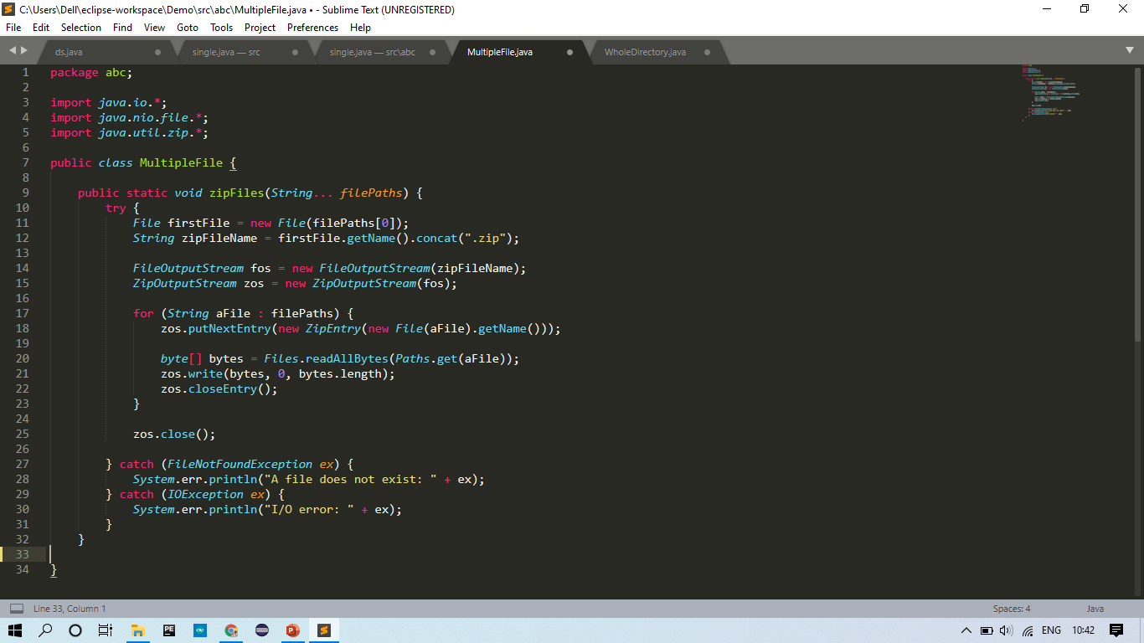
M
U
L
T
I
P
L
E
Z
I
P
P
I
N
G
C
O
D
E

Slide 9
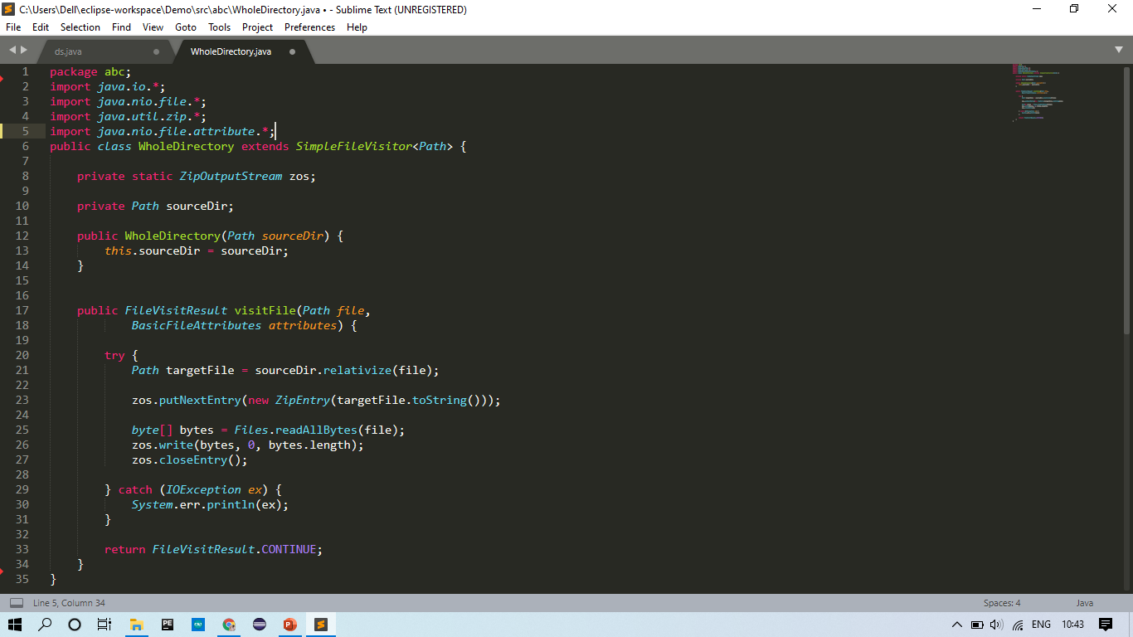
W
H
O
L
E
D
I
R
E
C
T
O
R
Y
Z
I
P
P
I
N
G
C
O
D
E

Slide 10
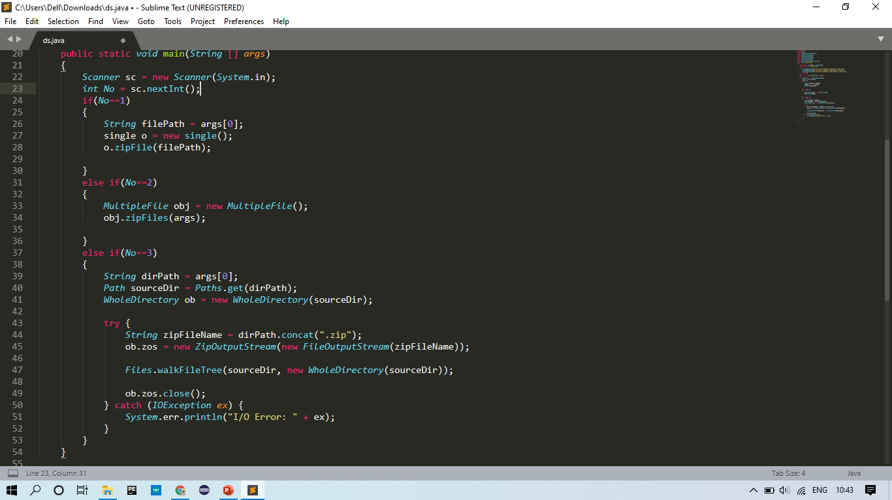

Slide 11
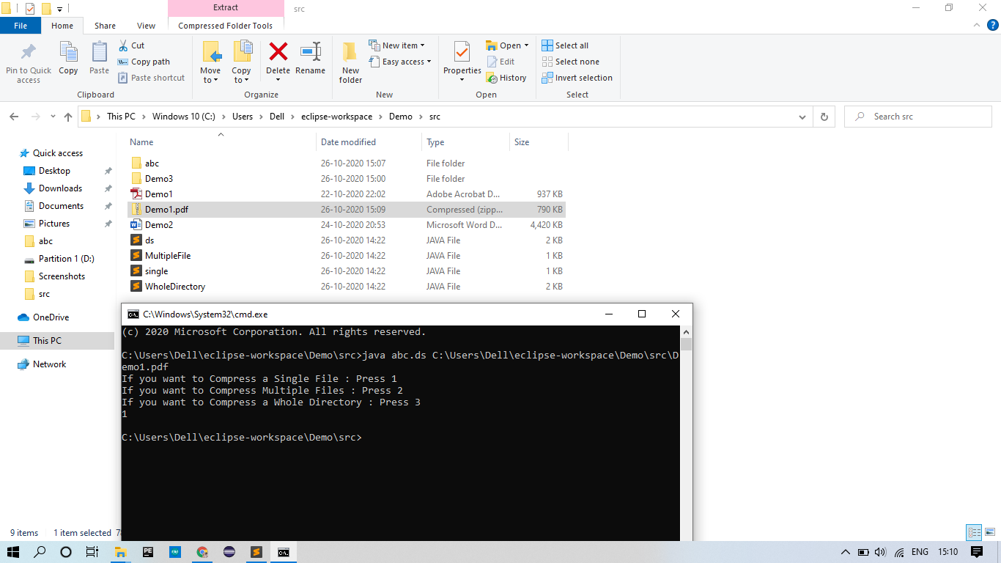
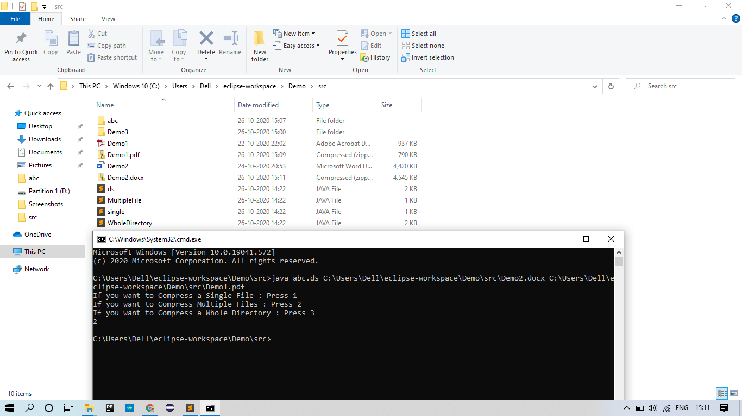
EXAMPLE OF ZIPING FILE(SINGLE FILE AND MULTIPLE FILES)

Slide 12
REFFERENCE
https://www.baeldung.com/java-compress-and-uncompress
https://www.codejava.net/java-se/file-io/how-to-compress-files-in-zip-format-in-java
https://docs.oracle.com/javase/7/docs/api/java/util/zip/ZipFile.html
https://www.geeksforgeeks.org/zipfile-getname-function-in-java-with-examples/

Slide 13
THANK YOU

