Slide 1
KPIT APEX LAB · COEP TECHNOLOGICAL UNIVERSITY
Smart Collision Detection and
Automatic Emergency Braking System
A Multi-Node CAN Bus Platform with Sensor Fusion, Fail-Safe Control,
Event Data Recording, and Adaptive Cruise Control
Meet Shinde · Siddhant Wankhede · Vedant Yadav
Mentor: Jayanth Subramanian — KPIT Technologies
AEB System — KPIT APEX LAB, COEP Technological University
1

Slide 2




MOTIVATION
The Gap Between Production ADAS and Hands-On Learning
AEB is now standard
But the architecture is opaque
Autonomous Emergency Braking is one of the most widely deployed ADAS features, credited with major reductions in rear-end collisions.
Commercial systems run on distributed ECU networks over automotive CAN — well documented at a high level, rarely accessible for hands-on study.
Academic projects stay shallow
Our goal: reproduce, not simulate
Most student projects touch one piece in isolation: a single-MCU braking demo, a two-node CAN test, or a logging exercise — never the full picture.
Build a low-cost, distributed platform that faithfully reproduces real automotive safety patterns — not just a proxy for them.
AEB System — KPIT APEX LAB, COEP Technological University
2

Slide 3






PROJECT OBJECTIVES
One Integrated Platform, Not Isolated Demos
The core contribution is systems integration: proving that distributed sensing, a hardware-independent fail-safe, adaptive control, and black-box-style logging can be reproduced faithfully — and made to interoperate correctly — on low-cost development boards.
Multi-Node CAN Architecture
Sensor Fusion
Hardware Fail-Safe
Four independent ECUs on a shared 500 kbps CAN bus
LIDAR + ultrasonic, zone-weighted, cross-validated
Heartbeat deadman-switch, independent of main logic
Event Data Recorder
Adaptive Cruise Control
UDS-Style Diagnostics
EEPROM-based, pre/post-trigger telemetry capture
PID-based continuous distance regulation (design target)
Request/response runtime state introspection (design target)
AEB System — KPIT APEX LAB, COEP Technological University
3

Slide 4




SYSTEM ARCHITECTURE
Four Nodes, One Shared CAN Bus
2.4 GHz RF
Arduino Nano
RF Joystick TX
Arduino Uno
RF → CAN Bridge
Arduino Mega 2560
Perception ECU + EDR
The STM32 motor controller consumes all three identifiers and originates no CAN traffic of its own — a fault in perception never directly corrupts the motor controller's state.
0x100
0x200, 0x050
CAN BUS — 500 kbps
RX: 0x100, 0x050, 0x200
STM32 Nucleo F446RE
Motor Controller
AEB System — KPIT APEX LAB, COEP Technological University
4

Slide 5
NODE OVERVIEW
What Each Node Owns
Arduino Nano
Reads joystick analog input, transmits over 2.4 GHz nRF24L01 to the bridge node.
Arduino Uno
Receives RF joystick packets, re-publishes onto CAN bus under 0x100 — the wireless-to-wired gateway.
Arduino Mega 2560
Fuses LIDAR + ultrasonic readings, broadcasts AEB telemetry (0x200) and heartbeat (0x050). Hosts the EDR.
STM32 Nucleo F446RE
Consumes all CAN traffic, arbitrates driver input vs. AEB/ACC intervention, drives the L298N H-bridge.
AEB System — KPIT APEX LAB, COEP Technological University
5

Slide 6
PERCEPTION
Zone-Weighted Dual-Sensor Fusion
Neither sensor alone is fully reliable. LIDAR offers higher precision but can misread reflective or transparent surfaces; ultrasonic is more robust to reflectivity but has wider beam divergence and slower response. Fusing both allows cross-validation.
Fusion Weight by Distance Zone
Zone
LIDAR Weight
Ultrasonic Weight
< 250 mm
LIDAR-Lite v3HP Primary sensor, I2C, high precision
25%
75%
HC-SR04 Ultrasonic Secondary sensor, robust to reflectivity
250 – 1000 mm
60%
40%
Moving-average filter Applied to both raw streams before fusion
> 1000 mm
32-bit fusion math Fixed a 16-bit overflow defect found during development
90%
10%
At close range, LIDAR precision matters most for braking decisions. At longer range, weighting balances toward ultrasonic robustness.
AEB System — KPIT APEX LAB, COEP Technological University
6

Slide 7


AEB LOGIC
Escalating Response, Not a Single Trigger
CRUISE
DECEL
EMERGENCY
> 500 mm
250 – 500 mm
< 250 mm
Joystick active — forward speed capped at 70% PWM (179/255).
Linear PWM ramp: 30% + 40 × (dist − 250) / 250 — 70% down to 30%.
Active back-EMF brake (reverse polarity via L298N) — joystick fully overridden.
This staged approach mirrors production AEB calibration philosophy — escalating intervention balances false-positive braking against stopping performance.
AEB System — KPIT APEX LAB, COEP Technological University
7

Slide 8



FAIL-SAFE DESIGN
The Heartbeat Deadman-Switch
Independent of AEB zone logic, the STM32 expects a heartbeat frame (0x050) from the Mega at a regular interval. Silence for too long means something has failed — and the system fails safe.
Heartbeat every 30 ms
Mega originates 0x050 (0xA5) on the shared CAN bus
80 ms silence → fault
80 ms
2.67×
50 ms
STM32 declares STATE_NETWORK_FAULT and enters hardware lockout
Watchdog threshold
Frame margin before fault
Button debounce period
Lockout is non-recoverable in software
Motor stays braked via back-EMF; 0x200 telemetry is silently discarded, even after the Mega reconnects
“A design choice analogous to fault-latching behavior in automotive safety-critical ECUs — certain fault classes require an explicit reset rather than self-clearing.”
Manual recovery only
Debounced PC13 button press (≥50 ms) clears the lockout → STATE_IDLE
AEB System — KPIT APEX LAB, COEP Technological University
8

Slide 9


EVENT DATA RECORDER
A Black Box for the Perception Node
The Mega captures a rolling window of telemetry around every emergency-zone trigger — pre- and post-event — in the same spirit as an automotive crash data recorder.
21 frames total, sampled at 20 Hz ≈ 1.05 s window
10 PRE-TRIGGER FRAMES
TRIGGER
10 POST-TRIGGER FRAMES
Trigger condition
Fused distance drops below the 250 mm emergency threshold
Storage
254 bytes total in internal EEPROM — 12 bytes/frame, no SD card
Watchdog-safe writes
Heartbeat injected after every frame write — keeps the 80 ms STM32 watchdog alive through the ≈832 ms worst-case flush
AEB System — KPIT APEX LAB, COEP Technological University
9

Slide 10
DESIGN TARGETS
Adaptive Cruise Control & Diagnostics
Adaptive Cruise Control
UDS-Style Diagnostics
DESIGN TARGET
DESIGN TARGET
Replaces discrete braking zones with continuous PID control toward a fixed following gap.
A lightweight layer modeled on ISO 14229 (UDS) for runtime state inspection without a physical debugger.
u(t) = Kp·e(t) + Ki∫e(t)dt + Kd·de(t)/dt
Current fused obstacle distance
Active AEB zone / ACC state
Target gap: 300 mm · Fixed 20 ms control loop · Derivative low-pass filtered
Heartbeat & lockout status
Implementation status: current firmware implements the Decel-zone response as a linear PWM ramp rather than the full PID law above.
Most recent EDR trigger timestamp
Implementation status: not yet implemented in verified firmware; CAN bus load analysis confirms ample headroom (<2% of 40% budget) to add it.
AEB System — KPIT APEX LAB, COEP Technological University
10

Slide 11
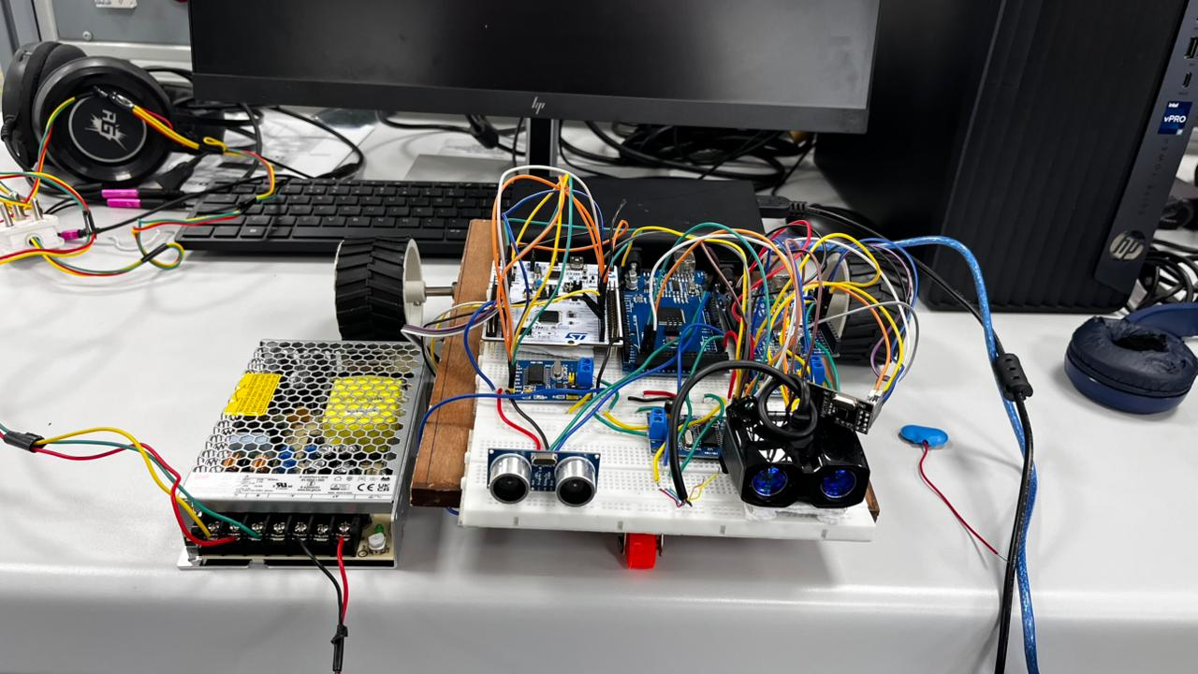
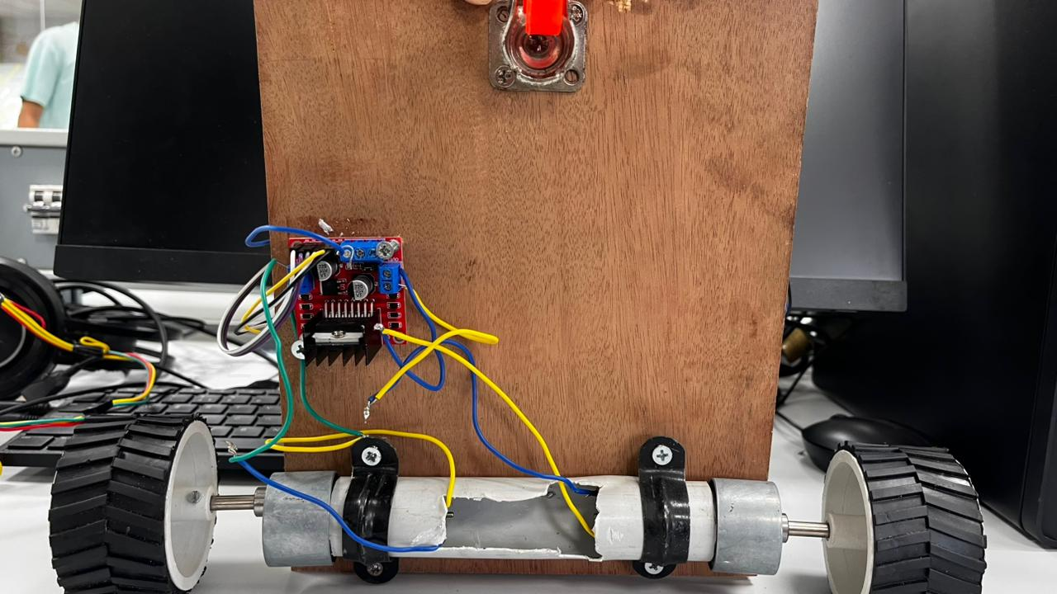
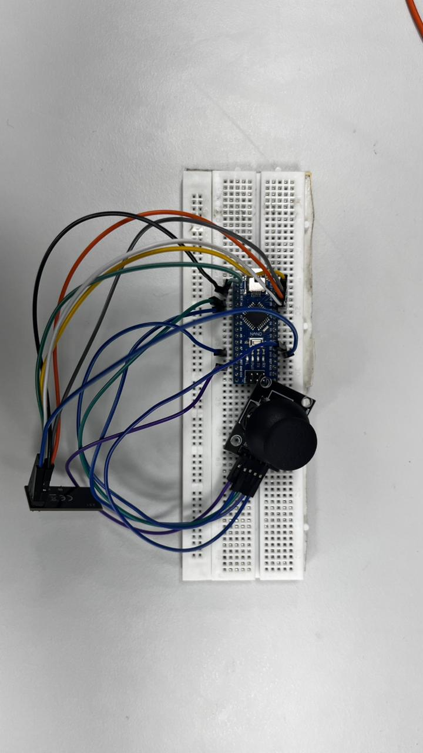
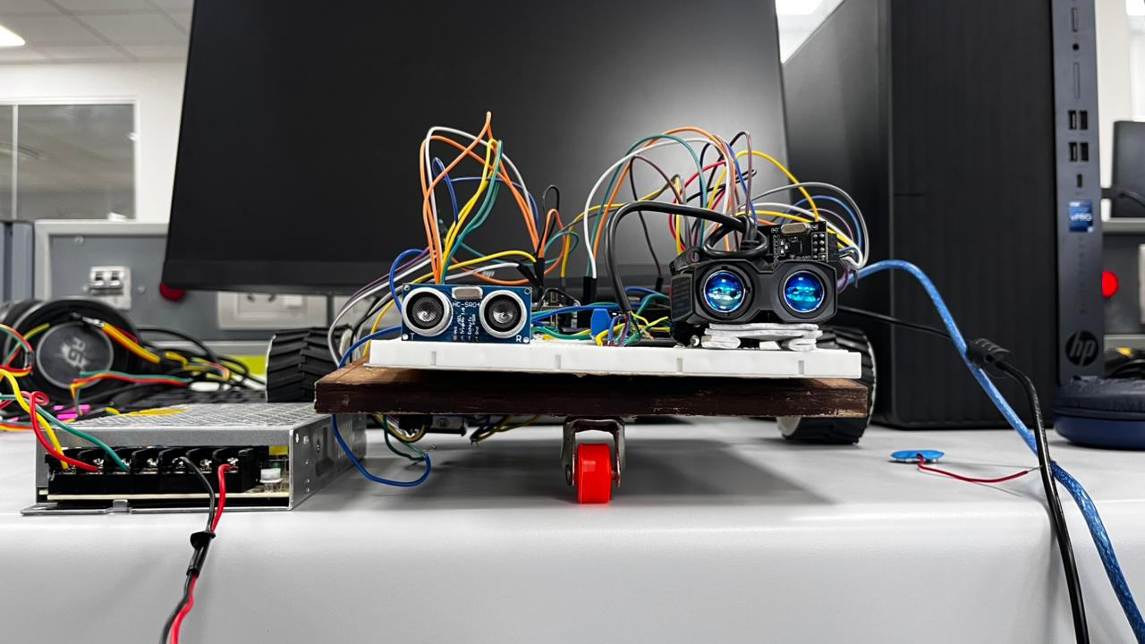
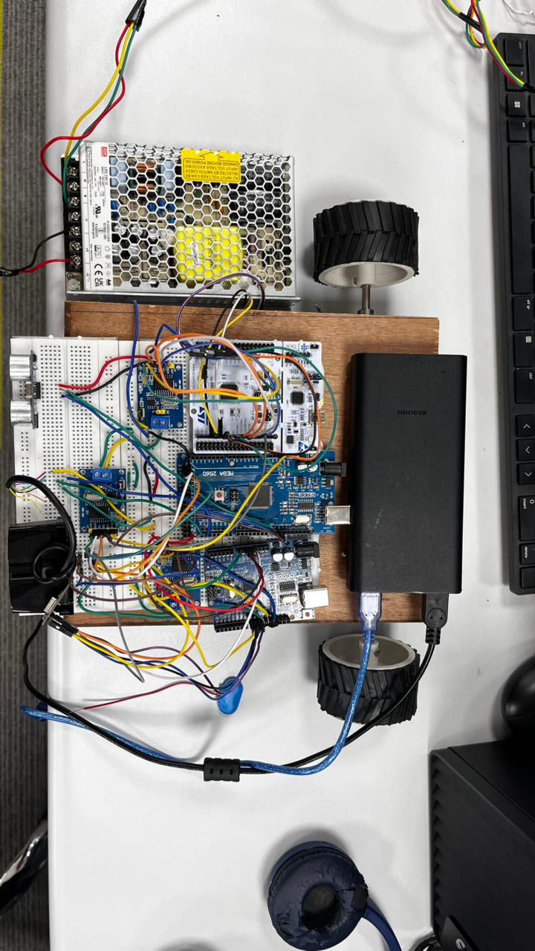
PHYSICAL BUILD
The Platform on the Bench
Full assembly — side view
L298N H-bridge & drive motors
LIDAR + ultrasonic mount
Top-down test platform
Nano transmitter node
AEB System — KPIT APEX LAB, COEP Technological University
11

Slide 12
POWER ARCHITECTURE
As-Built Power Distribution
Source
Target
Notes
Hardware Risk
12 V supply #1
L298N VIN / GND
Drives both DC motors
12 V supply #2
Arduino Mega Vin / GND
Powers perception ECU directly
STM32 VDD Overvoltage
VDD is the STM32F446RE's 3.3 V logic rail. Per datasheet, normal operating range is 1.7–3.6 V and the absolute maximum is 4.0 V.
12 V supply #2
Arduino Uno Vin / GND
Powers RF-to-CAN bridge directly
5 V-rated supply
STM32 VDD pin / GND
Measured output: 4.2 V
4.2 V
4.0 V
—
Shared extension board
Both bench supplies share a common mains strip
supplied
absolute max
Exceeds the absolute maximum rating, not just the recommended range — real risk of permanent MCU damage (latch-up / dielectric breakdown). Tracked as an open item; safer fix is the dedicated 5V pin, which regulates down automatically.
AEB System — KPIT APEX LAB, COEP Technological University
12

Slide 13
RESULTS
Qualitative Validation & Design-Target Metrics
Qualitative Bench Validation
Theoretical Design-Target Metrics
CAN frames correctly filtered by identifier - no cross-talk observed
INSTRUMENTED MEASUREMENT PENDING
AEB zone state machine transitions cleanly: CRUISE ↔ DECEL ↔ EMERG
Heartbeat timeout → lockout
≤ 80 ms
Bus severance / node reset reliably triggers hardware lockout
ACC / Decel speed regulation
30% – 70% PWM
Lockout clears only via debounced PC13 button press
EDR capture window
21 frames @ 20 Hz (≈1.05 s)
EDR triggers correctly on emergency-zone entry; full log retrievable
CAN bus load (3-frame pattern)
≈ 1.10% of 500 kbps
Observations were qualitative (eye + stopwatch), consistent with but not a substitute for the instrumented verification procedures defined in the project's test appendix.
Values are derived directly from firmware constants and control logic — not measured data. Emergency-zone stopping distance is not derivable from firmware alone; it depends on vehicle mass, motor torque, and surface friction.
AEB System — KPIT APEX LAB, COEP Technological University
13

Slide 14



LIMITATIONS & FUTURE WORK
What's Next
Sensor suite
Bus timing analysis
ACC controller validation
LIDAR + ultrasonic lacks the angular resolution of automotive-grade radar single-point, not full-scene, perception.
No formal worst-case CAN latency analysis under full bus load yet.
Full closed-loop stability / step-response characterization remains future work.
Scale & actuation
Formal fault coverage
STM32 power fix
DC motor + L298N is illustrative, not representative of true vehicle braking dynamics.
Heartbeat watchdog covers liveness faults only not sensor plausibility or CAN bus-off recovery.
Move VDD supply to the dedicated 5V pin to eliminate the overvoltage risk.
AEB System — KPIT APEX LAB, COEP Technological University
14

Slide 15
CONCLUSION
Automotive Safety Patterns, Faithfully Reproduced
This project demonstrates that distributed sensing and actuation, weighted multi-sensor fusion, a multi-stage braking response, and a hardware-enforced heartbeat fail-safe can be integrated not just studied in isolation using low-cost Arduino and STM32 development boards.
4
3
CAN nodes
CAN identifiers
EEPROM-based event data recording and PID-based adaptive cruise control identified as further design targets
21
80 ms
Remaining work centers on instrumented quantitative validation and closing the ACC/diagnostics implementation gap
EDR frames/event
Watchdog threshold
AEB System — KPIT APEX LAB, COEP Technological University
15

Slide 16
Thank You
Questions & Discussion
Meet Shinde · Siddhant Wankhede · Vedant Yadav
KPIT APEX LAB · COEP Technological University
AEB System — KPIT APEX LAB, COEP Technological University
16

