Slide 1
CS5570 Architecture of Database Management Systems
Basics Vijay Kumar Computer Science Electrical Engineering University of Missouri-Kansas City Kansas City, MO, USA.

Slide 2
Outline
Introduction to Transaction
Transaction Properties
Atomicity and Two-Phase Commit
Availability
Performance
Styles of System

Slide 3
Transaction
A transaction is a mechanism for manipulating a database in consistency-preserving manner.
Some real-life examples of a transaction
Airline seat reservation transaction to buy an airline ticket
On-line purchase from Internet
Withdraw money from an ATM.
E-bay bidding
Etc.

Slide 4
Transaction Processing (TP)
The consistency-preserving requirement of a transaction makes its processing quite hard. It must satisfy the following:
Reliability and Availability: system should rarely fail and running all the time
Response and Throughput: within 1 second and at least thousands of transactions/second
Scalability: can grow from balance enquiry to internet scale
Security: must not compromise the institution’s integrity
Atomicity: must install its updates in the database successfully
Durability: a transaction is a legal contract, therefore, its updates must persist in the database

Slide 5
Transaction Processing (TP)
What makes TP Important:
It is at the core of electronic commerce and soon will be the core of mobile commerce too
It is the core of most medium-to-large businesses. They use TP for their production systems and cannot operate without it
It is probably the single largest computer application with more than $80B/year cost
Nearly all academic research and development use TP to manage their research and data

Slide 6
TP System (DBMS) Infrastructure
End User’s Viewpoint
Enter a request transaction from an input device (monitor, cell phone, PDA, tablet, ATM, browser, etc.)
The transaction is processed by the DBMS that installs transaction’s updates in the database successfully
The user receives a reply, if a reply is required
The TP system (DBMS) ensures that each transaction
is an Atomic action (independent unit of work),
executes and commits exactly once, and
produces results that persist (durable) in the database.
TP system has tools to enforce these requirements

Slide 7

TP System (DBMS) Infrastructure
End-User
Request
Reply
Presentation Manager
Front-End (Client)
Transaction Control
(routes requests)
Back-End (Server)
DBMS

Slide 8
DBMS Characteristics
Transaction characteristics
Typically < 100 transaction types per application (finance, bank, load, etc.)
Transaction size varies with application. Typically 0-30 disk accesses, 10K - 1M instructions executed, 2-20 messages
A large-scale example: airline reservation system
150,000+ active display devices (direct access)
Indirect DB accesses through Internet (travel agents, customers, etc.)
thousands of disk drives
3000 transactions per second, peak

Slide 9
Application Servers
An application server is a software module that creates, executes and manage TP application. It is also referred to as TP monitors. Actually application server can be defined as
App Server = TP monitor + web functionality
Application programmer writes an application (e.g., a transaction) to process a single request and application server scales it up and deploys it on large systems. For example,
Application developer writes a transaction for debit/credit task. The application server deploys it to 10s/100s of servers and on the Internet.

Slide 10
Application Servers
Main components of an application server
an application programming interface (API) (e.g., Enterprise Java Beans)
tools for program development (programming language, library, functions, etc.)
tools for system management (application deployment, auditing, fault and performance monitoring, billing, resource and user management)

Slide 11
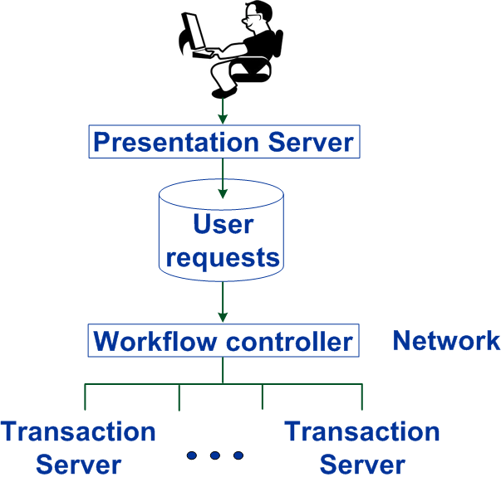
Application Servers Architecture

Slide 12
ATM Application Example

Slide 13
Application Servers Architecture (Web)

Slide 14
Internet Retailer

Slide 15
Prologue
We presented an intuitive introduction to the basic components of database management systems. We will now discuss each of these topics formally in detail and understand their theoretical foundations.

