Slide 1
CS5570 Architecture of Database Management Systems
Vijay Kumar Computer Science Electrical Engineering University of Missouri-Kansas City Kansas City, MO, USA.

Slide 2
Outline
Introduction to DBMS Architecture
Transaction Properties
Recoverability
Serializability

Slide 3
DBMS Architecture

Slide 4
DBMS Architecture (Cache)
Data item = BeFore IMage (BFIM – last committed value)
AFter IMage (AFIM - new committed value)
Mod Bit = Indicates AFIM is generated
Pin/Unpin = Indicates if data item must remain in cache
Modbit | Pin/Unpin | Result
1 | 1 | AFIM (x) is pinned in the cache
1 | 0 | AFIM(x) can be removed after copying it to disk
0 | 1 | BFIM (x) is pinned in the cache
0 | 0 | BFIM (x) can be removed from the cache

Slide 5
Transaction Processing
T operations: r and w. DBS operations: a and c
Transaction execution:
TM presents r and w of a T one at a time to the scheduler
Scheduler submits r(x) to the DM if the data item x is available. If not then it rejects the request
RM consults CM to see if x is in cache. If it is then it executes r(x) and generates AFIM of x.
If x is not in cache then CM first finds a cache slot and transfer x from disk to cache (end of r)
Item is modified and copied to the log
After log is successfully written to disk then the item is flushed to the database.
T commits if all its updates are successfully saved in the log and in the database.

Slide 6
Transaction Syntax
/* A fund transfers transaction
Begin Transaction (BT)
Input (from-account, to-account, amount);
temp : = Read(Accounts[from-account]);
if temp < amount then begin
output( “insufficient funds”) and Abort;
else begin
Write(Accounts[from-account], temp - amount);
temp : = Read(Accounts[to-account]);
Write(Accounts[to-account], temp + amount);
End
End Transaction (ET)
Commit; (outputs message “transfer completed”)
BT and ET
defines this segment as
an atomic
operation and commit operation implements it

Slide 7
Commit and Abort
Abort implements “nothing” or “never started” state and Commit implements “Done” or “Completed” state of a transaction.
Abort (a): When a transaction does not commit then it is aborted. It is a system operation. It removes all AFIMs of the transaction from the database but not from the log. The system uses log to implement abort.
Commit (c): After ET system commits the transaction. It is a system operation. A commit guarantees that all AFIMs of a transaction are successfully first written to the log and then to the stable database (disk copy). Note that after commit a transaction cannot be aborted. Some transactions may be compensated.

Slide 8
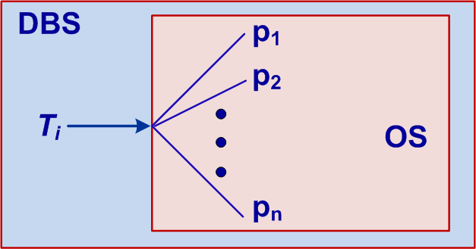
Messages
Transactions do not directly communicate with each other. T_{i} does not send or receive any message to T_{j}. However, communication exists between them through shared data items. The scheduler is responsible for this indirect communication. A T_{i} does not know if it is communicating with T_{j}.

Slide 9
Discussion
Question and Answer

Slide 10
Recoverability
System failure is an integral state of any system. We cannot eliminate a failure state, we can only recover the system from a failure. In our earlier discussion on history, we established that we need to generate a history that is serializable (consistency preserving). Under recoverability we discuss what schedule is recoverable and what is not. If a schedule is not recoverable then the system will not generate it. In other words the system component that is responsible for generating a schedule (scheduler) will never generate a schedule that is not recoverable. As we will see, we need both serializability and recoverability in a schedule for keeping the database consistent in transaction processing and in a failure.

Slide 11
Types of Failure
Transaction Failure
Incorrect data input, Involve in a deadlock, Forced abort by the operator, and some addressing error.
System Failure
Addressing error, Forced system shutdown, RAM failure, and programming error.
Media Failure
Disk crash.

Slide 12
Operations for Recovery
Transaction Failure: Roll-back
Roll-back failed transaction.
System Failure: Roll-back and Roll-forward
Active transactions are rolled-back and transactions that executed “ET” are rolled-forward.
Media Failure: Disk recovery
May involve disk replacement, re-execution of committed transactions, and some other recovery operations.

Slide 13
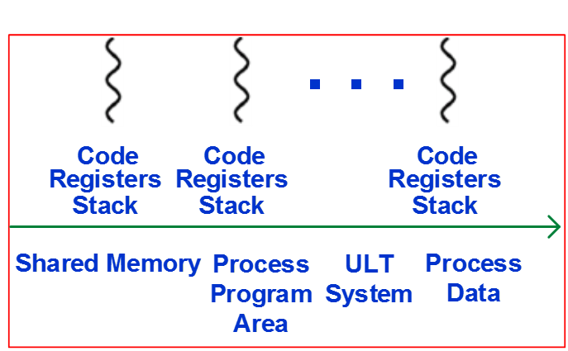
Current Transaction Processing Scenario
Use of ULT (user level thread library)
ULT library provides a clean approach to implement multithreading with a very small overhead. ULT system has different code and different execution for each thread and uses a single shared memory, as shown in the figure.
TP Monitor can implement multithreading and run TS in each thread that communicate with each other. The operating system is unaware of this setup and it executes TM Monitor process as any other process.

Slide 14
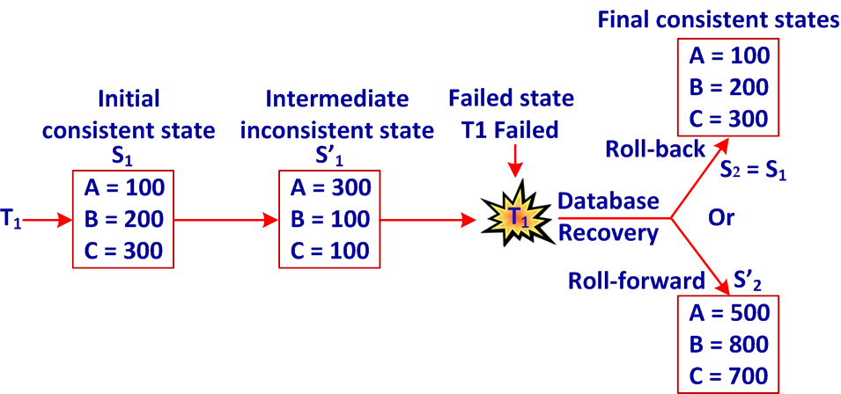
Recoverability
A transaction failure: The failed transaction has to be rolled-back. There could be cascade roll-back.

Slide 15
System Failure
State of transactions when system failed:
T1: Active so it must be rolled back
T2 and T3 : Executed ET so they will be rolled-forward
T4: Committed so it is durable. No action is required.

Slide 16
Recoverability
Consider the following schedule of T₁ and T₂
S_{1,2} = w₁[x, 2] r₂[x] w₂[y, 3].
T₂ reads from T₁ (recall reads-from relationship), so T₂ is dependent on T₁. w₂[y, 3] is not a function of r₂[x].
Consider the following scenario of S_{1,2}:
S’_{1,2} = w₁[x, 2] r₂[x] w₂[x, 3] c₂
Is S’_{1,2} recoverable?
No, because T₂ (a dependent of T₁) commits first. If T₁ fails then it will be rolled-back and T₂ must as well but it cannot be rolled-back and if we do to make database consistent, it will violate commit semantics.

Slide 17
Recoverability
Recoverability condition 1
If T_{j} reads from T_{i} (T_{j} is dependent on T_{i}) then T_{j} must commit after T_{i} has committed (recall that this is a RC history)
Consider the following scenario of S_{1,2}:
S’_{1,2} = w₁[x, 2] r₂[x] w₂[y, 3] a₂
Is S’_{1,2} recoverable?
Yes, because T₁ is not dependent on T₂ and the roll-back of T₂ does not dirty any data.
Recoverability condition 2
The roll-back of a dependent transaction does not generate a dirty data so the schedule is recoverable.

Slide 18
Recoverability
Testing your understanding
Consider the following scenario of schedules
S₁ = w₁[x, 2] r₂[x] w₂[y, 3] a₁ Recoverable?
S₂ = w₁[x, 2] r₂[x] w₂[y, 3] a₁ a₂ Recoverable?
S₃ = w₁[x, 2] r₂[x] w₂[y, 3] a₂ a₁ Recoverable?
S₄ = w₁[x, 2] r₂[x] w₂[y, 3] a₁ c₂ Recoverable?
S₅ = w₁[x, 2] r₂[x] w₂[y, 3] c₁ a₂ Recoverable?
S₂ = w₁[x, 2] r₂[x] w₂[y, 3] a₁ c₂ Recoverable?
S₂ = w₁[x, 2] r₂[x] w₂[y, 3] a₁ a₂ Recoverable?
S₂ = w₁[x, 2] r₂[x] w₂[y, 3] a₂ a₁ Recoverable?

Slide 19
Terminal I/O
Interactive transactions present dirty data problem in a different way. Suppose T₁ and T₂ are two transactions. The execution of T₁ and T₂ is a total order T₁ → T₂ (T₂ reads from T₁.) The commit semantics indicates that T₁ must commit before T₂ does. User starts T₁ first and the intermediate result of T₁ is input to T₂. T₂ commits and T₁ fails. T₂ has dirty data but cannot be rolled-back.
Solution: User should wait for T₁’s commit message from the system before using its output in T₂.

Slide 20
Avoiding Cascading Aborts
Avoiding Cascading Aborts
Must read from a committed transaction.

Slide 21
Strictness
Strictness
Must read and/or write from a committed transaction
w₁[x, 1] w₁[y, 3] w₂[y, 1] c₁ r₂[x] a₂
The final value of y in the database will be 3 after T₂ is rolled-back. This is a correct value. In this case the solution is to restore BFIMs of all writes.
Not always a correct solution.

Slide 22
Strictness
Consider the following schedule. Let BFIM (x) = 1
w₁[x, 2] w₂[x, 3] a₁
Roll-back of T₁ will set x = 1. If T₂ commits then database will remain consistent because T₂ does not read before it writes.
Now consider the following schedule
w₁[x, 2] w₂[x, 3] a₁ a₂
The BFIM of x after w₁[x, 2] is 2. Thus, a1 will set x = 1 and a₂ will set x = 2, an inconsistent state.

Slide 23
Strictness
To maintain strictness do the following:
Delay all r(x) of a transaction until all transaction that previously wrote into x had either committed or rolled-back (this is also required for avoiding cascade roll-backs)
Delay all w(x) of a transaction until all transaction that previously wrote into x had either committed or rolled-back

Slide 24
Strictness
Consider the following schedule
w₁[x, 2] w₂[x, 3] a₁
The final value of x in the database will be 3 (an intermediate result) after T₁ is rolled-back. This will be a correct value only if T₂ commits. But this cannot be guaranteed because T₂ is still active. If T₂ commits then we are safe. If it aborts then:
w₁[x, 2] w₂[x, 3] a₁ a₂
In this case the solution is to restore BFIMs of all writes.

Slide 25
Serializability
Consider the following scenario of S_{1,2}:
S’_{1,2} = w₁[x, 2] r₂[x] w₂[y, 3] a₂
Is S’_{1,2} serializable?
Yes, because all conflicting operations of T1 come before all conflicting operation of T2.
Is S’_{1,2} recoverable?
Yes, because T2 reads from T1 and rolls-back.

Slide 26
Serializability
Consider the following scenario of S_{1,2}:
S’_{1,2} = w₁[x, 2] r₂[x] w₂[y, 3] a₁
Is S’_{1,2} serializable?
Yes, because all conflicting operations of T1 come before all conflicting operation of T2.
Is S’_{1,2} recoverable?
No, because T2 reads from T1 but T1 rolls-back.

Slide 27
Summary
We formalized the concept of recoverability. A clear understanding of recoverability is required to develop recovery protocols. We will cover this topic later. It is important that you create all transaction processing scenarios (a finite number) and identify which schedule is recoverable and which one is not. If you clear about recoverability, you will identify them correctly.

Slide 28
Discussion
Question and Answer

