Slide 1
CS5570 Architecture of Database Management Systems
Vijay Kumar Computer Science Electrical Engineering University of Missouri-Kansas City Kansas City, MO, USA.

Slide 2
Database Recovery
Introduction to system and transaction failure
Recoverable schedules
Recovery protocols
Log management
Implementation
Media failure

Slide 3
DBMS Architecture

Slide 4
Transaction and System Failure
A transaction failure is a system failure on a smaller scale. There are some differences. A failure may occur because of addressing error, RAM failure, and operator error. A transaction abort should not be counted as a failure because it can be a solution to a deadlock event.
A failure requires some external interference to eliminate its effects before a normal processing can begin.

Slide 5
Transaction and System Failure
We revisit the following system components:
RAM: A volatile storage. Its contents are destroyed in a failure.
Stable database storage: Disks where the entire database is stored.
Stable log storage: Disks where system and transaction logs are stored.
Cache: A high speed set of registers where data modification takes place.

Slide 6
Transaction and System Failure
Since RAM and the cache are volatile, their contents cannot be trusted in a failure. This is the reason that the system has to go through a complex process of recovery. Thus, a recovery process must
Recover the database quickly to minimize the downtime
Must recover the last consistent or next consistent state of the database
Must manage the log correctly.

Slide 7
Transaction and System Failure
We define two additional operations
Abort: a transaction forward execution is stopped and marked it for roll-back
Roll-back: an aborted transaction is rolled-back
Roll-forward: an uncommitted transaction is committed.
Roll-back and Roll-forward are “idempotent” operations, that is, multiple roll-back or roll-forward of a transaction give the same result as one application of these operations.

Slide 8
Data Modification
System supports the following modes of data modification on disk
In-place update: BFIM is overwritten by its AFIM
Shadow: BFIM is not overwritten, AFIM is written at a completely new disk location
Immediate update: as soon as AFIM is created, it is written to disk. This can be an in-place update or shadow
Deferred update: the AFIM is written after some delay which can be for a variety of reasons. A deferred update can be in-place of shadow

Slide 9
Data Modification
System supports data buffering facility called cache. The following operations are supported on cache
Fetch: fetch the desired data item from disk and store it in the cache.
Shadow: BFIM is not overwritten, AFIM is written at a completely new disk location
Immediate update: as soon as AFIM is created, it is written to disk. This can be an in-place update or shadow
Deferred update: the AFIM is written after some delay which can be for a variety of reasons. A deferred update can be in-place of shadow

Slide 10
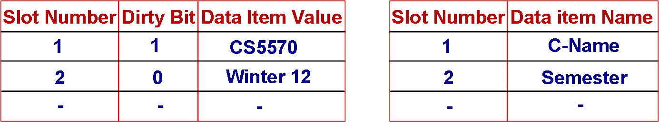
Data Access and Modification
System supports data buffering facility called cache. The following operations are supported on cache
Fetch: gets the desired data item from disk and store it in the cache.
Cache Cache Directory
Cache slots are allocated dynamically so the system uses some cache replacement algorithm.

Slide 11
Data Access and Modification
System supports data buffering facility called cache. The following operations are supported on cache
Shadow: BFIM is not overwritten, AFIM is written at a completely new disk location

Slide 12
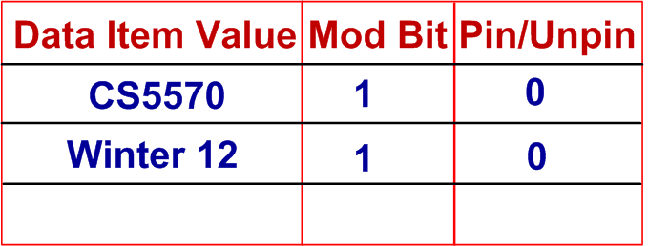
Data Access and Modification
System supports data buffering facility called cache. The following operations are supported on cache
Immediate update: as soon as AFIM is created, it is written to disk. This can be an in-place update or a shadow.

Slide 13
Data Access and Modification
System supports data buffering facility called cache. The following operations are supported on cache
Deferred update: the AFIM is written after some delay which can be for a variety of reasons. A deferred update can be in-place or shadow

Slide 14
Transaction (System) Log
Every operation of a transaction and of the system is recorded in a log. It is a sequential file and activity record is appended chronologically at the end of the log. Many parameter values are written in the log. A sample of a log with a few values are given below.

Slide 15
Physical Log and Logical Log
Physical Log
A log record stores operations and its result (BFIM and AFIM). As a result, no interpretation is required to discover the type of an operation and data item on which the operation was applied. During database recovery, the recovery manager can execute the log from the last record for transaction roll-back or roll-forward. The entire logging operation is called “Physical Logging.” Unfortunately, it uses a lot of space to store a transaction log.

Slide 16
Physical Log and Logical Log
Logical Log
A log record neither stores the operation on data item nor the BFIMs or AFIMs. A statement describing the operation and the state of data item is recorded. A logical log record may state “A tuple was inserted in a relation Employee and the indexes on Employee were modified accordingly.” This is called logical logging. A physical log record on the other hand will record BFIMs and AFIMs of the tuple and indexes of the relation Employee.
Significant amount of space is saved in logical logging and less amount of RAM is required for its processing but on the cost of record interpretation. The recovery manager must correctly interpret a logical log record during recovery. We will come back to logical logging later.

Slide 17
More data structure for Recovery
Active List or Table
It is a list of transactions that are active (not aborted and not committed). When a transaction is scheduled for execution, the transaction id is appended to this list.
Question: When does a transaction is appended to this list? Just before it is marked to be scheduled or after it becomes active?
Commit List or Table
It is a list of transactions that were active and not are committed. When an active transaction scheduled to commit it is moved from the active list to commit list.
Question: How is the transfer managed? Is the transaction ID first deleted from the active list and appended to this list?

Slide 18
More data structure for Recovery
Commit List or Table
It is a list of transactions that were active and may not be committed. When an active transaction scheduled to commit it is moved from the active list to commit list.
Question: How is the transfer managed?
Is the transaction ID first deleted from the active list and appended to commit list?
Is the ID from the active list deleted after it is safely inserted to the commit list?

Slide 19
More data structure for Recovery
Abort List or Table
It is a list of transactions that were active but then aborted for some reason. When an active transaction is selected to be aborted then it is moved from the active list to abort list.
Question: How the transfer is managed?
Is the transaction ID first deleted from the active list and appended to abort list?
Is the ID from the active list deleted after it is safely inserted to the abort list?

Slide 20
Undo Rule
Undo rule
To complete an undo of a transaction, BFIMs of its data items must be available. To make sure that they are available, the system must save them on a non-volatile store (disk) before AFIMs overwrite these BFIMs. This must be followed by every transactions at all stages of their execution. For this reason this is defined as a rule and implemented by the recovery manager.
Rule: If the BFIM (the last committed value) of a data item x is on the disk then it must be saved to a stable storage before it is written by its AFIM (uncommitted value).

Slide 21
How the Undo Rule is enforced
Undo rule; This rule is referred to as Write Ahead Logging (WAL) because of the following reason.

Slide 22
Redo Rule
Redo rule
To complete a redo of a transaction, AFIMs of its data items must be available. To make sure that they are available, the system must save them on a non-volatile store (disk) before the transaction processes commit. This rule must be followed by every transactions just before they are ready to commit. For this reason this is defined as a rule and implemented by the recovery manager.
Rule: The system must save all AFIMs of this transaction on disk before the commit for this transaction is processed.

Slide 23
Garbage Collection
Garbage Collection Rule
Since log continuously expands and the storage size is limited, unwanted portion of the log must be archived and log disk must be garbage collected.
Rule: The entry (T_{i}, x, v) can be removed from the log iff (1) T_{i} has aborted or (2) T_{i} has committed but some other committed transaction wrote into x after T_{i} did (hence v is not the last committed value of x).

Slide 24
RM Operations
The RM interface is defined by five procedures:
RM-Read(T_{i}, x): RM reads the value of x for T_{i};
RM-Write(T_{i}, x, v): RM writes v into x on for T_{i};
RM-Commit(T_{i}): RM commits T_{i};
RM-Abort(T_{i}): RM aborts T_{i}; and
Restart: RM brings the stable database to the committed state following a system failure.
These operations are executed atomically under the supervision of the scheduler. The scheduler uses a concurrency control mechanism to execute these operations concurrently.
We will assume that the system uses a physical log and a granularity that is used by I/O and the lock command.

Slide 25
The Undo/Redo Recovery Protocol
This protocol supports Undo to manage aborted transactions and Redo to manage completely executed (not committed) transactions. Thus, CM independently makes the decision to update the stable database. This helps to minimize I/O.
Undo: This operation is required if the system fails before the transaction commits. The undo operation is logged.
Redo: This operation is required if the system fails before the transaction commits but after it executes completely (after ET).

Slide 26
The Undo/Redo Algorithm
The algorithm executes the five operations as follows:
RM-Read (T_{i}, x). Here x is a data item whose value is read in the cache.
If x (BFIM) is not in the cache then fetch it. If there is no free cache slot then obtain one using cache replacement algorithm and WAL protocol. This may require a number of other operations to make sure that the write to the stable database is performed correctly.
(The value of x is in cache). Return the value of x to the scheduler. This value may be copied to the log in RAM.
End of a read operation. If a system failure occurs then cache and log records are discarded.

Slide 27
The Undo/Redo Algorithm
RM-Write (T_{i}, x, v)
Add T_{i} to the active list, if it’s not already there.
If x is not in the cache, fetch it. Note that the BFIM of x is stored in the cache and a AFIM (i.e., v) is generated there.
Append (T_{i}, x, v) to the log. This step copies its BFIM and AFIM (i.e., v) to the log.
Acknowledge the processing of RM-Write(T_{i}, x, v) to the scheduler.

Slide 28
The Undo/Redo Algorithm
RM-Commit (T_{i})
Add T_{i} to the commit list. Note that the commit list is a part of the log. So when T_{i} is added to the commit list, the RM flushes the log to the log disk that makes the updates of this transaction durable. If a system failure occurs before T_{i} is transferred the commit list, the transaction will be redone.
Acknowledge the commitment of T_{i} the scheduler. Locks of T_{i} are released by the scheduler in this step.
T_{i} is deleted from the active list.

Slide 29
The Undo/Redo Algorithm
RM-Abort (T_{i}). Note that this is a backward execution of T_{i} . The CPU does not know anything about roll-forward or roll-back.
BFIMs of all data items that T_{i} modified are restored in the database. It is done as follows:
load x (BFIM) in the cache. Set mod bit to 1 (indicates modified) and unpin bit to 0 (can be flushed to database). Continue this steps until all BFIMs of T_{i} have been flushed to database.
Add T_{i} to the abort list.
Acknowledge the abortion of T_{i} the scheduler. Locks of T_{i} are released by the scheduler in this step.
T_{i} is deleted from the active list.

Slide 30
The Undo/Redo Algorithm
Restart. After reboot the RM initiates restarts process (undone and redone).
Discard all cache slots. In a system failure RAM and cache are not trusted.
Let redone : = {} and undone : = {}
Start with the last entry in the log and scan backwards toward the beginning. Repeat the following steps until either redone ∪ undone equals the set of all data items in the database, or there are no more log entries to examine. For each log entry (T,, x, v), if x ∉ redone ∪ undone, then
if T_{i} is in the commit list, copy v (AFIM) to cache and set Mod bit = 1 and pin/unpin = 0. set redone : = redone ∪ {x}
otherwise if T_{i} is in the abort list or in the active but not the commit list then copy the BFIM of x to cache and set undone : = undone ∪ {x}.
For each T_{i} in the commit list, if T_{i} is in the active list, remove it from there and acknowledge the completion of Restart to the scheduler.

Slide 31
The Undo/Redo Algorithm
Class Discussion
Task 1: Show that Undo/Redo algorithm satisfies Undo rule.
Task 2: Show that Undo/Redo algorithm satisfies Redo rule.

Slide 32
Issues in a Database Restart
Database restart is a time consuming process. Important reasons are:
Backward scan of the entire log
The garbage collector may not have removed unwanted log records. As a result, a large number of such records are scanned by the restart
Database system cannot continue to process new transactions during recovery. As a result, the system is not available to users until the restart completes successfully. The system may fail during restart

Slide 33
Checkpointing
Transactions that are marked to be committed (they are in the commit list) do not need redo so their log records should not be scanned during restart. This can be achieved if we mark the log to identify that all transactions before this mark wrote their updates to the database. The backward scan of the log can safely stop at this mark.

Slide 34
Checkpointing
The process of marking the log with a special record is called “Checkpointing” and the record is called “Checkpoint (C).” In a checkpointing.
At the time of a checkpoint
Stop accepting any new transaction
Process commit, undo, and redo of existing transactions
Write a checkpoint record in the log (since commit and abort lists are parts of the log, they are marked in a checkpointing). This record clearly indicates to restart not to process log records before the “C”.

Slide 35
Minimizing Checkpointing Time
If checkpoint is taken frequently then we do not gain much. On the other hand if it taken less frequently (say, once a day or a week) then it increases the recovery time. There are three types of checkpointing:
Commit consistent checkpointing
Stop taking any new transaction
Commit, undo, and redo existing transaction
Flush all dirty cache slots.
Write checkpoint record in the log.
Too much work for the restart operation.

Slide 36
Minimizing Checkpointing Time
The second type of checkpointing tries to reduce user waiting time.
Cache consistent checkpointing
Continue to accept new transactions but force them to wait (blocked state).
Flush all dirty cache slots (must follow WAL protocol). Note that during this flush all active transactions are waiting.
Write checkpoint record in the log.
This scheme reduces wait time to some extent. All AFIMs (committed data) and BFIMs are in the database. The restore just has to take care of the active transactions that were waiting for the checkpoint to complete.

Slide 37
Minimizing Checkpointing Time
The third type of checkpointing tries to further reduce user waiting time and restore time.
Fuzzy checkpointing
Continue to accept new transactions but force them to wait (blocked state).
Flush all dirty cache slots (must follow WAL protocol) that have not been flushed since the last checkpoint.
Write checkpoint record in the log.

Slide 38
Minimizing Checkpointing Time
Class Discussion
Task: Compare the three checkpointing schemes.

Slide 39
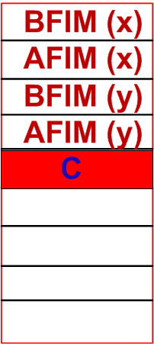
Minimizing Checkpointing Time
In physical logging, the entire lockable unit is written to the log. Thus, if a lockable unit size is 1K and a transaction changes only a byte of data then total space occupied in the log is BFIM (1K) + AFIM (1K) = 2K. In addition some space is required to add transaction id, data, time, etc. So for a single update, about 2.5K log space may be needed.

Slide 40
Minimizing Checkpointing Time
Partial Data Item Logging: It is not necessary to copy the entire the BFIM and AFIM to the log. Instead, if only modified portion of BFIM is logged then significant space can be saved. For this, we need a mechanism to find the modified portion of the data. This is done by using offset as follows:
Partial BFIM and AFIM and their offsets are recorded.

Slide 41
Minimizing Checkpointing Time
Buffering log records before saving log: It is expensive to flush log to log disk whenever a data item is modified and written to the database. Significant saving is done if a few log records are buffered in RAM and copied to log disk when the buffer is full. The buffering mechanism may jeopardize undo and redo rule if some care is not taken.

Slide 42
Minimizing Checkpointing Time
Taking care of Redo rule: The buffering may jeopardize Redo rule if a transaction commits before all its log records in the buffer are written to the log disk. This does not happen.
Reason: When a transaction is ready to commit, it is moved to commit list from active list. Recall commit list is a part of the log and when transaction is moved there, all its log records are flushed to the log disk before processing the commit. This satisfies redo rule.
Issue: This scheme writes log buffer records to log disk after every commit or when the buffer is full. It is possible that a partially full buffer is written to the disk. As a result, it may not offer any reduction in I/O cost. A better approach would be to use group commit.

Slide 43
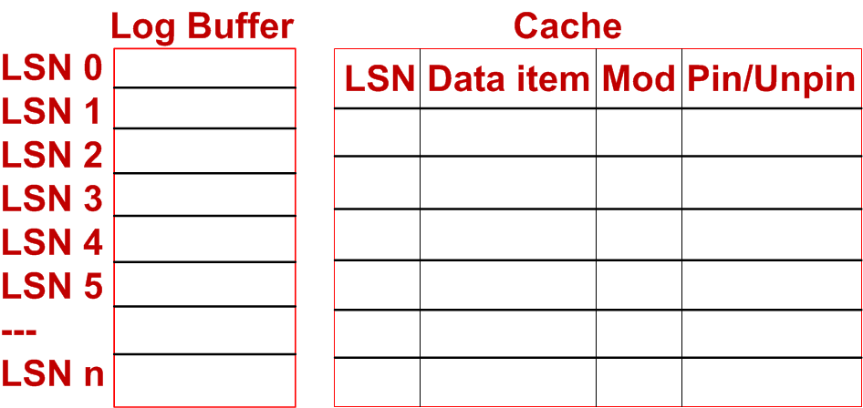
Minimizing Checkpointing Time
Taking care of Undo rule: The buffering may jeopardize Undo rule.
Reason: When a transaction writes its log records to the buffer, it assumes that its updates are safe in the log and it may update the database. This violates WAL protocol.
Solution: Identify each log entry with the address of the log record, i.e., Log Sequence Number (LSN).

Slide 44
Minimizing Checkpointing Time
Steps
Load BFIM of the data in cache and generate its AFIM (v)
Add (T_{i}, x, v) to the log
Get the LSN entry of (T_{i}, x, v) in the log and insert it in the LSN entry of the cache that has the same data item (AFIM).
Unpin (1 to 0) and make sure that all entries of this transaction are in the log with matching LSNs. Thus, it must make sure that for T_{i}, (4 w 1 0) and (2 v 1 0) are in the log with correct LSNs.
Flush cache slots of T_{i} under WAL. Undo is satisfied.

Slide 45
Minimizing Checkpointing Time
Class Task
Read and understand material of pages 187 through 195. You may be asked to explain your understanding in the class. This will be a topic of class discussion.

Slide 46
Undo/No-Redo Algorithm
This algorithm does not support Redo that means database recovery is performed only through Undo. Any transaction that is not committed is undone. At least one of the updates of a transaction is forced to the database before it commits.
Class Task
Read and understand the remaining three algorithms. We will organize a discussion session for these topics.

