Slide 1
CS5551 Advanced Software Engineering Observer Design Pattern
Team 7:
Sri Harsha Chennavajjala (7)
Teja Garidepally (12)
Raj Kiran Reddy Munnangi (32)
Suhas Sai Raparthi (51)

Slide 2
Need of Observer Pattern
When the change made by the object should be received by other objects.
Example:
In Stock market, individual stocks get updates from multiple stocks.
The publisher sends multiple stocks to the observers.
The observer chooses from them and use the data sent by the publisher for those particular stocks.

Slide 3
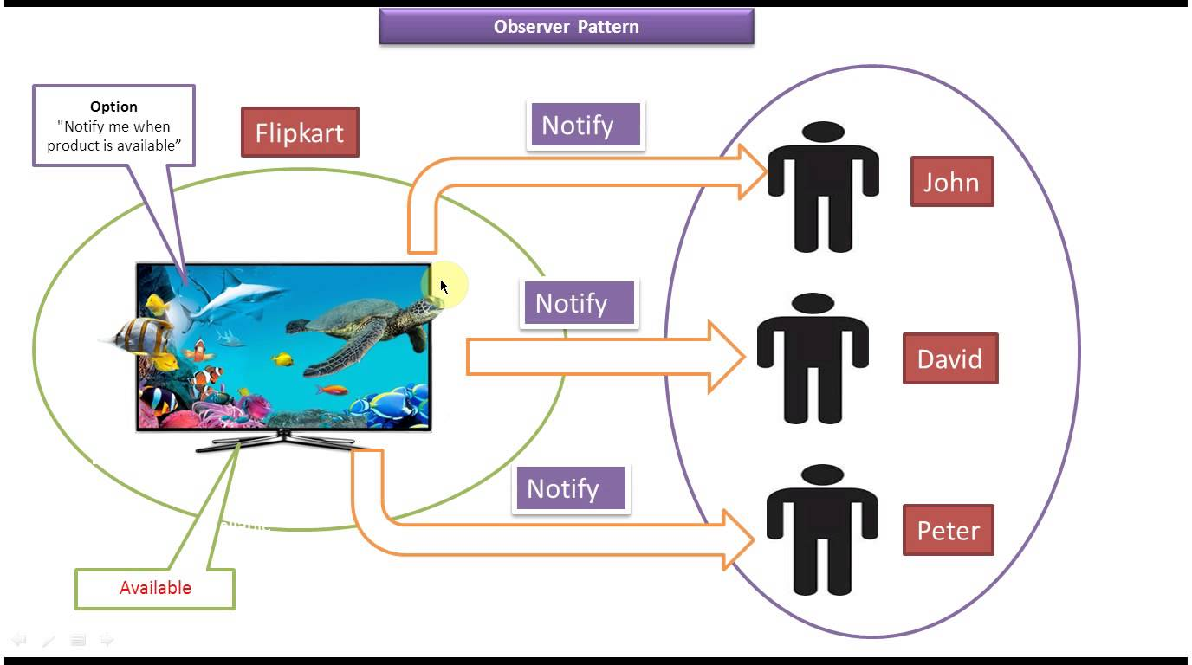
Observer
Observer pattern is used when there is one-to-many relationship between objects
If one object is modified, its dependent objects are to be notified automatically.
Observer pattern falls under behavioral pattern category.

Slide 4
Observer Design Pattern
Advantages:
Loose Coupling between the objects, observer and observable.
The subject has information about list of observers but not their implementation.
All the observers are notified by subject in a single event call as Broadcast communication.
Disadvantages:
Debugging becomes difficult as flow of control is implicitly between observers and observable.
Subject sends update information to observer which is of no use by observer.

Slide 5
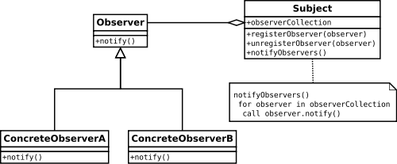
UML Diagram

Slide 6
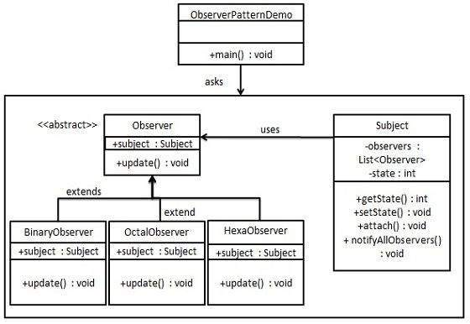
UML Diagram

Slide 7
Example
Subject.java
Observer.java
BinaryObserver.java
OctalObserver.java
HexaObserver.java
ObserverPatternDemo.java

Slide 8
Subject.java
import java.util.ArrayList;
import java.util.List;
public class Subject
{
private List<Observer> observers = new ArrayList<Observer>();
private int state;
public int getState()
{
return state;
}
public void setState(int state)
{
this.state = state; notifyAllObservers();
}
public void attach(Observer observer)
{
observers.add(observer);
}
public void notifyAllObservers()
{
For (Observer observer : observers) { observer.update();
}
}
}

Slide 9
Observer.java
public abstract class Observer
{
protected Subject subject;
public abstract void update();
}
public class HexaObserver extends Observer
{
public HexaObserver(Subject subject)
{
this.subject = subject; this.subject.attach(this);
}
@Override
public void update()
{
System.out.println( "Hex String: " + Integer.toHexString( subject.getState() ).toUpperCase() );
}
}
public class BinaryObserver extends Observer
{
public BinaryObserver(Subject subject){
this.subject = subject; this.subject.attach(this);
}
@Override public void update()
{
System.out.println( "Binary String: " + Integer.toBinaryString( subject.getState() ) );
}
}
public class OctalObserver extends Observer
{
public OctalObserver(Subject subject){
this.subject = subject; this.subject.attach(this);
}
@Override public void update() {
System.out.println( "Octal String: " + Integer.toOctalString( subject.getState() ) );
}
}

Slide 10
ObserverPatternDemo.java
public class ObserverPatternDemo
{
public static void main(String[] args)
{
Subject subject = new Subject();
new HexaObserver(subject);
new OctalObserver(subject);
new BinaryObserver(subject);
System.out.println("First state change: 15");
subject.setState(15);
System.out.println("Second state change: 10");
subject.setState(10);
}
}

Slide 11
References
Observer Pattern – Wiki - https://en.wikipedia.org/wiki/Observer_pattern
Understanding observer patterns - http://www.dummies.com/how-to/content/understanding-observer-patterns.html
Observer Design Pattern Tutorial - http://www.newthinktank.com/2012/08/observer-design-pattern-tutorial/
Observer design Pattern in Java with Real world code Example - http://javarevisited.blogspot.com/2011/12/observer-design-pattern-java-example.html

