Slide 1
The Community Source Approach to Software Development
and
the Kuali Experience
Appana,Sravan Kumar (03)
Chennavajjala,Sri Harsha (07)
Munnangi,Raj Kiran Reddy (32)

Slide 2
Software Development Approaches
Why should it be modified?
Old and needs to be updated.
Maintenance cost is too high.
Information exchange is not optimal.

Slide 3
Available Options
Revamp the Existing system: Increasing Platform complexity and maintenance.
Acquire and customize platform: High cost and Limited Flexibility.
Open Source Software Development (OSSD): Greater Flexibility and no control on development process.

Slide 4
Community Based Open Source
Hybrid development (Commercial software + OSSD)
Individual partners share resources to develop software solutions.
Challenges:
Diverse and conflicting requirements by partners.
Kuali Initiative: Community Source Project
A longitudinal case study methodology.

Slide 5
Data Collection
Project experience , problems encountered, solutions, general perceptions.
Interview time varied from 30-90 minutes.
Participants are senior executives, project managers, developers, IS staff members.

Slide 6
Data Collection (contd.,)
Three different periods of time:
Period-I (November 2008)
Questions on development issues from
Kuali projects, roles and their tasks.
Period-II (November 2011)
Kuali deployment issues.
Period-III (May and July 2012)
Questions on perceived trends and anticipated
future of community source effort.

Slide 7
Data Analysis
Three rounds of coding:
Open Coding: Patterns in respondent’s experiences,perceptions are divided into Concepts & categories.
Axial Coding: Interactions,project mechanisms,changes in Kuali experience.
Selective Coding: Core category and linking.
Open and axial coding after phase1 & phase2.
Third round of Data Collection involves axial and selective coding.
Each person work on different rounds of coding and results are shared among the team.

Slide 8
The Case of Kuali
What is Kuali?
Kuali - a comprehensive administrative software suite
Started in 2004 as a partnership between Indiana University and National Association of College and University Business Officers (NACUBO) with support from Andrew W. Mellon Foundation.

Slide 9
The Case of Kuali (contd.,)
What is Kuali’s Goal?
Replacing the existing outdated and too difficult to maintain system with the cost-effective, sustainable and flexible software system.
Why a big “No” to commercial softwares?
Because commercial softwares are costly and inflexible to the institutions requirements.

Slide 10
The Case of Kuali (contd.,)
Fresher’s party
University of Arizona, Cornell University, the University of Hawaii, and Michigan State University

Slide 11
Kuali Architecture

Slide 12
Experience of Colorado State University
In 2006, CSU needed an integrated system for financial management.
Commercial enterprise system cost - $5 million to $7 million.
Also doesn’t have the institution required functionalities.
So, in 2007, CSU decided to join Kuali community with less than 20% of the price of cheapest commercial enterprise system as joining fee.
They implemented the system in 2009 with less than $2 million as an investment.

Slide 13
Kuali motivations
Wait-and-deploy is not encouraged.
Kuali is similar to OSSD in terms of open source code, openness to multiple approaches.
Other institutions can deploy the Kuali tools, but they are not allowed to participate in the community activities.

Slide 14
Kuali motivations (contd.,)
Cost reduction
Independence
System customization
Developer training
Community involvement

Slide 15
Parallels with Commercial Development
Developers will work on specific design requirements, not on whatever elements they wish.
Kuali involve an institutional-control element.
Institutional control integrates new developers and manages the projects in a coordinated way.

Slide 16
Mechanisms of Control
The three primary mechanisms of control
Markets: Exchange of commodities between two or more parties in which transactions are mediated by a price mechanism.
Bureaucracies: Imply creation of a corporate structure by directing the developers.
Clans: The goals of individuals are aligned through socialization into a system of shared beliefs and values.

Slide 17
Mechanisms of Control (Contd..)
Community source development is controlled by combination of bureaucracies and clans.
Projects managed in an integrated fashion and tasks directed through a formal chain of relationships shows bureaucracies control mechanism.
Community source development is evolved based on the shared values and sustained commitment among participating individuals and organisation which shows clan control mechanism.

Slide 18
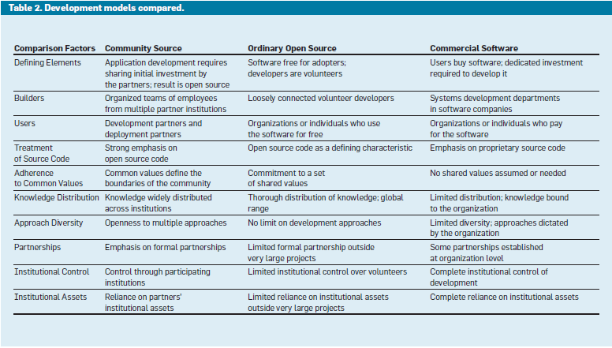
Mechanisms of Control (Contd..)

Slide 19
Strengths and Challenges
Strengths
reduction in costs.
solutions tailored to needs through development of functionality
Challenges
limited access to development talent.
managing levels of institutional commitment.
Management of growth is the salient challenge in the Kuali process.

Slide 20
Future Work
Community source development taking root in industries other than higher education.
Community evolution and modular design are emerging as central themes.
Exploring ways community source projects can employ the principles of modularity to achieve sustainability and a predictable evolutionary products

Slide 21
Thank You !!!

