Slide 1

Specification and Description Language (SDL)
Sri Harsha Chennavajjala
Teja Garidepally
Karthik Reddy Vundela
Raj Kiran Reddy Munnangi

Slide 2
SDL - Introduction
More and more systems are real-time, distributed and operates in heterogeneous environments.
As telecommunication grows internationally, equipment from different manufacturers must be able to communicate with each other.
Developed by ITU-T
In 1972, the development of SDL started. First version was released in 1976
Targeted for real-time and distributed systems
SDL is originally focused on telecommunication systems
Two types of system representation
Graphical Representation (GR)
Phrase Representation (PR)

Slide 3
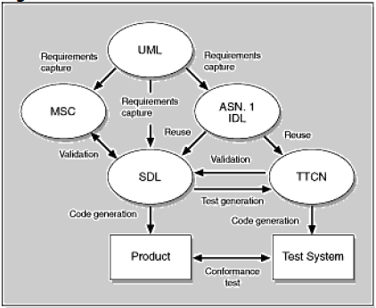
SDL and Other Languages
SDL has the ability to communicate with other languages like Mobile Switching Center, Abstract Syntax Notation One (ASN.1), Interface Description language (IDL), Tree and Tabular Combined Notation (TTCN)

Slide 4
Why SDL?
It's the nonproprietary internationally standardized language
It is graphical and symbol based - easy to understand
It is OO language - supports encapsulation, polymorphism

Slide 5
SDL Components
Structure - system, block, process, procedure hierarchy
Communication – signals
Behavior – Processes
Data - abstract data types
Inheritance - describing relations and specialization

Slide 6
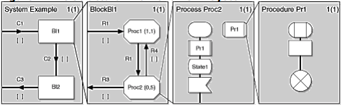
SDL System Structure

Slide 7
SDL System Structure (contd..,)
SDL comprises four main hierarchical levels:
System
Block
Process
Procedures
Dividing a system in to system, block and process hierarchy is called partitioning of a system. Below are objectives of partitioning:
Hiding information
Following natural functional subdivisions
Creating modules of intellectually manageable sizes
Creating correspondence with actual software or hardware
Reusing already-existing specifications

Slide 8
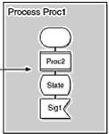
Behavior
The dynamic behavior of system is described in the processes. Processes in SDL can be created at system start or created and terminated at runtime.
More than one instance of a process can exist. Each instance has a unique process identifier(pid).
This makes it possible to send signals to individual instances of a process.
The concept of process and process instances
that work autonomously and concurrently makes
SDL a true real-time language.

Slide 9
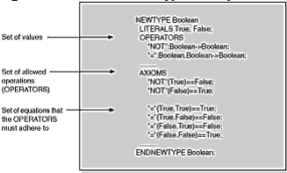
Data
SDL accepts two ways of describing data, abstract data type(ADT) and Abstract syntax notation(ASN1).
The integration of ASN.1 enables sharing of data between languages ,as well as the reuse of existing data structures.
The ADT concept used within SDL is very well suited to a specification language. An abstract data type is a data type with no specified data structure.
Instead, it specifies a set of values,
a set of operations allowed, and a set
of equations that operations must fulfill.

Slide 10
Inheritance
The OO concepts of SDL give the user powerful tools for structuring and reuse. The concept is based on type declarations.
Type declarations can be placed anywhere, either inside the system close to their context , or at system level.
One of major benefits of using an object-oriented language is the simple and intuitive way new objects can be created by adding new properties to existing objects or by redefining properties of existing objects.

Slide 11
SDL Implementation
The basic model of a SDL specification is to communicate extended state machines.
In order to understand SDL the following concepts are to be explained :
Structural Concepts
Dynamic Behavioral Concepts
Data Concepts

Slide 12
Structural Concepts
Structural Concepts contains BLOCKS and CHANNELS
They form functional entities of the system to be composed and deals with communication between these entities.
SDL has the ability to describe the following structures of a specification:
Static Structure
Dynamic Structure

Slide 13
Static and Dynamic Structure
Static structure is defined in terms of blocks and channels.
A block is a module with well-known black box model.
Dynamic Structure is defined in terms of process and signal route concepts.
A process is an independent device that reacts to stimuli in the form of signals

Slide 14
Channel
A channel is a carrier of two or more signals.
It may be unidirectional or bidirectional.
In the following figure , traffic is structured into two blocks.
traffic_control_centre
local_control
Communication between these two blocks is done through tcc_lc channel.

Slide 15
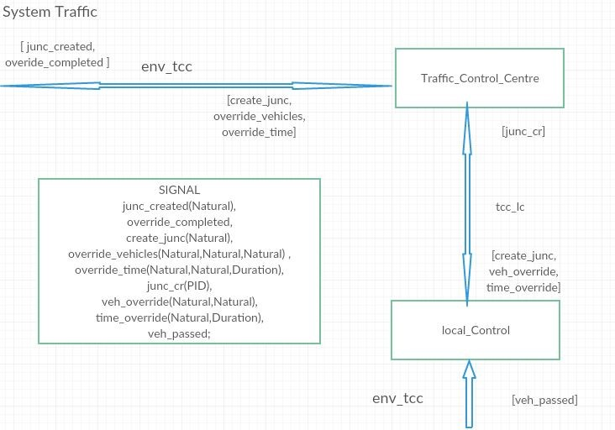
Channel (contd..,)

Slide 16
Block, Signal and Process
A system can be further structured with BLOCK diagrams.
SIGNAL carries information as parameters.
PROCESSES can be created either at the start of system invocation or dynamically by another process within the same block which is shown in the next diagram.

Slide 17
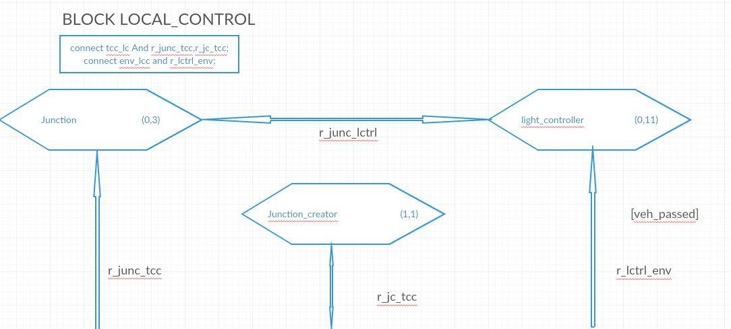
Block, Signal and Process(contd..,)
process “junction” dynamically creates process “light_controller”.

Slide 18
Dynamic Concepts
Process graphs describe the dynamic behavior of a system.
In a process graph, start node indicates the point at which interpretation of process begins.
Process has the ability to do :
receive signals
preserve signals for process in a later state
call procedures
create other processes
show the variable of another process
export its own variables
import the variable of other process
make decisions on data
change and set timers

Slide 19
DATA TYPES
In SDL system data can be defined anywhere within a text symbol.
Data types
a) Pre-defined
b) User-defined
Pre-defined data types
Boolean
Character
Integer
Real
User defined data types
Example: Array instantiation
newtype A1 Array(Character, Integer)
endnewtype;

Slide 20
Advantages
More Secure Software: SDL helps to build more secure software by reducing the severity of vulnerabilities in code through encapsulation.
Compatibility with other languages: SDL has the ability to communicate with other languages because it follows object oriented terminology.
Reduce Costs: SDL ensures that vulnerabilities are found and ﬁxed prior to application deployment and thereby reducing the total cost of software development.

Slide 21
Disadvantages
Integration: Increased difficulty of integrating the SDL with other components of the system.
Weak Knowledge repository: Proper documentation is not available for understanding SDL.
Inefficient usage of resources: SDL doesn't utilize the maximum performance of the processor.

Slide 22
Tools using SDL
Rational SDL Suite – tool for SDL generation.
SDL-RT( Specification and Descriptive Language-Real Time): A tool for graphical representations of traditional concepts.
Sandrila SDL - Add-in for Microsoft Visio for SDL, UML generation.

Slide 23
References
Specification and Description Language - https://en.wikipedia.org/wiki/Specification_and_Description_Language
ITU – T - https://en.wikipedia.org/wiki/ITU-T
SDL Overview - http://www.sdl-forum.org/SDL/Overview_of_SDL.pdf
Data types in SDL - http://www.cse.msu.edu/rgroups/sens/Software/Telelogic-3.5/locale/english/help/htmlhlp/datatypes.html#871848

Slide 24
UML
Requirements capture
Requirements capture
MSC
Requirements capture
ASN.1
IDL
Reuse
Reuse
Validation
SDL
Validation
TTCN
Test generation
Code generation
Code generation
Product
Test System
Conformance test
Fig: The Relations between Different Languages and SDL

Slide 25
Thank You!!!

