Slide 1
GENI
By
Helen Gebre-Amlak

Slide 2
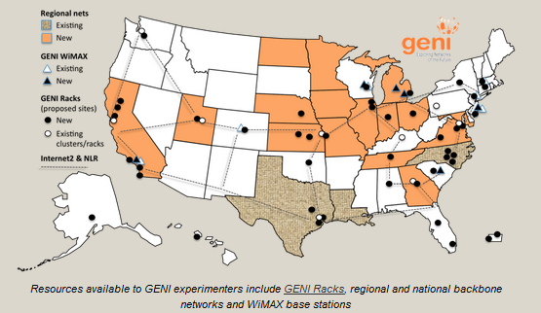
What is GENI?
Global Environment for Network Innovation,
Provides virtual laboratory for networking and distributed systems research and education

Slide 3
Why should I use GENI?
Large-scale experiment infrastructure
Non-IP connectivity across resources
Deep programmability
Reproducibility
Instrumentation and measurement tools

Slide 4
GENI Terminology

Slide 5
project
slice
experimenter
resource
aggregate

Slide 6
An experimenter
is a researcher who uses GENI resources
Different types of experimenters have different roles and permissions:
Advisor vs Grad Student
Teacher vs TA vs Student
Experimenter

Slide 7

Creating an Account
GENI Portal is at:
https://portal.geni.net

Slide 8


GENI User Authentication
The GENI Portal leverages InCommon for single sign-on authentication
Students from 518 educational and research institutions have InCommon accounts
For many experimenters:
no new passwords
familiar login screens
GENI Project Office runs a federated IdP to provide accounts for non-federated organizations.

Slide 9
Projects organize research in GENI
Project
Slice
Lead
Members
Projects contain both people and their experiments
A project is led by a single responsible individual:
the project lead

Slide 10


A slice is a container of resources used in an experiment.
A slice can contain resources from one or more aggregates
A slice is in a single project
A slice has an expiration
Slice names are public, reusable and unique (within a project)

Slide 11
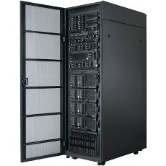
A resource
is a piece of infrastructure
A resource can be real or virtual.
Resource specifications (aka. RSpecs) are used to describe and request resources.
Examples:
Compute: computer vs virtual machine (VM)
Wireline Network: VLAN or OpenFlow
Wireless: WiMAX

Slide 12
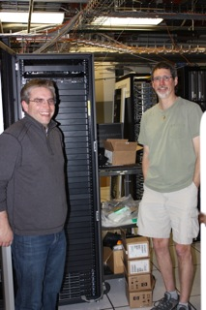
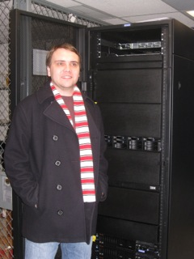


InstaGENI Rack
ExoGENI Rack
An aggregate manages a set of reservable resources
Aggregates include:
GENI racks
OpenFlow
WiMAX

Slide 13

project
Lead:
Member:
Experimenter
(aka Professor)
Experimenter
(aka Student)
slice
aggregate
resource
resource
Layer 2

Slide 14


How SSH With a Private Key Works
Sponsored by the National Science Foundation
www.geni.net

Slide 15
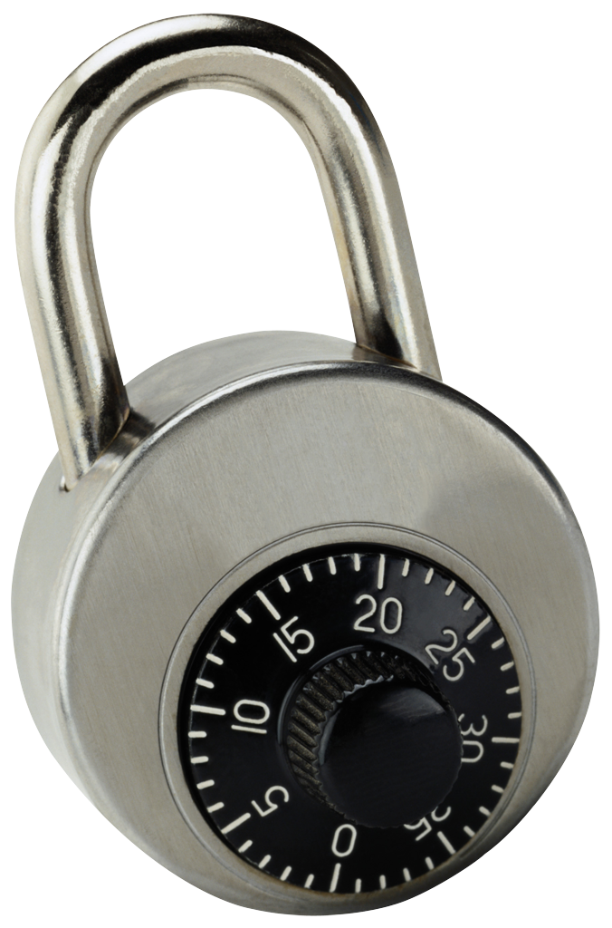
SSH with a password
*nix-based system (Windows behavior may vary)
local> ssh jdoe@remote.edu
jdoe@remote.edu’s password:
########
Welcome to remote!
jdoe@remote> exit
local> ssh jdoe@remote2.edu
jdoe@remote2.edu’s password:
########
ssh
User enters password
once for
each connection to each machine
Hash of password stored on each remote machine
Sponsored by the National Science Foundation
www.geni.net

Slide 16

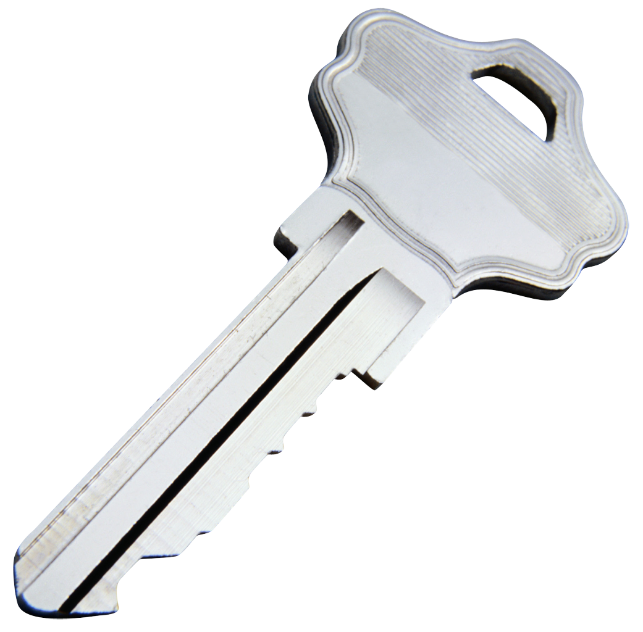
SSH with a private key
*nix-based system (Windows behavior may vary)
local> ssh-add ~/.ssh/id_rsa
Enter passphrase for ~/.ssh/id_rsa:
########
local> ssh jdoe@remote.edu
Welcome to remote!
jdoe@remote> exit
local> ssh jdoe@remote2.edu
Welcome to remote2!
jdoe@remote2> exit
local> ssh jdoe@remote3.edu
Welcome to remote3!
jdoe@remote3> exit
local> ssh-add –D
ssh
User enters passphrase to unlock private key for all connections
to all machines
Private key is stored only on local machine
Public key is stored on each remote machine
Sponsored by the National Science Foundation
www.geni.net

Slide 17
SSH with a private key
*nix-based system (Windows behavior may vary)
local> ssh-add ~/.ssh/id_rsa
Enter passphrase for ~/.ssh/id_rsa:
########
local> ssh jdoe@remote.edu
Welcome to remote!
jdoe@remote> exit
local> ssh jdoe@remote2.edu
Welcome to remote2!
jdoe@remote2> exit
local> ssh jdoe@remote3.edu
Welcome to remote3!
jdoe@remote3> exit
local> ssh-add –D
✔
ssh
User enters passphrase to unlock private key for all connections
to all machines
Private key is stored only on local machine
Public key is stored on each remote machine
Sponsored by the National Science Foundation
www.geni.net

Slide 18

SSH with a private key is both easier to use and more secure
Sponsored by the National Science Foundation
www.geni.net

Slide 19

You should never be prompted for a password to log into a GENI compute node.
If you are, something has always gone wrong.
Sponsored by the National Science Foundation
www.geni.net

Slide 20
GENI Expiration and Renewal
Notes:
GENI resources are provided for free on a first-come-first-serve basis. GENI uses expiration times to ensure resources are returned to the pool of available resources for use by other experimenters. To prevent reserved resources from returning to the pool, an experimenter must renew their resources before they expire.

Slide 21
project
slice
resource
resource
resource
(optional)
project
expiration time
resource
expiration time
slice
expiration time
now
slice expiration time ≤ project expiration time
each resource expiration time ≤ slice expiration time
each resource expiration time ≤ aggregate’s max expiration
To extend the lifetime of your resource reservation, you must renew the slice and all resources
Notes:
| Resources have an expiration that is | bound by an individual aggregate’s limit. | In addition, resources are reserved within a slice and the resource reservation’s expiration time | can not be any later than the slice’s expiration time.
Moreover, different resources within the same slice may have distinct expiration times.
| In turn, the slice’s expiration time | can not be any later than the project’s expiration time (if it has one).
| So in general, to renew your reservation, you must renew (or extend the expiration time) of both the resource reservation and the slice containing those resources.

Slide 22
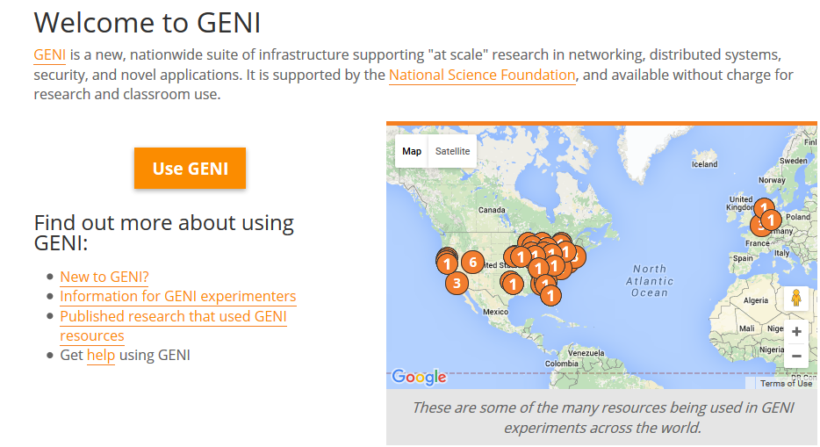
Login with UMKC ID
Notes:
GENI resources are provided for free on a first-come-first-serve basis. GENI uses expiration times to ensure resources are returned to the pool of available resources for use by other experimenters. To prevent reserved resources from returning to the pool, an experimenter must renew their resources before they expire.

Slide 23
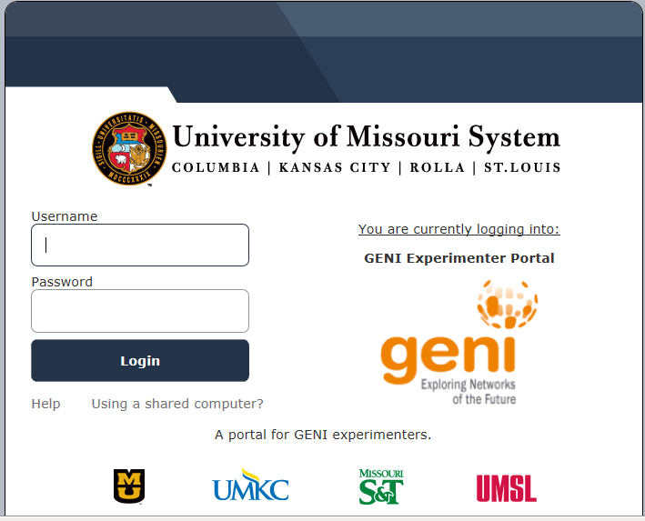
ID & PW

Slide 24
Questions?

