Slide 1
Advanced Computer Networking
SANTHOSH KUMAR VIDALA - 700639887
BOGGULA SAIPRASANNA REDDY - 700641020
KISHORE VALLAPUNENI - 700639379

Slide 2
ABSTRACT
Instant Messaging with Client - Server Architecture.
Broadcasting messages using single Server between Multiple Users

Slide 3
INTRODUCTION
Client Server Architecture:
A Network Architecture in which each process in the network is either a client or Server.
Client Makes Request whereas Server Process the Client Request.

Slide 4
IMPLEMENTATION
In this application we use two classes
ConfServer
ConfUser
We also used “ Whisper Mode” which is used for one to one messaging

Slide 5
Concepts
Multi Threading
Socket connection
I/O Stream
Buffer Reader

Slide 6
Port number is provided default in ConfServer
Can also provide new port number while executing the server program
The number of users are restricted

Slide 7
Challenges
Need to use the keyword “Whisper” every time we try to make a one to one messaging
Couldn’t establish peer to peer architecture as required

Slide 8
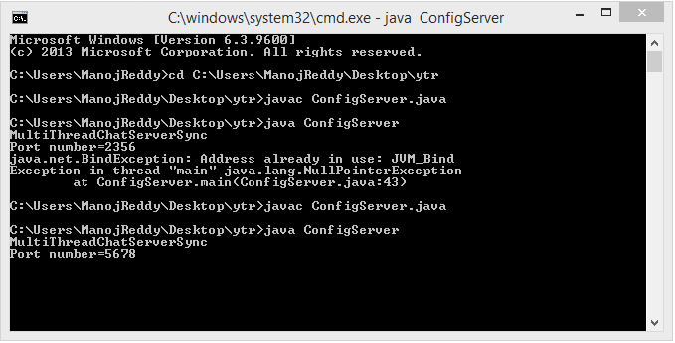
ConfigServer…

Slide 9
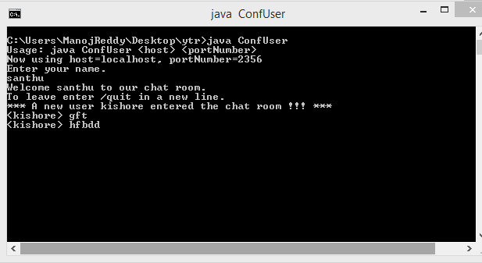
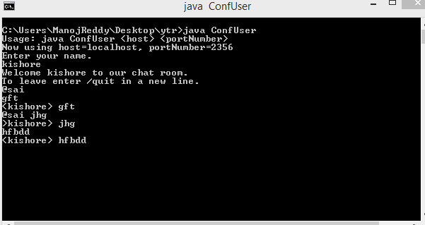

Slide 10
