Slide 1
CSEE 5110: Network Architecture I
Welcome to

Slide 2
About Myself
Baek-Young Choi, PhD
Associate professor
Office: FH 550D
Phone: 816-235-2750
Email: choiby@umkc.edu
URL: www.csee.umkc.edu/~choiby
Office hours: T/Th
11:15-noon or by appointment

Slide 3
Graduate Teaching Assistant
Helen Haymanot Gebre-Amlak, PhD student
Office: FH 453
Phone: 816-235-5339
Email: hhgc77@mail.umkc.edu,
Office hours: W
11:00am-1:00 pm or by appointment

Slide 4
Course Description
First Networking Course for Graduate-Level
You’ll …
Learn fundamental principles and concepts in computer networks
Understand how Internet works
Gain hands-on experiences (via projects, assignments)
Focus on network software architecture and mechanisms
Notes:
General purpose computer networks
Not specialized networks (e.g., telephone or cable)
Fundamental principles
Not survey of existing protocol standards
Focus on network software architecture
Only discuss some relevant network hardware
Designing and building network systems
Not queuing theory
Now something about the contents of this course. This course is about general purpose computer networks not specialized networks such as telephone networks or cable networks. Though we can connect to the internet using telephone lines and cable modems, we will be focusing on data networks.
Computer networking is very complex area. There so many technologies, protocols and abbreviations. In this course, we will be stressing more on fundamental concepts rather than details of existing protocol standards.
Also our focus is on the software architecture and not on hardware. Particularly for us the specifics physical media are not very important. We are interested only their logical characteristics such as bandwidth, loss rate etc
Finally we discuss how different components of the network system work together and how to design and build such a system. Though queuing theory is very central to any service system such as a network, there are other courses that deal with this subject

Slide 5
Course Objectives
Understanding of:
the Internet architecture, layering
protocol design principles particularly TCP/IP
naming and routing related issues
Particularly, be able to apply your understanding for
analyzing network protocols for tradeoffs
designing and/or implementing an protocol for a given set of constraints

Slide 6
Course Prerequisites
CS 243, CS 420 or CS 421, CS 431.
Programming, Algorithms, Computer Architecture, OS
Basic knowledge of probability
Programming experiences (in C/C++/Java)
Required!
More importantly
Willing to learn and work hard
Love to ask questions and solve problems

Slide 7
Course Materials
Required Textbook:
“Computer Networks: A Systems Approach,” Larry L. Peterson and Bruce S. Davie, Morgan Kaufman, 5th edition, 2011.
Other Useful Textbooks:
Computer Networking: A Top-Down Approach by Kurose & Ross, 6th Edition, Addison Wesley
“Computer Networks,” Andrew S. Tanenbaum, David Wetherall, Prentice Hall, 5th Edition, 2011.
Class Notes, Other assigned readings

Slide 8
Course Requirements
Do assigned readings
Be prepared, read articles/lecture notes before class
Attend and participate in class activities
Please ask and answer questions in (and out of) class!
Let’s try to make the class interactive and fun!
Workload/Weights
Three Exams (60%)
Final Exam: Thursday, May 12, 10:30 a.m.-12:30 p.m.
Two programming projects (20%)
Four or five homework assignments, pop quizzes, attendance/participation/professionalism (20%)

Slide 9
Grade scale
Total point is 100 and an approximate grading range is as follows:
A: 92 - 100.
A-: 88 - 91.
B+: 84 - 87.
B: 71 - 83.
B-: 65 – 70
C: 60 - 64.
D: 50 - 59.
F: <50

Slide 10
Grading Policy
No late assignment/project
Please start working on your hw assignments/projects early and hand them in on time!
Cheat policy
Absolutely no cheating!!!!!
0 score, report to dept/univ.
‘I’ncomplete grade: not granted, unless
proof of emergency, “agreement for incomplete” form

Slide 11
Scholastic behavior: Guidelines
You are encouraged to study in groups, but do your work independently!
Acknowledge reference/credit if applied!
University’s code of conduct enforced!
Generally, use honor system
Use common sense
Ask for clarification

Slide 12
On Plagiarism
Plagiarism is the *ultimate academic crime*
do not underestimate the *shame* of this act
it ends student careers and destroys academics
Plagiarism is...
cheating, lying, stealing, dishonor
J. Sterbenz

Slide 13
Class Webpage
http://blackboard.umkc.edu
Contents
Syllabus
Lecture Notes
Posted on website at least a day before the class
Announcements
Check the web page periodically!
Reference links
Tentative schedule
Submissions: Both Electronic (Bb) and paper submissions
Notes:
Please take a note of the class website. All the class information is available on this web site. We will be posting Week notes on the web at least a day before the class. We plan to minimize the amount of material handed out in the class. So please check the web site and print the relevant material before coming to the class.
Also there is an announcements section where we will post all the notices. Things like availability of new material on the site. Please check the web page periodically.

Slide 14
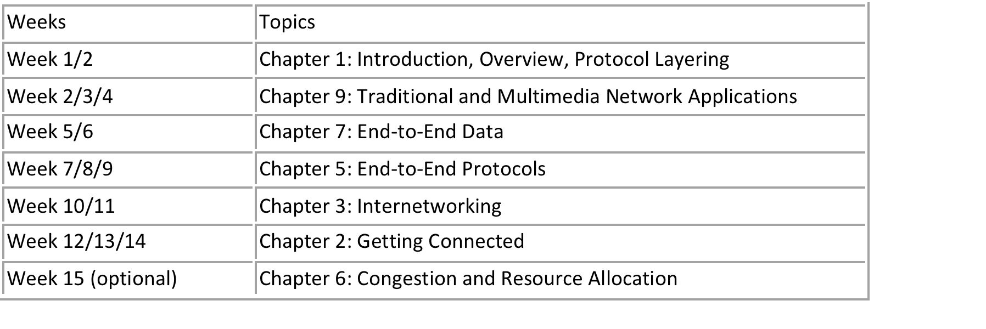
Tentative Schedule, Course Overview

Slide 15
Tips for Doing Well
Realize what is involved
Stay current
Ask questions/Get feedback
Use different learning strategies
Know what to expect from exams
Persist

Slide 16
Meanings of Attendance, Participation, Professionalism
Attendance
Being in class
On time
Regular
Mental attendance/alert
Participation
Interactive
Being active
Presence of mind
Take part of class
Ask question
Responsive
Know what’s going on from outside and bring those in class
Professionalism
Turn off cell phone
Sincere attitude
Respectful
Following protocols
Help others
Don’t interrupt others

Slide 17
Inappropriate Student Comments/Actions
(After cheating) “I didn’t know it is a serious issue. I am from a different culture.”
“I am from EE background. Therefore I can’t do programming projects.”
“I had a friend from other country/state (not from other classmates) to do programming projects.”
“I didn’t do well in the exam, because I had other exam(s) to prepare. Can I do some extra work or have another exam to make up my scores?”
“I worked really hard for this course. A better grade will help and encourage me to be successful…”
“I got an excellent job offer, but it is contingent on GPA. Please help me for this once-in-a-lifetime opportunity.”
“I want to redo the course work to improve my grade. Please give me ‘incomplete’ grade, and allow me to take it again next time.”

Slide 18
Questions?

Slide 19
Connecting Computers Together
Full mesh
No. of links? ports?
n(n-1)/2, n(n-1)
Economical way?

Slide 20
This course is about
Fundamental issues in computer networking
Fundamental problems in computer networking
What to do in response to the problems

Slide 21
Fundamental Issues in Networking
Routing/Forwarding
Finding out neighbors, building routing tables, determining where to send towards the destination
Naming/Addressing
Identifying/finding name/address of the party (or parties) you would like to communicate with
0001
A
0110
0101
B
E
0011
0111
0111
0100
C
D
1100
1101
Dst | port
Notes:
The purpose of a network is to enable communication between end hosts. It has to resolve two fundamental issues. How to find the address of the party we would like to communicate with and how to reach there.
In networks, address is a byte string that identifies the node. Different types of addresses possible, unicast, broadcast, multicast. Unicast address is specific to a node. When you want to communicate with a particular node, you use its unicast address. By using a broadcast address, we can communicate with all the nodes in the network. You may use broadcast address to find out whether there exists any server in the network that provides a specific service. Multicast address is used to communicate with a specific subset of nodes in the network.
Routing is the process of deciding where to send the packets such that they reach the destination. The destination address should provide enough information on how to reach the destination. It’s the job of a router to find out its neighbors and build routing tables such that it can forward a packet in the direction of the destination. Later in the course we will be looking at how different routing protocols and algorithms are used to perform this task.

Slide 22
Fundamental Problems in Networking
What can go wrong?
Bit-level errors: due to electrical interferences
Packet-level errors: packet loss due to congestion /buffer overflow
Out of order delivery: packets may takes different paths
Link/node failures: cable is cut or system crash
Others: e.g., malicious attacks
Notes:
What are the fundamental problems in networking. There are many things that can go wrong.
Due to noise and interference, it is possible that a bit transmitted as 0 is interpreted as 1 at the receiver. As we discussed earlier, in packet switching it is possible that buffers at a congested link may overflow. This results in packet loss. We will see later that it is not necessary that all the packets to a destination follow the same path. Each packet is routed in isolation and so it possible that two packets take two different paths, experience different delays and reach the destination out of order. How do we deal with link and node failures. The cable may get cut. This is not as unusual as it seems. The systems may crash.
So what can be done. Lets look some potential solutions. One way to deal with bit level errors is to add redundancy in the packet so that we can detect such bit errors and discard the packet. Or we can add enough redundancy such that we know how to correct/repair the error. We can use selective retransmission with timeout to recover the lost packets. If each packet received is acknowledged, sender can retransmit a packet if the acknowledgement doesn’t reach within the timeout period. To deal with out of order delivery, we can assign each packet a sequence number and buffer the packets reached out of order at the receiver and reorder them at the receiver. A router can send are you alive packets to its neighbors periodically to confirm that the link and the node are up. If it doesn’t get a response, it can declare them down and reset the routing tables such that failed links and nodes are avoided.
These are not the only problems. This is just a small representative list of problems. The basic goal of networking software is to fill the gap between expectations of applications and the capabilities of the underlying technology. For example, if applications expect a reliable transmission and underlying channel is noisy, it’s the job of networking software to add error correction bits or error detection bits with retransmission. The networking software that addresses these problems is generally designed in a modular way to make the complexity manageable.

Slide 23
What To Do with the Problems in Networking
What can be done?
Add redundancy to detect and correct erroneous packets
Acknowledge received packets and retransmit lost packets
Assign sequence numbers and reorder packets at the receiver
Sense link/node failures and route around failed links/nodes
Goal: to fill the gap between what applications expect and what underlying technology provides
Notes:
What are the fundamental problems in networking. There are many things that can go wrong.
Due to noise and interference, it is possible that a bit transmitted as 0 is interpreted as 1 at the receiver. As we discussed earlier, in packet switching it is possible that buffers at a congested link may overflow. This results in packet loss. We will see later that it is not necessary that all the packets to a destination follow the same path. Each packet is routed in isolation and so it possible that two packets take two different paths, experience different delays and reach the destination out of order. How do we deal with link and node failures. The cable may get cut. This is not as unusual as it seems. The systems may crash.
So what can be done. Lets look some potential solutions. One way to deal with bit level errors is to add redundancy in the packet so that we can detect such bit errors and discard the packet. Or we can add enough redundancy such that we know how to correct/repair the error. We can use selective retransmission with timeout to recover the lost packets. If each packet received is acknowledged, sender can retransmit a packet if the acknowledgement doesn’t reach within the timeout period. To deal with out of order delivery, we can assign each packet a sequence number and buffer the packets reached out of order at the receiver and reorder them at the receiver. A router can send are you alive packets to its neighbors periodically to confirm that the link and the node are up. If it doesn’t get a response, it can declare them down and reset the routing tables such that failed links and nodes are avoided.
These are not the only problems. This is just a small representative list of problems. The basic goal of networking software is to fill the gap between expectations of applications and the capabilities of the underlying technology. For example, if applications expect a reliable transmission and underlying channel is noisy, it’s the job of networking software to add error correction bits or error detection bits with retransmission. The networking software that addresses these problems is generally designed in a modular way to make the complexity manageable.

Slide 24
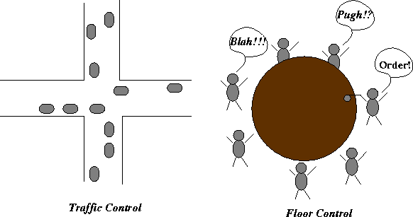
Protocols
Protocol: rules by which network elements communicate
Protocols define the agreement between peering entities
The format, meaning, and order of messages exchanged
Protocols in everyday life
Eg. traffic control, open round-table discussion, etc.
Notes:
Protocol is a common term you hear while talking about networks. Protocol is simply the rules by which two peer entities communicate with each other. Protocol defines the syntax of a message, semantics of messages, and actions to be taken upon receipt of a message. In other words, protocols define the format and meaning of the messages exchanged.
Protocols are common in everyday life. For example, traffic control. We know what the meaning of a signal and what action to take when you see a signal. Similarly round table discussion, question and answer session in the class etc.
Traffic control also helps explain why there are so many protocols. You have signal lights, two-way stop, four-way stop, yield. Each of them are ideal for some traffic conditions. When there is lot of traffic, its better to have signals each way getting a time slice. Under light traffic, its better to have four-way stop type coordination.

Slide 25
Reminder
Submit Survey form on Bb by this weekend
Scan and upload on Bb
Chapter 1 reading

