Slide 1
Cassandra - A Decentralized Structured Storage System
Presented by:
Mani Teja Kurapati
Sairam Vudatha
Likitha Janga
Bhargavi Pannem
Yaswanth Bonda
Kogila Vani Kannan
Tharkin Vankayala
Notes:
We designed this template so that each member of the project team has a set of slides with its own theme where he/she can present their research. Members, here’s how you add a new slide to just your set:
Mark where you want to add the slide: Select an existing one in the Thumbnails pane, click the New Slide button, then choose a layout.
The new slide gets the same theme as the previous one you selected.
Careful! Don’t annoy your fellow presenters by accidentally changing their themes. That can happen if you choose a theme Variant from the Design tab, which changes all of the slides in your presentation to that look.

Slide 2
What is Cassandra?
Cassandra is a distributed database management system for managing very large amounts of structured data spread out across many commodity servers, while providing highly available service with no single point of failure.
Cassandra system was designed to run on cheap commodity hardware and handle high write throughput while not sacrificing read efficiency.
Cassandra offers robust support for clusters spanning multiple datacenters, with asynchronous masterless replication allowing low latency operations for all clients.

Slide 3

History Of Cassandra
Cassandra was initially developed at Facebook to power their Inbox Search feature.
It was released as an open source project on 2008.
In 2009, it became an Apache Incubator project.
In 2010 it graduated to a top-level project.

Slide 4
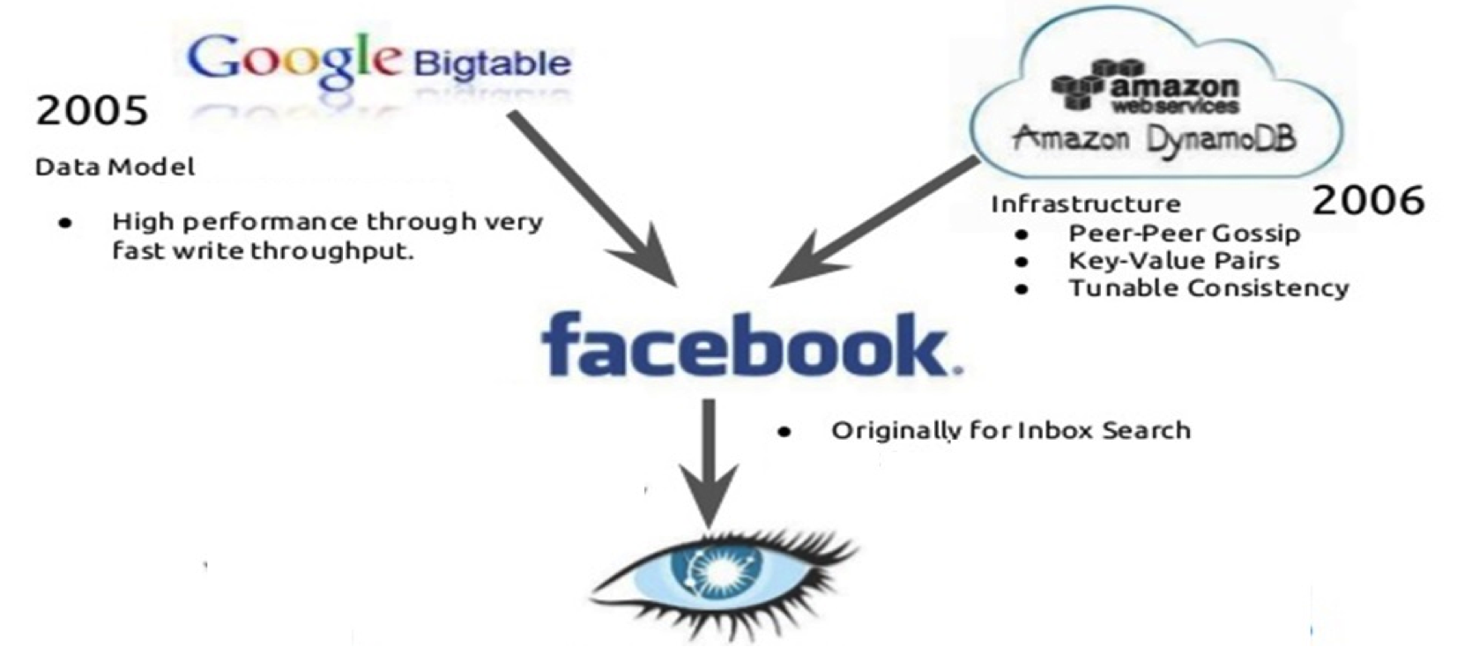
Evolution of Cassandra
2008
*Image source: http://www.slideshare.net/datastaxjp/e35-cassandra
Notes:
Cassandra’s core design brings together the data model described in Google’s Big table paper and the eventual consistency behavior of Amazon’s Dynamo .

Slide 5
Features Of Cassandra
Decentralized and Distributed
Fault tolerant
Durable
Tunable Consistency
Linearly Scalable

Slide 6
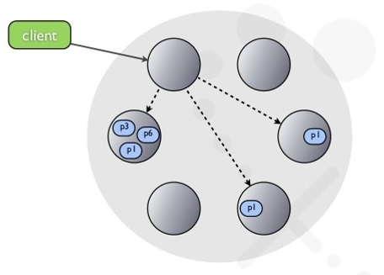
Decentralized and Distributed
Peer-peer distributed system.
Data portioned among all nodes in the
cluster.
There are no master or slave nodes.
Every node in cluster is identical.
There are no single points of failure.
There are no network bottlenecks.
*Image taken from http://image.slidesharecdn.com/nosqlmatters2012-130102154135-phpapp01/95/cassandra-at-nosql-matters-2012-11-638.jpg?cb=1357141501

Slide 7
Fault Tolerant
Data is automatically replicated to multiple nodes for fault-tolerance.
Replication across multiple data centers is supported.
Failed nodes can be replaced with no downtime.

Slide 8
Durable
Durability is the property that writes, once completed, will survive permanently, even if the server is killed or crashes or loses power.
All writes to a replica node are recorded both in memory and in a commit log on disk before they are acknowledged as a success.

Slide 9
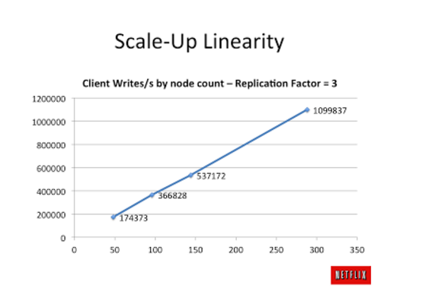
Linearly Scalable
Read and write throughput both increase linearly as new machines are added, with no downtime or interruption to applications.
Capacity can be increased by adding new nodes online.
*Image taken from http://1.bp.blogspot.com/-ZFtW7MFMqZQ/TrG5ujuDGdI/AAAAAAAAAWw/heceeMD50x4/s400/scale.png

Slide 10
Tunable Consistency
Consistency is tunable per operation, allowing consistency to be traded for higher availability as desired.
Consistency Levels : All, Quorum, One, Two, Any.
Configurable synchronous/asynchronous operations.
Hinted-handoff feature and Read Repair feature.

Slide 11
Questions?

Slide 12
Data Model
Table is a multi dimensional map indexed by key.
Columns are grouped together into sets called column families.
Column Families are of 2 types:
- Simple Column Family
- Super Column Family
Each Column has name, value and time stamp.

Slide 13
Comparison to relational model
Relational Model | Cassandra
Database | Keyspace
Table | Column Family
Primary Key | Row Key
Column Name | Column Name / Key
Column Value | Column Value

Slide 14
Column Family
Toy Stores (Keyspace)
Toy Store 1 (Column Family)
Toy Store 2
(Column Famliy)
Name | Price
Toy 1 | $ 2
Toy 2 | $2.22
Toy 3 | $4.6
Key 1
Key 2
Key 3
Toy Store 3
(Column Family)

Slide 15
Super Column Family
Company (Keyspace)
Employee details (Super Column Family)
Demographics
(Super Column)
Work Profile
(Super Column)
Age | Sex
20 | M
30 | F
33 | M
Role | Salary
Manager | 40,000
Supervisor | 30,000
Team lead | 28,000
Rowkey 1
Rowkey 2
Rowkey 3

Slide 16
Hierarchy of data model
Key
Cluster
Keyspace
Keyspace
Column Family
Super Column Family
Key-value
Column Family
Key-value column
Key-value column
Column Family
Key-value column
Key-value column

Slide 17
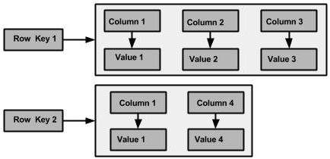
Schema is Flexible
In Contrast to relational model Cassandra supports flexible schema.
*Figure taken from http://www.tutorialspoint.com/cassandra/cassandra_data_model.htm

Slide 18
Cassandra Query Language (CQL)
Cassandra Query Language (CQL) is a query language for the Cassandra database.
CQL Statements:
Data Definition Statements
Data Manipulation Statements
Queries

Slide 19
CQL Data Definition Statements:
CREATE KEYSPACE - creates a keyspace.
USE - connects to a keyspace.
ALTER KEYSPACE - alters properties of a keyspace.
DROP KEYSPACE - removes a keyspace.
CREATE TABLE - creates a new table.
ALTER TABLE - alters the table definition.
DROP TABLE - removes a table.
TRUNCATE – removes all data from a table.

Slide 20
CQL Data Manipulation Statements :
INSERT - writes one or more columns for a given row in a table.
UPDATE - updates one or more columns.
DELETE - deletes columns and rows.
CQL Queries :
SELECT CLAUSE- determines which columns needs to be queried and returned in the result-set.
WHERE CLAUSE - specifies the rows must to be queried.

Slide 21


Creating a Keyspace “sairam”
Using Keyspace “sairam”
Creating a table/Column Family “Students”
Inserting rows into Column Family“Students”

Slide 22
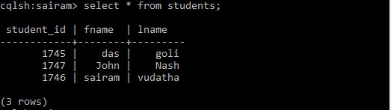
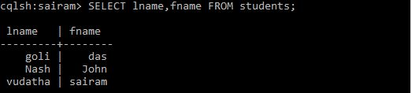
select * from students
select lname,fname from students

Slide 23
API
The Cassandra API consists of following three methods:
- insert(table; key; rowMutation)
- get(table; key; columnName)
- delete(table; key; columnName)

Slide 24
Questions?

Slide 25
System Architecture
Cassandra was designed with the understanding that system/ hardware failures can and do occur
Peer-to-peer, distributed system
All nodes are the same
Data partitioned among all nodes in the cluster
Custom data replication to ensure fault tolerance
Read/Write-anywhere design
As we know the architecture of a storage system is complex as to obtain data consistency.
Additional requirement to these is:
Failure detection and recovery
Concurrency and job scheduling
System monitoring
Configuration management

Slide 26
Contd.
Techniques used in Cassandra:
Partitioning
Replication
Membership
Failure handling
Scaling
All these work in synchrony to handle any requests.
For writes, system routes the requests and waits for acknowledgement but whereas for reads the system does according to the client requirement.

Slide 27
Partitioning
Key feature - Scale incrementally.
Cassandra partitions data dynamically across nodes in a cluster using consistent hashing.
It uses an order pre-serving hash functions for hashing.
Consistent Hashing Algorithm
Logical Ring of hash values.
Each node is given a position on this ring.
Each node is responsible for a LEFT range of hashes.
Each data item’s RIGHT neighbor is responsible for storage and replication.

Slide 28
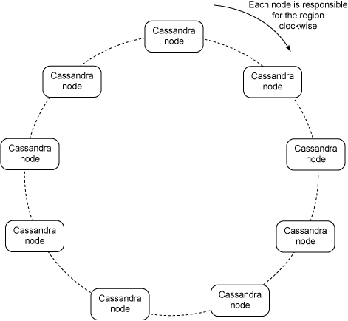

Slide 29
Example:
Now consider a case where the replication factor is 3; clients randomly write or read from a coordinator (every node in the system can act as a coordinator and a data node) in the cluster.
The node calculates a hash of the row key and provides the coordinator enough information to write to the right node in the ring.
The coordinator also looks at the replication factor and writes to the neighbouring nodes in the ring order.
Cassandra uses the Gossip Protocol in the background to allow the nodes to communicate with each other and detect any faulty nodes in the cluster.

Slide 30
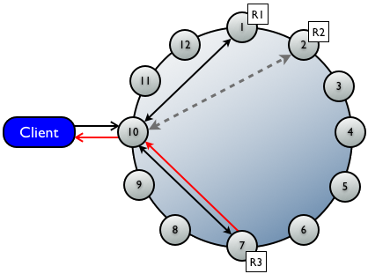

Slide 31
Advantages
The main advantage is that departure or arrival of each node only affects its immediate neighbour nodes.
Decentralized design
Each node has the same role
No single point of failure
Avoids issues of master-slave DBMS’s
No bottlenecking
Minimal administration
Replication
Data is automatically replicated to multiple nodes
Allows failed nodes to be immediately replaced
Distribution of data to multiple data centers
An entire data center can go down without data loss occurring

Slide 32
Transparent Elasticity
Nodes can be added and removed from Cassandra online, with no downtime being experienced.
1
12
2
1
11
3
6
2
10
4
5
3
9
5
4
8
6
7

Slide 33
Transparent Scalability
Addition of Cassandra nodes increases performance linearly and ability to manage TB’s-PB’s of data.
1
12
2
1
11
3
6
2
Performance throughput = N
10
Performance throughput = N x 2
4
5
3
9
5
4
8
6
7

Slide 34
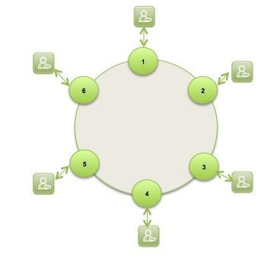

High Availability
Cassandra, with its peer-to-peer architecture has no single point of failure.

Slide 35
Disadvantages
Some challenges of consistent hashing algorithm:
Random position assignment.
Heterogeneity.
Ordering per partition is done and is specified at table creation time. Again, this is to enforce good application design; sorting thousands or millions of rows can be fast in development, but sorting billions in production is a bad idea.
No join or subquery support, and limited support for aggregation. This is by design, to force you to de-normalize into partitions that can be efficiently queried from a single replica, instead of having to gather data from across the entire cluster.

Slide 36
Questions?

Slide 37
Core Distributed Technique : Replication
High availability and durability
Ensure fault tolerance and no failure by replicating one or more copies of every row in a column family across nodes in cluster
Replication

Slide 38
Replication Factor
Replication is controlled by replication factor
Total number of replicas across the cluster
Replicator factor 1 means only one copy of a row on node in a cluster.
2 means two copies of a row stored in a cluster.
column family
data is inserted and assigned a row key
In a column family copy of the row is replicated across various nodes in cluster
Original row
Node 1
Node 2
Node 3
Node 4
Node 5
Copy of row

Slide 39
Replication Policies
Cassandra provides various options how the data needs to be replicated.
Various replication Policies
Rack Unaware [Simple Strategy]
Rack Aware(within data center ) [Network Topology Strategy]
Data Center aware [Network Topology Strategy]

Slide 40
Rack Unware: Simple Strategy
Places the original row on a node determined by the partitioner. Additional Replica rows are placed on the next nodes clockwise in the ring without considering rack or data center location.
Original row
column family
Node 1
Node 2
Node 3
Node 4
Node 5
Copy of row

Slide 41
Rack Aware : Network Topology Strategy
Original row is placed according to the partitioner .Additional replica rows in the same data center are then placed clockwise until a node in a different rack from the previous replica is found.If there is no such node additional replicas will be placed in the same rack.
R1
Node 1
Node 2
Node 3
Node 4
Node 5
RACK 1
RACK 2
R1
R2
Node 1
Node 4
Node 2
Node 5
Node 3
Node 6
R2
Data center 1
R-Replicas for a column family row key

Slide 42
Data Center Aware-Network Topology Strategy
Allows replication between multiple data centers.
R1
R3
Node 1
Node 2
Node 3
Node 4
Node 5
Node 7
Node 8
Node 9
Node 10
Node 11
Data Center 2
RACK 1
RACK 2
R1
Node 1
Node 4
R2
Node 2
Node 5
RACK 1
RACK 2
Node 3
Node 6
Node 7
Node 10
R2
R3
Node 8
Node 11
Data Center 1
Node 9
Node 12
R-Replicas for a column family row key

Slide 43
Core Distributed Technique-Membership
Node1
Node 4
Node 2
Cluster membership in Cassandra is based on the Scuttlebutt Gossip based mechanism.
There is a need to know the state of every other node
In peer to peer network if every node talks with every other node then there would lot of network communication.
Cassandra intelligent solution : intercommunication
The node communicates with other node,it passes the information of itself along with the information of the other it has communicated in the past ,so it is gossip.
Node 3

Slide 44
Gossip Failure Detection
Node1
Node1
Node2
GossipDigestSynMessage
Node1
GossipDigestAckMessage
Node2
Node 4
Node 2
Node1
GossipDigestAck2Message
Node2
Node 3
Node1
GossipDigestSynMessage
Node3
No Ack Message Received
Node 3 is down

Slide 45
Network clog is reduced
Maintaining the state information efficient
Information gathering very efficient
Gossip Protocol-failure detection

Slide 46
Questions?

Slide 47
Bootstrapping:
Bootstrapping is adding a new node to the ring.
If we don’t give a token position explicitly for the new node, it chooses a random token for its position in the ring or else it takes the position as specified.
There will be a sizes to each cluster so that we can add nodes only up to that maximum number in that cluster.

Slide 48
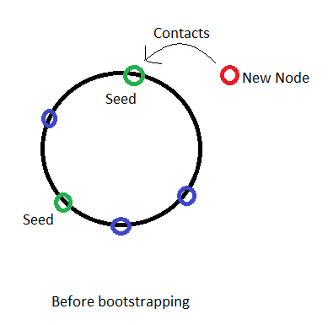
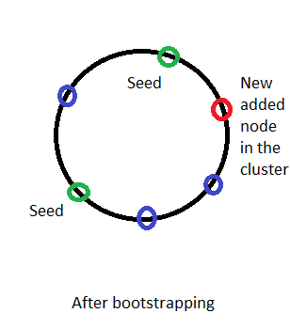
Before joining into the cluster:
Every node needs to contact any one of few particular node called seeds of the cluster before joining into the cluster.
Example: If we want to add a node into a cluster with cluster size 7 :-

Slide 49
After bootstrapping:
After this, the existing token information is gossiped around the ring/cluster, so that all the other nodes know about its location.
Thus any other node can request a required key to the correct node directly.
Note: You should make sure that the gossiping is finished before starting another bootstrap.
Administrators can use a command line tool or a browser to connect to Cassandra node and add or delete a node in the cluster.

Slide 50
Scaling the cluster:
When we have different loads on each node in the cluster, the cluster is unbalanced.
So we use scaling to balance the load on each node in a cluster.
We bootstrap a node next to the node with high load so that the node’s load can be relieved by half.
Any node can initiate the Cassandra bootstrap algorithm.
Example:-

Slide 51
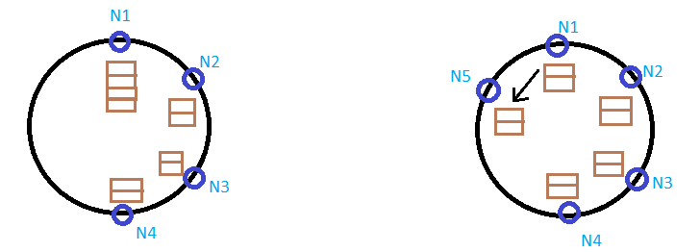
Example of scaling:
We have a cluster with size=7.
The cluster is unbalanced due to it’s load on the nodes.
So node 1 initiates the Cassandra bootstrap algorithm, now see the result.

Slide 52
Data Rate:
A Node can share its work by sending data from it to other with a transfer at a rate of 40 MB/sec.
Research has been going on to have multiple replicas in this transfer by parallelizing the effort.

Slide 53
Local Persistence:
Cassandra relies on the local system for data persistence.
We can discuss this further by seeing read and write operations.

Slide 54
Write Operation:
We write into both the commit log and update into the in-memory data structure.
Because if Cassandra system crashes then we can recover it from the commit log.
Then when the memTable is full we flush the data into the disk and empty the commit log also.
Note: Here all writes are sequential to the disk and generate an index for easy lookups based on rowkey.

Slide 55
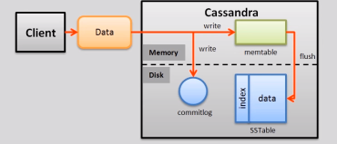
Fig taken from: https://www.youtube.com/watch?v=d9NvnMcTVdQ

Slide 56
Read Operation:
We first look in the memTable if we have the asked data of the read, else we look into sstables.
We look from the latest to oldest files.

Slide 57
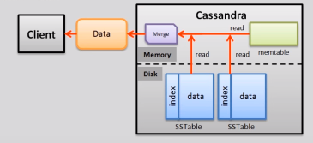
Fig taken from: https://www.youtube.com/watch?v=d9NvnMcTVdQ

Slide 58
Bloom Filter:
If we perform a read operation, we may end up searching all the memtables for the required file so we can overcome that by using a bloom filter.
The columns of a key may be spread out in several sstables. If it wasn't for bloom filters, every read of a key would have to read every sstable, which is prohibitively expensive. By using bloom filters, cassandra almost always only has to look in the sstables which contain data for that key.
Bloom filter maintains column indices which allow us to jump to the right chunk on disk for column retrieval.
Thus making the read operation much easy and keeping the data persistent.

Slide 59
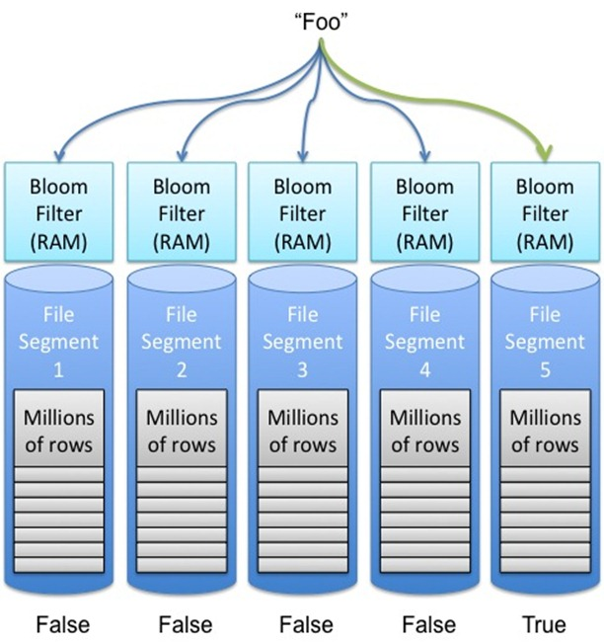
Fig taken from: http://kellabyte.com/2013/01/24/using-a-bloom-filter-to-reduce-expensive-operations-like-disk-io/

Slide 60
Questions?

Slide 61
Implementation Details:
Cassandra consists of the following modules:
Partitioning module
Cluster membership module
Failure detection module
Storage Engine module
All modules rely on an event driven substrate – the message processing pipeline and the task pipeline are split into multiple stages along the line of the SEDA (Staged Event Driven Architecture)
Each module has been implemented using Java

Slide 62
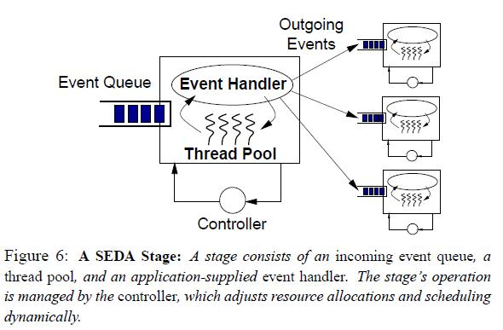
SEDA Architecture

Slide 63
Implementation Details Contd.
All system control messages rely on UDP and the application related messages for replication and request routing rely on TCP.
The request routing modules are implemented using state machine. Stages in the state machine for any read/write requests:
Identify the nodes
Routes the requests to the nodes
If the replies not arrive within a timeout value fail the response based on timestamp
Schedule a repair of the data
It can be configured to perform either synchronous or asynchronous writes. If a system requires high throughput then asynchronous write is used

Slide 64
Commit Log
Rolling commit log is used where a new commit log is rolled out if the older one exceeds a particular configurable size. Every commit log has a header of fixed size and it is a bit vector.
Bit in the commit log is set whenever a particular column family is dumped to a disk.
Write operation can be in normal or in fast sync mode. The write to the commit logs are buffered in the fast-sync mode and there is a chance of data loss if machine crashes.
Cassandra maximizes throughput by morphing all writes to disk into sequential writes . The server instance of Cassandra is lockless for read/write operations

Slide 65
Cassandra system indexes data based on primary key and data file is broken into many blocks on disk. Each block is differentiated by block index and contains 128 keys
The index is maintained for fast access
Read operation always looks up data first in the in-memory data structure. If found data is returned and the in-memory contains latest data for any key. If the data is not found then disk I/O is performed against all files in reverse time order.

Slide 66
Questions?

Slide 67
Practical Experiences
Gained a lot of knowledge by designing and by the implementation of Cassandra.
Don’t add any new features without knowing the effects of it’s usage
Most problematic scenarios do not stem from just node crashes and n/w partitions.

Slide 68
Practical Experiences (contd)
Before launch of inbox application data is indexed. Then load it into Cassandra from MySQL. The Map-Reduce process acts as the client for Cassandra. Some background channels are added to compensate the serialization and deserialization overhead. By this way Cassandra is bottlenecked by n/w bandwidth.
Most applications only require one atomic operation per replica whereas some applications require atomic operation for also secondary indices.
Experimented with various implementations of failure detectors.
Cassandra integration with Ganglia.
Cassandra integration with Zookeeper.

Slide 69
Comparison between MySQL and Cassandra
The read time in MySQL is approximately 350ms where as in Cassandra, it is 15ms.
The write time in MySQL is approximately 300ms where as in Cassandra, it is 0.12ms
https://news.ycombinator.com/item?id=683885

Slide 70
Facebook Inbox Search
Cassandra is mainly developed for this inbox search problem.
The Cassandra is tested on a system that stores 50+TB of data on a150 node cluster.
There are two kinds of search features to search for the message
1. Term Search
2. Interaction Search

Slide 71
Term search and interaction search
In the term search we retrieve the messages based on the word given in the search box whereas in the interaction search the name of the recipient is given.
In term search user id is the key. The words that make up the message will be super column and the message identifiers will be sub-columns In the super column.
In interaction search user id is the key. The recipient id is the super column and the message identifiers will be sub-columns in the super column.
Latency Stat | Search Interaction | Term Search
Min | 7.69ms | 7.78ms
Median | 15.69ms | 18.27ms
Max | 26.13ms | 44.1ms

Slide 72
Conclusion
So the storage system providing high performance, scalability and wide applicability is built and implemented.
We have empirically demonstrated that Cassandra can support a very high update throughput while delivering low latency.

Slide 73
Questions?

Slide 74
References:
https://wiki.apache.org/cassandra/Operations#Range_changes
http://stackoverflow.com/questions/5849283/bloomfilter-and-cassandra-why-used-and-why-hashed-several-times
https://www.youtube.com/watch?v=d9NvnMcTVdQ
http://kellabyte.com/2013/01/24/using-a-bloom-filter-to-reduce-expensive-operations-like-disk-io/
http://docs.datastax.com/en/getting_started/doc/getting_started/usingCQL.html
http://www.tutorialspoint.com/cassandra/cassandra_data_model.htm
http://static.googleusercontent.com/media/research.google.com/en//archive/bigtable-osdi06.pdf
http://www.slideshare.net/patrickmcfadin/the-data-model-is-dead-long-live-the-data-model
https://www.cs.cornell.edu/projects/ladis2009/papers/lakshman-ladis2009.pdf

Slide 75
thank you ☺

