Slide 1
HIVE – A Petabyte Scale Data Warehouse Using Hadoop Ashish Thusoo, Joydeep Sen Sarma, Namit Jain, Zheng Shao, Prasad Chakka, Ning Zhang, Suresh Antony, Hao Liu and Raghotham Murthy
Presented by,
Sneha Lagandula
Abhiram A
Dinesh Reddy Paduru
Niranjan Nuthalapati
Lakshmi Sirisha Devineni
Jyoshna Bollineni
BhuLakshmi Makkena

Slide 2
DATA MODEL
Hive stores data in tables
Hive supports primitive type and complex types
Hive supports queries in SQL like langauge called HiveQL
Analogous to the tables in relational database
CS 5540 – Hive : A Petabyte Scale Data Warehouse Using Hadoop

Slide 3
TYPE SYSTEM
Primitive Types
Integers - BIGINT (8 bytes), INT (4 bytes), SMALLINT (2 bytes), TINYINT(1 byte)
Floating point numbers - float, double
String
Complex Types
Map - map<key-type, value-type>
map<‘PB’: 90>
Array – array<element-type>
array[‘a’, ‘b’, ‘c’], A[0] returns a.
Structs – struct<file-name: field-type, ..>
Structs : address struct< street: string, city: string, zip: int>
CS 5540 – Hive : A Petabyte Scale Data Warehouse Using Hadoop

Slide 4
Example
Create a table student with a complex schema
Dot(.) operator – used to access fields within in structs
[ ] operator – used to access maps and arrays.
CS 5540 – Hive : A Petabyte Scale Data Warehouse Using Hadoop

Slide 5
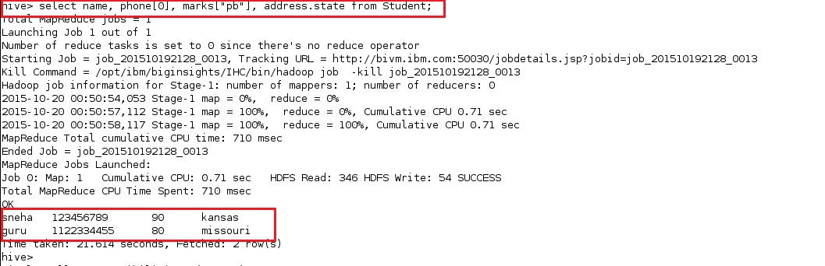
Example (cont..)
CS 5540 – Hive : A Petabyte Scale Data Warehouse Using Hadoop

Slide 6
Serialization/Deserialization
Serialization – Turns data into a stream of bytes
Deserialization – Turns a stream of bytes back into copy of the original copy
Hive provides build-in serialization format
Can add new data formats by defining custom serialize and de-serialize methods.
SerDe java interface in Hive – designed to read data separated by different delimiter characters
SerDes are located in jar files
CS 5540 – Hive : A Petabyte Scale Data Warehouse Using Hadoop

Slide 7
Serialization/Deserialization (cont..)
Following statement adds a jar containing SerDe and ObjectInspector interfaces to create table with custom serde
Example
Add jar /jars/myFormat.jar
CREATE TABLE t1
ROW FORMAT SERDE ‘com.myFormat.MySerDe’;
CS 5540 – Hive : A Petabyte Scale Data Warehouse Using Hadoop

Slide 8
HiveQL
HQL is a subset of SQL and extensions used in big data environment
HQL Supports SQL features such as from clause, sub queries, joins, all arithmetic functions for primitive and complex type of data format.
Some metadata functions like show, describe are available.
HQL table data are immutable.
Partitions in a Hive table can help optimize performance of queries.

Slide 9
Limitations
Hive does not support inserting into, deleting and updating data into an existing table.
We use OVERWRITE
INSERT OVERWRITE TABLE t1;
Joins support only equality predicate and should be specified as ANSI join syntax
SELECT t1.a1 as c1, t2.b1 as c2
FROM t1 join t2 ON (t1.a2=t2.b2)
We cannot have SELECT t1.a1 as c1, t2.b1 as c2
FROM t1, t2 where t1.a2 = t2.b2;

Slide 10
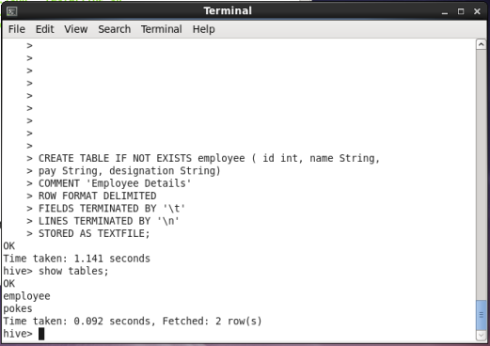

Slide 11
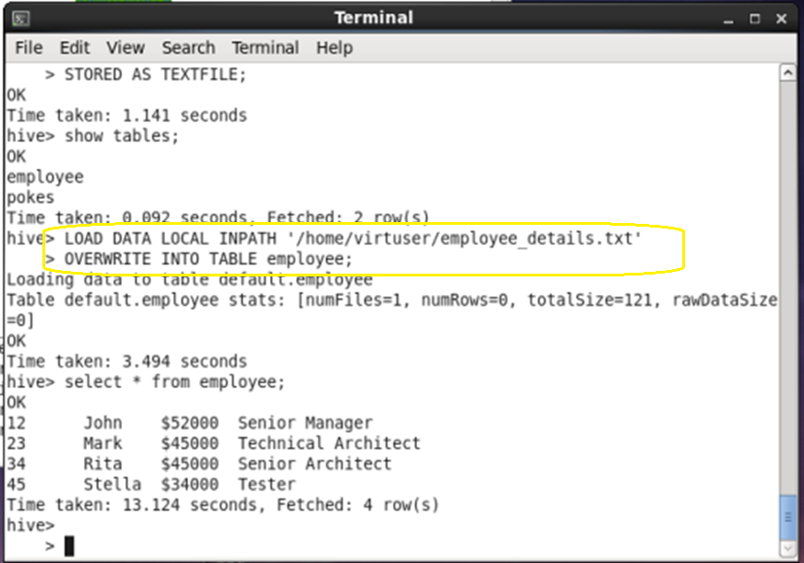

Slide 12
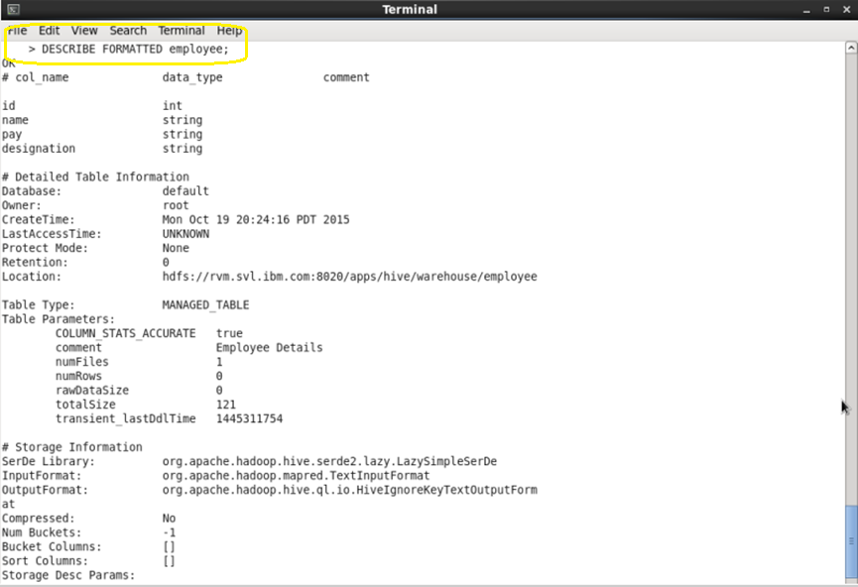

Slide 13
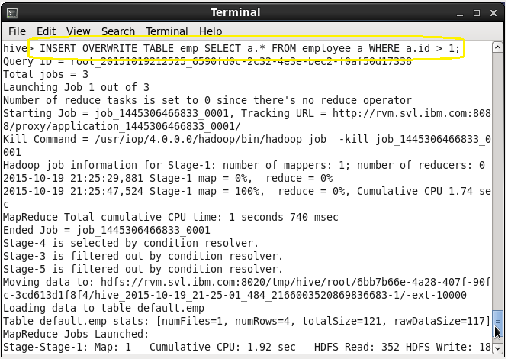

Slide 14
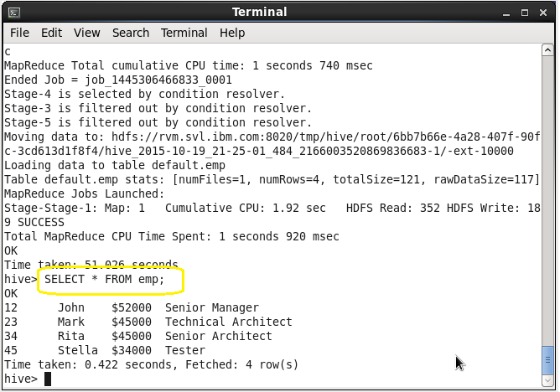

Slide 15
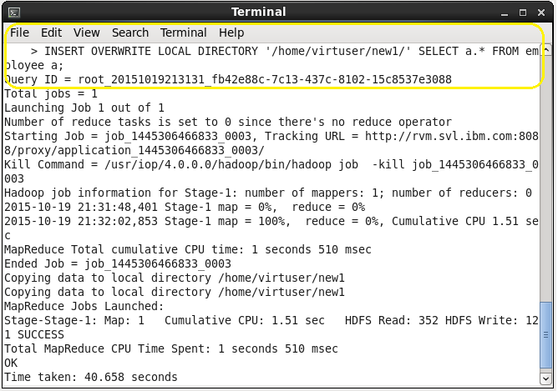

Slide 16
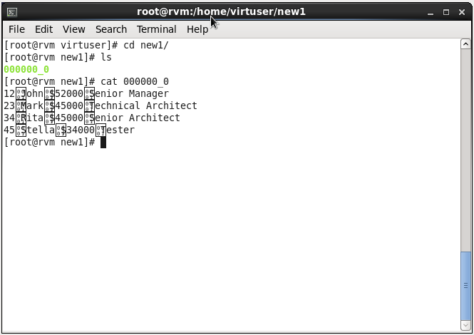

Slide 17
Extensions
Hive supports extensions which support analysis which can be expressed as Map-Reduce program in the choice of any programming language.
Hive enables us to express complex logic in terms of map reduce programs that can still be implemented with HiveQL.
This is helpful when we want to use any external libraries to transform the table data.

Slide 18
Example
FROM (
MAP doctext USING 'python wc_mapper.py' AS (word, cnt)
FROM docs
CLUSTER BY word
) a
REDUCE word, cnt USING 'python wc_reduce.py';

Slide 19
More Examples
FROM (
FROM session_table
SELECT sessionid, tstamp, data
DISTRIBUTE BY sessionid SORT BY tstamp
) a
REDUCE sessionid, tstamp, data USING 'session_reducer.sh';

Slide 20
Data Storage
The primary data units in hive are Tables, Partitions and Buckets.
In hive, tables are the logical data units and table metadata associates the data in the table to HDFS directories.
Data units in hive are mapped in the HDFS as:
Table: Stored in a directory in HDFS.
Partition: Stored in a sub directory within a table’s directory.
Buckets: Stored in a file within the partition’s or table directory.
Tables:
In Hive, tables are similar to tables in Relational Databases.
Syntax:
CREATE TABLE t (id string, ds string, hr int, location string);

Slide 21
Partitions
Partitions are nothing but the segregation of data that classifies the given information based on certain attributes.
It allows users to efficiently retrieve the information based on specific attributes.
Syntax:
CREATE TABLE test_part(c1 string, c2 int) PARTITIONED BY (ds string, hr int);
A new partition can be added using INSERT and ALTER statements.
Ex:
INSERT OVERWRITE TABLE test_part PARTITION(ds='2009-01-01', hr=12)
SELECT * FROM t;
In this case, INSERT statement populates the data from table t.
It creates a directory /user/hive/warehouse/test_part/ds=2009-01-01/hr=12
ALTER TABLE test_part ADD PARTITION(ds='2009-02-02', hr=11);
In this case, ALTER statement creates an empty partition.
SELECT * FROM test_part WHERE ds= '2009-02-02' AND hr=11;
The above statement will only scan the files within /user/hive/warehouse/test_part/ds=2009-01-01/hr=12.
Note: Assuming /user/hive/warehouse/ is the present workplace.

Slide 22
Buckets
Buckets are similar to partitions but in this case the separation of data is based on the hash function applied.
Hash function decides the position of record for a bucket.
Partitions and Buckets are optional concepts that are used to achieve efficiency in retrieving and managing the data.
Ex:
Let us consider an example that contains 16 buckets based on the attribute ‘id’ from table t.
SELECT * FROM t TABLESAMPLE(4 OUT OF 16);
In the above select statement it would scan the data present in the fourth bucket based on ‘id’

Slide 23
External Tables
External table points to the existing data directories in HDFS.
When a drop command is performed on table it drops the metadata and also deletes the data but in case of external table it only drops the metadata without deleting data.
External tables are also used to create partitions and Buckets.
Syntax:
CREATE EXTERNAL TABLE Test(ds string, hr int) LOCATION '/user/tables/data‘;
From the above statement, a Test external table is created with ‘ds’ and ‘hr’ attributes in the location '/user/tables/data' in HDFS.

Slide 24
Example
From the table t,
Note: Assuming /user/hive/warehouse/ is the present workplace.
Data Unit | Entity | HDFS Location
Table | T | /user/hive/warehouse/T
Partition | ds=‘xyz’ and hr=k | /user/hive/warehouse/T/ds=‘xyz’/hr=k
Bucket | id( Hash function applied on ‘id’ considering 16 buckets) | /user/hive/warehouse/T/part-0 . . . /user/hive/warehouse/T/part-15

Slide 25
Serialization/Deserialization- SerDe:
Flexible Interface to translate unstructured data into structured data
Designed to read data separated by different delimiter characters
LazySerDe – Default in Hive
Called lazy because, deserializes only if the query asks for.
Default delimiters are newline (ASCII code 13) for Row and ctrl-A (ASCII code 1) for columns within a row
Can also be used to read data with other delimiters.
Example:
CREATE TABLE test_delimited2(c1 string, c2 list<map<string, int>>)
ROW FORMAT DELIMITED
FIELDS TERMINATED BY '\002'
COLLECTION ITEMS TERMINATED BY '\003'
MAP KEYS TERMINATED BY '\004';

Slide 26
Serialization/Deserialization- SerDe (contd)
Hive has many other SerDe’s are located in hive_contrib.jar
Example: RegexSerDe – can specify regular expression to parse various columns out from a row
add jar 'hive_contrib.jar';
CREATE TABLE apachelog( host string, identity string, user string, time string, request string, status string, size string, referer string, agent string)
ROW FORMAT SERDE
'org.apache.hadoop.hive.contrib.serde2.RegexSerDe'
WITH SERDEPROPERTIES(
'input.regex' = '([^ ]*) ([^ ]*) ([^ ]*) (-|\\[[^\\]]*\\]) ([^\"]*|\"[^\"]*\") (-|[0-9]*) (-|[0-9]*)(?: ([^ \"]*|\"[^\"]*\") ([^\"]*|\"[^\"]*\"))?',
'output.format.string' = '%1$s %2$s %3$s %4$s %5$s %6$s%7$s %8$s %9$s');
Other examples of SerDe’s are:-
ThriftSerDe depends on thrift protocol
ColumnarSerDe proprietary column based
LazyBinarySerDe (HIVE-640) proprietary binary
BinarySortableSerDe proprietary binary sortable
Reference : http://www.slideshare.net/ragho/hive-icde-2010

Slide 27
File formats:
A file format in Hadoop specifies how records are stored in a file.
Users has free hand to implement their customized file formats.
Hive does not impose any restrictions on type of file format.
Format can be specified while creating the table as shown below
Example:
CREATE TABLE dest1(key INT, value STRING)
STORED AS
INPUTFORMAT
'org.apache.hadoop.mapred.SequenceFileInputFormat'
OUTPUTFORMAT
'org.apache.hadoop.mapred.SequenceFileOutputFormat‘
STORED AS class specifies formats of any with File input and output format java interfaces.
This has to be provided to Hadoop as “jar”.

Slide 28
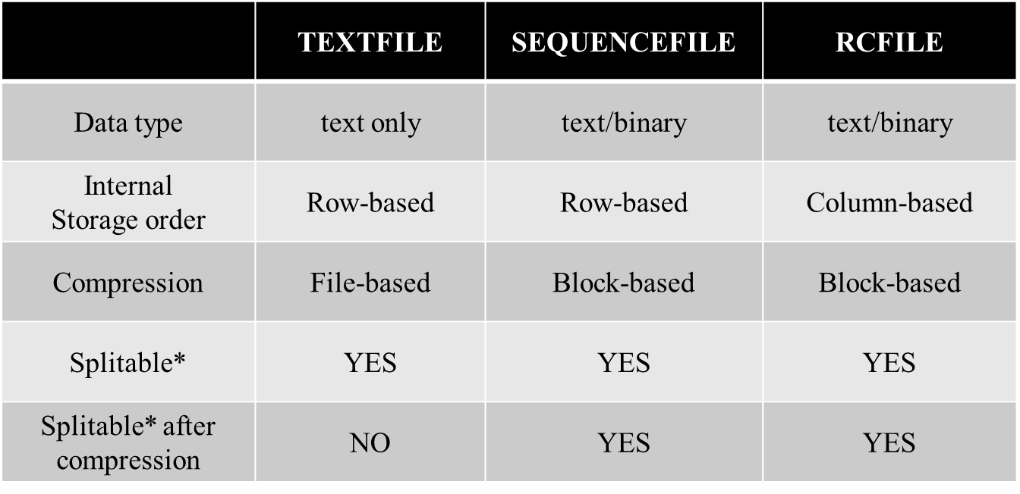
Different file formats :
*Splitable: Capable of splitting the file so that a single huge file can be processed by multiple mappers in parallel.
Reference : http://www.slideshare.net/ragho/hive-icde-2010

Slide 29
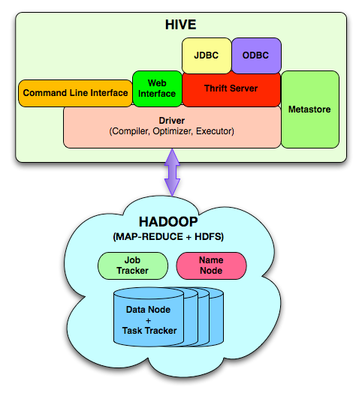
System Architecture and Components

Slide 30
System Architecture and Components
JDBC
ODBC
Web
Interface
Command Line Interface
Thrift Server
Metastore
Driver
(Compiler, Optimizer, Executor)
Metastore
The component that store the system catalog and meta data about tables, columns, partitions etc.
Stored on a traditional RDBMS

Slide 31
System Architecture and Components
JDBC
ODBC
Web
Interface
Command Line Interface
Thrift Server
Metastore
Driver
(Compiler, Optimizer, Executor)
Driver
The component that manages the lifecycle of a HiveQL statement as it moves through Hive. The driver also maintains a session handle and any session statistics.

Slide 32
System Architecture and Components
JDBC
ODBC
Web
Interface
Command Line Interface
Thrift Server
Metastore
Driver
(Compiler, Optimizer, Executor)
Query Compiler
The component that compiles HiveQL into a directed acyclic graph of map/reduce tasks.

Slide 33
System Architecture and Components
JDBC
ODBC
Web
Interface
Command Line Interface
Thrift Server
Metastore
Driver
(Compiler, Optimizer, Executor)
Execution Engine
The component that executes the tasks produced by the compiler in proper dependency order. The execution engine interacts with the underlying Hadoop instance.

Slide 34
System Architecture and Components
JDBC
ODBC
Web
Interface
Command Line Interface
Thrift Server
Metastore
Driver
(Compiler, Optimizer, Executor)
HiveServer
The component that provides a thrift interface and a JDBC/ODBC server and provides a way of integrating Hive with other applications.

Slide 35
System Architecture and Components
JDBC
ODBC
Web
Interface
Command Line Interface
Thrift Server
Metastore
Driver
(Compiler, Optimizer, Executor)
Client Components
Client component like Command Line Interface(CLI), the web UI and JDBC/ODBC driver.

Slide 36
The Process:
A HiveQL statement is submitted via the CLI, the Web UI or an external client using thrift, odbc or jdbc interfaces.
The driver first passes the query to the complier.
The complier generates a logical plan which is optimized through a simple rule based optimizer.
The optimized plan is in the form of map-reduce tasks and hdfs tasks.
The execution engine executes these tasks in the order of their dependencies, using Hadoop.

Slide 37
MetaStore:
It acts as system Catalog for Hive.
As the information stored in metastore has to be served fast to the complier, this information is stored in traditional RDMS.
It uses ORM layer called DataNucleus to convert object representations into a relational schema and vice versa, which allows to plugin many different RDMS technologies.
Without System Catalog it is not possible to impose a structure on hadoop files, hence it is important to back up metastore regularly.
Ideally, a replicated server should be deployed which will be able to scale number of queries submitted by users and also should be available for many production environment needs.

Slide 38
MetaStore:
Any metadata that is needed by mapper or reducer is passed through xml plan files that are generated by compiler.
The ORM logic in the Metastore can be deployed in client libraries such that it runs on client side and issues direct calls to an RDMS.
This deployment is ideal only if the clients are CLI or the Web UI.

Slide 39
Query Compiler
Hive Compiler processes Hive QL statements in the following steps
1. PARSE
Hive uses Antlr to generate Abstract Syntax tree for Query
2. Type Checking and Semantic Analysis
Compiler fetches information and logical plan is created
Checks type compatibilities and identifies errors at run time
Compiler converts nested queries to parent child relationships
3. OPTIMIZATION
The operator DAG is passed as an input from one transformation to other
Any one can change compiler or add new optimization logic
CS 5540 – Hive : A Peta byte Scale Data Warehouse Using Hadoop

Slide 40
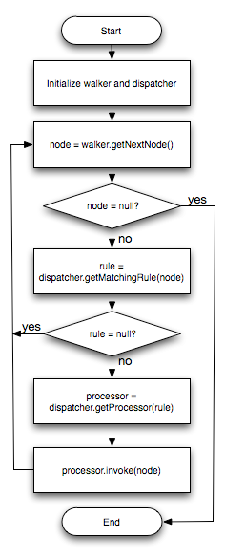
Flowchart for typical transformation during optimization
CS 5540 – Hive : A Peta byte Scale Data Warehouse Using Hadoop

Slide 41
Transformations done in Hive during Optimization stage
Column Pruning
Predicate pushdown
Partition pruning
Map side Joins
SELECT /*+ MAPJOIN(t2) */ t1.c1, t2.c1
FROM t1 JOIN t2 ON(t1.c2 = t2.c2);
Join Reordering
CS 5540 – Hive : A Peta byte Scale Data Warehouse Using Hadoop

Slide 42
Example
SELECT * FROM students; Steve 2.8 Raman 3.2 Mary 3.9
SELECT * FROM grades; 2.8 B 3.2 B+ 3.9 A
SELECT students.*, grades.* FROM students JOIN grades ON (students.grade = grades.grade) Steve 2.8 2.8 B Raman 3.2 3.2 B+ Mary 3.9 3.9 A
CS 5540 – Hive : A Peta byte Scale Data Warehouse Using Hadoop

Slide 43
Additional Hints
Repartioning of data to handle skews in GROUP BY processing
Map/Reduce stages for Aggregation
Better Performance
Parameter
set hive.groupby.skewindata=true;
SELECT t1.c1, sum(t1.c2)
FROM t1
GROUP BY c1;
Hash Based Partial aggregations in Mappers
hive.map.aggr.hash.percentmemory
CS 5540 – Hive : A Peta byte Scale Data Warehouse Using Hadoop

Slide 44
EXAMPLE
SELECT C.NAME, C.SUM(SALARY) FROM C GROUP BY NAME; OUTPUT
NAME SALARY NAME SUM(SALARY)
X 200 X 600
Y 300 Y 400
X 400
Y 100
CS 5540 – Hive : A Peta byte Scale Data Warehouse Using Hadoop

Slide 45
Single join followed by two different aggregations
FROM (SELECT a.status, b.school, b.gender
FROM status_updates a JOIN profiles b
ON (a.userid = b.userid
AND a.ds='2009-03-20' )) subq1
INSERT OVERWRITE TABLE gender_summary
PARTITION(ds='2009-03-20')
SELECT subq1.gender, COUNT(1)
GROUP BY subq1.gender
INSERT OVERWRITE TABLE school_summary
PARTITION(ds='2009-03-20')
SELECT subq1.school, COUNT(1)
GROUP BY subq1.school
CS 5540 – Hive : A Peta byte Scale Data Warehouse Using Hadoop

Slide 46
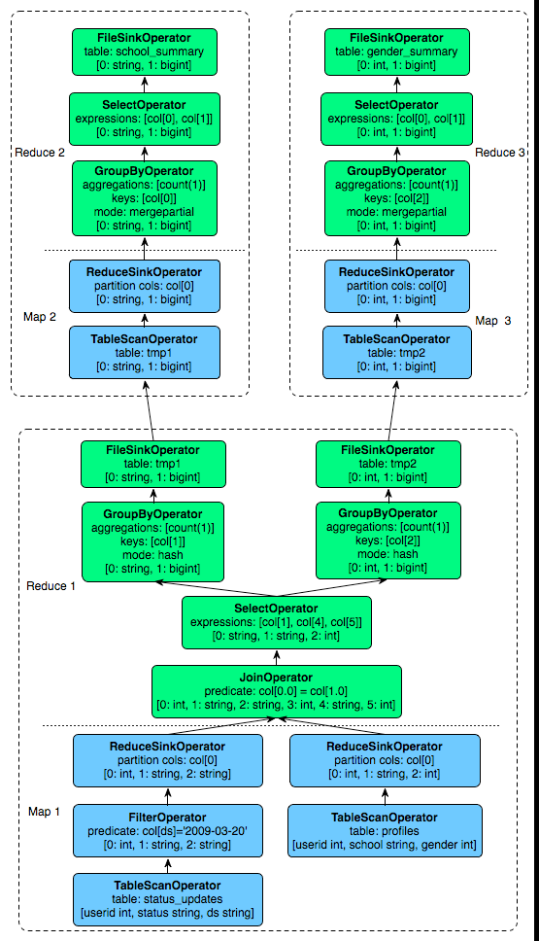
Query plan for multi-table insert query with 3 map/reduce jobs
CS 5540 – Hive : A Peta byte Scale Data Warehouse Using Hadoop

Slide 47
Execution Engine:
Tasks are executed in the order of dependencies.
A map/reduce task serializes its part of plan into a plan.xml.
ExecMapper and ExecReducers deserializes the xml and executes the relevant part.
Final results are stored in a temporary location, final data is moved to desired location in case of DML’s.

Slide 48
Hive Usage in Facebook
On any day more than 7500 jobs are submitted to cluster and more than 75TB of compressed data is processed.
Facebook currently has 700TB (2.1PB after 3 way replication) of data on Hadoop.
More than half workload is on adhoc queries rest is for reporting dashboards.
Sharing of same resources by adhoc users and reporting users presents operational challenges.
It maintains separate clusters for adhoc queries and reporting queries.

Slide 49
Related Work
SCOPE - Structured Computations Optimized for Parallel Execution
SQL like language
Parallel execution on large clusters
Pig – allows users to write declarative scripts o process data.
Difference: Hive provides a system catalog that contains metadata about tables within the system.

Slide 50
Conclusions And Future Work
Working towards making HiveQL subsume SQL syntax.
Build a cost based optimizer and adaptive techniques.
Exploring columnar storage and more intelligent data placement to improve scan performance
Enhancement of JDBC and ODBC drivers for Hive integration with BI tools which only work with traditional relational warehouses.
Multi query optimization techniques and performing generic n-way joins in single map-reduce job .

