Slide 1

Applications of Map-Reduce
Team 3
CS 4513 – D08

Slide 2

Distributed Grep
Very popular example to explain how Map-Reduce works
Demo program comes with Nutch (where Hadoop originated)

Slide 3
Distributed Grep
For Unix guru:
grep -Eh <regex> <inDir>/* | sort | uniq -c | sort -nr
- counts lines in all files in <inDir> that match <regex> and displays the counts in descending order
- grep -Eh 'A|C' in/* | sort | uniq -c | sort -nr
- Analyzing web server access logs to find the top requested pages that match a given pattern
File 1
C
B
B
C
File 2
Result
C
A
3 C
1 A

Slide 4
Distributed Grep
Map function in this case:
- input is (file offset, line)
- output is either:
1. an empty list [] (the line does not match)
2. a key-value pair [(line, 1)] (if it matches)
Reduce function in this case:
- input is (line, [1, 1, ...])
- output is (line, n) where n is the number of 1s in the list.

Slide 5
Distributed Grep
File 1
C
B
B
C
File 2
Result
C
A
3 C
1 A
Map tasks:
(0, C) -> [(C, 1)]
(2, B) -> []
(4, B) -> []
(6, C) -> [(C, 1)]
(0, C) -> [(C, 1)]
(2, A) -> [(A, 1)]
Reduce tasks:
(A, [1]) -> (A, 1)
(C, [1, 1, 1]) -> (C, 3)

Slide 6
Large-Scale PDF Generation
The Problem
The New York Times needed to generate PDF files for 11,000,000 articles (every article from 1851-1980) in the form of images scanned from the original paper
Each article is composed of numerous TIFF images which are scaled and glued together
Code for generating a PDF is relatively straightforward

Slide 7
Technologies Used
Large-Scale PDF Generation
Amazon Simple Storage Service (S3)
  Scalable, inexpensive internet storage which can store and retrieve any amount of data at any time from anywhere on the web
  Asynchronous, decentralized system which aims to reduce scaling bottlenecks and single points of failure
Amazon Elastic Compute Cloud (EC2)
  Virtualized computing environment designed for use with other Amazon services (especially S3)
Hadoop
  Open-source implementation of MapReduce

Slide 8
Results
Large-Scale PDF Generation
4TB of scanned articles were sent to S3
A cluster of EC2 machines was configured to distribute the PDF generation via Hadoop
Using 100 EC2 instances and 24 hours, the New York Times was able to convert 4TB of scanned articles to 1.5TB of PDF documents

Slide 9
Artificial Intelligence
Compute statistics
  Central Limit Theorem
N voting nodes cast votes (map)
Tally votes and take action (reduce)

Slide 10
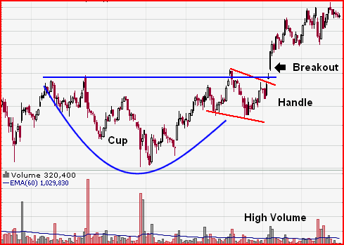

Artificial Intelligence
Statistical analysis of current stock against historical data
Each node (map) computes similarity and ROI.
Tally Votes (reduce) to generate expected ROI and standard deviation
Photos from: stockcharts.com

Slide 11
Geographical Data
Large data sets including road, intersection, and feature data
Problems that Google Maps has used MapReduce to solve
  Locating roads connected to a given intersection
  Rendering of map tiles
  Finding nearest feature to a given address or location

Slide 12
Example 1
Geographical Data
Input: List of roads and intersections
Map: Creates pairs of connected points (road, intersection) or (road, road)
Sort: Sort by key
Reduce: Get list of pairs with same key
Output: List of all points that connect to a particular road

Slide 13
Example 2
Geographical Data
Input: Graph describing node network with all gas stations marked
Map: Search five mile radius of each gas station and mark distance to each node
Sort: Sort by key
Reduce: For each node, emit path and gas station with the shortest distance
Output: Graph marked and nearest gas station to each node

Slide 14
Rackspace Log Querying
Platform
Hadoop
HDFS
Lucene
Solr
Tomcat

Slide 15
Rackspace Log Querying
Statistics
More than 50k devices
7 data centers
Solr stores 800M objects
Hadoop stores 9.6B ~ 6.3TB
Several hunderd Gb of email log data generated each day

Slide 16
Rackspace Log Querying
System Evolution
The Problem
Logging V1.0
V1.1
V2.0
V2.1
V2.2
V3.0, mapreduce introduced.

Slide 17

PageRank

Slide 18
PageRank
Program implemented by Google to rank any type of recursive “documents” using MapReduce.
Initially developed at Stanford University by Google founders, Larry Page and Sergey Brin, in 1995.
Led to a functional prototype named Google in 1998.
Still provides the basis for all of Google's web search tools.

Slide 19
PageRank
Simulates a “random-surfer”
Begins with pair (URL, list-of-URLs)
Maps to (URL, (PR, list-of-URLs))
Maps again taking above data, and for each u in list-of-URLs returns (u, PR/|list-of-URLs|), as well as (u, new-list-of-URLs)
Reduce receives (URL, list-of-URLs), and many (URL, value) pairs and calculates (URL, (new-PR, list-of-URLs))

Slide 20
PageRank: Problems
Has some bugs – Google Jacking
Favors Older websites
Easy to manipulate

Slide 21
Statistical Machine Translation
Used for translating between different languages
A phrase or sentence can be translated more than one way so this method uses statistics from previous translations to find the best fit one

Slide 22
Statistical Machine Translation
the quick brown fox jumps over the lazy dog
  Each word translated individually:
  la rápido marrón zorro saltos más la perezoso perro
  Complete sentence translation:
  el rápido zorro marrón salta sobre el perro perezoso
Creating quality translations requires a large amount of computing power due to p(f|e)p(e)
Need the statistics of previous translations of phrases

Slide 23
Google Translator
Statistical Machine Translation
When computing the previous example it would not translate "brown" and "fox" individually, but it translated the complete sentence correctly
After providing a translation for a given sentence, it asks the user to suggest a better translation
The information can then be added to the statistics to improve quality

Slide 24
Statistical Machine Translation
Benefits
  more natural translation
  better use of resources
Challenges
  compound words
  Idioms
  Morphology
  different word orders
  Syntax
  out of vocabulary words

Slide 25
Map Reduce on Cell
Peak performance rating of 256 GFLOPS at 4GHz. However,
Programmers must write multi-threaded code unique to each of the SPE (Synergistic Processing Element) cores in addition to the main PPE (Power Processing Element) core.
SPE local memory is software-managed, requiring programmers to individually manage all reads and writes to and from the global memory space.
The SPEs are statically scheduled Single Instruction, Multiple Data (SIMD) cores. This requires a lot of parallelism to achieve high performance.

Slide 26
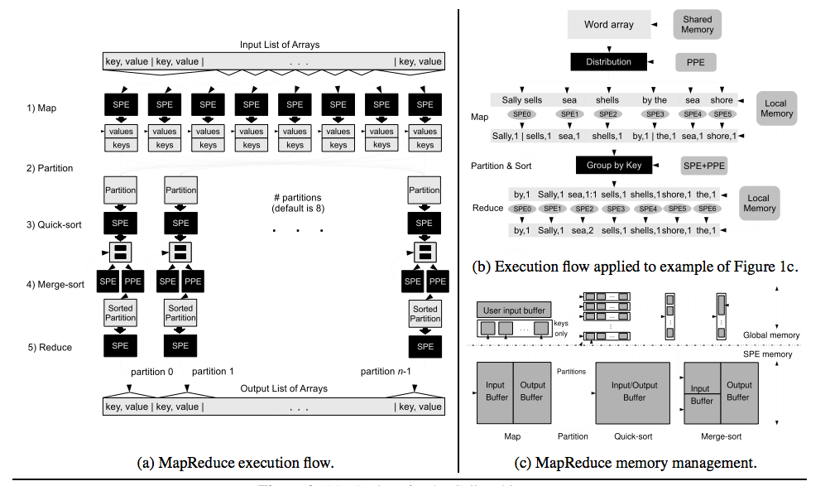
Map Reduce on Cell

Slide 27
Map Reduce on Cell
Takes out the effort in writing multi-processor code for single operations that are performed on large amounts of data. As easy to develop as single-threaded code.
Depending on input, data processed was 3x to 10x faster with Cell vs. 2.4 Core2 Duo.
However, computationally weak data went slower.
Code not fully developed; Currently no support for variable length structures (such as strings).

Slide 28
Map Reduce Inapplicability
Database management
Sub-optimal implementation for DB
Does not provide traditional DBMS features
Lacks support for default DBMS tools

Slide 29
Map Reduce Inapplicability
Database implementation issues
Lack of a schema
No separation from application program
No indexes
Reliance on brute force

Slide 30
Map Reduce Inapplicability
Feature absence and tool incompatibility
Transaction updates
Changing data and maintaining data integrity
Data mining and replication tools
Database design and construction tools

