Slide 2
Introduction
Big Data:
Big data is the buzzing word in the present software industry. Huge amounts of data is being generated daily from various sources.
Apache Spark:
Apache Spark is an open source cluster computing framework originally developed in the AMPLab at University of California, Berkeley but was later donated to the Apache Software Foundation where it remains today.
Spark SQL is a component on top of Spark Core that introduces a new data abstraction called DataFrames, which provides support for structured and semi-structured data.
Introduction to IBM Bluemix:
IBM Bluemix is a cloud platform as a service (PaaS) developed by IBM. It supports several programming languages and services as well as integrated DevOps to build, run, deploy and manage applications on the cloud.
Bluemix provides the following features:
• A range of services that enable you to build and extend web and mobile apps fast.
• Processing power for you to deliver application changes continuously.
• Fit-for-purpose programming models and services.
• Manageability of services and apps.
• Optimized and elastic workloads.
• Continuous availability.

Slide 3
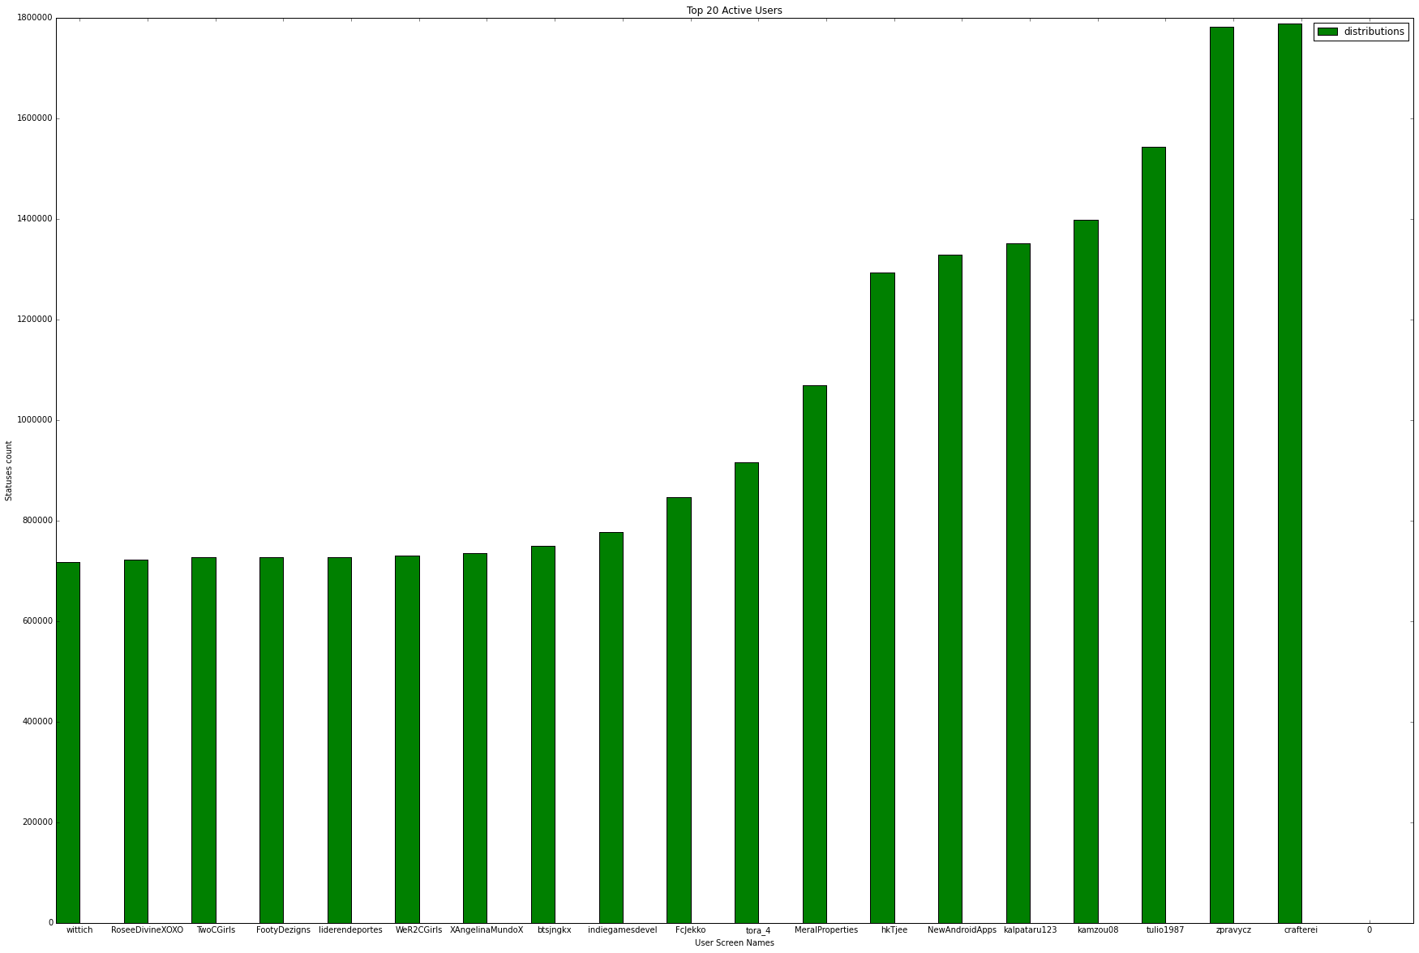
Query 1
Description: To find top active users in dataset
SELECT TWEET_USER_SCREEN_NAME, MAX(TWEET_USER_STATUSES_COUNT) AS TWEET_USER_STATUSES_COUNT FROM tweetdata group by TWEET_USER_SCREEN_NAME order by TWEET_USER_STATUSES_COUNT DESC LIMIT 20
Visualization

