Slide 1













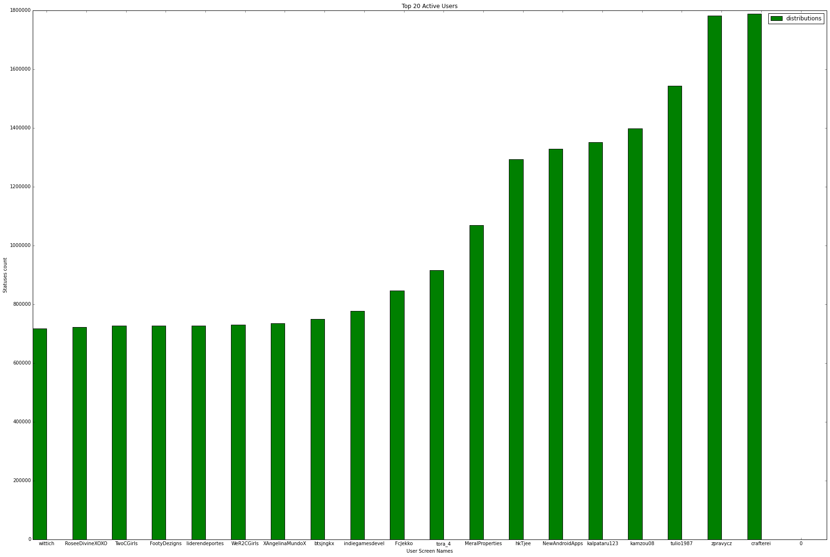
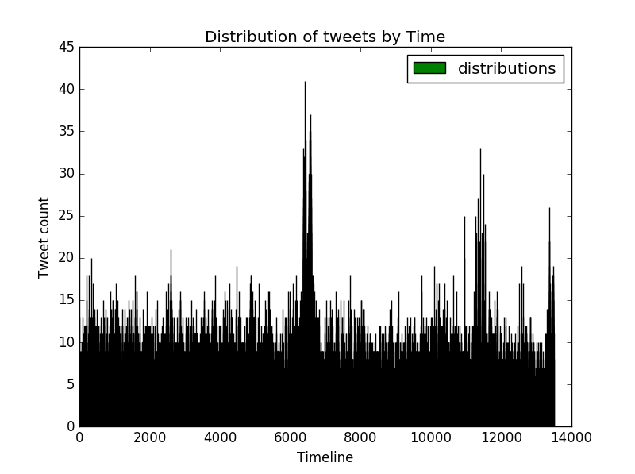
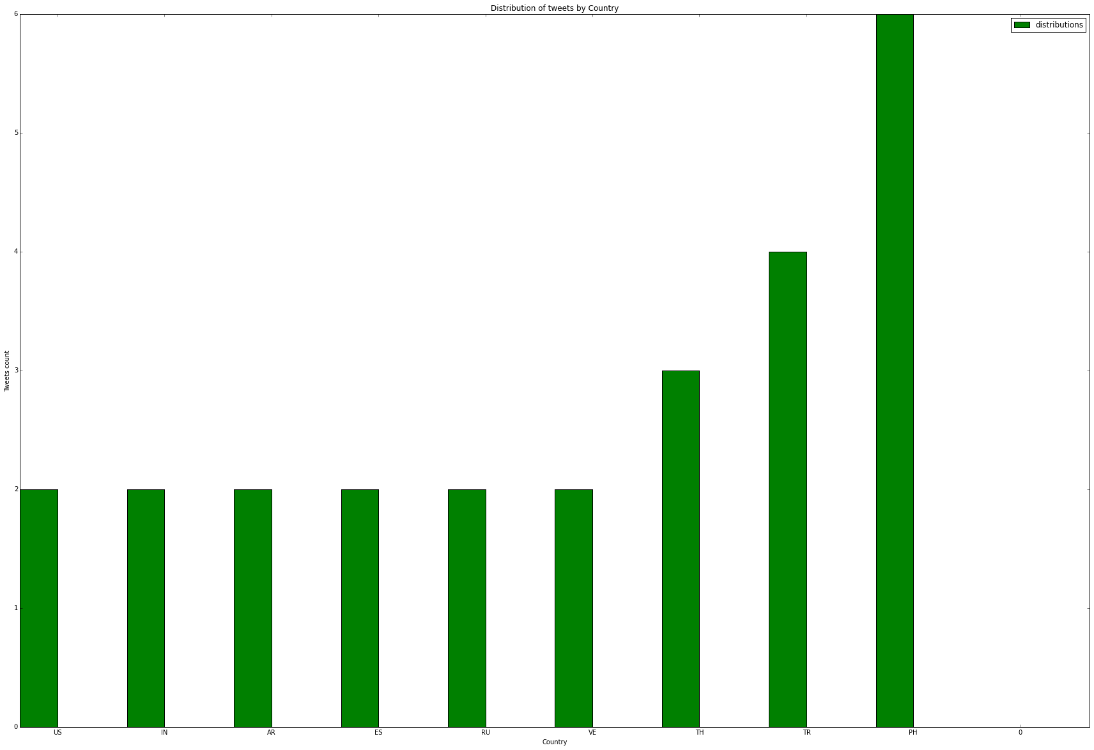
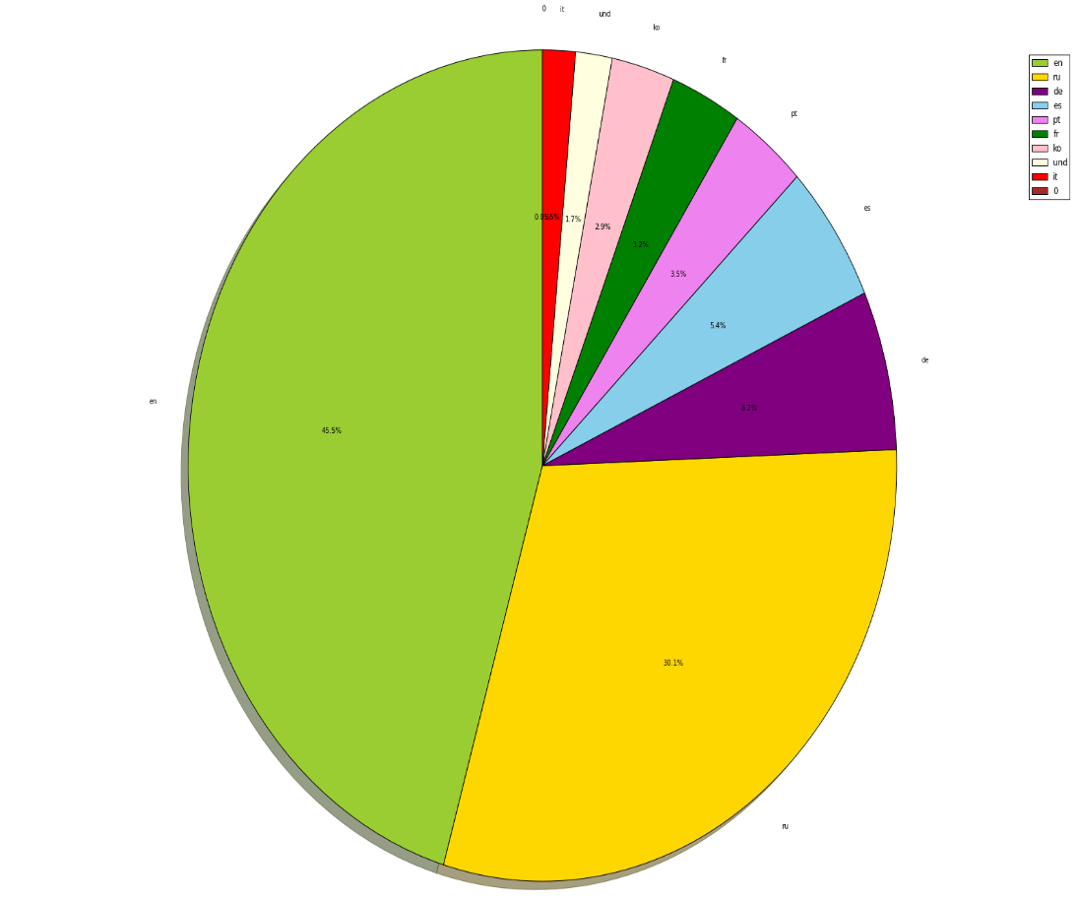
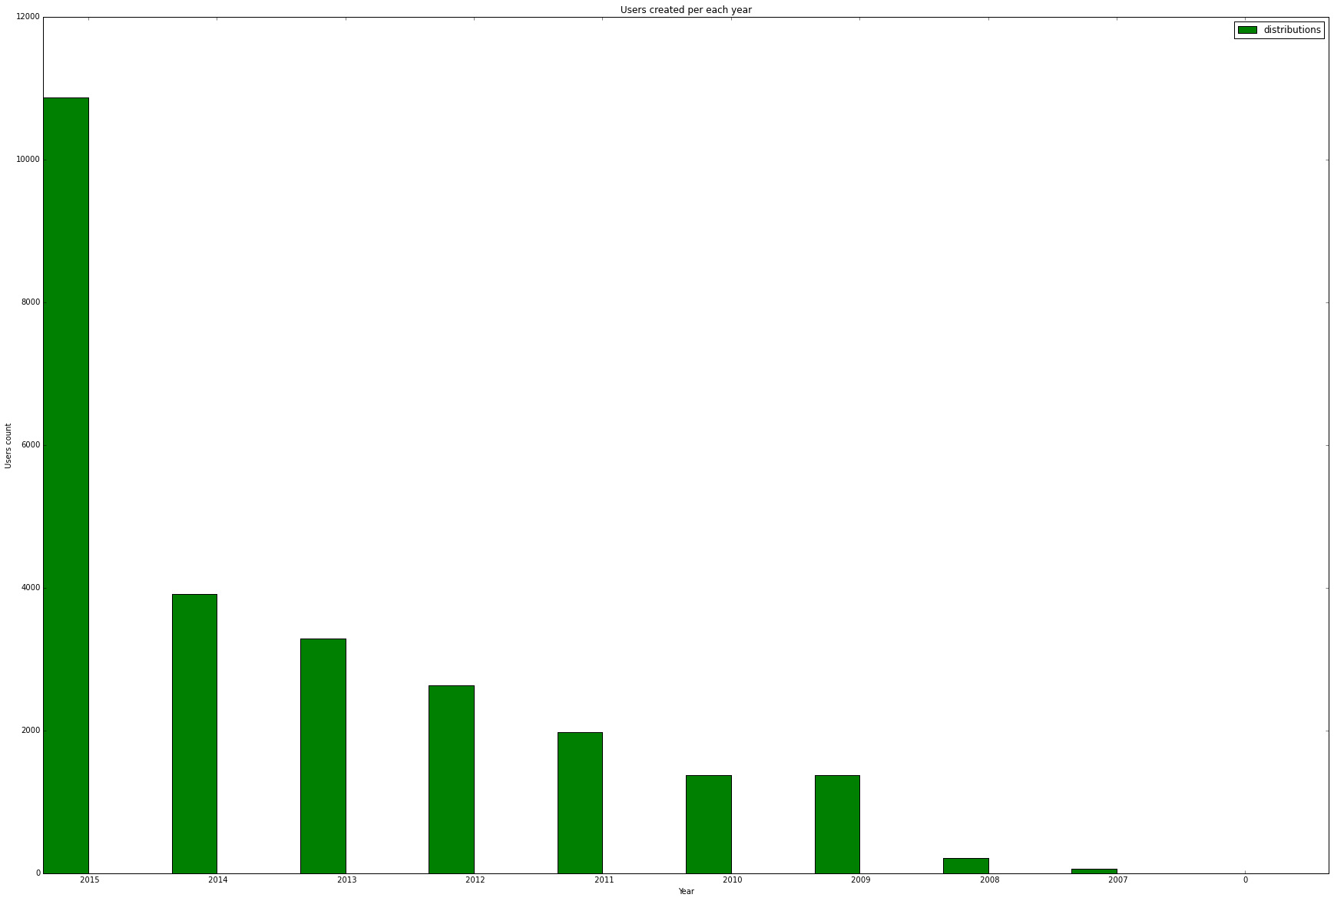
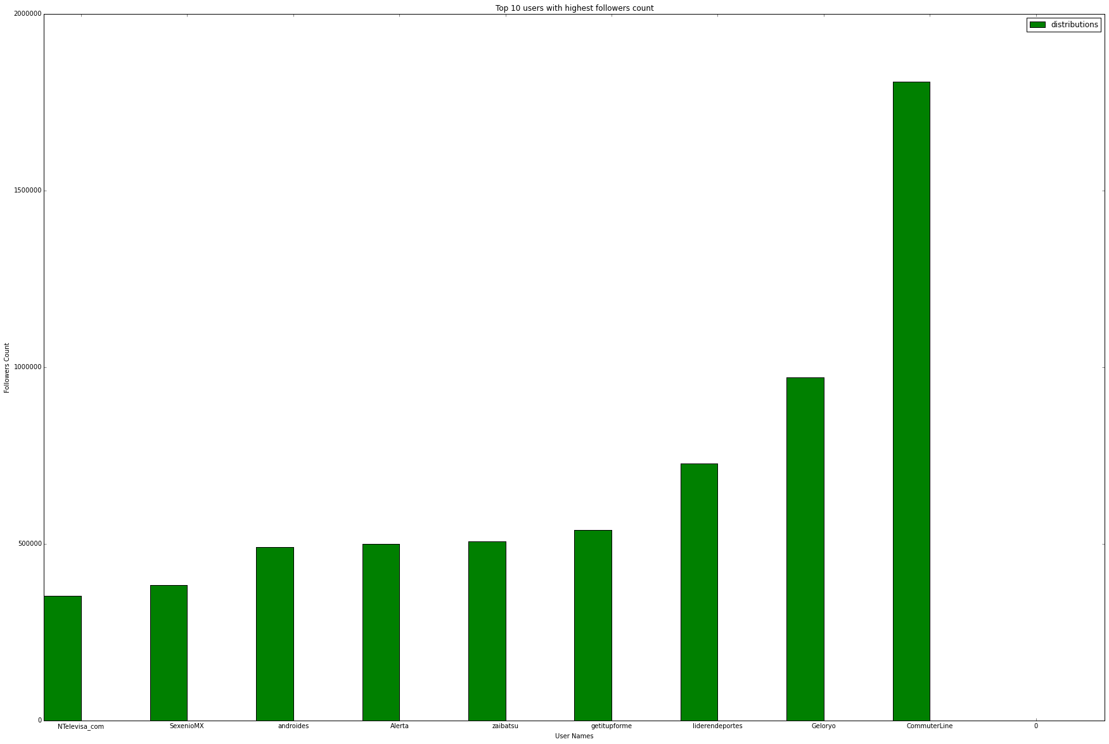
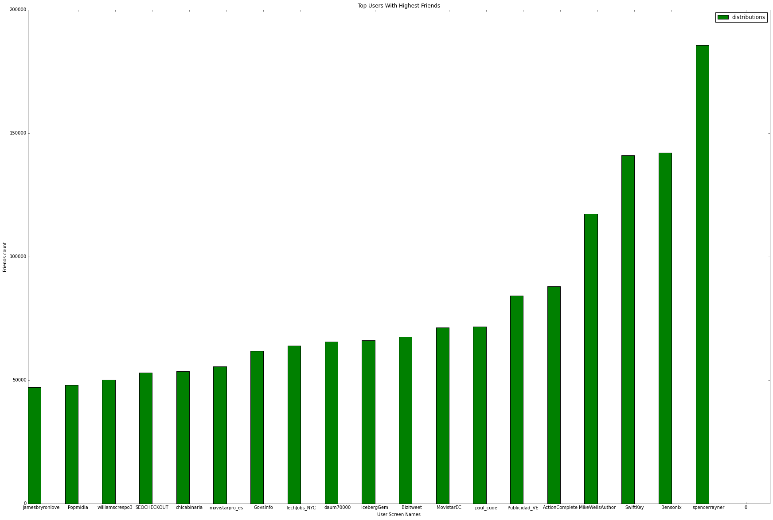
Twitter Big Data Analysis
Using Spark Principles of Big Data Management (CS5540)
Sri Harsha Chennavajjala, Teja Garidepally, Raj Kiran Reddy Munnangi
Introduction
Architecture
Services we used in Bluemix:
Big Data:
Big data is the buzzing word in the present software industry. Huge amounts of data is being generated daily from various sources.
Apache Spark:
Apache Spark is an open source cluster computing framework originally developed in the AMPLab at University of California, Berkeley but was later donated to the Apache Software Foundation where it remains today.
Spark SQL is a component on top of Spark Core that introduces a new data abstraction called DataFrames, which provides support for structured and semi-structured data.
Introduction to IBM Bluemix:
IBM Bluemix is a cloud platform as a service (PaaS) developed by IBM. It supports several programming languages and services as well as integrated DevOps to build, run, deploy and manage applications on the cloud.
Bluemix provides the following features:
• A range of services that enable you to build and extend web and mobile apps fast.
• Processing power for you to deliver application changes continuously.
• Fit-for-purpose programming models and services.
• Manageability of services and apps.
• Optimized and elastic workloads.
IBM Cloudant:
IBM Cloudant is a fully managed JSON document DBaaS that’s optimized for data availability, durability, and mobility…perfect for fast-growing mobile & web apps.
dashDB:
dashDB offers massive scalability and performance through its MPP architecture, and is compatible with a wide range of business intelligence toolsets and analytics
Node-RED:
Node-RED provides a browser-based UI for creating flows of events and deploying them to its light-weight runtime. With built in node.js, it can be run at the edge of the network or in the cloud.
Object Storage:
IBM Object Storage for Bluemix provides us with access to a fully provisioned Swift Object Storage account to manage our data.
#android
JSON files
Flat map JSON to tables
Input to Spark
Parquet file to IPython notebook
Results to matlab tool
Drawing graphs
Query 1:
Query 2:
Query 3:
Query 4:
Description: To find top active users in dataset
SELECT TWEET_USER_SCREEN_NAME, MAX(TWEET_USER_STATUSES_COUNT) AS TWEET_USER_STATUSES_COUNT FROM tweetdata group by TWEET_USER_SCREEN_NAME order by TWEET_USER_STATUSES_COUNT DESC LIMIT 20
Visualization:
Description: To find tweets per second
val tweetCreatedDt = tweets.filter(_.nonEmpty).map(x => (extractTweetDate(x), 1)) val tweetCreatedDtCnt = tweetCreatedDt.reduceByKey((a, b) => a + b) tweetCreatedDtCnt.repartition(1).saveAsTextFile("D:/UMKC/Docs/Subjects/PBDM/PB_Project/TweetsPerTime")
Visualization:
Description: To find tweets per country
SELECT TWEET_PLACE_COUNTRY_CODE, COUNT(1) AS TWEETS_PER_COUNTRY FROM tweetdata group by TWEET_PLACE_COUNTRY_CODE order by TWEETS_PER_COUNTRY DESC LIMIT 10
Visualization:
Description: To find number of tweets per language
SELECT TWEET_LANG, count(1) as totTweets from tweetdata group by TWEET_LANG order by totTweets
Visualization:
Query 5:
Query 6:
Query 7:
Conclusion:
Description: To find user accounts created per year
SELECT t1.YR as YR, count(1) as CNT FROM (select DISTINCT TWEET_USER_ID, substring(TWEET_USER_CREATED_AT,26) AS YR FROM tweetdata where TWEET_USER_CREATED_AT IS NOT NULL) t1 group by YR order by YR
Visualization:
Description: To find Top Users with highest Followers Count
SELECT TWEET_USER_SCREEN_NAME, MAX(TWEET_USER_FOLLOWERS_COUNT) AS TWEET_USER_FOLLOWERS_COUNT FROM tweetdata group by TWEET_USER_SCREEN_NAME order by TWEET_USER_FOLLOWERS_COUNT DESC LIMIT 10
Visualization:
Description: To find Top Users with highest Friends Count
SELECT MAX(TWEET_USER_FRIENDS_COUNT) AS FRIENDS_COUNT, TWEET_USER_SCREEN_NAME FROM tweetdata GROUP BY TWEET_USER_SCREEN_NAME ORDER BY FRIENDS_COUNT DESC LIMIT 20
Visualization:
Social media provides valuable datasets, but the real challenge is in collecting and analyzing the live streaming data. In this project we’ve analyzed and visualized twitter data on a #android keyword.
In future work, we would like to perform domain specific live streaming analysis and try to capture valuable insights from data.
Acknowledgements:
We would like to thank Dr.Rao , Anas Katib and Venu Kolla for their extended support in successful execution of this project.

