Slide 1
Applications
The Yahoo! Applications which motivated and influenced PNUTS:
User Database
Social Applications
Content Meta-Data
Listings Management
Session Data
Yahoo! applied PNUTS on some of these applications, while others are still under progress.

Slide 2
User Database
Yahoo!’s User Database has hundreds of millions of active users and billions of total users.
Each record contains profile information, application-specific data, usage statistics.
The volume of traffic is very high which is balanced using massive parallelism and the asynchrony model of PNUTS.
Relaxed consistency is accepted.

Slide 3
Social Applications
Social applications require a flexible data store supporting information sharing and connection between users.
PNUTS resolves this by the massive parallelism concept and the ordered table abstraction is used to represent connections in social graph.
Social applications have large number of writes and require a scalable system such as PNUTS.
Relaxed consistency is accepted.

Slide 4
Content Meta-Data
Yahoo! faces a challenge of storing massive data such as mail attachments, images and videos.
Although PNUTS is not optimized to provide mass storage, it stores the metadata of a distributed bulk storage system.
PNUTS ensures high performance for metadata operations such as file creation, deletion, renaming and moving between directories.

Slide 5
Listings Management
Comparison shopping sites such as Yahoo! Shopping aggregate listings of items from many sources.
The ordered table implementation in PNUTS provides us to store listings, sorted by timestamp.
This implementation provides us to create a view of the data using secondary attributes.

Slide 6
Session Data
Websites generally maintain per-session state, and in a large website like Yahoo! there are a large number of concurrent sessions active.
To store this data, which would be increasing with every new user, scalability is the main concern which is resolved by PNUTS.
Managing session data is very common across web applications and using PNUTS as a service provides applications to use the session store.

Slide 7
Experimental Results
Experimental Setup:
Three PNUTS regions
2 west coast, 1 east coast
5 storage units, 2 message brokers, 1 router
West: Dual 2.8 GHz Xeon, 4GB RAM, 6 disk RAID 5 array
East: Quad 2.13 GHz Xeon, 4GB RAM, 1 SATA disk
Workload
1200-3600 requests/second
0-50% writes
80% locality

Slide 8
Inserting Data
One region (West 1) is the tablet master
Hash: 99 clients (33 per region), MySQL: 60 clients
1 million records, 1/3 per region
Result:
Hash: West1: 75.6ms; West2: 131.5ms, East 315.5ms
Ordered: West1: 33ms; West2: 105.8ms, East 324.5ms
MySQL is faster than hash, although more vulnerable to contention

Slide 9
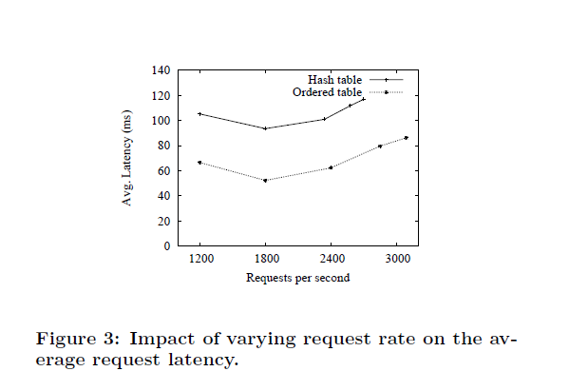
Varying Load:
Requests vary between 1200 – 3600 requests/second with 10% writes

Slide 10
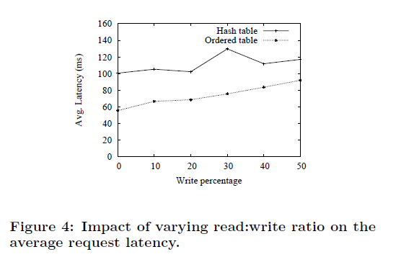
Varying Read/Write Ratio:
Ratios vary between 0 and 50%
Fixed 1,200 requests/second

Slide 11
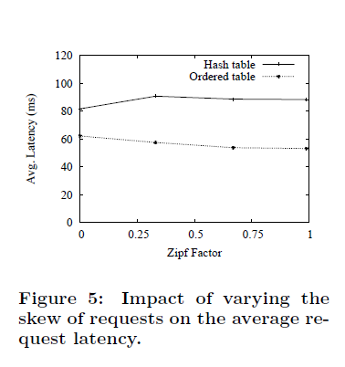
Varying Skew:
Zipf parameter vary from 0(uniform) to 1(highly skewed)
1200 requests per second

Slide 12
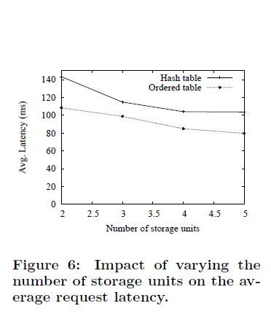
Varying Number of Storage Units:
Storage units per region vary from 2-5
10% writes, 1,200 requests/seconds

Slide 13
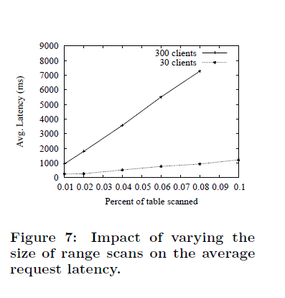
Varying Size of Range Scans:
Range scan between 0.01 to 0.1% size
Ordered table only
30 clients vs. 300 clients

Slide 14
Ongoing work
Indexes and materialized views
Bundled updates
Batch query processing
Conclusion:
Rich database functionality and low latency at massive scale
Tradeoffs between functionality, performance and scalability
Choose asynchronous replication to ensure low write latency
Delivers the data management as hosted service

