Slide 1
PNUTS: Yahoo!’s Hosted Data Serving Platform
B.F. Cooper, R. Ramakrishnan, U. Srivastava, A. Silberstein,
P. Bohannon, H. Jacobsen, N. Puz, D. Weaver and R. Yerneni
Yahoo! Research
Seminar Presentation for CSE 708 by Ruchika Mehresh
Department of Computer Science and Engineering
22nd February, 2011

Slide 2
Motivation
To design a distributed database for Yahoo!’s web applications, which is scalable, flexible, available.
(Colored animation slides borrowed from openly available presentation on PNUTS by Yahoo!)

Slide 3
What does Yahoo! need?
Web applications demand
  Scalability
  Response time and Geographic scope
  High Availability and Fault Tolerance
Characteristic of Web traffic
  Simple query needs
  Manipulate one record at a time.
  Relaxed Consistency Guarantees
Serializable transactions
Vs
Eventual consistency
Serializability

Slide 4
PNUTS
Structure
Features
Data and Query Model
System Architecture
Data Storage and Retrieval
Consistency (Yahoo! Message Broker)
Recovery
Query Processing
Experiments
Future Work

Slide 5
Features
Record-level operations
Asynchronous operations
Novel Consistency model
Massively Parallel
Geographically distributed
Flexible access: Hashed or ordered, indexes, views; flexible schemas.
Centrally managed
Delivery of data management as hosted service.

Slide 6
PNUTS
Structure
Features
Data and Query Model
System Architecture
Data Storage and Retrieval
Consistency (Yahoo! Message Broker)
Recovery
Query Processing
Experiments
Future Work

Slide 7
Data and Query Model
Data representation
  Table of records with attributes
  Additional data types: Blob
Flexible Schemas
Point Access Vs Range Access
Hash tables Vs Ordered tables

Slide 8
PNUTS
Structure
Features
Data and Query Model
System Architecture
Data Storage and Retrieval
Consistency (Yahoo! Message Broker)
Recovery
Query Processing
Experiments
Future Work

Slide 9
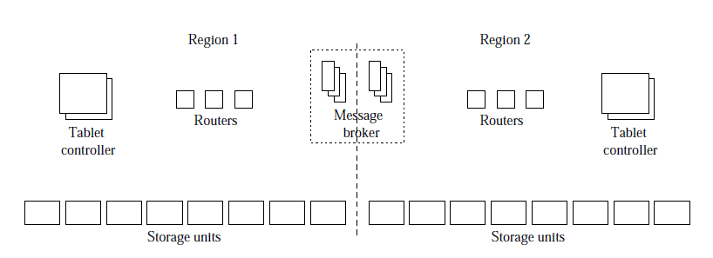
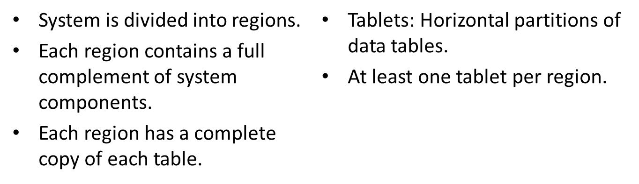
System Architecture
Animation

Slide 10
PNUTS
Structure
Features
Data and Query Model
System Architecture
Data Storage and Retrieval
Consistency (Yahoo! Message Broker)
Recovery
Query Processing
Experiments
Future Work

Slide 11
Data Storage and Retrieval
Storage unit
  Store tablets
  Respond to get(), scan() and set() requests.
Tablet controller
  Owns the mapping
  Routers poll periodically to get mapping updates.
  Performs load-balancing and recovery

Slide 12
Data Storage and Retrieval
Router
  Determines which tablet contains the record
  Determines which storage unit has the tablet
  Interval mapping- Binary search of B+ tree.
  Soft state
  Tablet controller does not become bottleneck.

Slide 13
PNUTS
Structure
Features
Data and Query Model
System Architecture
Data Storage and Retrieval
Consistency (Yahoo! Message Broker)
Recovery
Query Processing
Experiments
Future Work

Slide 14
Consistency model
Per-record timeline consistency
  All replicas apply updates to the record in same order.
    Events (insert/update/delete) are for a particular primary key.
    Reads return a consistent version from this timeline.
    One of the replicas is the master. All updates forwarded to the master.
    Replica master chosen based on the locality of majority of write requests.
    Every Record has sequence number: Generation of record (New insert), Version of record (Update).
Insert
Update
Update
Delete
Insert
Update
v.1.0
v.1.1
v.1.2
v.1.3
v.2.0
v.2.1
v.2.2
Related Question

Slide 15
Consistency model
API Calls
  Read-any
  Read-critical (required version)
  Read-latest
  Write
  Test-and-set-write (required version)
Animation

Slide 16
Yahoo! Message broker
Topic based Publish/subscribe system
Used for logging and replication
PNUTS + YMB = Sherpa data services platform
Data updates considered committed when published to YMB.
Updates asynchronously propagated to different regions (post-publishing).
Message purged after applied to all replicas.
Per-record mastership mechanism.

Slide 17
Yahoo! Message broker
Mastership is assigned on a record-by-record basis.
All requests directed to master.
Different records in same table can be mastered in different clusters.
Basis: Write requests locality
Record stores its master as metadata.
Tablet master for primary key constraints
  Multiple values for primary keys.
Related Question (Write locality)
Related Question (Tablet Master)

Slide 18
PNUTS
Structure
Features
Data and Query Model
System Architecture
Data Storage and Retrieval
Consistency (Yahoo! Message Broker)
Recovery
Query Processing
Experiments
Future Work

Slide 19
Recovery
Any committed update is recoverable from a remote replica.
Three step recovery
  Tablet controller requests copy from remote (source) replica.
  “Checkpoint message” published to YMB, for in-flight updates.
  Source tablet is coped to destination region.
Support for recovery
  Synchronized tablet boundaries
  Tablet splits at the same time (two-phase commit)
  Backup regions within the same region.
Related Question

Slide 20
PNUTS
Structure
Features
Data and Query Model
System Architecture
Data Storage and Retrieval
Consistency (Yahoo! Message Broker)
Recovery
Query Processing
Experiments
Future Work

Slide 21
Bulk load
Upload large blocks into the database.
Bulk inserts done in parallel to multiple storage units.
Hash table – natural load balancing.
Ordered table – Avoid hot spots.
Avoiding hot spots in ordered table

Slide 22
Query Processing
Scatter-gather engine
  Receives a multi-record request
  Splits it into multiple individual requests for single records/tablet scans
  Initiates requests in parallel.
  Gather the result and passes to client.
Server-side design?
  Prevent multiple parallel client requests.
  Server side optimization (group requests to same storage)
Range scan - Continuation object.

Slide 23
Notifications
Service to notify external systems of updates to data.
Example: popular a keyword search engine index.
Clients subscribe to all topics(tablets) for table
  Client need no knowledge of tablet organization.
  Creation of new topic (tablet split) - automatic subscription
Break subscription of slow notification clients.

Slide 24
PNUTS
Structure
Features
Data and Query Model
System Architecture
Data Storage and Retrieval
Consistency (Yahoo! Message Broker)
Recovery
Query Processing
Experiments
Future Work

Slide 25
Experimental setup
Production PNUTS code
  Enhanced with ordered table type
Three PNUTS regions
  2 west coast, 1 east coast
  5 storage units, 2 message brokers, 1 router
  West: Dual 2.8 GHz Xeon, 4GB RAM, 6 disk RAID 5 array
  East: Quad 2.13 GHz Xeon, 4GB RAM, 1 SATA disk
Workload
  1200-3600 requests/second
  0-50% writes
  80% locality

Slide 26
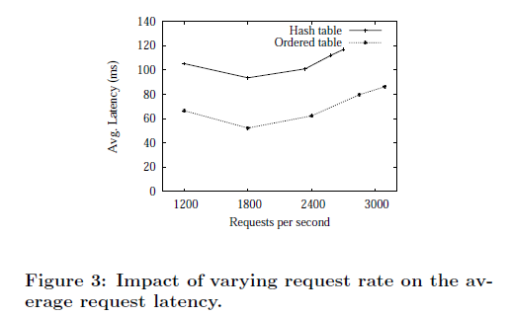
Experiments
Inserts
  required 75.6 ms per insert in West 1 (tablet master)
  131.5 ms per insert into the non-master West 2, and
  315.5 ms per insert into the non-master East.

Slide 27
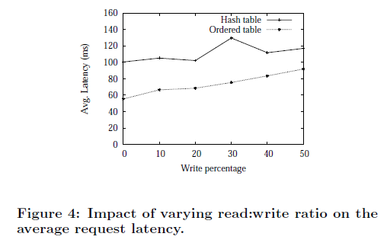
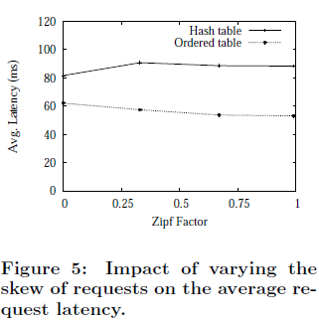
Experiments
Zipfian Distribution

Slide 28
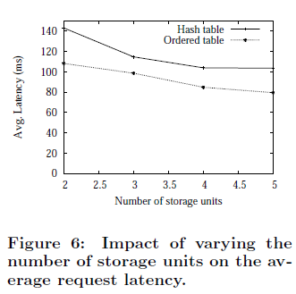
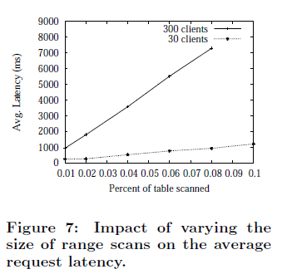
Experiments

Slide 29
Bottlenecks
Disk seek capacity on storage units
Message Brokers
  Different PNUTS customers are assigned different clusters of storage units and message broker machines. Can share routers and tablet controllers.

Slide 30
PNUTS
Structure
Features
Data and Query Model
System Architecture
Data Storage and Retrieval
Consistency (Yahoo! Message Broker)
Recovery
Query Processing
Experiments
Future Work

Slide 31
Future Work
Consistency
  Referential integrity
  Bundled update
  Relaxed consistency
Data Storage and Retrieval:
  Fair sharing of storage units and message brokers
Query Processing
  Query optimization: Maintain statistics
  Expansion of query language: join/aggregation
  Batch-query processing
Indexes and Materialized views
Related Question

Slide 32
Question 1 (Dolphia Nandi)
Q. In section 3.3.2:Consistency via YMB and mastership~~
It is saying that 85% of writes to a record originate from the same data center which obviously justify locating the master at that point.
Now my question is remaining 15% (with timeline consistency) must go across the wide area to the master and making it difficult to enforce SLA which is often set to 99%. What is your thought about this?
A. SLA’s define a requirement of 99% availability. The remaining 15% of traffic that needs wide-area communciation increases latency and does not effect availability.
Back

Slide 33
Question 2 (Dolphia Nandi)
Q. Can we develop a strong consistent system which will deliver acceptable performance and maintains availability in the face of any single replica failure?
Or is it still a fancy dream?
A. Strong consistency means ACID. ACID properties are in trade-off with availability, graceful degradation and performance. See references 1,2 and 17. This tradeoff is fundamental.
CAP theorem (2000) outlined by Eric Brewer. It says that a distributed database system can only have at most two of the following three characteristics:
  Consistency
  Availability
  Partition tolerance
Also see the NRW notation that describes at a high level how a distributed database will trade off consistency, read performance and write performance
http://www.infoq.com/news/2008/03/ebaybase
.

Slide 34
Question 3 (Dr. Murat Demirbas)
Q. Why would users need table-scans, scatter-gather operations, bulk loading? Are these just best effort operations or is some consistency provided?
A. Some social applications may need these functionalities for instance, searching through all the available users to find the ones that reside in Buffalo, NY. Bulk loading may be needed in user database like applications, for uploading statistics of page views
At the time this paper was written
  Technology was there to optimize bulk loading. However, for consistency, the paper says, “In particular, we make no guarantees as to consistency for multi-record transactions. Our model can provide serializability on a per-record basis. In particular, if an application reads or writes the same record multiple times in the same “transaction,” the application must use record versions to validate its own reads and writes to ensure serializability for the “transaction.”
  Scatter-gather are best effort operations. They propose bundled updates-like consistency operations as future work.
No major literature available since then.

Slide 35
Question 4a (Dr. Murat Demirbas)
Q. How does primary replica recovery and replica recovery work?
A. In slides.
Q. Is PNUTS (or components of PNUTS) available as open source?
A. No. (Source: http://wiki.apache.org/hadoop/Hbase/PNUTS)
Back

Slide 36
Question 4b (Dr. Murat Demirbas)
Q. Can PNUTS work in a partitioned network? How does conflict resolution work when the network is united again?
A. In this mentioned as future work.“Under normal operation, if the master copy of a record fails, our system has protocols to fail over to another replica. However, if there are major outages, e.g., the entire region that had the master copy for a record becomes unreachable, updates cannot continue at another replica without potentially violating record-timeline consistency. We will allow applications to indicate, per-table, whether they want updates to continue in the presence of major outages, potentially branching the record timeline. If so, we will provide automatic conflict resolution and notifications thereof. The application will also be able to choose from several conflict resolution policies: e.g., discarding one branch, or merging updates from branches, etc.
Back

Slide 37
Question 5 (Dr. Murat Demirbas)
Q. How do you compare PNUTS algorithm with the Paxos algorithm?
PNUTS though uses leadership is not entirely based on Paxos algorithm. It does not need a quorum to agree before deciding to execute/commit a query. The query is first executed and then applied to rest of the replicas.
That being said, it does however seem to use it in publishing to the YMB (unless it uses chain replication, or something else).

Slide 38
Question 6 (Fatih)
Q. Is there any comparison with other data storage systems like Cassandra of Facebook, because it seems like latency is quite a bit high for figures (e.g. Figure3). In addition, when I was reading I was surprised with the quality of machines used in the experiment (Table 1). Could it be a reason for high latency?
SLA guaratees generally start from 50 ms and extend up to 150 ms across geographically diverse regions. So the first few graphs are within the SLA agreement, unless the number of clients is increased (in which case, a production environment can load balance to provide better SLA). It is an experimental setup, hence the limitations.
Here is a link to such comparisons (Cassandra, Hbase, Sherpa and MySQL): http://www.brianfrankcooper.net/pubs/ycsb-v4.pdf
These systems are not similar, for instance, Cassandra is P2P.

Slide 39
Question 7 (Hanifi Güneş)
Q. PNUTS leverages locality of updates. Given the typical applications running over PNUTS, we can say that the system is designed for single-write-multiple-read applications, say, in case of Flickr or even Facebook where only a single user is permissible to write and all others to see. Locality of updates, thus, seems a good cut for this design. How can we translate what we have learned from PNUTS in to multiple-read-multiple-write applications like a wide-area file system? Any ideas?
PNUTS is not strictly single-read-multiple-write, but good conflict resolution is the key if it needs to handle multiple-writes more effectively. PNUTS serves a different function than a wide-area file system. It is designed for simple queries of web traffic.
Also, in case of a primary replica failure or partition, where/how exactly are the new coming requests routed? And how is the data consistency ensured in case of a 'branching' (the term, branching, is used in the same context as mentioned in the paper, pg 4)? Can you throw some light on?
A. Record has soft state metadata. Resolving branching is future work.

Slide 40
Question 8 (Yong Wang)
Q. In section 2.2 about per-record timeline consistency, it seems that consistency is serializability. All updates are forwards to master, suppose there are two replica who update their record at the same time, according to the paper, they would forward update record to master, since their timeline is similar (update at the same time), how the master recognize that scenario?
A. Tablet masters resolve this scenario.
Back

Slide 41
Question 9 (Santosh)
Sec 3.21: How are changes in data handled while the previous data is yet to be updated to all the systems ?
Versioning of updates for timeline consistency.
How are hotspots related to user profiles handled?
A. In slides.
Back (Consistency Model)
Back (Bulk load)

Slide 42
Question 10
The author states In section 3.2.1 "While stronger ordering guarantees would simplify this protocol (published messaging), global ordering is too expensive to provide when different brokers are located in geographically separated datacenters." Since this paper was published in 2008, has any work been done to provide for global ordering and to mitigate the disadvantage of being too expensive? Wouldn't simplifying the protocol make it easy for robustness and further advancement?
They have done optimizations of Sherpa but have not really changed the basic PNUTS design, or at least have not published.
Global ordering being expensive translates to the fundamental trade-off of consistency vs performance.
Simplifying how? This is the simplest Yahoo! tried to keep it while still meeting the demands of their applications.

Slide 43
Thank you !!

Slide 44
Additional Definitions
JSON (JavaScript Object Notation) is a lightweight data-interchange format. It is easy for humans to read and write. It is easy for machines to parse and generate.
InnoDB is a transactional storage engine for the MySQL open source database.
Soft state expires unless it is refreshed.
A transaction schedule has the Serializability property, if its outcome (e.g., the resulting database state, the values of the database's data) is equal to the outcome of its transactions executed serially, i.e., sequentially without overlapping in time.
Source: http://en.wikipedia.org
Back

Slide 45
Zipfian distribution
A distribution of probabilities of occurrence that follows Zipf’s Law.
Zipf’s Law: The probability of occurrence of words or other items starts high and tapers off. Thus, a few occur very often while many others occur rarely
Formal Definition: P_{n} 1/nª, where P_{n} is the frequency of occurrence of the n^{th} ranked item and a is close to 1.
Source: http://xw2k.nist.gov
Back

Slide 46
Bulk loading support
An approach in which a planning phase is invoked before the actual insertions. By creating new partitions and intelligently distributing partitions across machines, the planning phase ensures that the insertion load will be well-balanced.
Source: A. Silberstein, B. F. Cooper, U. Srivastava, E. Vee, R. Yerneni, and R. Ramakrishnan. Efficient bulk insertion into a distributed ordered table. In Proc. SIGMOD, 2008.
Related Question

Slide 47
Consistency model
Goal: make it easier for applications to reason about updates and cope with asynchrony
What happens to a record with primary key “Brian”?
Record inserted
Update
Update
Update
Update
Update
Update
Update
Delete
v. 1
v. 2
v. 3
v. 4
v. 5
v. 6
v. 7
v. 8
Time
Generation 1
Time

Slide 48
Consistency model
Read
Stale version
Stale version
Current version
v. 1
v. 2
v. 3
v. 4
v. 5
v. 6
v. 7
v. 8
Time
Generation 1

Slide 49
Consistency model
Read up-to-date
Stale version
Stale version
Current version
v. 1
v. 2
v. 3
v. 4
v. 5
v. 6
v. 7
v. 8
Time
Generation 1

Slide 50
Consistency model
Read-critical(required version):
Read ≥ v.6
Stale version
Stale version
Current version
v. 1
v. 2
v. 3
v. 4
v. 5
v. 6
v. 7
v. 8
Time
Generation 1

Slide 51
Consistency model
Write
Stale version
Stale version
Current version
v. 1
v. 2
v. 3
v. 4
v. 5
v. 6
v. 7
v. 8
Time
Generation 1

Slide 52
Consistency model
Test-and-set-write(required version)
Write if = v.7
ERROR
Stale version
Stale version
Current version
v. 1
v. 2
v. 3
v. 4
v. 5
v. 6
v. 7
v. 8
Time
Generation 1

Slide 53
Consistency model
Write if = v.7
ERROR
Stale version
Stale version
Current version
Mechanism: per record mastership
v. 1
v. 2
v. 3
v. 4
v. 5
v. 6
v. 7
v. 8
Time
Generation 1
Back

Slide 54
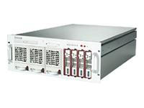

What is PNUTS?
A 42342 E
A 42342 E
B 42521 W
B 42521 W
C 66354 W
C 66354 W
D 12352 E
D 12352 E
E 75656 C
E 75656 C
F 15677 E
F 15677 E
Parallel database
Geographic replication
A 42342 E
B 42521 W
C 66354 W
Structured, flexible schema
D 12352 E
E 75656 C
F 15677 E
Hosted, managed infrastructure

Slide 55
Detailed architecture
Clients
Data-path components
REST API
Routers
Message
Broker
Tablet
controller
Storage units

Slide 56
Detailed architecture
Local region
Remote regions
Clients
REST API
Routers
YMB
Tablet controller
Storage
units

Slide 57
Accessing data
4
1
Record for key k
Get key k
2
3
Get key k
Record for key k
SU
SU
SU

Slide 58
Bulk read
1
{k₁, k₂, … k_{n}}
Get k₁
2
Get k₂
Get k₃
SU
SU
SU
Scatter/
gather server

Slide 59
Range queries
Apple
Avocado
Banana
Blueberry
MIN-Canteloupe
MIN-Canteloupe | SU1
Canteloupe-Lime | SU3
Lime-Strawberry | SU2
Strawberry-MAX | SU1
SU1
Grapefruit…Pear?
Canteloupe-Lime
SU3
Lime-Strawberry
SU2
Grapefruit…Lime?
Canteloupe
Grape
Kiwi
Lemon
Strawberry-MAX
SU1
Router
Lime…Pear?
Lime
Mango
Orange
Strawberry
Tomato
Watermelon
Storage unit 1
Storage unit 2
Storage unit 3

Slide 60
Updates
8
1
Sequence # for key k
Write key k
Routers
Message brokers
3
Write key k
2
4
7
Write key k
Sequence # for key k
5
SU
SU
SU
SUCCESS
6
Write key k

Slide 61
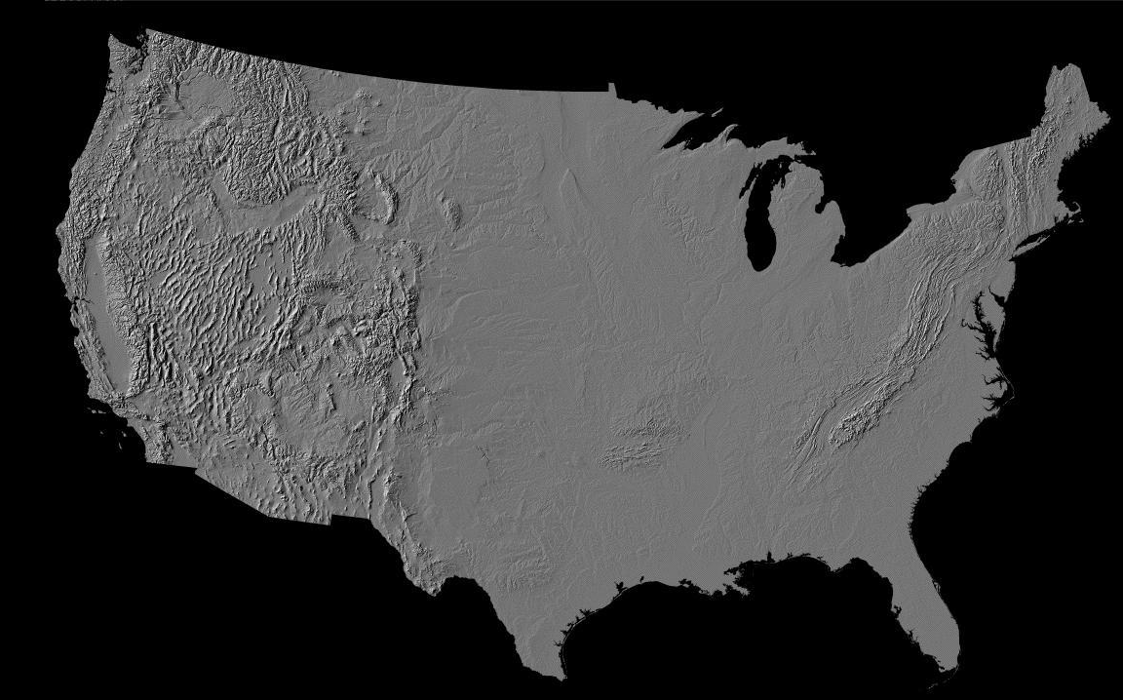


Asynchronous replication
Back

