Slide 1
CS5543 Real-time Big Data Analytics Tutorial 1-2: Spark -1

Slide 2
Ways to use spark
Spark Local Installation (Explained in first section of this ppt)
Running spark in IntelliJ (Recommended)

Slide 3
Overview
Installation of spark locally
Spark – WordCount
Running WordCount in IntelliJ
Running WordCount in VMWare/ locally

Slide 4
Installation of spark locally

Slide 5
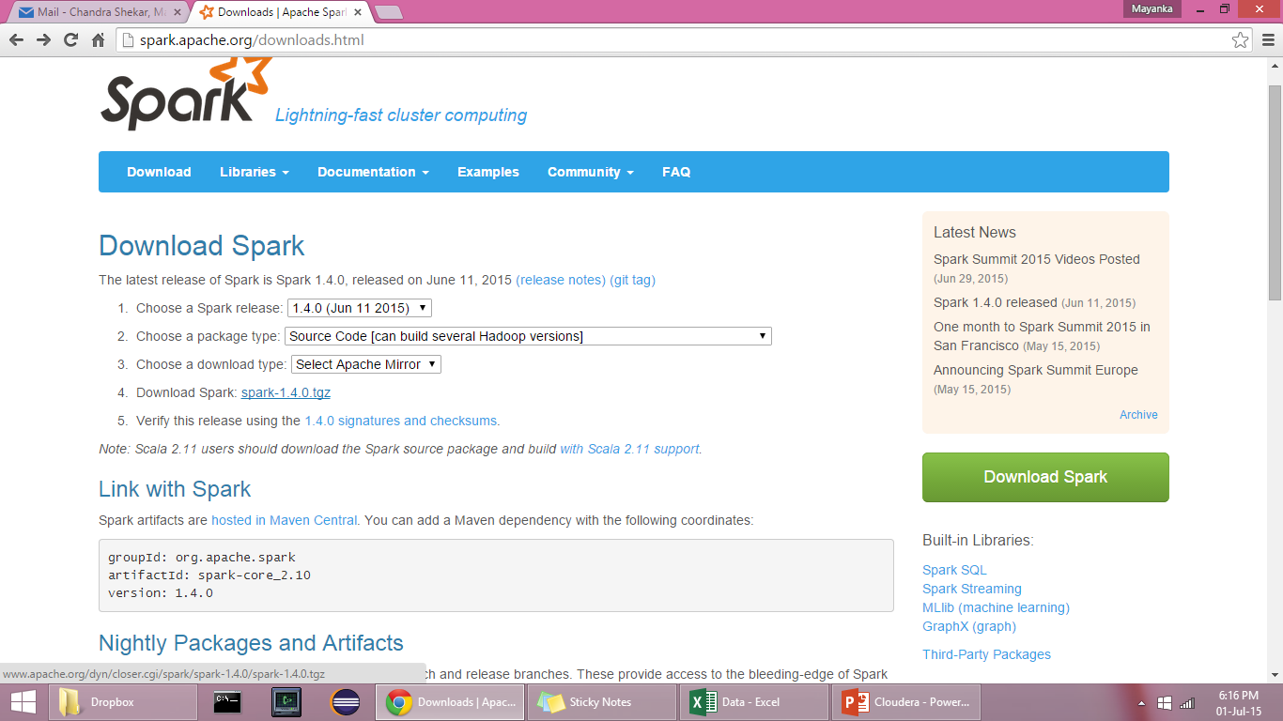
Install Apache Spark Locally
http://spark.apache.org/downloads.html

Slide 6
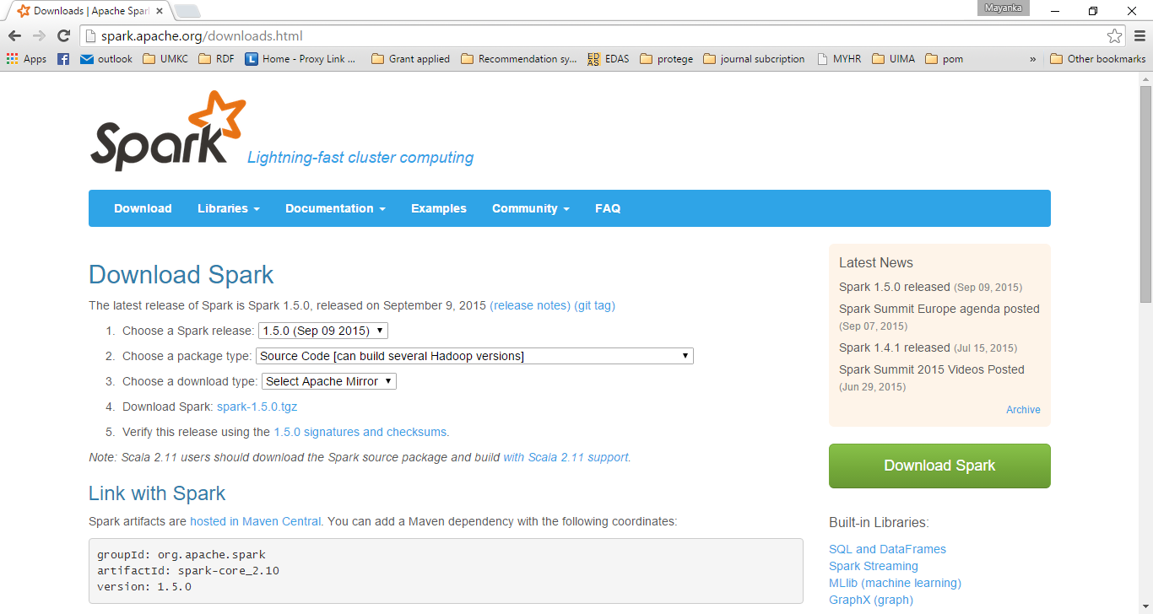

Slide 7
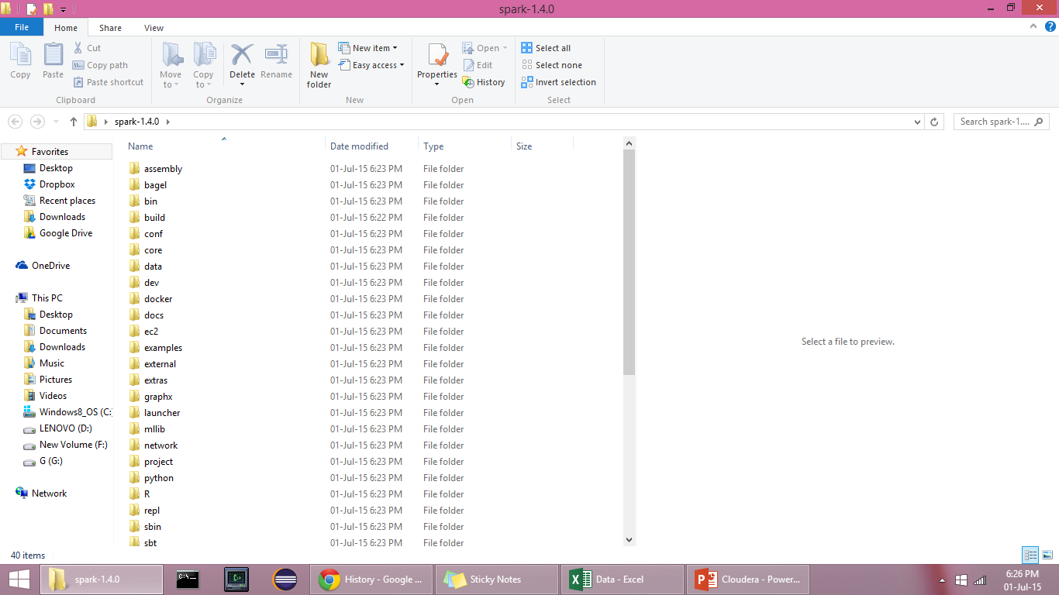
spark-1.5.0.tgz will be downloaded
Use Winrar or some tool to extract the archived file on to the destination folder.

Slide 8
Git
Install Git because the Spark building relies on Git repos.
Don’t forget to check the option to install git command to command prompt.
From now on, use the Git bash tool instead of the Command prompt. Because it depicts the unix terminal style commands.

Slide 9
SBT
http://www.scala-sbt.org/0.13/tutorial/Installing-sbt-on-Windows.html
Install SBT.
Now go to the root folder of spark using terminal/Command Prompt

Slide 10
Building Spark
Go to Git Bash.
To the spark folder and run the following command.
bulid/sbt clean assembly.
It takes a while to bulid spark

Slide 11
Starting Spark
Use the terminal to run spark-shell.
Go to spark1.5.0/bin folder.
Run the following command
spark-shell : spark-shell command opens a scala terminal
You can use this terminal, to type scala commands to execute

Slide 12
Spark – WordCount

Slide 13
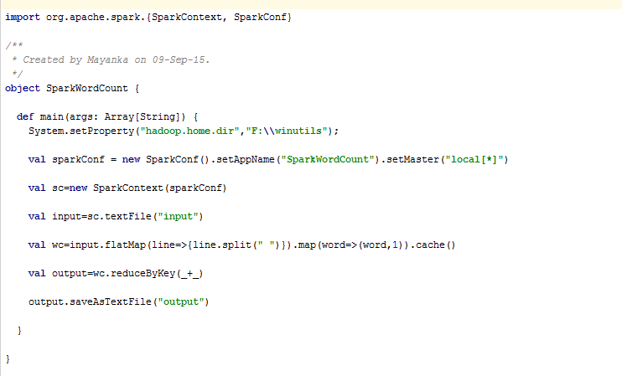
Spark - Word Count : Code Snippet

Slide 14
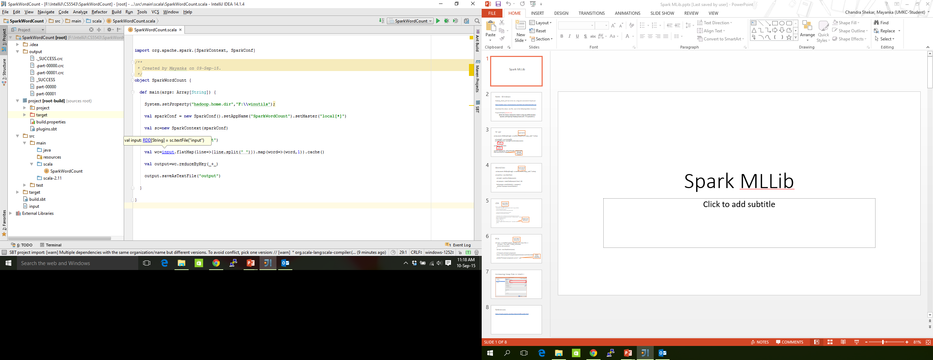
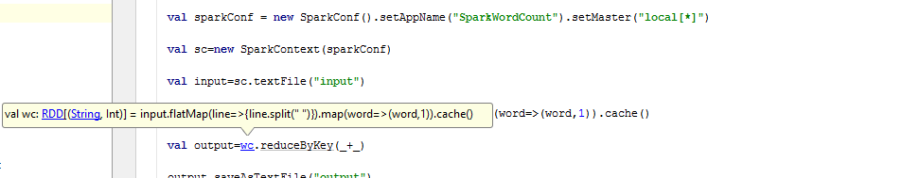
Spark FlatMap and Map Functions

Slide 15
Note : Windows
Hadoop_Home_Dir has to be set, a bug not corrected in Spark yet.
http://public-repo-1.hortonworks.com/hdp-win-alpha/winutils.exe
Download the above .exe file, save in the following folder structure
F:\winutils\bin\winutils.exe
Write the below statement, before using any Mlib function
System.setProperty("hadoop.home.dir","F:\\winutils");

Slide 16
Running WordCount in IntelliJ

Slide 17
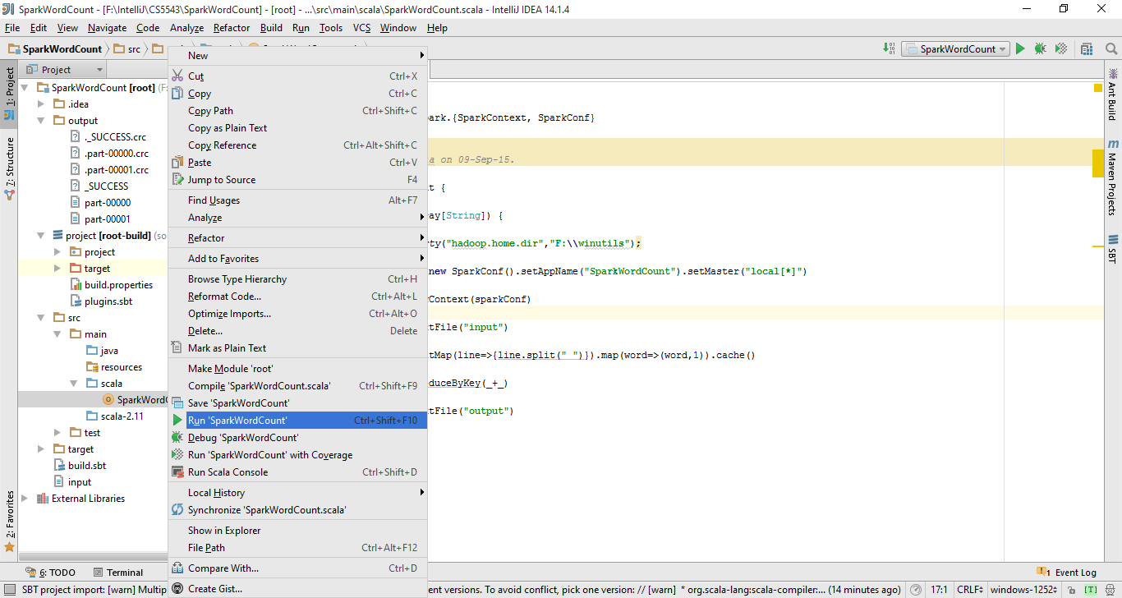
Run The Main Class

Slide 18
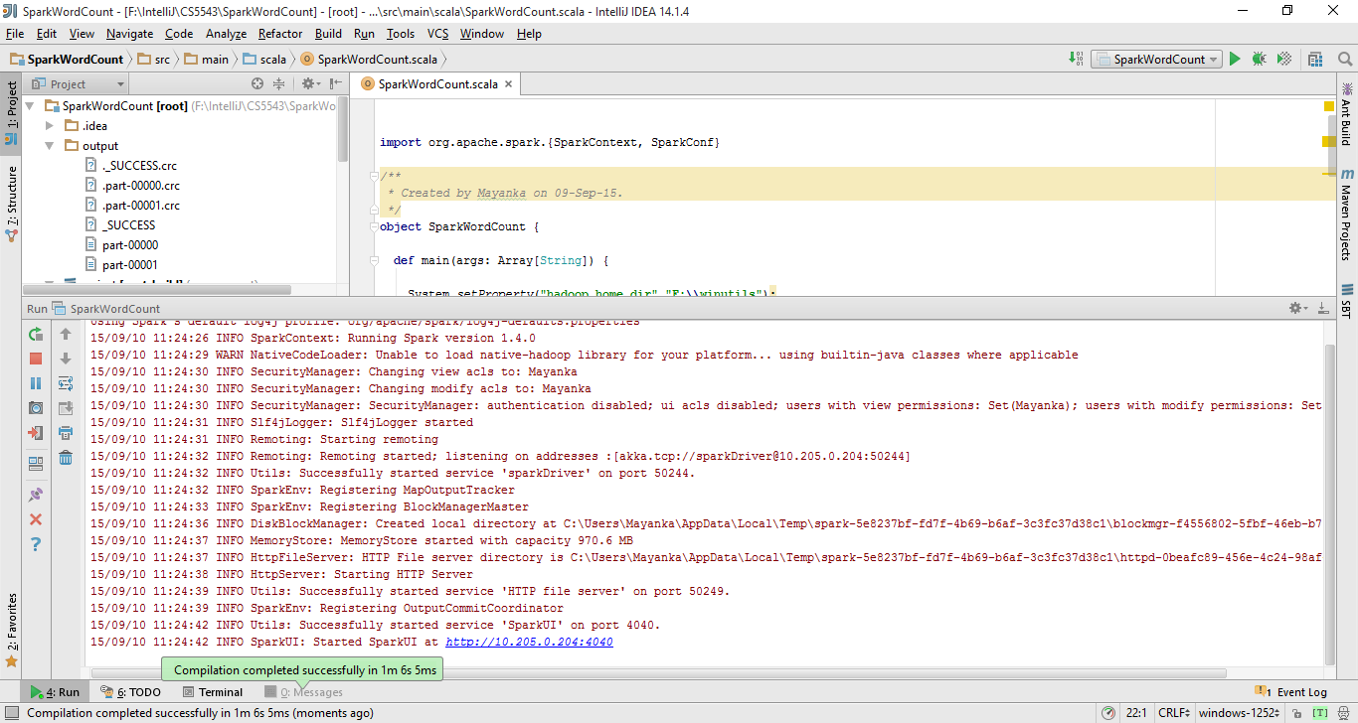

Slide 19
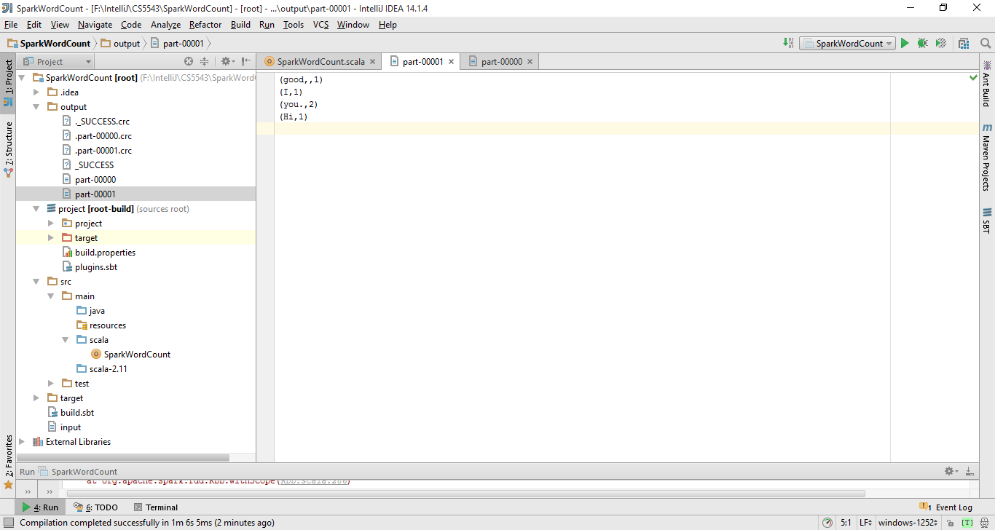
Output Folder

Slide 20
Running WordCount in VMWare/ locally

Slide 21
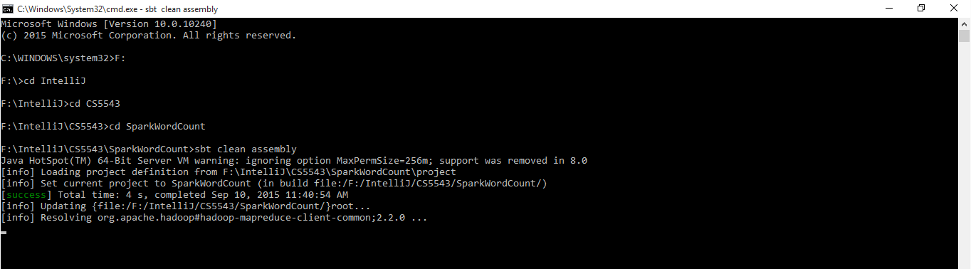
Creation of Fat Jar

Slide 22
Run in VMWare / locally
spark-submit --class <MainClass> <jar-name>

