Slide 1
Resnet9 architecture

Slide 2
Agenda:
Introduction on Resnet
Dataset – CIFAR10
Resnet9
Hyperparameters –
Optimizers
Epoch
Dropout
Learning rate
Experiments around hyperparameters
Analysis

Slide 3
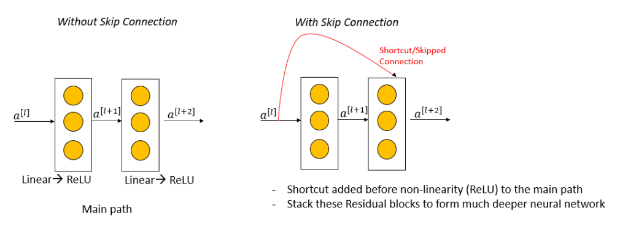
Introduction on Resnet
A residual network, or ResNet for short, is an artificial neural network that helps to build deeper neural network by utilizing skip connections or shortcuts to jump over some layers. Skipping connections helps build deeper network layers without falling into the problem of vanishing gradients.
There are different versions of ResNet, including ResNet-9 ,ResNet-18, ResNet-34, ResNet-50, and so on. The numbers denote layers, although the architecture is the same.
Notes:
Source: https://www.coursera.org/lecture/convolutional-neural-networks/resnets-HAhz9

Slide 4
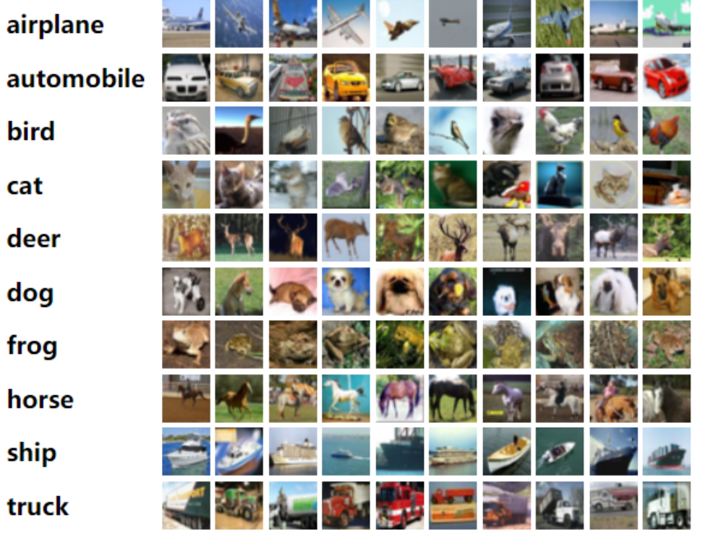
Dataset
CIFAR10 dataset has been used. CIFAR stands for Canadian Institute for Advanced Research. The CIFAR10 dataset consists of 60,000 32x32 color images, belonging to 10 classes with 6,000 images per class. The ten classes of image in it are frog, bird, automobile, airplane, cat, dog, truck, horse, ship, deer. There are 50,000 images for training data with 5,000 images per class and 10,000 for testing the model with 1000 images per class.
Notes:
https://paperswithcode.com/dataset/cifar-10

Slide 5
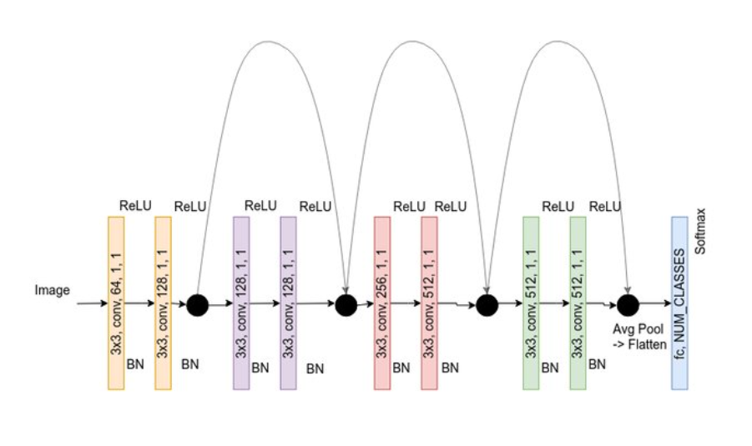
Resnet9
It uses two types of layers:
Convolution layers: There are 8 convolutional layers, which are used for feature extraction
Linear layer: there is 1 linear layer, final classification layer
Notes:
Source: https://www.researchgate.net/publication/363585139_Deep_learning_in_a_bilateral_brain_with_hemispheric_specialization/figures?lo=1

Slide 6
Hyperparameters –
Optimizers - [ SGD, Adam, RMSprop ]
Epoch – [10, 20, 25, 30]
Learning rate – [0.01, 0.001]
Dropout – [0.2, 0.4]
Weight decay – 0.0001

Slide 7
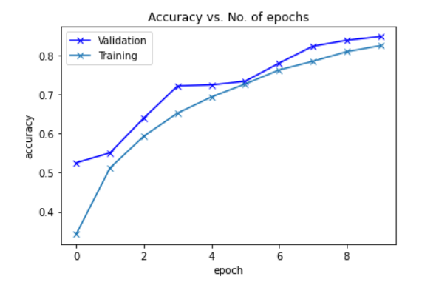
Model 1: Resnet9
Epochs : 10
Optimizer : SGD
Learning rate : 0.01
Weight_decay : 0.0001

Slide 8
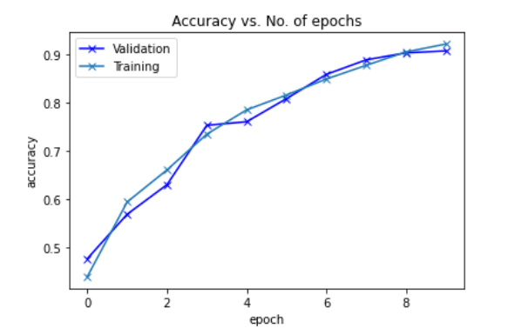
Model 2: Resnet9
Epochs : 10
Optimizer : Adam
Learning rate : 0.01
Weight_decay : 0.0001

Slide 9
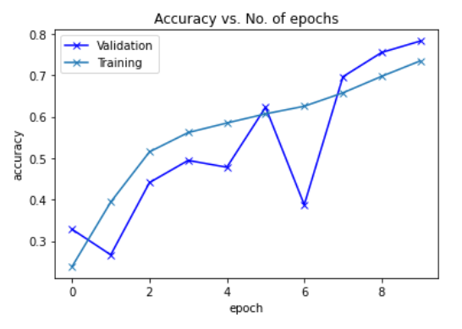
Model 3: Resnet9
Epochs : 10
Optimizer : RMSprop
Learning rate : 0.01
Weight_decay : 0.0001

Slide 10
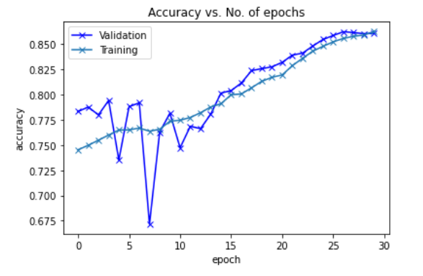
Model 4: Resnet9
Epochs : 30
Optimizer : Adam
Learning rate : 0.01
Weight_decay : 0.0001

Slide 11
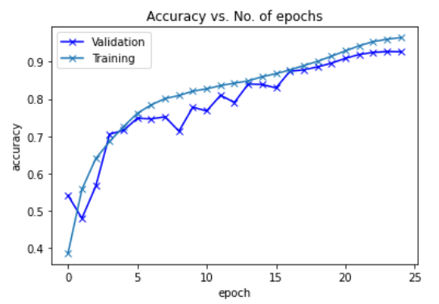
Model 5: Resnet9
Epochs : 25
Optimizer : Adam
Learning rate : 0.01
Weight_decay : 0.0001

Slide 12
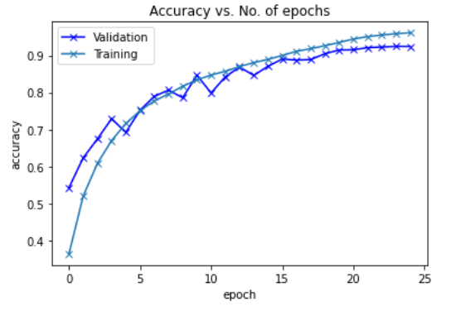
Model 6: Resnet9
Epochs : 25
Optimizer : Adam
Learning rate : 0.001
Weight_decay : 0.0001

Slide 13
Summary of all experiments
Hyperparameters | Model 1 | Model 2 | Model 3 | Model 4 | Model 5 | Model 6 | Model 7
Epoch | 10 | 10 | 10 | 30 | 25 | 25 | 25
Optimizer | SGD | Adam | RMSprop | Adam | Adam | Adam | Adam
Learning Rate | 0.01 | 0.01 | 0.01 | 0.01 | 0.01 | 0.01 | 0.001
Dropout | 0.2 | 0.2 | 0.2 | 0.2 | 0.2 | 0.4 | 0.2
Observation | Model accuracy is 84.8% | Model accuracy increased to 92% | Model accuracy decreased to 78% | Model accuracy is 86% | Model accuracy increased to 92.6% | Model accuracy decreased to 89% | Model accuracy remains comparable to 92.4%

Slide 14
Results
- Adam optimizer gives better accuracy than SGD and RMSprop
- Increasing the epoch leads to better accuracy, but further increasing the epoch value leads to accuracy decrease
- Increasing dropout from 20% to 40%, decreases the accuracy
- Decreasing the learning rate from 0.01 to 0.001, gives comparable accuracy value

