Slide 1




Sustainable Industry
Rinse over Run
Submitted By: Meetu
Tarun

Slide 2
01
Introduction
Analytical Methods
05
02
Data Description
Findings
06
Agenda
03
Research Question
Limitations
07
04
Data Cleaning

Slide 3
Introduction
Data Driven Challenge
Save Water
Data collected from Driven Data website to predict return turbidity
Running dishwasher only when full, can save average family nearly 320 gallons of water annually
Food related Illnesses
Rigorous cleaning standards
47.8 million estimated annual illnesses related to food in the US (Cdc.gov)
3,037 deaths annually
Rigorous multi-phase cleaning industry standard: rinse, clean, rinse and sanitize

Slide 4
Data Description
Training and Testing Data
Training: 1703361 KB / 1048576 rows / 36 columns
Test data: 532281 KB / 1048576 rows / 36 columns
Dependent Variable: return_turbidity_final (continuous variable), calculated from return_flow and return_turbidity variables
return_turbidity_final = SUM(MAX(0, return_flow) * return_turbidity )
Independent Variables: selected features including categorical and continuous
'process_id', 'supply_flow’, 'supply_pressure’, 'return_flow’, 'return_turbidity’, 'object_id’, 'return_temperature’, 'return_conductivity’, 'tank_level_pre_rinse’, 'tank_level_caustic’, 'tank_level_acid’, 'tank_level_clean_water',
'tank_temperature_pre_rinse','tank_temperature_acid’, 'acid', 'caustic', 'intermediate_rinse’, 'pre_rinse'

Slide 5


Research Question
To predict turbidity in all the phase to help minimize the use of water, energy and time, while ensuring high cleaning standards.

Slide 6
Data Cleaning
Creating Y
Summary Stats
One hot encoding
Grouping
Feature Engineering
Computed column:
Y variable- return_turbidity_final = SUM(MAX(0, return_flow) * return_turbidity)
Check the summary statistics and define ranges for the continuous variables
E.g. Turbidity cannot be negative, we replaced it with a 0
Creating dummies for our phases and pipelines.
E.g. the process pre_rinse – caustic – intermediate_rinse – acid – final_rinse means 11111
Grouping phases by process_id as each process id contains multiple phases.
We only want to predict for each phase.
Implemented Backward Selection & Random Forest Feature Importance
To identify significant features to be used in the model

Slide 7
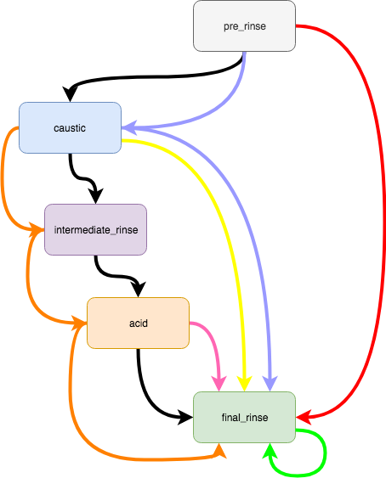
Plots

Slide 8
Analytical Methods
Linear Regression
Lasso Regression
Ridge Regression
Elastic Net Regularization
Random Forest Regressor
No penalty
General prediction on the continuous variable
Impose L1 penalty
To impose sparsity among the coefficients to make model more interpretable
Impose L2 penalty
To limit the size of the coefficient vector
Imposes L1 and L2 penalty
Uses a combination of both Lasso and Ridge Regression as a compromise between Lasso and Ridge
Random Forest Regression with 100 decision trees and Hyperparameter Tuning:
Depth = Max_depth
Min leaf = 1
Random state = 32

Slide 9
Findings
Phase | Score | Linear | Lasso | Ridge | Elastic | Random Forest
Pre_Rinse | Train R-squared | 0.536 | 0.536 | 0.536 | 0.535
 | Test R-squared | 0.4758 | 0.4758 | 0.4758 | 0.475
 | RMSE | 14603 | 14603 | 14603 | 14604 | 2022
Caustic | Train R-squared | 0.799 | 0.798 | 0.798 | 0.798
 | Test R-squared | 0.7477 | 0.7477 | 0.7477 | 0.7477
 | RMSE | 14036 | 14038 | 14036 | 14036 | 2140
Intermediate_Rinse | Train R-squared | 0.755 | 0.755 | 0.755 | 0.755
 | Test R-squared | 0.6575 | 0.657 | 0.657 | 0.6575
 | RMSE | 12702 | 12700 | 12702 | 12702 | 2256
Acid | Train R-squared | 0.791 | 0.791 | 0.791 | 0.791
 | Test R-squared | 0.7095 | 0.7096 | 0.7095 | 0.7096
 | RMSE | 7025 | 70239 | 70252 | 70245 | 1238
Recommendations
Most Important Variables in Prediction of Final_Turbidity: return_temperature, return_conductivity, tank_temperature, supply_flows

Slide 10
Limitations
Large Dataset
Took us overnight to run the models and tuning in Python. Time period in getting Cluster access was long
Sparse Data for Dependent Variable
Our dependent variable ranged from 0 to 42128
Complex Models
Decision Trees, XGBoost, LightGBM, Neural networks

Slide 11
Thank you
Any Questions?

