Slide 1
Transformers -Meetu

Slide 2
AGENDA
Word Embeddings
Introduction about Transformer
Understanding important terms –
- Attention
- key-Query- Values
- Positional embeddings
- self Attention
Applications of transformers
Implementation using Hugging Face platform

Slide 3
Word Embeddings
In order to feed out text data into a neural network, we need to first encode it,
meaning transferring these words to numbers with a fixed-length vector
There are many types of word embeddings such as count vectors, TF-IDF vectors, Word2Vec etc. which are used in neural networks to perform NLP related tasks such as topic modeling, next word prediction, information retrieval etc.
RNNs are used to handle these embeddings, but there are certain drawbacks –
- They cannot retain the contextual meaning especially in long sentences (more than 30 words)
They are used in sequential manner, so computationally very expensive on complex tasks such as text translation, question-answer text generation.
Text

Slide 4
What is a Transformer?
Introduced in 2017, a transformer is a type of neural network or attention-based NN, which processes complex NLP tasks involving long sequences of data in text generation, summarization, generating codes, writing poems etc.
Transformers consider the entire input sequence at once rather than processing it sequentially
LSTM
LSTM
LSTM
LSTM
Transformer
What
is
your
name
What is your name

Slide 5
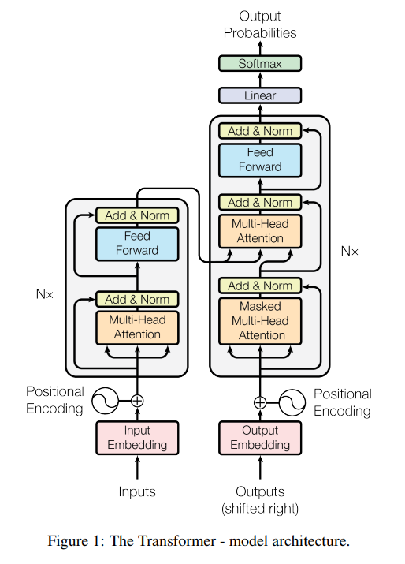
DECODER
ENCODER

Slide 6
3 Key Features in a transformer
It is not sequential in nature. It can work on word embeddings in parallel
Attention/Self attention mechanism – To capture the context of a word with respect to surrounding words, attention mechanism is used. In simple terms, it can differentiate the word “bank” (riverbank or financial institute) by considering its surrounding words
3. Positional Encoding – in this a number is assigned to each token in a sentence. So now instead of feeding the tokens, these numbers also are fed into the NN as a part of input text data that helps NN to learn about the word order
She
sings
really
well
1
2
3
4

Slide 7
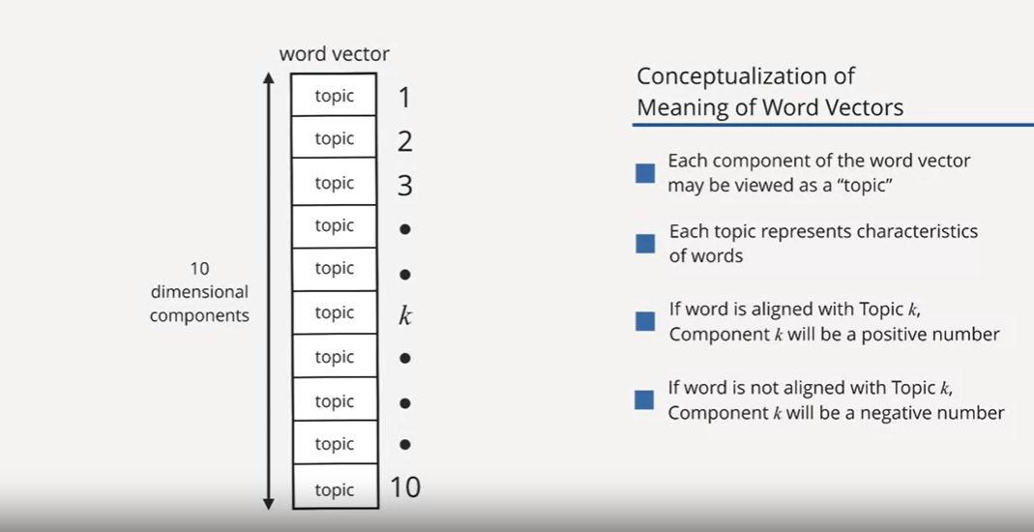
Inside the transformer

Slide 8
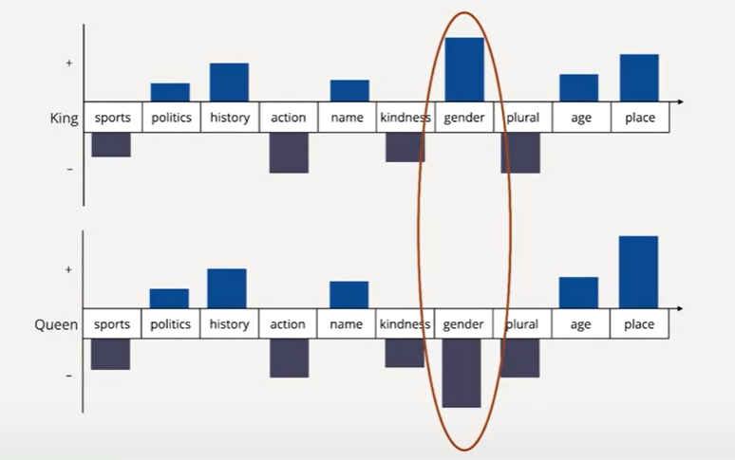
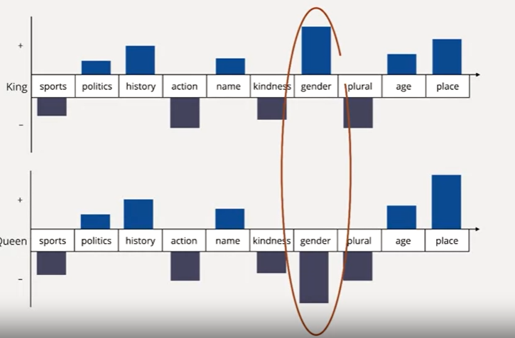

Slide 9
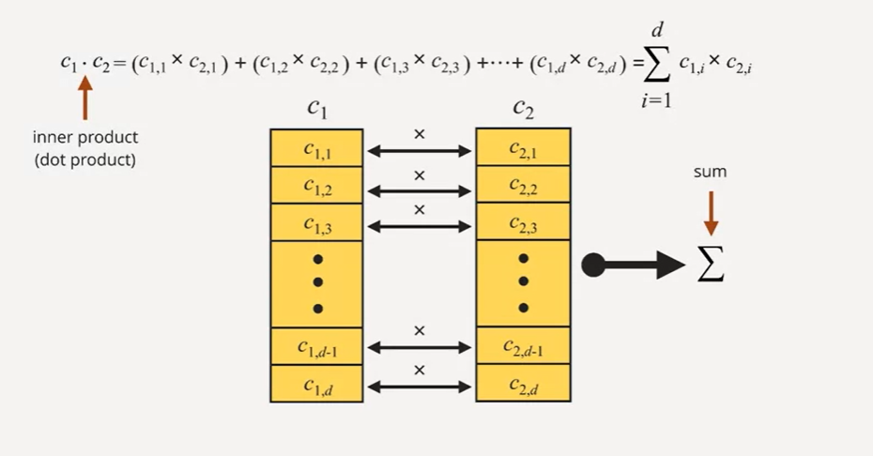
Inner(Dot) Product of word embeddings

Slide 10
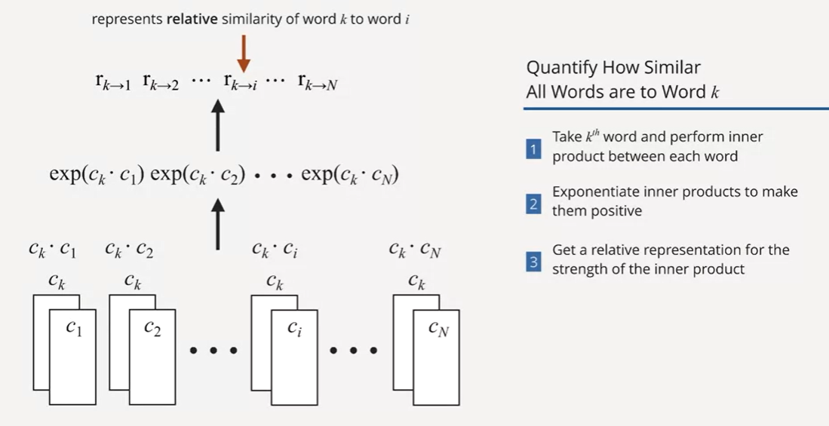
RELATIVE SIMILARITY

Slide 11
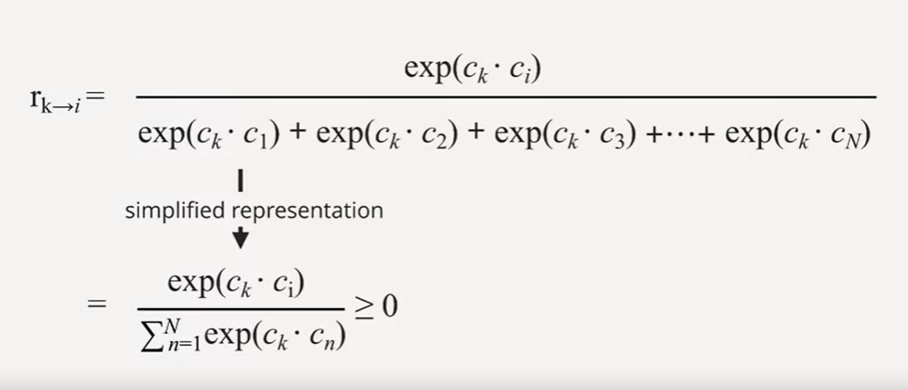
These relative weights are always between 0 and 1
Larger is the value, larger is the degree of correlation between the two words
Until this point, we have not considered “context” of the word

Slide 12
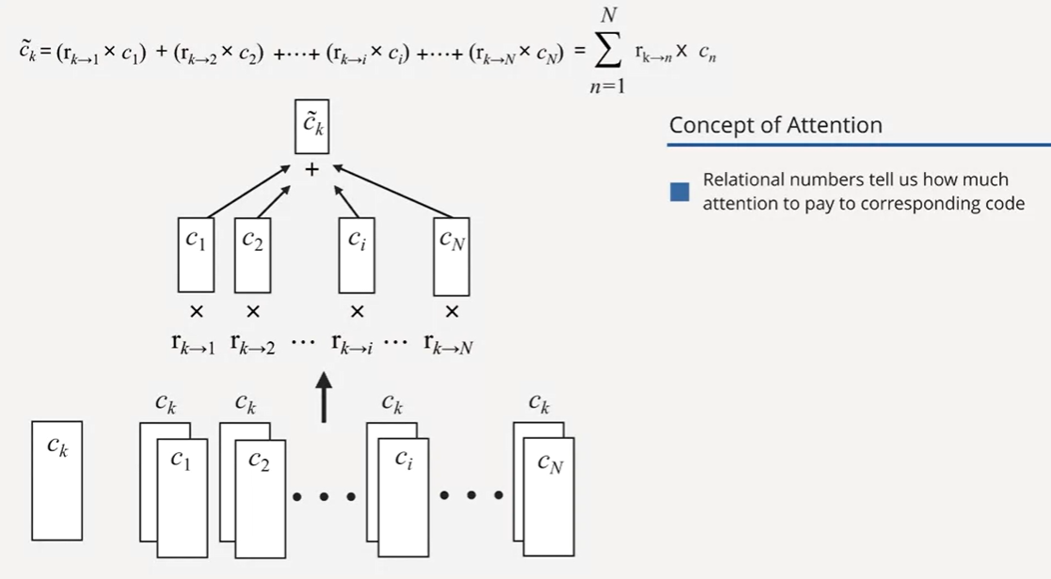
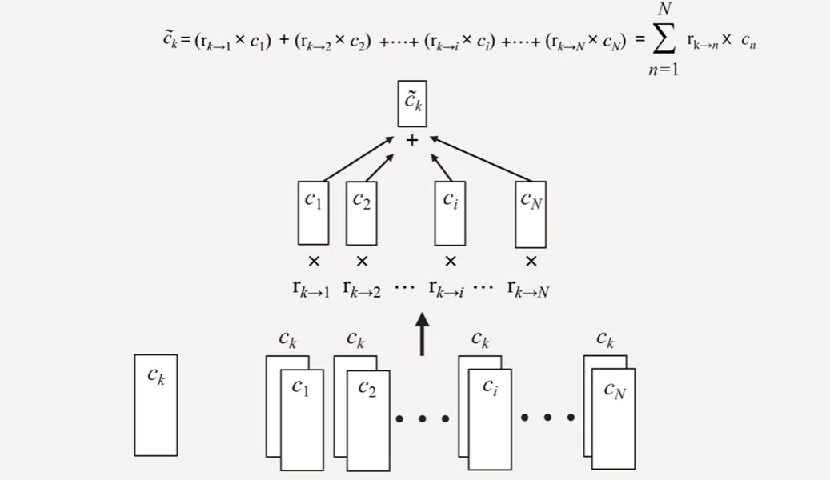
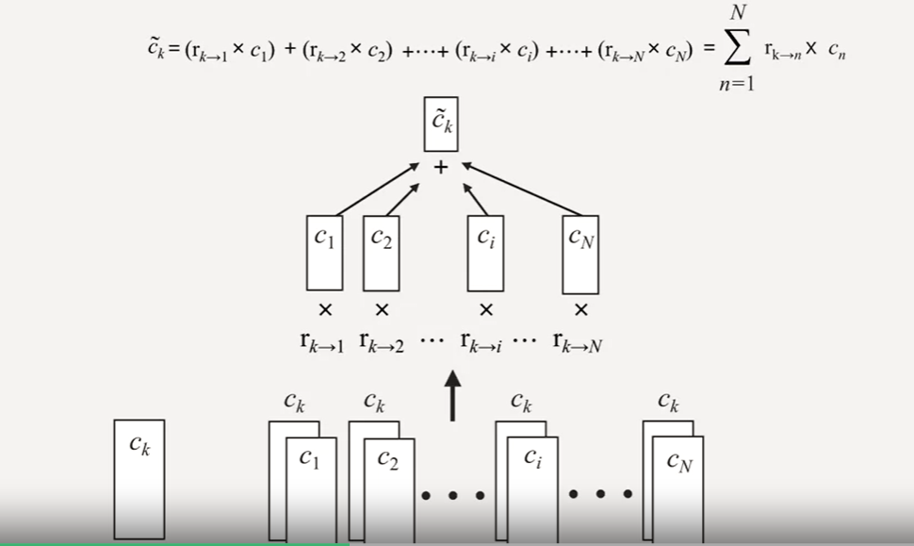

Slide 13
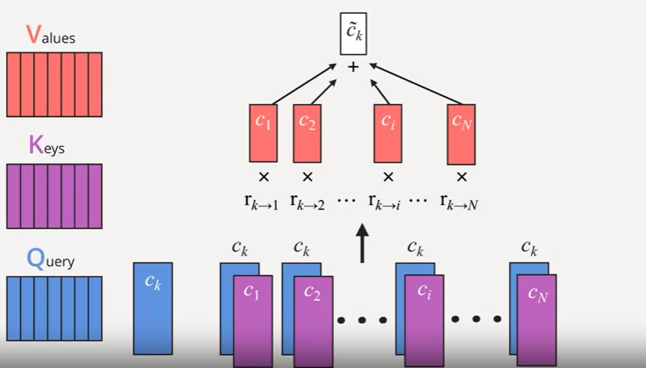
Queries, keys and Values

Slide 14
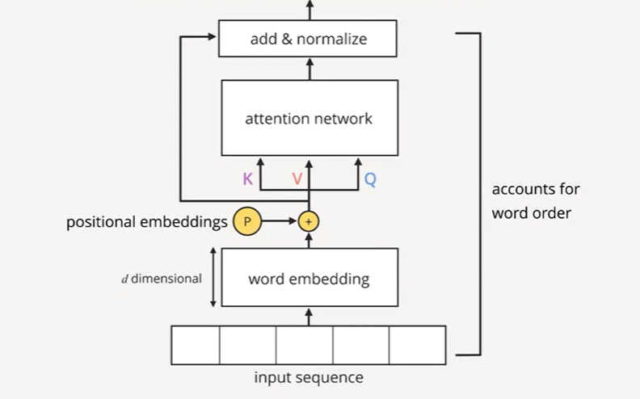
Adding positional embedding

Slide 15
Applications of transformers
Sentiment analysis: is a text positive or negative?
Text generation (in English): provide a prompt, and the model will generate what follows
Name entity recognition (NER): in an input sentence, label each word with the entity it represents (person, place, etc.)
Question answering: provide the model with some context and a question, extract the answer from the context
Summarization: generate a summary of a long text
Language Translation: translate a text into another language

Slide 16
Implementation using Hugging Face platform
Hugging Face Transformers is a platform that provides the community with APIs to access and use SOTA pre-trained models available on its website
It’s a platform with 60K models, 6K datasets and 6K demos, which helps people collaborate in their ML flows
The APIs are based on libraries such as Pytorch, Tensorflow, fastai etc.
The Hugging Face Transformers have pipelines, which provide an easy-to-use API through pipeline() method. It encapsulates the overall process of every Natural Language Processing task, such as text cleaning, tokenization, embedding and decoding.
Basic structure of pipeline :
from transformers import pipeline
# To use an existing pre-trained model
pipeline("<task-name>", model="<model_name>")

Slide 17
References:
https://www.datacamp.com/tutorial/an-introduction-to-using-transformers-and-hugging-face
https://jalammar.github.io/illustrated-transformer/
Vaswani, Ashish & Shazeer, Noam & Parmar, Niki & Uszkoreit, Jakob & Jones, Llion & Gomez, Aidan & Kaiser, Lukasz & Polosukhin, Illia, “Attention is all you need” , 2017.
https://www.coursera.org/learn/machine-learning-duke/lecture/AMoyH/self-attention-and-positional-encodings
https://peterbloem.nl/blog/transformers
https://huggingface.co/docs/transformers/autoclass_tutorial

Slide 18
THANK YOU

