Slide 1
8087 NUMERCAL DATA PROCESSOR
MATH Co-Processor

Slide 2
Compatible Processor and Coprocessor
Processors
1. 8086 & 8088
2. 80286
3. 80386DX
4. 80386SX
5. 80486DX
6. 80486SX
Coprocessors
1. 8087
2. 80287,80287XL
3. 80287,80387DX
4. 80387SX
5. It is Inbuilt
6. 80487SX

Slide 3
8087 NDP
It is a processor which works in parallel with the main processor.
It has its own set of specialized instructions.
The number crunching part of the program is executed by 8087.
Instruction for 8087 are written in the main program interspersed with the 8086 instructions.
All the 8087 instruction codes have 11011 as the most significant bits of their first code byte.

Slide 4
Pin Diagram of 8087
GND
1
40
Vcc
(A₁₄)
AD₁₄
2
39
AD₁₅
(A₁₃)
AD₁₃
3
38
A₁₆/S₃
(A₁₂)
AD₁₂
4
37
A₁₇/S₄
(A₁₁)
AD₁₁
5
36
A₁₈/S₅
(A₁₀)
AD₁₀
6
35
A₁₉/S₆
_____
BHE/S₇
(A₉)
AD₉
7
34
________
RQ/GT₁
(A₈)
AD₈
8
8087
NPX
33
AD₇
9
32
INT
AD₆
_______
RQ/GT₀
10
31
AD₅
11
AD₄
30
NC
12
AD₃
13
29
NC
_
S₂
AD₂
28
__
S₁
14
27
__
S₀
AD1
15
26
AD₀
16
25
QS₀
NC
17
24
QS₁
NC
18
23
BUSY
CLK
19
22
READY
GND
20
21
RESET

Slide 5
8087 DATA TYPES
Binary Integers
Packed Decimal Numbers
Real Numbers

Slide 6
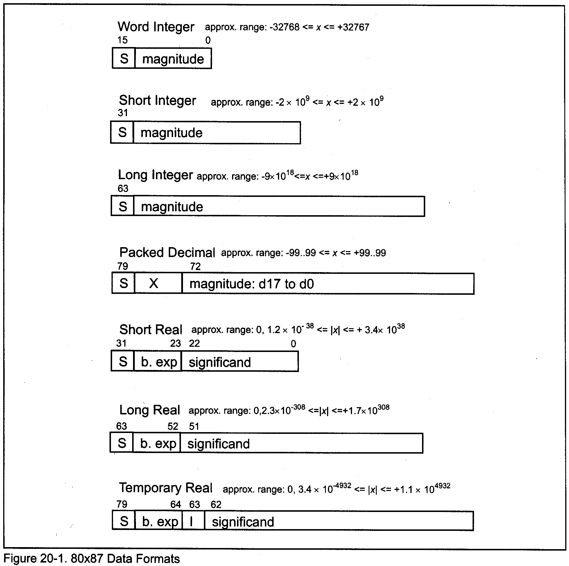
Different Data Representation of 8087

Slide 7
8087 recognizes three real data types
Short real, long real and temporary real
Number is stored as
(-1)^{S} X 2E X1.F
Short real : 8 bits for Biased exponent (E) and 23 bits for fraction.
E=exp+127
Let short real number is stored as
e.g. 0 10000010 01101100000000000000000
Exp=130-127=3
No is 1.011011 X 2³ =1011.011=11.375
Represent 20.59375 into short real format

Slide 8
10100 + .10011=10100.10011
1.010010011 X 2⁴
S=0 E=127=4=131=10000011
0 10000011 01001001100000000000000
Biased exponent with all 1 is reserved to represent NAN : overflow
Biased exponent with all 0 is reserved to show underflow

Slide 9
Long real 64 bit: 11 exponent bits and 52 fraction bits
8087 internally stored all numbers as temporary real(80 bits) : 15 bits for exponent and 64bits for mantissa
Assembler support directives
e.g. s_real dd 1.125
Long_int dq
BCD dt -91557
Tempreal dt -1.3

Slide 10
Architecture of 8087
Control Unit
Execution Unit

Slide 11
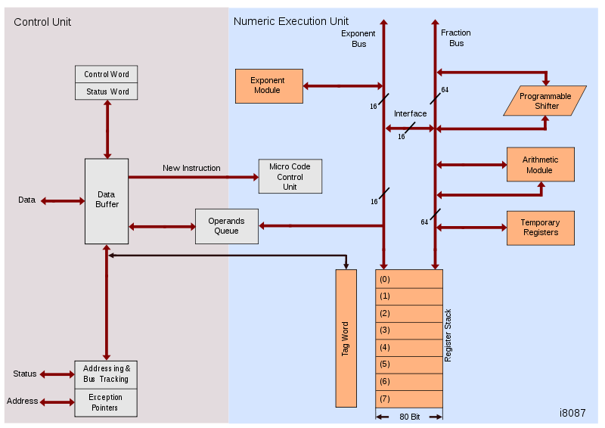
THE 8087 INTERNAL ARCHITECTURE

Slide 12
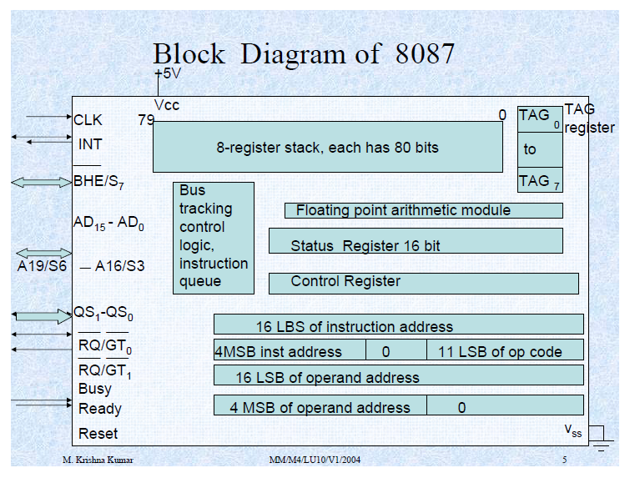

Slide 13
Control Unit
Control unit: To synchronize the operation of the coprocessor and the processor.
This unit has a Control word and Status word and Data Buffer
If instruction is an ESCape (coprocessor) instruction, the coprocessor executes it, if not the microprocessor executes.

Slide 14
Status Register (cont..)
15
0
B
C₃
ST
C₂
C₁
C₀
IR
PE
UE
OE
ZE
DE
IE
C₃-C₀ Condition code bits
TOP Top-of-stack (ST)
IR Interrupt Request
PE Precision error
UE Under flow /error
OE Overflow /error
ZE Zero divide/error
DE Denormalized operand/error
IE Invalid operand/error
B Busy

Slide 15
Status Register (cont..)
Status register reflects the over all operation of the coprocessor.
B-Busy bit indicates that coprocessor is busy executing a task. Busy can be tested by examining the status or by using the FWAIT instruction. Newer coprocessor automatically synchronize with the microprocessor, so busy flag need not be tested before performing additional coprocessor tasks.
C₃-C₀ Condition code bits indicates conditions about the coprocessor. SEE- TEST/COMPARE instruction

Slide 16
Status Register (cont..)
TOP- Top of the stack (ST) bit indicates the current register address as the top of the stack.
PE- Precision error , round off has been performed precision.
UE-Under flow error
OE-Over flow error indicates a result that is too large to be represented.
ZE : Divide by zero
DE : operand is not normalized
IE : invalid operation such as square root of negative number

Slide 17
Control Register
Control register selects precision, rounding control, infinity control.
It also masks an unmasks the exception bits that correspond to the rightmost Six bits of status register.
Instruction FLDCW is used to load the value into the control register.

Slide 18
Control Register
0
15
IC
RC
PC
PM
UM
OM
ZM
DM
IM
IC Infinity control
RC Rounding control
PC Precision control
PM Precision
UM Underflow mask
OM Overflow mask
ZM Division by zero mask
DM De-normalized operand mask
IM Invalid operand mask

Slide 19
Numeric Execution Unit
This performs all operations that access and manipulate the numeric data in the coprocessor’s registers.
Numeric registers in NUE are 80 bits wide.
NUE is able to perform arithmetic, logical and transcendental operations

Slide 20
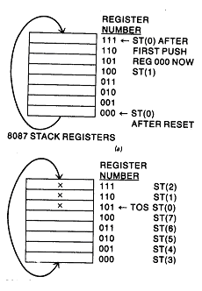
8087 Stack Operations
PUSH: first decrement ST by one and loads operand to new top of stack
POP: it first retrieves then increments ST by 1
When it used as register, relative stack addressing is used
e.g. ST is 3 then ST(2) is 5 and ST(6) is register

Slide 21
Tag register holds the status of the contents of the data registers
00 : valid
01: zero
10: NAN or infinity ,denormal
11: empty

Slide 22
Instruction set
Total 68 divided into six groups
Data transfer
Arithmetic
Comparison
Transcendental
Constant
Processor control

Slide 23
8087 instruction start with F assembler generates two machine instruction : wait followed by an ESC instruction
Operand field is denoted as
//SRC/DST,SRC
Source and destination operands are implicit, or source is specified and destination is implicit or both are specified

Slide 24
Data transfer
FLD SRC push real data from ST(i) or memory
FILD SRC push integer data from memory
FBLD SRC push BCD from memeory
FST DST : store contain of top of stack to destination may be ST(i) or memory
FIST DST : convert contain of top of stack to integer and store to destination (memeory)
FBSTP DST :pop BCD
FSTP DST : pop real
FISTP DST: pop integer
FXCH //DST : interchange destination with top of stack
DST may be ST(i) or not specified then ST(1)

Slide 25
Arithmetic
FADD //SRC/DST,SRC : (DST)=(DST)+(SRC)
If DST is not specified then ST is used and SRC must be memory operand of real data
If both are specified them must be ST,ST(i) or ST(i),ST
If neither is given then ST(1) , ST is assumed and ST is incremented to store result
FADDP DST, SRC (ST(i)=ST(i) + (ST) increment ST
FIADD SRC (ST)=(ST)+(SRC)
FSUB //SRC/DST,SRC (DST)=(DST)-(SRC)
FSUBP DST,SRC (ST(i)=ST(i)- (ST) increment ST
FSUBR //SRC/DST,SRC (DST)=(SRC)-(DST)
FSUBRP DST,SRC (ST(i)=(ST)-(ST(i)) increment ST
FISUB SRC : (ST)=(ST)-(SRC)
FISUBR SRC (ST)=(SRC)-(ST)

Slide 26
FMUL //SRC/DST, SRC (DST)=(DST)*(SRC)
FMUP DST,SRC (ST(i)=(ST(i) *(ST)) st is incremented
FIMUL SRC
FDIV //SRC/DST, SRC (DST)=(DST)/(SRC)
FDIVP DST,SRC ST(i)=ST(i)/(ST) st is incremented
FDIVR //SRC/DST,SRC (DST)=(DST)/(SRC)
FDIVRP DST,SRC (ST(i))=(ST)/(ST(i)) increment ST
FIDIV SRC (ST)=(ST)/(SRC)
FIDIVR SRC
FABS (ST)=|(ST)|
FCHS (ST)=-(ST)
FPREM (ST)=(ST) %(ST(1))
FRNDINT (ST)=integer((ST))

Slide 27
FSCALE (ST)=(ST)*2^{n}
N is integer part of (ST(1))
FSQRT
FXTRACT (ST)=exponent decrement ST, (ST)=Fraction
Compare instructions
FCOM //SRC
FCOMP //SRC
FCOMPP ST is increment by 2
FICOM SRC
FICOMP SRC
FTEST test stack of top with 0
FXAM examine top of stack

Slide 28
Transcendental instructions
F2xm1
FPATAN find tan⁻¹ of ST(1)/(ST) ST is incremented
FPTAN find tan in form of y and x
FYL2X
FYL2XP1
Constant instructions
FLDZ : load zero decrement ST then (ST)=0
FLD1,FLDPI,FLD2E,FLD2T, FLDLG2,FLDLN2
Processor Control instructions
FINIT, FDIST, FENI, FCLEX, FINCSTP, FDECSTP

Slide 29
Example (cont..)
FSTSW STATUS ;copy 8087 status word to memory
MOV AX, STATUS ;copy status word to AX to check bits
FLDCW SRC
FSTEW DST
FLDENV SRC
FSAVE DST
FRSTOR SRC
FFREE DST
FNOP
.

Slide 30
