Slide 1
Basics of Operating Systems
Dr N M Patel
Associate Professor
Computer Engineering Department
BVM Engineering College

Slide 2
Operating systems
Course Objective:
To impart knowledge of operating system from user and design perspectives
Course Outcomes (COs): After learning the course students will be able to
1. Understand various Operating Systems concepts such as process, system calls, multiprocessing, race and dead-locks etc.
2. Analyze various scheduling algorithms
3. Apprehend virtual memory management, and compare various paging and segmentation schemes.
4. Analyze file systems from user and design perspective.
5. Analyze protection and security mechanisms of OS
6. Experiment with low level implantation of OS concepts, at lab and mini-projects level.

Slide 3
Operating systems
List of References:
1. Andrew S. Tanenbaum, “Modern Operating Systems”, Prentice Hall International
2. Silberschatz and Galvin, “Operating System Concepts”, John Willey and Sons
3. William Stallings,“Operating Systems” Prentice Hall of India
4. D.M.Dhamdhere, “Operating Systems”, Tata McGraw Hill

Slide 4
Why os is required?
Modern computer system consists of one or more processors, some main memory, disks, keyboard,
a display, a network interfaces and other I/O devices.
Writing programs that keep track of all these components and use them correctly and optimally is an difficult job.
For this reason, computers are equipped with a layer of software called the OS, whose job is to manage all these devices and provide user programs with a simple interface to the hardware.
An operating system (OS) is system software that manages computer hardware and software resources and provides common services for computer programs.

Slide 5
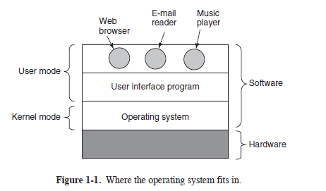
Computer with OS can be viewed as set of layers. Most computers have two modes of operation: kernel mode and user mode. The operating system, the most fundamental piece of software,
runs in kernel mode (also called supervisor mode). complete access to all the hardware and can execute any instruction the machine is capable of executing. The rest of the software runs in user mode, in which only a subset of the machine instructions is available.

Slide 6
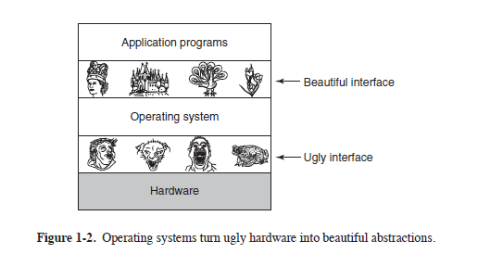
Functions of os
Two basic functions
1)Os as an extended machine: It hide the hardware complexity &provide simple interface with the hardware.It present the user with the equivalent of an extended machine that is easier to program than the underlying hardware.
-Abstraction:disk contains a collection of named files
One of the major tasks of the operating system is to hide the hardware and present programs (and theirprogrammers) with nice, clean, elegant, consistent, abstractions to work with instead.

Slide 7
2)Resource manager: Provide an orderly and controlled allocation of the processors, memories, and I/O devices among the programs competing for them

Slide 8
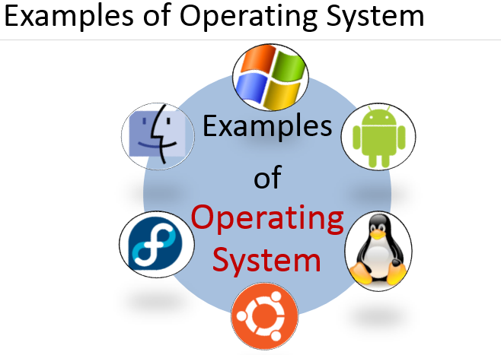

Slide 9
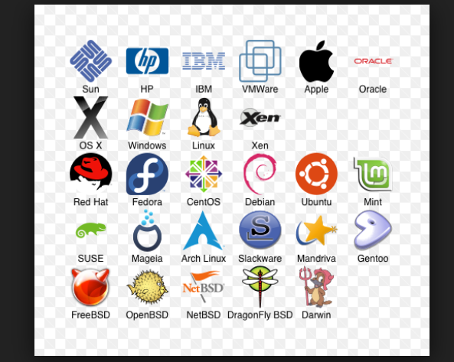
Windows, Linux, Android, Mac,

Slide 10
When we switch on machine what happens?

Slide 11
Two perspective : User and design
Two important concepts
Process
File
Process
Is an instance of program in execution
Each process has its address space : list of memory locations which it can read and write
The address space contain the executable program, data and stack. Also it has set of registers including PC ,SP , other required resources and all other information needed to run the program.
Every process has unique id called PID
Process table : all the information about each process is stored in process table, which is an array(or linked list) of structures, one for each process in existence.

Slide 12
System call related to process e.g. fork, execl, wait, exit, brk,…
IPC
Command to know about running process : ps, top,…
Every person authorized to use a system is assigned a UID and GID by the system administrator. User who create process become owner of that process. A child process has same UID of its parent
One UID called superuser in UNIX has special power and may violate many of the protection rules.
Environment to run process : provided by Shell running on top of os

Slide 13
Common shells for Linux
ash : a small shell
bash : bourne again shell. The default shell for Red Hat Linux
ksh, tcsh and zsh
$chsh -l

Slide 14
Files
User perspective
How they are named and organized
Hierarchical File System
Process and file hierarchies both are organized as trees
Process hierarchies are not very deep, short-lived ( few minutes), ownership and protection

Slide 15
Directory Structure
/
bin
boot
home
etc
usr
dev
lib
c
a
t
l
s
user1
user2
user3
p
r
o
g
r
m
1
p
r
o
g
r
m
2
Desktop
Directory
s
t
a
r
t
File
Directory : As a way of grouping files together

Slide 16
File system
Every file can be specified by giving its path name from the top of directory hierarchy, the root directory
Two types of path : absolute and relative
Every process has current directory
System call related to files : open,read,write, dup, lseek, fcntl,…
Mounting files : attach other file system with root file system
Special files : devices are treated as files, block and character, pipe
Security : nine bit protection code
For directory x indicates search permission

Slide 17
OS
Goals of an operating system:
• Execute user programs and make solving user problems easier.
• Convenience
• Efficiency

Slide 18
History of operating systems
Os Evolved through the years because enhancement in semiconductor technology, evolved new hardware
OS closely tied to the architecture of the computers on which they run
First digital computer was designed by Charles Babbage. It was purely mechanical
First generation : vacuum tubes, used for numerical calculations such as tables of sines, cosines and log
All programming was done in absolute machine language. No OS. Wiring up plug boards to control the machine’s basic functions
Second generation : transistor
Known as mainframes. Used for scientific and engineering calculations such as solving the partial differential equations

Slide 19
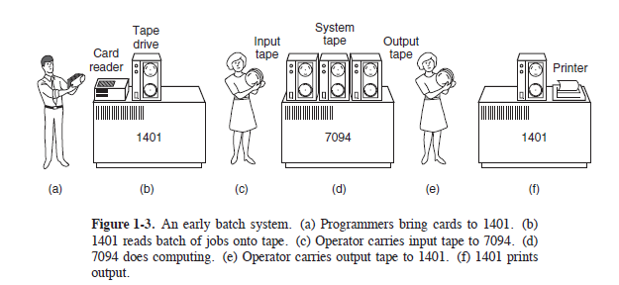
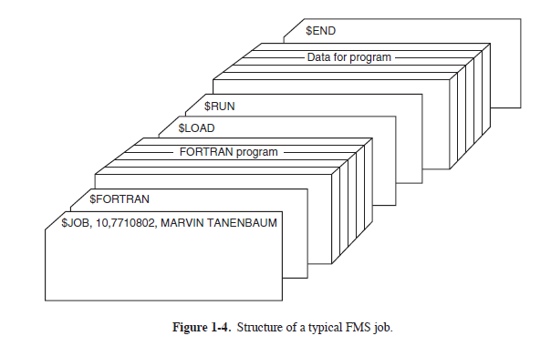
Given the high cost of the equipment, it is not surprising that people quickly looked for ways to reduce the wasted time. The solution generally adopted was the batch system. Batch operating system : FMS(Fortran monitor system) and IBSYS (IBM os for 7094)

Slide 20
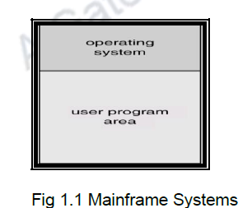
Batch OS : in form of monitor program
Software that controls the sequence of events
Batch jobs together. (i.e., a program or set of programs), Hence the operating system in this case had to just transfer control from one job to another in a sequential manner
Program branches back to monitor when finished
Limitations : separate machine for I/O and computation
Current job paused to wait for a tape or other I/O operation , CPU simply sat idle until the I/O finished(scientific calculation : I/O is infrequent but Commercial data processing, The I/O wait can be 80 to 90% of total time)

Slide 21
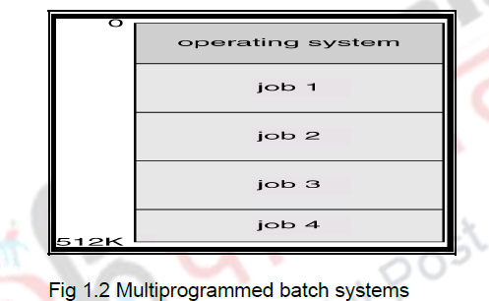
Third generation : ICS &Multiprogramming OS:
e.g. IBM 360, 370,4300,3080,3090..
Multiple jobs are in memory
When one job needs to wait for I/O, the processor can switch to the other job. Enough job could be held in memory at once the CPU could be busy nearly 100% of the time
The operating system now has additional functionalities of selecting jobs from the disk to be brought into the main memory(This is done by the job scheduler ) and selecting one of the jobs in the main memory to be given to the CPU( CPU scheduler)

Slide 22
Multiprogramming OS
Decision has to be made as to where to place the jobs in the main memory. Hence memory management was added as a functionality of the operating system. I/O devices also have to be allocated to processes. Hence I/O management was included as a functionality to the operating system.

Slide 23
Spooling : Simultaneous peripheral operation on line)
Limitation : no user interaction
Limitation: no use interaction
Multiprogrammed systems provide an environment in which the various system resources (for example, CPU, memory, and peripheral devices) are utilized effectively, but they do not provide for user interaction with the computer system.
. Hence, a new system was developed called the time-sharing systems. These time-sharing systems are basically an extension of multiprogramming systems and are called multitasking systems. In time-sharing system the CPU executes multiple jobs by switching among them but the switches occur so frequently that users can interact with each program while it is running

Slide 24
Third generation : Minicomputer &Time sharing Os
Using multiprogramming to handle multiple interactive jobs
Processor’s time is shared among multiple users
Multiple users simultaneously access the system through terminals
Memory management with swapping required
Since many users are using the computer, each user will have his/her own files and these files have to be placed in the secondary storage device / disks. Hence, file systems were included as a part of operating systems
Objective: Minimize response time
Bell lab, MIT and GE together developed MULTICS (Multiplexed information and computing Service)
Ken Thompson developed UNIX at Bell lab
Two major version : System V and BSD (Berkely software distribution) from the university of California at Berkeley
Linus Torvalds developed LINUX

Slide 25
Time sharing Os
It is possible to have many processes of a particular user or different users to run concurrently. At a particular time, only one process can use the CPU. When one process is waiting for I/O, another process may use the CPU and vice versa. This may not be felt by the users using the computer. Thus concurrent execution of processes is possible.
When many processes execute concurrently, they may have to communicate among themselves or may have to share common variables or data structures. Hence job synchronization and communication are needed. Similarly, when processes execute concurrently and share resources of the computer, it is possible that deadlocks may occur. Hence the operating system must have the capability to handle deadlocks.

Slide 26
Personal systems
Fourth Generation : When personal computers were introduced, there was a need for an operating system for this new type of computer. During this era, single-user operating systems such as DOS (Disk Operating System) were introduced.
Goal : user convenience along with resource utilization
Windows 95, 98 (16bit)
Windows NT (32 bit), Windows NT 5.0(Windows 2000)
Unix for personal computer, support windowing system called X windows , basic windows management. Often a complete GUI, such as Gnome or KDE, is available to run on top of X11, giving UNIX a look and feel something like the Macintosh or Microsoft Windows. Unix/Linux is multiuser, timesharing, multitasking

Slide 27
Multi processor system: Tightly coupled and loosely coupled
The advantages of multiprocessor systems are increased throughput, economy of scale and increased reliability
Tightly coupled: The need for more speed and efficiency led to the design of parallel systems: multiple CPUs on the same machine. Each CPU can be used to serve one program or a part of a program, which means that many tasks can be accomplished in parallel instead of serially. The operating systems required for this are more complex than those that support single CPUs
Loosely coupled : Multi computer system
Two os : Network and distributed os.
Network os : Communication facility, user is aware about existence of multiple computers and can log in to remote machines and copy files from one machine to another. Each machine run its own local operating system and has its own local user

Slide 28
Distributed systems
Distributed os is one that appear to its users as a traditional uniprocessor system even though it is actually composed of multiple processors. Transparency is main goal
e.g. framework Hadoop
Real-time systems
A real-time system is expected to do a task within a specific time constraint. They are used with real-time applications, which monitor, respond to or control external processes or environments. Hard and soft Qnx, VxWorks, RTLimux

Slide 29
Embedded OS : palmtop and embedded systems
Size, memory and power make them special
e.g. palm os, Windows CE
The Fifth Generation (1990–Present): Mobile Computers Handheld systems include PDAs, cellular phones etc. The main issues with these systems are that they have a small size, small amount of memory, include slow processors, and feature small display screens. Examples of handheld operating systems are Android, Apple:iOS, Symbian (Samsung, Sony Ericsson, Motorola, and especially Nokia.etc.)
Smart card OS
The smallest os run on smart card which are credit card size device containing CPU chip
They have severe processing power and memory constraints. They handle single function such as electronics payment

Slide 30
Some smart cards are Java oriented. This means that the ROM on the smart
card holds an interpreter for the Java Virtual Machine (JVM). Java applets (small programs) are downloaded to the card and are interpreted by the JVM interpreter.
Some of these cards can handle multiple Java applets at the same time, leading to multiprogramming and the need to schedule them. Resource management and protection also become an issue when two or more applets are present at the same time. These issues must be handled by the (usually extremely primitive) operating system present on the card.
Fifth Generation : massive parallism, super computer, support AI, Machine learning and deep learning

Slide 31
System call
Interface between process and operating system
Actual mechanisms of issuing a system call are highly machine dependent and often must be expressed in assembly code
A procedure library is provided to make system calls from C programs and often from other languages as Fortran….

Slide 32
If the system call cannot be carried out return
-1 and error number is put in global variable errno
System calls are performed in a series of steps

Slide 33
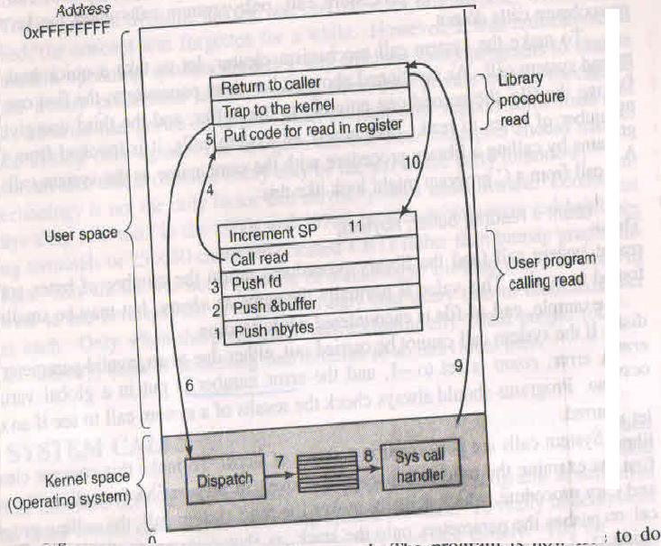

Slide 34
Linux operating system
main()
{
char m[20]=“hello\n”;
asm(“mov $4,%eax”);
asm(“mov $1,”ebx”);
asm(“mov $m,”%ecx”);
asm(“mov $7,%edx”);
Asm(“int $128”);

Slide 35
POSIX
POSIX has about 100 procedure calls
Mapping of POSIX procedure calls onto system calls is not one to one. However most of the POSIX procedures do invoke system calls

Slide 36
The POSIX standard specifies a number
of procedures that a conformant system must supply, but it does not specify whether they are system calls, library calls, or something else.
If a procedure can be carried out without invoking a system call (i.e., without trapping to the kernel), it will
usually be done in user space for reasons of performance.
However, most of the POSIX procedures do invoke system calls, usually with one procedure mapping directly onto one system call.
In a few cases, especially where several required procedures
are only minor variations of one another, one system call handles more than one library call

Slide 37
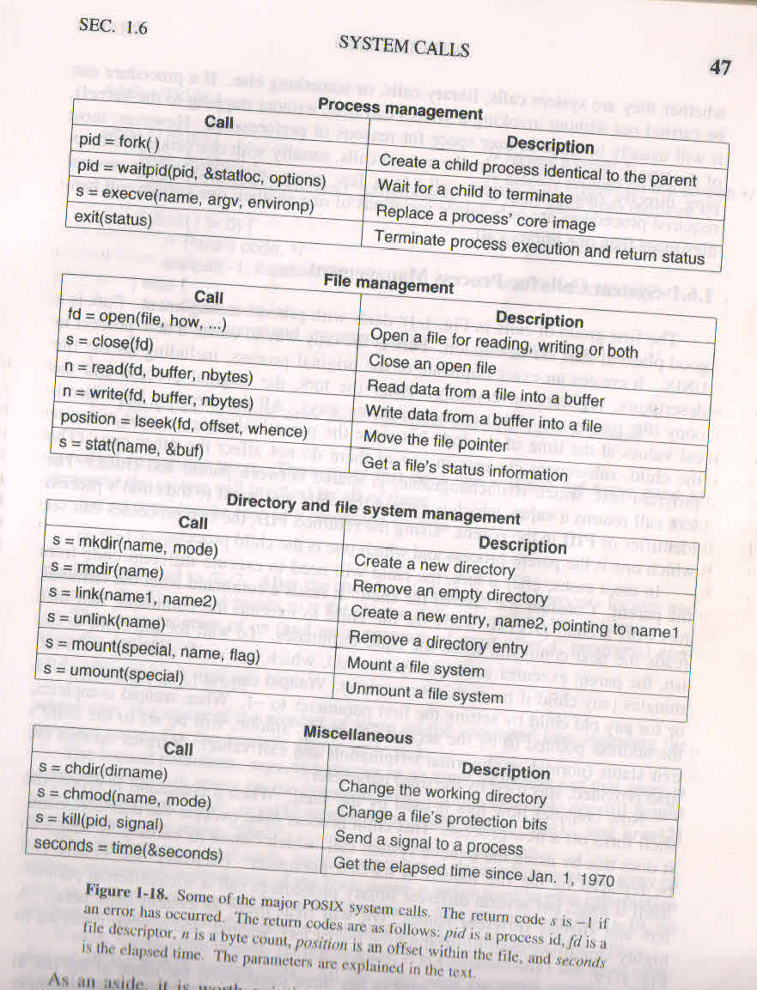

Slide 38
#define TRUE 1
while (TRUE) { /* repeat forever */
type prompt( ); /* display prompt on the screen */
read command(command, parameters); /* read input from terminal */
if (for k( ) != 0){ /* fork off child process */
/* Parent code. */
waitpid( parameters); /* wait for child to exit */
} else {
/* Child code. */
execve(command, parameters, 0); /* execute command */
}
}
Figure 1-19. A stripped-down shell. Throughout this book, TRUE is assumed to
be defined as 1.

Slide 39
Win32 API
Windows and UNIX differ in a fundamental way in their respective programming models.
A UNIX program consists of code that does something or other, making system calls to have certain services performed
windows program is normally event driven Main program waits for some event to happen, then calls a procedure to handle it.
Microsoft has defined a set of procedures called the Win32 API (Application Programming Interface) that programmers are expected to use to get operating system services
By decoupling the API interface from the actual system calls, Microsoft retains the ability to change the actual system calls in time (even from release to release) without invalidating existing programs.
Win32 has a huge number of calls for managing the GUI
Windows does not have a process hierarchy so there is no concept of a parent and child process
Win32 interface does not have links to files, mounted file systems, security or signals

Slide 40
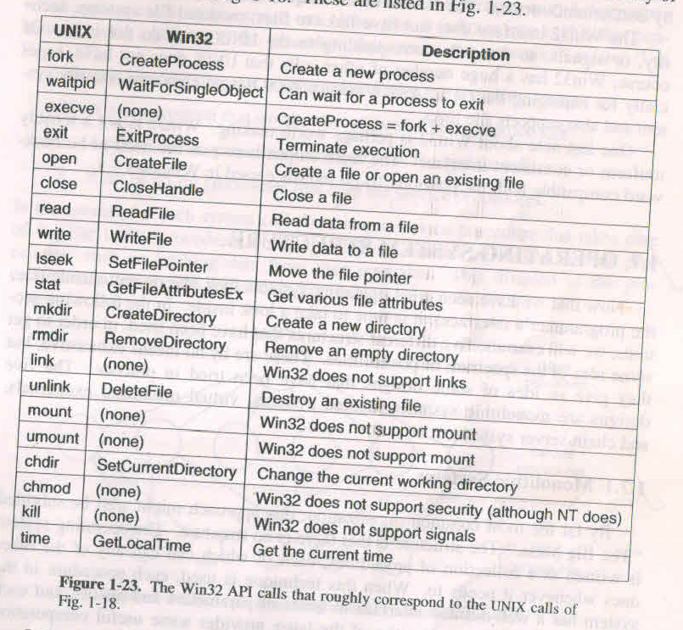
Win32 API calls & corresponding Unix calls

Slide 41
Design structures
Monolithic systems
In the monolithic approach the entire operating system runs as a single program in kernel mode. The operating system is written as a collection of procedures, linked together into a single large executable binary program.
Os is written as a collection of procedures each of which can call any of the other ones whenever it needs to
OS occupy single address space. To construct the actual object program of the OS, one first compiles all the individual procedures or files containing the procedures and then binds them all together into a single object file using the linker
Advantage : efficient Disadvantage : any part of OS fail, entire OS fail e.g. Unix, Linux

Slide 42
Little structure exists : The services (system calls) provided by the operating system are requested by putting the parameters in a well-defined place (e.g., on the stack) and then executing a trap instruction. This instruction switches the machine from user mode to kernel mode and transfers control to the operating system

Slide 43
This organization suggests a basic structure for the operating system:
1. A main program that invokes the requested service procedure.
2. A set of service procedures that carry out the system calls.
3. A set of utility procedures that help the service procedures.

Slide 44
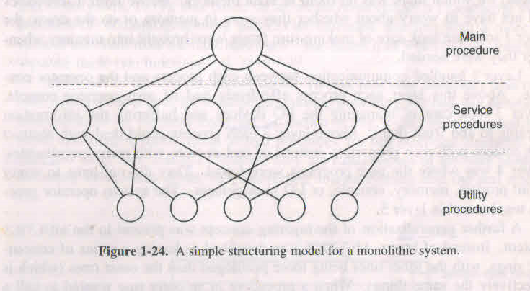
Design structures
In this model, for each system call there is one service procedure that takes care of it and executes it. The utility procedures do things that are needed by several service procedures, such as fetching data from user programs.

Slide 45
Design structure
Layered systems
Os is designed as a hierarchy of layers, each one constructed upon the one below it.
Each layer can be think as object, which has its own data and functions.
Advantage : debugging is easy, modularity
Disadvantage : careful definition of layers, less efficient
The first os : THE system, 6 layers

Slide 46
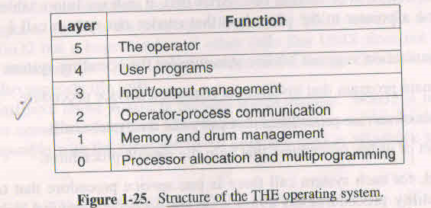
Design Structures

Slide 47
Design structures
Virtual machines
How to make Time sharing (multitasking) os
Mutiprogramming
Extended machine : with a more convenient interface then the bare hardware
Virtual machine runs on the bare hardware and does the multiprogramming, providing not one but several virtual machines to the next layer up
By completely separating the functions of multiprogramming and providing an extended machine, each of the pieces can be much simple, flexible and easier to maintain

Slide 48
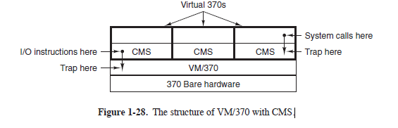
Because each virtual machine is identical to the true hardware, each one can
run any operating system that will run directly on the bare hardware.
Different virtual machines can, and frequently do, run different operating systems. On the original IBM VM/370 system, some ran OS/360 or one of the other large batch or transaction-processing operating systems, while others ran a single-user, interactive system called CMS (Conversational Monitor System) for interactive timesharing users. The latter was popular with programmers.

Slide 49
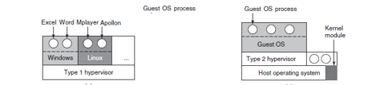
Virtual machine
Another use of virtualization is for end users who want to be able to run two or more operating systems at the same time, say Windows and Linux, because some
of their favorite application packages run on one and some run on the other
e.g. VMWare, Xen, KVM (for the Linux kernel), VirtualBox (by Oracle), and Hyper-V (by Microsoft).

Slide 50
Design Structures
Virtual machine
The idea of virtual machine is heavily used nowadays in a different context: running old MS-DOS programs on a PENTUM ( or 32 bit intel CPU) by providing a virtual 8086 mode on the Pentium. In this mode the machine acts like an 8086 including 16 bit addressing with a 1MB limit
However when a program tries to trap to the os to make a system call or tries to do protected I/O directly a trap to the virtual machine monitor occur
Two variant : MS-DOS itself is loaded into the virtual address space. In second approach virtual machine monitor just caches the first trap and does the I/O itself since its knows all the MS-DOS sy
tem calls . It only emulates MS-DOS correctly and not other OS
e.g. Virtual box

Slide 51
Design structures
JVM: Java virtual machine
Compile produces code for JVM which is executed by JVM interpreter
Solving system compatibility problem
e.g. windows applications run on sun microsystems

Slide 52
Design structures
Exokernels
In virtual machine each user process gets an exact copy of the actual computer
Researchers at MIT have built a system that gives each user a clone of the actual computer but with subset of the resources i.e. one machine might get blocks 0 to 1023, the next one might get 1024 to 2047 and so on
Exokernel is program running in kernel mode whose job is to allocates resources to virtual machines and then check attempts to use them to make sure no machine is trying to use somebody else’s resources
Each user level virtual machine can run its own os, except that each one is restricted to using only the resources it has asked for and been allocated
Advantages : it saves a layer of mapping
In earlier approach each virtual machine think that it has its own disk, with blocks running from 0 to some maximum, so VMM has to keep table
With exokernel this remapping is not needed. The exokernel need only keep track of which virtual machine has been assigned which resource

Slide 53
Design structures
Microkernel ( Client-server model)
A trend in modern OS is to take the idea of moving code up into higher layers even further and remove as possible from kernel mode leaving a minimal microkernel
The usual approach is to implement most of the OS in user processes. To request a service, such as reading a block of a file a user process (known as client) sends the request to a server process which then does the work and sends back the answer

Slide 54
The basic idea behind the microkernel design is to achieve high reliability by splitting the operating system up into small, well-defined modules, only one of which—the microkernel—runs in kernel mode and the rest run as relatively powerless ordinary user processes.
In particular, by running each device driver and file system as a separate user process, a bug in one of these can crash that component, but cannot crash the entire system. Thus a bug in the audio driver will cause the sound to be garbled or stop, but will not crash the computer.
In contrast, in a monolithic system with all the drivers in the kernel, a buggy audio driver can easily reference an invalid memory address and bring the system to a grinding halt instantly.

Slide 55
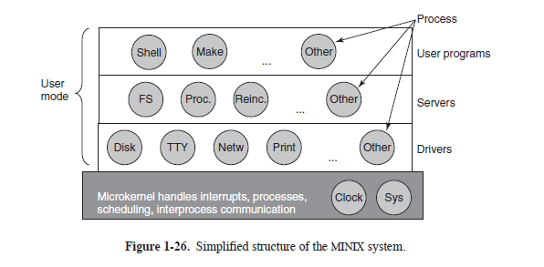
Microkernel
A few of the better- known microkernels include Integrity, K42, L4, PikeOS, QNX, Symbian, and
MINIX 3.
One interesting server is the reincarnation server, whose job is to check if the other servers and drivers are functioning correctly. In the event that a faulty one is detected, it is automatically replaced without any user intervention. In this way, the system is self healing and can achieve high reliability.

Slide 56
Design structures
Microkerenl
Kernel handle the communication between clients and servers, handling interrupts, I/O and minimal process and memory management
Advantages
Kernel is thin so manageable and ease of extending the os because new services are added to user space and do not required modification of the kernel
OS services in from of processes so if one fail other may continue to give service so will not usually bring the whole machine down
Its adaptability to use in distributed systems. If a client communicates with a server by sending messages the client need not to know whether message is handle locally in its machine or whether it was sent across a network to a server on a remove machine
It is easier to port from one hardware to another
Policy and mechanism can be separted
Disadvantages : less efficient because frequent mode change required
e.g. QNX, Windows NT, Windows 2000

Slide 57
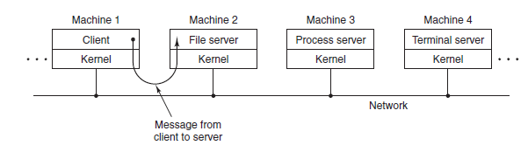
Client-Server
As far as the client is concerned, the same thing happens in both cases: requests are sent and replies come back. Thus the client-server model is an abstraction that can be used for a single machine or for a network of machines

Slide 58
Architecture of Unix/Linux Kernel
Buffer cache

Slide 59
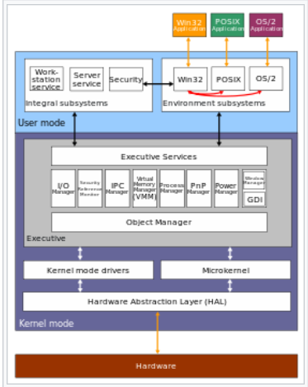
Windows NT

Slide 60
Questions
1.A portable operating system is one that can be ported from one system architecture to another without any modification. Explain why it is infeasible to build an operating system that is completely portable. Describe two high-level layers that you will have in designing an operating system that is highly portable.
2.What is the key difference between a trap and an interrupt? 3.Number of UNIX system calls have no Win32 API equivalents. What are the consequences for a programmer of converting a UNIX program to run under Windows?

Slide 61
Every system architecture has its own set of instructions that it can execute. Thus a Pentium cannot execute SPARC programs and a SPARC cannot execute Pentium programs. Also, different architectures differ in bus architecture used (such as VME, ISA, PCI, MCA, SBus, ...) as well as the word size of the
CPU (usually 32 or 64 bit).
Because of these differences in hardware, it is not feasible to build an operating system that is completely portable. A highly portable operating system will consist of two high-level layers---a machine dependent layer and a machine independent layer. The machine-dependent layer addresses the specifics of the hardware, and must be implemented separately for every architecture. This layer provides a uniform interface on which the machine-independent layer is built. The machine-independent layer has to
be implemented only once. To be highly portable, the size of the machine dependent layer must be kept as small as possible.

Slide 62
Answer
A trap instruction switches the execution mode of a CPU from the user mode to the kernel mode. This instruction allows a user program to invoke functions in the operating system kernel.
A trap is caused by the program and is synchronous with it. If the program is run again and again, the trap will always occur at exactly the same position in the instruction stream. An interrupt is caused by an external event and its timing is not reproducible.

Slide 63
Several UNIX calls have no counterpart in the Win32 API:
Link: a Win32 program cannot refer to a file by an alternative name or see it in more than one directory.
Mount and umount: a Windows program cannot make assumptions about standard path names because on systems with multiple disk drives the drive name part of the path may be different.
Chmod: Windows uses access control lists
Kill: Windows programmers cannot kill a misbehaving program that is not cooperating.

