Slide 1
Interrupts – (Chapter 12)
Interrupt Types
  Hardware Interrupts: External event
  Software Interrupts: Internal event (Software generated)
  Maskable and non-maskable interrupts
  Interrupt priority
Interrupt Vectors and Interrupt Handlers
Interrupt Controllers

Slide 2
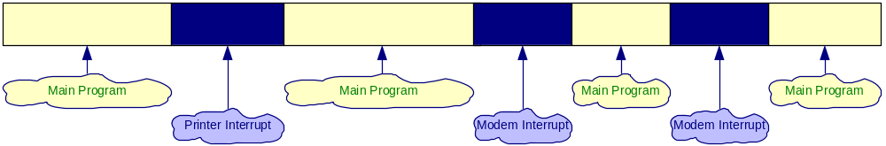
The Purpose of Interrupts
Interrupts are useful when interfacing I/O devices with low data-transfer rates, like a keyboard or a mouse, in which case polling the device wastes valuable processing time
The peripheral interrupts the normal application execution, requesting to send or receive data.
The processor jumps to a special program called Interrupt Service Routine to service the peripheral
After the processor services the peripheral, the execution of the interrupted program continues.

Slide 3
BASIC INTERRUPT TERMINOLOGY
Interrupt pins: Set of pins used in hardware interrupts
Interrupt Service Routine (ISR) or Interrupt handler: code used for handling a specific interrupt
Interrupt priority: In systems with more than one interrupt inputs, some interrupts have a higher priority than other
  They are serviced first if multiple interrupts are triggered simultaneously
Interrupt vector: Code loaded on the bus by the interrupting device that contains the Address (segment and offset) of specific interrupt service routine
Interrupt Masking: Ignoring (disabling) an interrupt
Non-Maskable Interrupt: Interrupt that cannot be ignored (power-down)

Slide 4
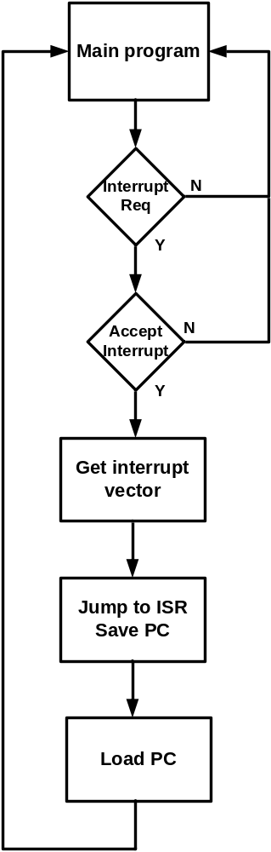
Interrupt processing flow

Slide 5
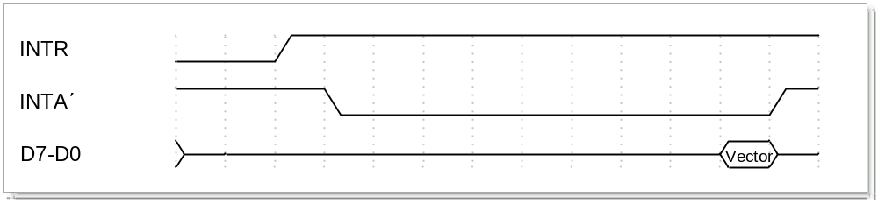
Hardware Interrupts – Interrupt pins and timing
x86 Interrupt Pins
  INTR: Interrupt Request. Activated by a peripheral device to interrupt the processor.
    Level triggered. Activated with a logic 1.
  /INTA: Interrupt Acknowledge. Activated by the processor to inform the interrupting device the the interrupt request (INTR) is accepted.
    Level triggered. Activated with a logic 0.
  NMI: Non-Maskable Interrupt. Used for major system faults such as parity errors and power failures.
    Edge triggered. Activated with a positive edge (0 to 1) transition.
    Must remain at logic 1, until it is accepted by the processor.
    Before the 0 to 1 transition, NMI must be at logic 0 for at least 2 clock cycles.
    No need for interrupt acknowledgement.

Slide 6
Interrupt Vectors
The processor uses the interrupt vector to determine the address of the ISR of the interrupting device.
In the 8088/8086 processor as well as in the 80386/80486/Pentium processors operating in Real Mode (16-bit operation), the interrupt vector is a pointer to the Interrupt Vector Table.
  The Interrupt Vector Table occupies the address range from 00000H to 003FFH (the first 1024 bytes in the memory map).
  Each entry in the Interrupt Vector Table is 4 bytes long:
    The first two represent the offset address and the last two the segment address of the ISR.
  The first 5 vectors are reserved by Intel to be used by the processor.
    The vectors 5 to 255 are free to be used by the user.

Slide 7
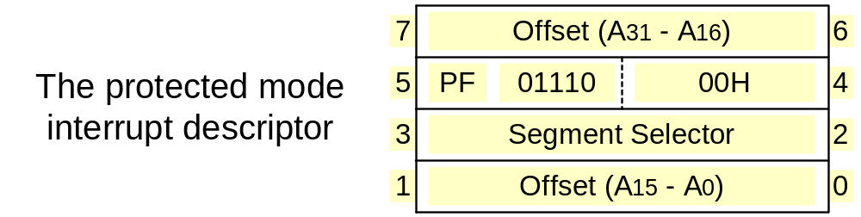
The Intel x86 Vector Interrupts:- Protected Mode (32-bit)
In the 80386/80486/Pentium processors operating in the Protected Mode (32-bit operation), the interrupt vector is a pointer to the Interrupt Descriptor Table.
  The Interrupt Descriptor Table can be located anywhere in the memory.
    Its starting address is pointed by the Interrupt Descriptor Table Register (IDTR).
  Each entry in the Interrupt Vector Table is 8 bytes long:
    Four bytes represent the 32-bit offset address, two the segment selector and the rest information such as the privilege level.
  The first 32 vectors are reserved by Intel to be used by the processor.
    The vectors 33 to 255 are free to be used by the user.

Slide 8
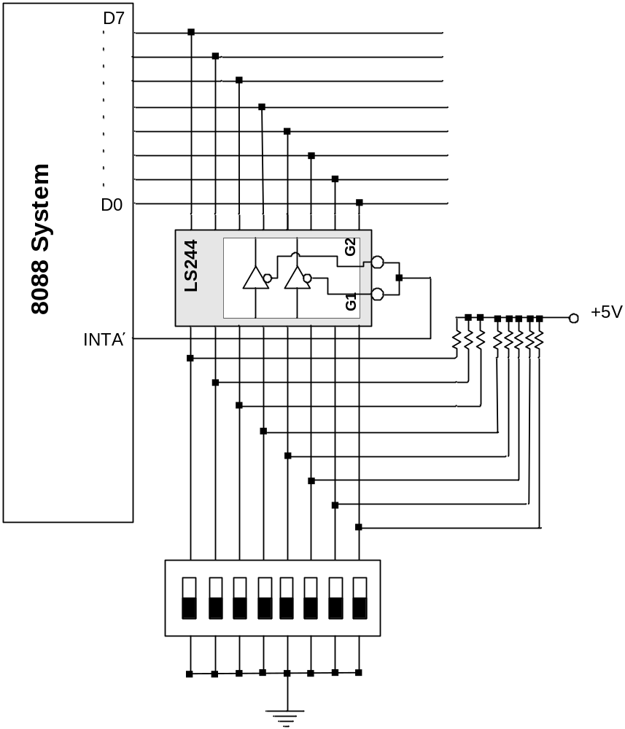
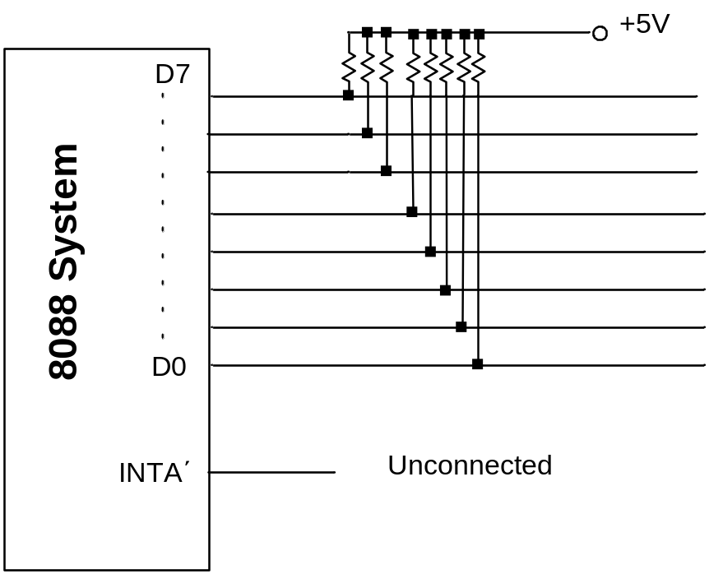
Circuits for generating Interrupt Vectors
Interrupt Vector: FFH
Interrupt Vector: any

Slide 9
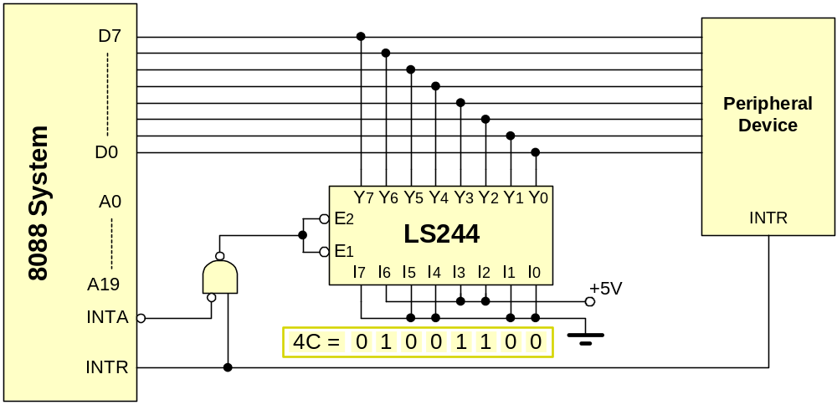
Interrupt Vector - Example
Draw a circuit diagram to show how a device with interrupt vector 4CH can be connected on an 8088 microprocessor system.
Answer:
  The peripheral device activates the INTR line
  The processor responds by activating the INTA signal
  The NAND gate enables the 74LS244 octal buffer
    the number 4CH appears on the data bus
  The processor reads the data bus to get the interrupt vector

Slide 10
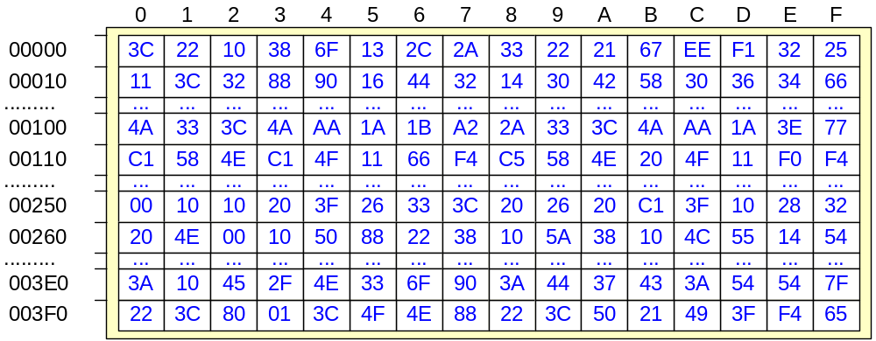
Interrupt Vector Table – Real Mode (16-bit) Example
Using the Interrupt Vector Table shown below, determine the address of the ISR of a device with interrupt vector 42H.
Answer: Address in table = 4 X 42H = 108H
(Multiply by 4 since each entry is 4 bytes)
Offset Low = [108] = 2A, Offset High = [109] = 33
Segment Low = [10A] = 3C, Segment High = [10B] = 4A
Address = 4A3C:332A = 4A3C0 + 332A = 4D6EAH

Slide 11
Interrupt Vector Table – Real Mode (16-bit) Example
Write a sequence of instructions that initialize vector 40H to point to the ISR “isr40”.
Answer: Address in table = 4 X 40H = 100H
Set ds to 0 since the Interrupt Vector Table begins at 00000H
Get the offset address of the ISR using the Offset directive
and store it in the addresses 100H and 101H
Get the segment address of the ISR using the Segment directive
and store it in the addresses 102H and 103H
push ax
push ds
mov ax,0
mov ds,ax
mov ax,offset isr40
mov [0100h],ax
mov ax,segment isr40
mov [0102h],ax
pop ds
pop ax
Save registers in the stack
Set ds to 0 to point to the interrupt vector table
Get the offset address of the ISR and store it in the address 0100h (4X40h = 100h)
Get the segment address of the ISR and store it in the address 0102h
Restore registers from the stack

Slide 12
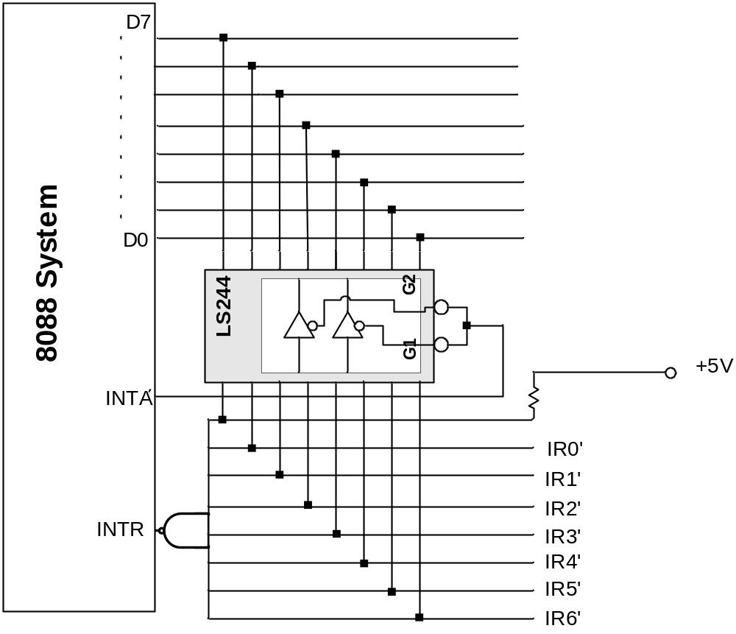
Expanding Interrupt to seven request lines
IR0΄ | IR1΄ | IR2΄ | IR3΄ | IR4΄ | IR5΄ | IR6΄ | Vector
1 | 1 | 1 | 1 | 1 | 1 | 0 | FEH
1 | 1 | 1 | 1 | 1 | 0 | 1 | FDH
1 | 1 | 1 | 1 | 0 | 1 | 1 | FBH
1 | 1 | 1 | 0 | 1 | 1 | 1 | F7H
1 | 1 | 0 | 1 | 1 | 1 | 1 | EFH
1 | 0 | 1 | 1 | 1 | 1 | 1 | DFH
0 | 1 | 1 | 1 | 1 | 1 | 1 | BFH

Slide 13
Identifying Interrupt Source
Software Polling,
  Checking each device
Hardware Polling, (Daisy Chain),
Hardware Identification (Vectored Interrupts).

Slide 14
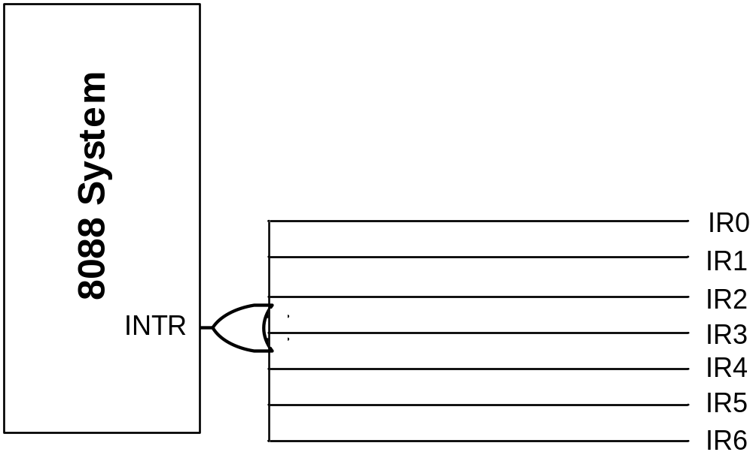
Daisy-Chained Interrupt
Each device is connected to the same interrupt request line, but there is only a single interrupt vector.
The device that sent the request will respond.

Slide 15
Interrupt Masking
The processor can inhibit certain types of interrupts by use of a special interrupt mask bit.
This mask bit is part of the flags/condition code register, or a special interrupt register.
If this bit is clear, and an interrupt request occurs on the Interrupt Request input, it is ignored.
NMI cannot be masked

Slide 16
Software Interrupts
Traps: (self-interrupt!)
  Single step mode
  Calls to Operating System (INT 21H - x86, SC – PPC)
Exceptions:
  Divide by zero
  Memory protection fault

Slide 17
Interrupt Processing
Save state
  Disable interrupts for the duration of the ISR or allow it to be interrupted too?
  Save program counter
  Save flags
  Save register values?
Jump to interrupt service routine
  Location obtained by interrupt vector
Process interrupt
Restore state
  Load PC, flags, registers etc.

Slide 18
Interrupt Processing on the 8086 Microprocessor
1. External interface sends an interrupt signal, to the Interrupt Request (INTR) pin, (or an internal interrupt occurs.)
2. The CPU finishes the present instruction (for a hardware interrupt) and checks the INTR pin.
If IF=0 the processor ignores the interrupt, else sends Interrupt Acknowledge (INTA) to hardware interface.
3. The interrupt type N is sent to the Central Processor Unit (CPU) via the Data bus from the hardware interface.
4. The contents of the flag registers are pushed onto the stack.
5. Both the interrupt (IF – FR bit 9) and (TF – FR bit 8) flags are cleared. This disables the INTR pin and the trap or single-step feature.
6. The contents of the code segment register (CS) are pushed onto the Stack.
7. The contents of the instruction pointer (IP) are pushed onto the Stack.
8. The interrupt vector contents are fetched, from (4 x N) and then placed into the IP and from (4 x N +2) into the CS so that the next instruction executes at the interrupt service procedure addressed by the interrupt vector.
9. While returning from the interrupt-service routine by the Interrupt Return (IRET) instruction, the IP, CS and Flag registers are popped from the Stack and return to their state prior to the interrupt.

Slide 19
The Intel x86 Interrupt Software Instructions
All x86 processors provide the following instructions related to interrupts:
  INT nn: Interrupt. Run the ISR pointed by vector nn.
    INT 0 is reserved for the Divide Error
    INT 1 is reserved for Single Step operation
    INT 2 is reserved for the NMI pin
    INT 3 is reserved for setting a Breakpoint
    INT 4 is reserved for Overflow (Same as the INTO (Interrupt on overflow) instruction.
  CLI: Clear Interrupt Flag. IF is set to 0, thus interrupts are disabled.
  STI: Set Interrupt Flag. IF is set to 1, thus interrupts are enabled.
  IRET: Return from interrupt. This is the last instruction in the ISR (Real Mode only). It pops from the stack the Flag register, the IP and the CS.
    After returning from an ISR the interrupts are enabled, since the initial value of the flag register is poped from the stack.
  IRETD: Return from interrupt. This is the last instruction in the ISR (Protected Mode only). It pops from the stack the Flag register, the EIP and the CS.

Slide 20
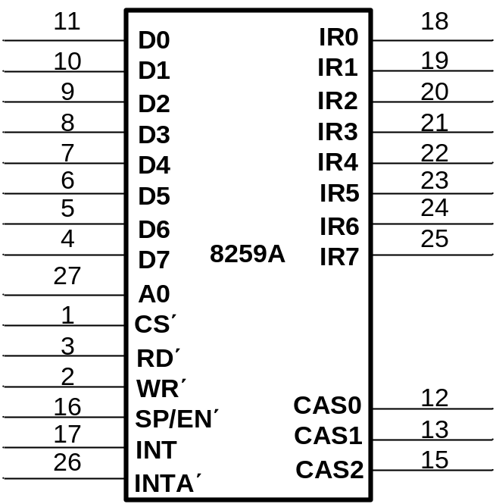
The 8259A Programmable Interrupt Controller
Adds 8 vectored priority encoded interrupts to the microprocessor
Can be expanded without additional hardware to accept up to 64 IRQ (one 8259A master, and one slave)
Requires 4 wait states to be connected to a x386
D0-D7: Bidirectional data connections
IR0-IR7: Interrupt request inputs
WR΄: Write input strobe
RD΄: Read input connects to the IORC΄signal
INT: Output, connects to μP INTR pin
INTA΄: Input, connects to μP INTA΄ pin
A0: Command word select
CS΄: Chip select input
SP/EN΄: Slave program/enable buffer pin
CAS0-CAS2: Outputs from master to slave for cascading multiple 8259A chips

Slide 21
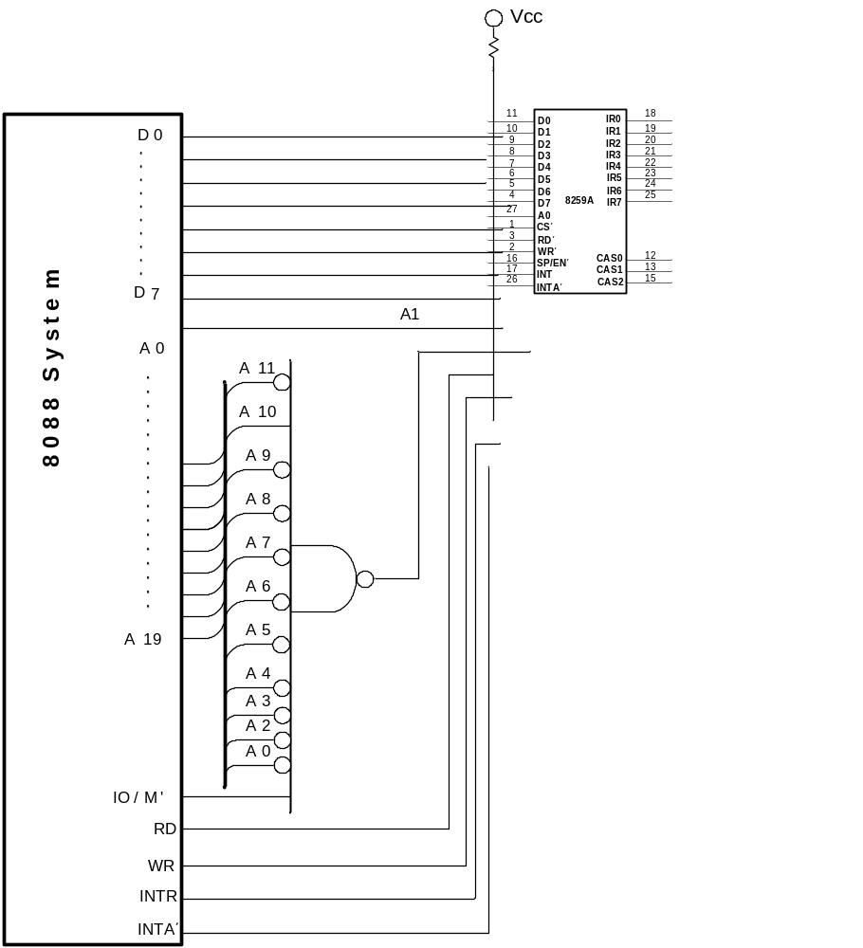
Connecting a single 8259A controller

Slide 22
Programming the 8259A
Initialization Control Words (ICWs)
  Prgrammed before 8259A begins to function
  A0 must be high
  There are four ICWs: ICW1, ICW2, ICW3, ICW4
  When there is only one 2259A in the system, ICW3 is not necessary
Operation Control Words (OCWs)
  Programmed during normal operation
  There are three OCWs: OCW1, OCW2, OCW3
  A0 must be low, except in OCW1

Slide 23
ICW1/ICW2
ICW1 Programs the basic operation of the 8259A
Initialization Control Word (ICW1) Bits
  7:5 (Interrupt Vector Addresses for MCS-80/85 Mode, don’t cares for x86.)
  4 (Must be set to 1 for ICW1)
  3 (1: Level Triggered Interrupts, 0: Edge Triggered Interrupts)
  2 (1: Call Address Interval of 4, 0: Call Address Interval of 8)
  1 (1: Single 8259A, 0: Cascaded 8259A)
  0 (1: Will be Sending ICW4, 0: Don't need ICW4)
ICW2 specifies the vector number used with the interrupt request inputs
  Example: for vectors 08H-0FH, write 08H in ICW2
  Example: for vectors 70H-77H, write 70H in ICW2

Slide 24
ICW3/ICW4
ICW3 only used in cascade mode, indicating where the slave is connected to the master.
  Example: If slave is connected in IR3, we write 00001000 = 04H in ICW3
ICW4 bits
  7-5: Always ‘0’
  4: When ‘1’ a IR request from a slave is recognized by the master while processing another slave interrupt
  3: 1- Buffered operation, 0 – Non-buffered operation
  2: 1- 8259A is master, 0 – 8259A is slave
  1: 1- Automatic end of interrupt (preferable), 0 – normal end of interrupt
  0: Always 1 in 8088/8086 mode

Slide 25
OCW1/OCW2
Operation Control Word 1 (OCW1) bits: Sets the mask register
  7 Mask IRQ7 (when ‘1’)
  6 Mask IRQ6 (when ‘1’)
  5 Mask IRQ5 (when ‘1’)
  4 Mask IRQ4 (when ‘1’)
  3 Mask IRQ3 (when ‘1’)
  2 Mask IRQ2 (when ‘1’)
  1 Mask IRQ1 (when ‘1’)
  0 Mask IRQ0 (when ‘1’)
OCW2 is used when automatic/normal end of interrupt is not selected

Slide 26
OCW3
OCW3 is used to read internal 8259A registers, specify the operation of the special mask register, and the poll command
Status registers:
  Interrupt Request Register (IRR): indicates which IR inputs are active
  In-Service Register (ISR): contains the level of the interrupt being serviced
  Interrupt Mask Register (IMR): Holds the interrupt mask bits
IRR and ISR are read by programming OCW3, IMR is read through OCW1

Slide 27
Example
Use an 8259A PIC to connect the I/O device in the example of slide 8

Slide 28
Interrupt Service Routine

Slide 29
Interrupt Vectors
The Interrupt Vector contains the address of the interrupt service routine
The Interrupt Vector Table is located in the first 1024 bytes of memory at address 000000H-0003FFH.
It contains 256 different 4-byte interrupt vectors, grouped in 18 types
  000H: Type 0 (Divide error)
  004H: Type 1 (Single-step)
  008H: Type 2 (NMI)
  00CH: Type 3 (1-byte breakpoint)
  010H: Type 4 (Overflow)
  014H: Type 5 (BOUND)
  018H: Type 6 (Undefined opcode)
  01CH: Type 7 (Coprocessor not available)
  020H: Type 8 (Double fault)
  024H: Type 9 (Coprocessor segment overrun)
  028H: Type 10 (Invlid task state segment)
  02CH: Type 11 (Segment not present)
    030H: Type 12 (Stack segment overrun)
    034H: Type 13 (General protection)
    038H: Type 14 (Page fault)
    03CH: Type 15 (Unassigned)
    040H: Type 16 (Coprocessor error)
    044H-07CH: Type 14-31 (Reserved)
    080H: Type 32-255 (User)

Slide 30
Interrupt Types
Type 0: Divide error – Division overflow or division by zero
Type 1: Single step or Trap – After the execution of each instruction when trap flag set
Type 2: NMI Hardware Interrupt – ‘1’ in the NMI pin
Type 3: One-byte Interrupt – INT3 instruction (used for breakpoints)
Type 4: Overflow – INTO instruction with an overflow flag
Type 5: BOUND – Register contents out-of-bounds
Type 6: Invalid Opcode – Undefined opcode occurred in program
Type 7: Coprocessor not available – MSW indicates a coprocessor
Type 8: Double Fault – Two separate interrupts occur during the same instruction
Type 9: Coprocessor Segment Overrun – Coprocessor call operand exceeds FFFFH
Type 10: Invalid Task State Segment – TSS invalid (probably not initialized)
Type 11: Segment not present – Descriptor P bit indicates segment not present or invalid
Type 12: Stack Segment Overrun – Stack segment not present or exceeded
Type 13: General Protection – Protection violation in 286 (general protection fault)
Type 14: Page Fault – 80386 and above
Type 16: Coprocessor Error – ERROR΄ = ‘0’ (80386 and above)
Type 17: Alignment Check – Word/Doubleword data addressed at odd location (486 and above)
Type 18: Machine Check – Memory Management interrupt (Pentium and above)

Slide 31
Real Mode Interrupt
When current instruction execution completes, the processor checks:
  Instruction executions
  Single-step
  NMI
  Coprocessor segment overrun
  INTR
  INT instruction
When there is a pending interrupt:
  The contents of the flag register are pushed onto the stack
  IF and TF are cleared, disabling the INTR pin
  CS is pushed to the stack
  IP is pushed onto the stack
  Interrupt Vector contents are fetched and placed into IP and CS, so the next instruction is the Interrupt Service Routine indicated by the Interrupt Vector

Slide 32
Protected Mode Interrupt
Exactly the same assignments as in Real Mode, but instead of Interrupt Vectors, there is an Interrupt Descriptor Table, located anywhere in memory (indicated by the IDTR)

Slide 33
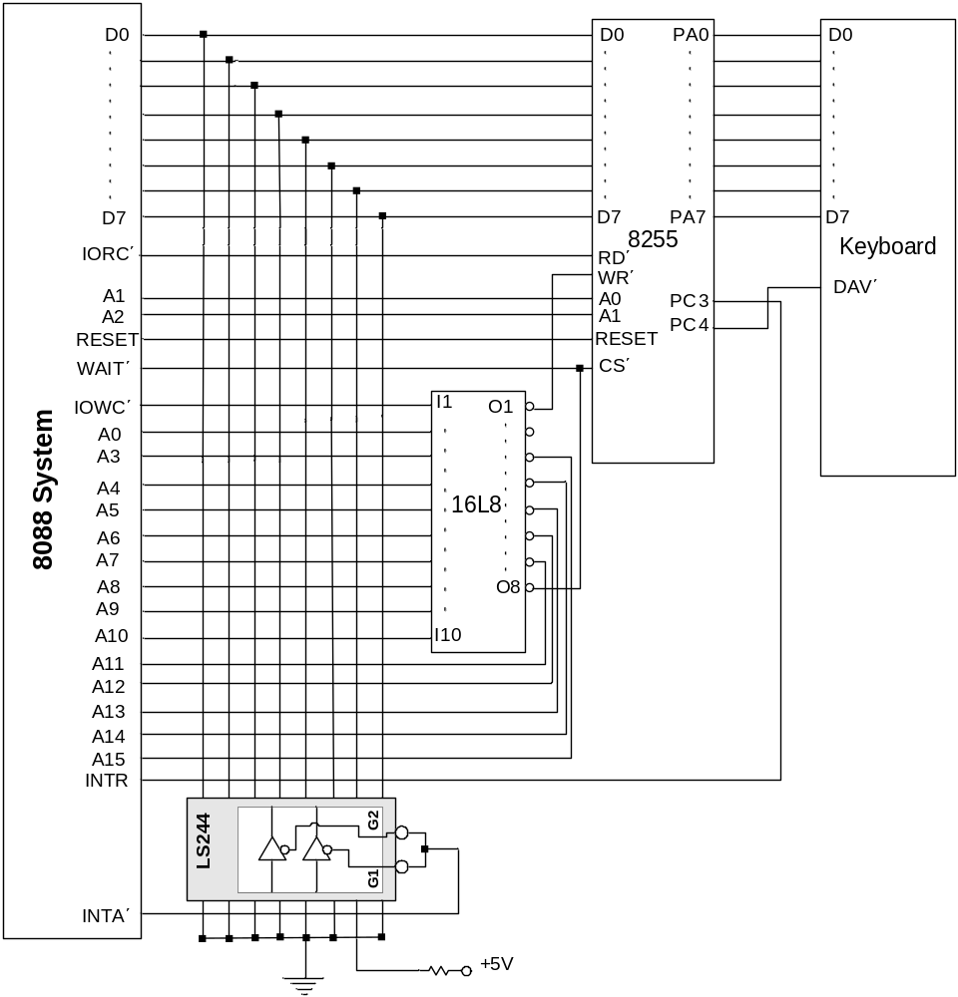
82C55 Keyboard Interrupt Circuit

Slide 34
Interrupt Service Routine for Keyboard

