Slide 1
8086 Interrupts and Interrupt Applications

Slide 2
8086 Interrupts and Interrupt Responses
The meaning of ‘interrupts’ is to break the sequence of operation
While the CPU is executing a program, an interrupt breaks the normal sequence of execution of instructions, diverts its execution to some other program called Interrupt Service Routine (ISR)
After executing ISR , the control is transferred back again to the main program

Slide 3
Contd..
An 8086 interrupt can come from any one of the three sources
One source is an external signal applied to the Non Maskable Interrupt (NMI) input pin or to the Interrupt (INTR) input pin
An interrupt caused by a signal applied to one of these inputs is referred to as a hardware interrupt

Slide 4
Contd..
A second source of an interrupt is execution of the Interrupt instruction, INT
This is referred to as Software Interrupt
The third source of an interrupt is some error condition produced in the 8086 by the execution of an instruction
An example of this is the divide by zero error

Slide 5
Contd..
ISR procedure
PUSH registers
-
-
-
POP registers
Mainline Program
PUSH Flags
CLEAR IF , TF
PUSH CS
PUSH IP
FETCH ISR ADDRESS
POP IP
POP CS
POP FLAGS
IRET
Notes:
imp

Slide 6
Contd..
It decrements SP by 2 and pushes the flag register on the stack
Disables INTR by clearing the IF
It resets the TF in the flag Register
It decrements SP by 2 and pushes CS on the stack

Slide 7
Contd..
5. It decrements SP by 2 and pushes IP on the stack
6. Fetch the ISR address from the interrupt vector table

Slide 8
03FFH
Type 255 (Available)
03FCH
Available Interrupts
(224)
080H
Type 32 (Available)
Type 31 (Reserved)
07FH
Reserved Interrupts (27)
0014H
Type 5
Reserved

Slide 9
Type 4 POINTER
(OVERFLOW)
010H
Type 3 POINTER
(BREAK POINT)
00CH
Type 2 POINTER
(NON-MASKABLE)
008H
Type 1 POINTER
(SINGLE STEP)
004H
Type 0 POINTER
(DIVIDE ERROR)
000H
CS base address
IP offset

Slide 10
Interrupt Vector Table
INT Number Physical Address
INT 00 00000
INT 01 00004
INT 02 00008
: :
: :
INT FF 003FC

Slide 11
Example
Find the physical address in the interrupt vector table associated with
INT 12H b) INT 8H
Solution: a) 12H * 4 = 48H
Physical Address: 00048H ( 48 through 4BH are set aside for CS & IP)
b) 8 * 4 = 20H
Memory Address : 00020H

Slide 12
Difference between INT and CALL instructions
S.No | CALL | INT
1. | Can Jump to any location with in 1MB address range | Goes to fixed memory location in the interrupt vector table to get address of ISR
2. | Used by the programmer in the sequence of instructions in the program | Externally activated hardware interrupt can come at any time
Notes:
Imp imp

Slide 13
Contd..
S.No | CALL | INT
3. | Cannot be masked (disabled) | INTR can be masked
4. | Automatically saves CS: IP of next instruction | In addition to CS:IP, Flags can be saved
5. | RET is the last instruction | IRET to pops of F, CS:IP

Slide 14
8086 Interrupt Types

Slide 15
Divide-by-Zero Interrupt – Type 0
INT 00 is invoked by the microprocessor whenever there is an attempt to divide a number by zero
When it does a type 0 interrupt, the 8086 will push the flags on the stack, reset TF and IF, and push the CS value and the IP value for the next instruction on the stack
ISR is responsible for displaying the message “Divide Error” on the screen

Slide 16
Contd..
Ex1: Mov AL,82H ;AL= 82
SUB CL,CL ;CL=00
DIV CL ;82/0 = undefined result
EX2: Mov AX,0 FFFFH; AX = FFFFH
Mov BL,2 ; BL=02
DIV BL ; 65,535/2 = 32767 larger than 255 maximum capacity of AL

Slide 17
Single-Step Interrupt – Type 1
In single-step mode, a system will stop after it executes each instruction and wait for further direction from us
The 8086 trap flag and type 1 interrupt response make it quite easy to implement a single-step feature in an 8086 based system

Slide 18
Contd..
For single stepping the trap flag must be set to 1
When it does a type 1 interrupt, the 8086 will push the flags on the stack, reset TF and IF, and push the CS value and the IP value for the next instruction on the stack
After execution of each instruction, 8086 automatically jumps to 00004H to fetch 4 bytes for CS: IP of the ISR
The job of ISR is to dump the registers on to the screen

Slide 19
Contd..
The 8086 has no instruction to directly set or reset the trap flag
These operations are done by pushing the flag register on the stack, changing the trap flag bit to what you want it to be, and then popping the flag register back off the stack

Slide 20
Contd..
Here is the instruction sequence to set the trap flag :
PUSHF ; Push flags on stack
MOV BP, SP ; Copy SP to BP for use as index
OR WORD PTR[BP+0], 0100H
; Set TF bit
POPF ; Restore flag register

Slide 21
Contd..
To reset the trap flag, simply replace the OR instruction in the preceding sequence with the instruction AND WORD PTR[BP+0], 0FEFFH
The trap flag is reset when the 8086 does a type 1 interrupt, so the single-step mode will be disabled during the interrupt-service procedure

Slide 22
NonMaskable Interrupt – Type 2
The 8086 will automatically do a type 2 interrupt response when it receives a low-to-high transition on its NMI input pin
When it does a type 2 interrupt, the 8086 will push the flags on the stack, reset TF and IF, and push the CS value and the IP value for the next instruction on the stack

Slide 23
Contd..
The name nonmaskable given to this input pin on the 8086 means that the type 2 interrupt response cannot be disabled (masked) by any program instructions
We use it to signal the 8086 that some condition in an external system must be taken care of

Slide 24
Contd..
For example, have a pressure sensor on a large steam boiler connected to the NMI input
If the pressure goes above some preset limit, the sensor will send an interrupt signal to the 8086
The type – 2 interrupt service procedure for this case might turn off the fuel to the boiler, open a pressure-relief valve and sound an alarm

Slide 25
Breakpoint Interrupt – Type 3
The main use of the type – 3 interrupt is to implement a breakpoint function in a system
A break point is used to examine the CPU and memory after the execution of a group of Instructions
When you insert a breakpoint, the system executes the instructions up to the breakpoint and then goes to the breakpoint procedure

Slide 26
Contd..
The breakpoint feature executes all the instructions up to the inserted breakpoint and then stops execution
When it does a type 3 interrupt, the 8086 will push the flags on the stack, reset TF and IF, and push the CS value and the IP value for the next instruction on the stack

Slide 27
Contd..
Depending on the system, it may then send the register contents to the CRT display and wait for the next command from the user

Slide 28
Overflow Interrupt – Type 4
The 8086 overflow flag (OF) will be set if the signed result of an arithmetic operation on two signed numbers is too large to be represented in the destination register or memory locations
There are two major ways to detect and respond to an overflow error in a program

Slide 29
Contd..
One way is to put the Jump if Overflow instruction, JO, immediately after the arithmetic instruction
If the overflow flag is set as a result of the arithmetic operation, execution will jump to the address specified in the JO instruction
At this address we can put an error routine which responds to the overflow in the way we want

Slide 30
Contd..
The second way of detecting and responding to an overflow error is to put the Interrupt on Overflow instruction, INTO, immediately after the arithmetic instruction in the program
If the overflow flag is not set when the 8086 executes the INTO instruction, the instruction will simply function as an NOP

Slide 31
Contd..
However, if the overflow flag is set, indicating an overflow error, the 8086 will do a type 4 interrupt after it executes the INTO instruction
When it does a type 4 interrupt, the 8086 will push the flags on the stack, reset TF and IF, and push the CS value and the IP value for the next instruction on the stack
Instructions in the interrupt-service procedure then perform the desired response to the error condition

Slide 32
Software Interrupts –
Type 0 through 255
The 8086 INT instruction an be used to cause the 8086 to do any one of the 256 possible interrupt types
The desired interrupt type is specified as part of the instruction

Slide 33
Contd..
The instruction INT 32, for example, will cause the 8086 to do a type 32 interrupt response
The 8086 will push the flags on the stack, reset TF and IF, and push the CS value and the IP value for the next instruction on the stack
It will then get the CS and IP values for the start of the ISR from the interrupt pointer table in memory

Slide 34
Contd..
Software interrupts produced by the INT instruction have many uses
One of them is to test various interrupt-service procedures

Slide 35
INTR Interrupts –
Type 0 through 255
The 8086 INTR input allows some external signal to interrupt execution of a program
Unlike the NMI input, however, INTR can be masked (disabled) so that it cannot cause an interrupt

Slide 36
Contd..
If the interrupt flag (IF) is cleared, then the INTR input is disabled
IF can be disabled at any time using the Clear Interrupt instruction, CLI
If the interrupt flag is set, the INTR input will be enabled
IF can be set at any time using the Set Interrupt instruction, STI

Slide 37
Contd..
When the 8086 is reset, the interrupt flag is automatically cleared
Before the 8086 can respond to an interrupt signal on its INTR input, we have to set IF with an STI instruction
The resetting of IF is done for two reasons

Slide 38
Contd..
First, it prevents a signal on the INTR input from interrupting a higher priority interrupt service procedure in progress
The second reason is to make sure that a signal on the INTR input does not cause the 8086 to interrupt itself continuously

Slide 39
Contd..
The IRET instruction at the end of an interrupt service procedure restores the flags to the condition they were in before the procedure by popping the flag register off the stack
This will re enable the INTR input
The interrupt type is sent to the 8086 from an external hardware device such as the 8259A priority interrupt controller

Slide 40
Priority of 8086 Interrupts
INTERRUPT | PRIORITY
Divide Error, INT n, INTO | Highest
NMI
INTR
Single-Step | Lowest

Slide 41
8259A Priority Interrupt Controller
If we are working with an 8086, we have a problem here because the 8086 has only two interrupt inputs, NMI and INTR
If we save NMI for a power failure interrupt, this leaves only one interrupt for all the other applications.

Slide 42
Contd..
For applications where we have interrupts from multiple source, we use an external device called a Priority Interrupt Controller ( PIC ) to the interrupt signals into a single interrupt input on the processor

Slide 43
8259A Overview and System Connections
If the 8086 interrupt flag is set and the INTR input receives a high signal, the 8086 will :
Send out two interrupt acknowledge pulses on its INTA pin to the INTA pin of an 8259A PIC. The INTA pulses tells the 8259A to send the desired interrupt type to the 8086 on the data bus

Slide 44
Contd..
Multiply the interrupt type it receives from the 8259A by 4 to produce an address in the interrupt vector table
Push the flags on the stack
Clear IF and TF
Push the return address on the stack

Slide 45
Contd..
Get the starting address for the interrupt procedure from the interrupt-vector table and load that address in CS and IP
Execute the interrupt service procedure

Slide 46
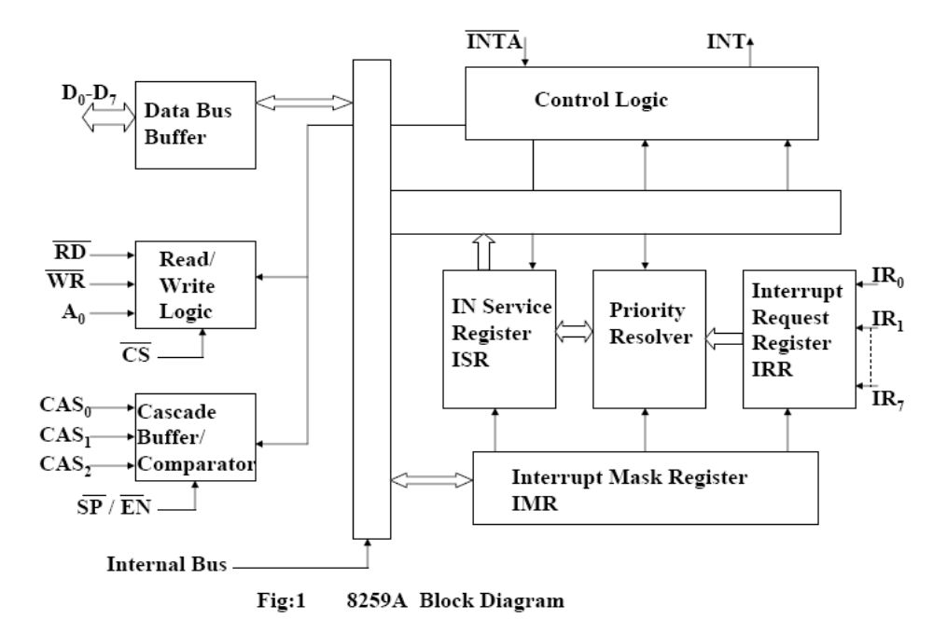
Internal Block Diagram of 8259A
ROSHAN FERNANDES, DEPT OF CSE

Slide 47
Contd..
The data bus allows the 8086 to send control words to the 8259A and read a status word from the 8259A
The RD and WR inputs control these transfers when the device is selected by asserting its chip select CS input low
The 8 bit data bus also allows the 8259A to send interrupt types to the 8086

Slide 48
Contd..
If the 8259A is properly enabled, an interrupt signal applied to any one of the inputs IR0 – IR7 will cause the 8259A to assert its INT output pin high
If this pin is connected to the INTR pin of an 8086 and if the 8086 interrupt flag is set, then this high signal will cause the INTR response

Slide 49
Contd..
The INTA input of the 8259A is connected to the INTA output of the 8086
The 8259A uses the first INTA pulse from the 8086 to do some activities that depend on the mode in which it is programmed
When it receives the second INTA pulse from the 8086, the 8259A outputs an interrupt type on the 8-bit data bus

Slide 50
Contd..
It sends the 8086 a specified interrupt type for each of the eight interrupt inputs
The IR0 input has the highest priority, the IR1 input the next highest, and so on down to IR7, which has the lowest priority
If two interrupt signals occur at the same time, the 8259A will service the one with the highest priority first, assuming that both inputs are unmasked (enabled) in the 8259A

Slide 51
Contd..
The Interrupt Mask Register (IMR) is used to disable (mask) or enable (unmask) individual interrupt inputs
Each bit in this register corresponds to the interrupt input with the same number
We can unmask an interrupt input by sending a command word with a 0 in the bit position that corresponds to that input

Slide 52
Contd..
The Interrupt Request Register keeps track of which interrupt inputs are asking for service
If an interrupt input has an interrupt signal on it, then the corresponding bit in the interrupt request register will be set

Slide 53
Contd..
The In-Service Register keeps track of which interrupt inputs are currently being serviced
For each input that is currently being serviced, the corresponding bit will be set in the In-Service Register

Slide 54
Contd..
The Priority Resolver acts as a “judge” that determines if and when an interrupt request on one of the IR inputs gets serviced

Slide 55
Contd..
Cascade Buffer/Comparator :
This block stores and compares the ID’s all the 8259A used in system
The three I/O pins CAS 0-2 are outputs when the 8259A is used as a master
The same pins act as inputs when the 8259A is in slave mode

Slide 56
Contd..
CAS0 – CAS2 Cascade Lines:
A signal 8259A provides eight vectored interrupts
If more interrupts are required, the 8259A is used in cascade mode
In cascade mode, a master 8259A along with eight slaves 8259A can provide up to 64 vectored interrupt lines
These three lines act as select lines for addressing the slave 8259A

Slide 57
Contd..
The device 8259A can be interfaced with any CPU using either Polling or Interrupt
In polling, the CPU keeps on checking each peripheral device in sequence to ascertain if it requires any service from the CPU
If any such service request is noticed, the CPU serves the request and then goes on to the next device in sequence

Slide 58
Contd..
After all the peripheral device are scanned as above the CPU again starts from first device
This type of system operation results in the reduction of processing speed because most of the CPU time is consumed in polling the peripheral devices

Slide 59
Contd..
In the interrupt driven method, the CPU performs the main processing task till it is interrupted by a service requesting peripheral device
The net processing speed of these type of systems is high because the CPU serves the peripheral only if it receives the interrupt request

Slide 60
Initializing an 8259A
The command words are sent to an 8259A to initialize it
According to the flow chart given in next slide, an ICW1 and an ICW2 must be sent to any 8259A in the system
If the system has any slave 8259As (cascade mode), then an ICW3 must be sent to the master and a different ICW must be sent to the slave

Slide 61
Contd..
The 8259A must be initialized by writing two to four command words into the respective command word registers
These are called as initialized command words
If A0 = 0 and D4 = 1, the control word is recognized as ICW1. It contains the control bits for edge/level triggered mode, single/cascade mode, call address interval and whether ICW4 is required or not

Slide 62
Contd..
If A0=1, the control word is recognized as ICW2. The ICW2 stores details regarding interrupt vector addresses

Slide 63
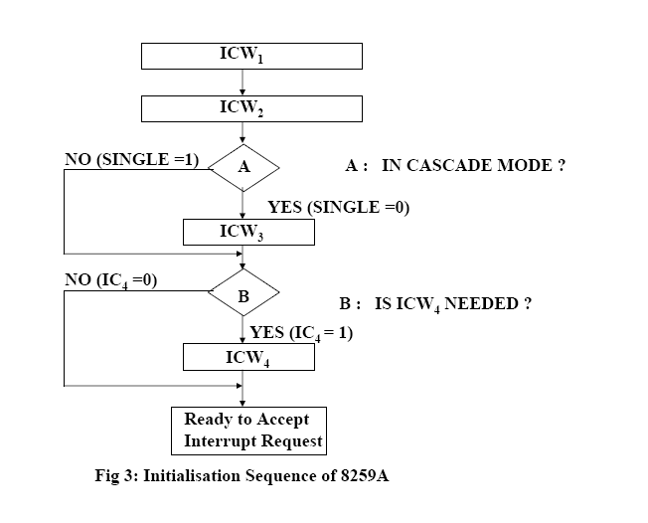
Contd..

Slide 64
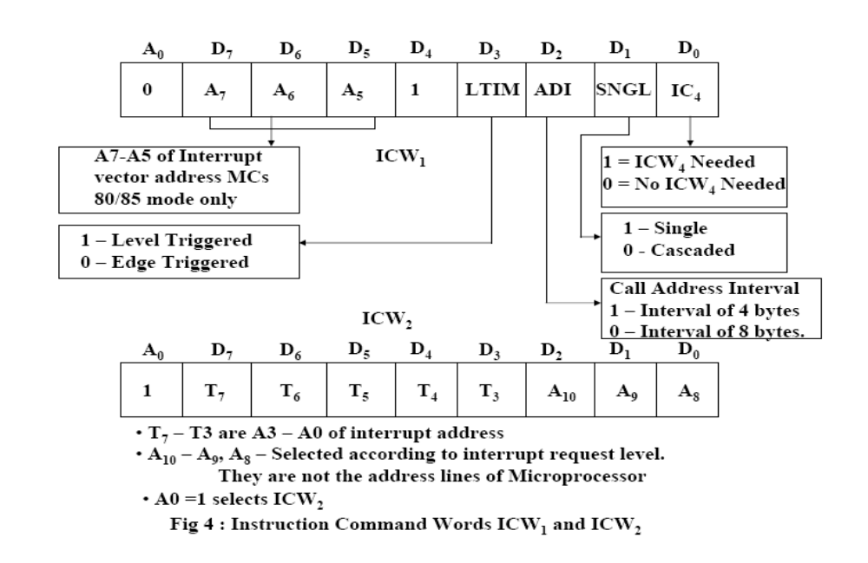
Contd..

Slide 65
Contd..
Once ICW1 is loaded, the following initialization procedure is carried out internally
  The edge sense circuit is reset, i.e. by default 8259A interrupts are edge sensitive
  IMR is cleared
  IR7 input is assigned the lowest priority
  Slave mode address is set to 7
  Special mask mode is cleared and status read is set to IRR
  If IC4 = 0, all the functions of ICW4 are set to zero Master/Slave bit in ICW4 is used in the buffered mode only

Slide 66
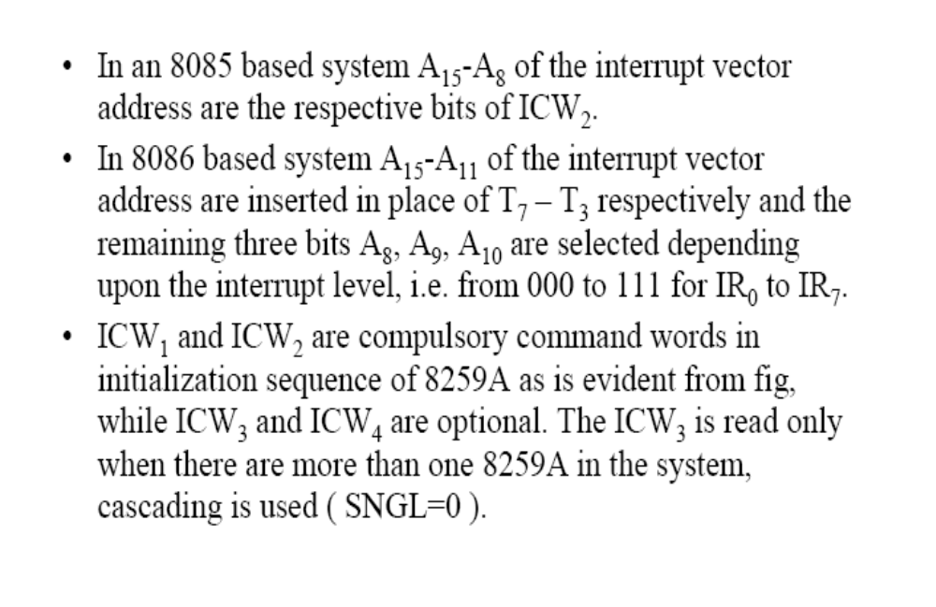
Contd..

Slide 67
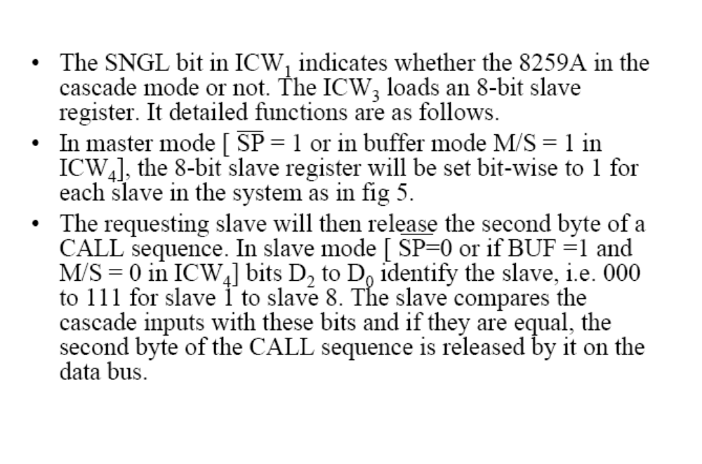
Contd..
ROSHAN FERNANDES, DEPT OF CSE

Slide 68
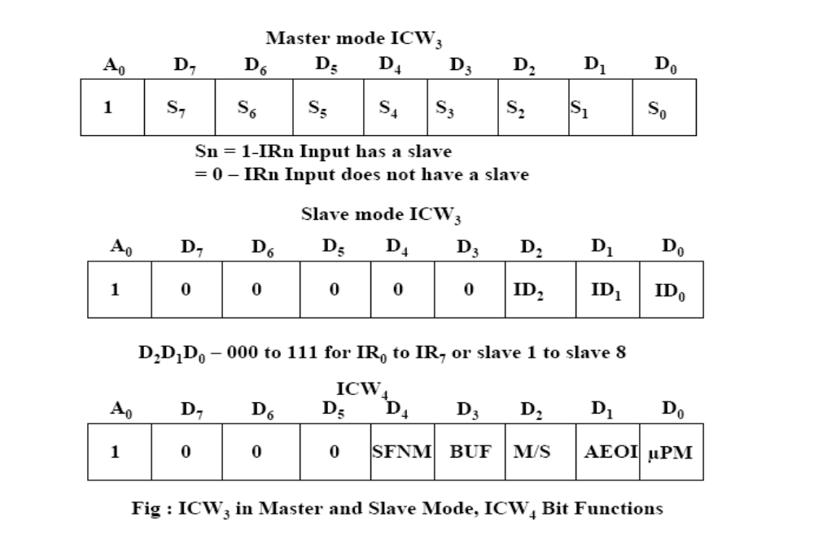
Contd..

Slide 69
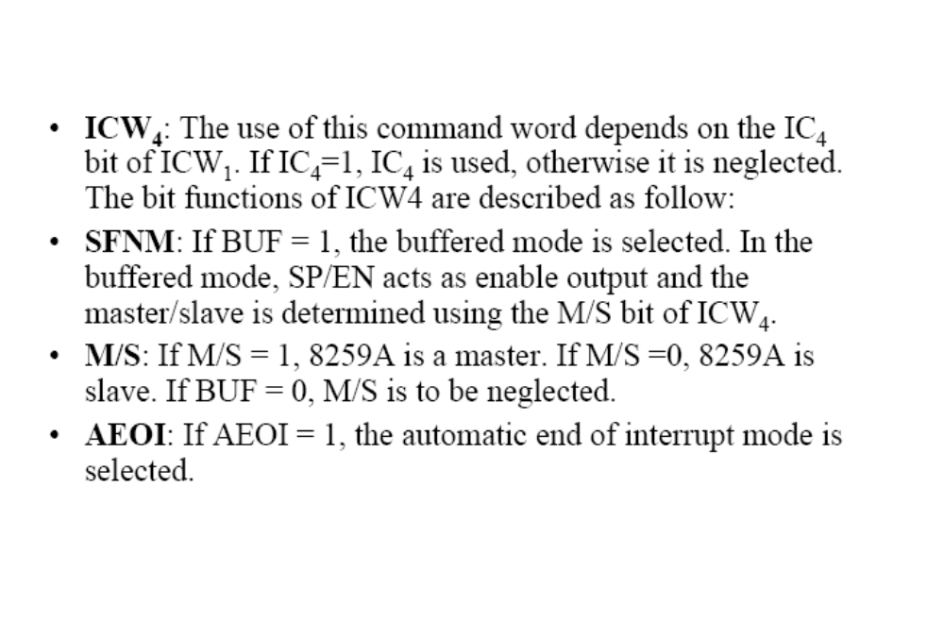
Contd..
ROSHAN FERNANDES, DEPT OF CSE

Slide 70

Contd..

