Slide 1
Computer architecture & Organization
Architecture describes what the computer does organization describes how it does it.
The architecture of a computer is the set of resources seen by the computer programmer. It includes general purpose registers, the status word, the instruction set, the address space, etc.
Computer organization is how operational attributes are linked together and contribute to realize the architectural specifications.
80x86 ISAs : instructions, operands, operations etc

Slide 2
Computer architecture
The term organization includes the high-level aspects of a computer's design, such as the memory system, the memory interconnect, and the design of the internal processor or CPU (central processing unit—where arithmetic, logic, branching, and data transfer are implemented).
For example, two processors with the same instruction set architectures but very different organizations are the
AMD Opteron 64 and the Intel Pentium 4. Both processors implement the x86 instruction set, but they have very different pipeline and cache organizations.
word architecture covers all three aspects of computer design—instruction set architecture, organization, and hardware.

Slide 3
Introduction
Single processor computer : Von Neumann
In this architecture a program is first stored in memory
Processor fetch, decode and execute instruction one at a time
Speed of this computer is limited by the speed at which processor retrieve instructions and data from memory and speed at which it can process the retrieved data

Slide 4
How do we increase speed of computers
How do we increase the speed of computers?
Use parallelism in single processor
Overlapping operations of various units of computer : Processor and I/o work simultaneously
Overlapping operations of successive instructions : pipelining
Superscalar architecture : multiple instructions in one clock cycle
Parallel computers
Use number of interconnected processors to work cooperatively to solve the problem

Slide 5
Introduction
bandwidth or throughput is the total amount of work done in a given time, such as megabytes per second for a disk transfer
latency or response time is the time between the start and the completion of an event, such as milliseconds for a disk access

Slide 6
Performance
Execution of program -turnaround time
CPU time needed to execute program: CPU clock cycles for a program x Clock cycle time
-cycles per instruction(CPI)
Time=Ic*CPI*ţ
=Ic*(p+m*k)*ţ
The above five performance parameters are influenced by four system attributes : instruction set architecture, Compiler technology, CPU implementation and control, cache and memory hierarchy

Slide 7
CPU time T =C*ţ=C/f where C number of cycles CPI=C/Ic
Cpu time T= Ic*CPI/f
MIPS=Ic/T*10⁶=f/(CPI*10⁶⁾=f*Ic/(C*1o⁶⁾
CPU time T=Ic*10⁻⁶/MIPS
Flops : floating point operations per second
Mega, tera and peta(10¹⁵)
Throughput rate : programs per second

Slide 8
Pipeline
The speed of execution of programs is influenced by many factors
One way to improve performance is to use faster circuit technology to implement the processor and the main memory
Another possibility is to arrange the hardware so that more than one operation can be performed at the same time.in this way the number of operations performed per second is increased, even though the time needed to perform any one operation is not changed

Slide 9
Pipeline
Pipe ling is an effective method of increasing the execution speed of processors provided the following ideal conditions. Also known as instruction level parallelism (ILP)
It is possible to break up an instruction into a number of independent parts each part taking equal time to execute
There is so called locality in instruction execution i.e. instructions are executed in sequence one after the other in the order in which they are written. If the instructions are not executed in sequence but jump around due to many branch instructions then pipelining is not effective
Successive instructions are also independent of one another
Sufficient resources are available in a processor so that if a resource is required by successive instructions in the pipeline it is readily available

Slide 10
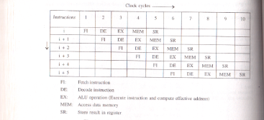
pipeline

Slide 11
pipeline
Performance
Let total number of instructions executed=m
CPI=n
Time taken w/o pieline=mn
Time taken with pipeline=n+(m-1)
Speedup=mn/n+(m-1)=n/n/m+(m-1)/m)
If m>>n then speedup=n

Slide 12
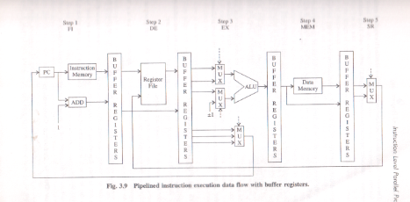
pipeline

Slide 13
Pipeline
First non ideal condition is extra buffer registers between pipeline stages
So it will take (1+e) clock cycles
Speedup=mn/(n+m-1)(1+e)=n/(1+e)
Speedup further reduces if the number of clock cycles needed per instruction in non-pipelined model is smaller than n i.e. number of stages of pipeline

Slide 14
Pipelining
Pipelining, however, has several limitations.
The speed of a pipeline is eventually limited by the slowest stage.
For this reason, conventional processors rely on very deep pipelines (20 stage pipelines in state-of-the-art Pentium processors).
However, in typical program traces, every 5-6th instruction is a conditional jump! This requires very accurate branch prediction.
The penalty of a misprediction grows with the depth of the pipeline, since a larger number of instructions will have to be flushed.

Slide 15
Hazards
Delays in pipeline execution of instructions due to non-ideal conditions are called pipeline hazards in the literature
Delays due to resource constraints is known as structural hazard or resource dependency
Delay due to dependency between instructions known as data hazard
Delays due to branch instructions known as control hazard or branch hazard

Slide 16
Structural hazard
Delay due to resource constraints
Suppose instruction I requires to read/write memory and i+3 require fetching from memory
Only one of these instructions can be carried out and other has to wait. Forced waiting of an instruction in pipeline processing is called pipeline stall
Solution : we used two different memories(cache) for instructions and data to avoid such stall
Pipeline execution may also be stalled if one of the steps takes longer then one clock cycle. Here resource is not available. Solution is to have to speed up floating point execution by extra hardware so it takes one clock cycle

Slide 17
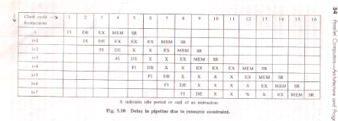
Structural hazards
Instruction i+1is floating point operation which takes 3 clock cycles

Slide 18
Loss of speedup due to resource non-availability
Assume fraction f of total number of instructions are floating point instructions which take n+k clock cycles. Total m instructions are executed
With no pipelining =m(1-f)n +mf(n+k) clock cycles
Time with pipelining=n+(m-1){(1-f)+kf}
Speed up=n/(1-f+kf) assuming m>>n and n>>kf
Let f=10%, k=2 speedup=n/1.1=0.909n

Slide 19
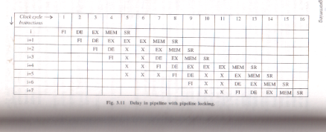
Pipeline
Some times they lock pipeline i.e. all the pipeline stages except the one that is yet to finish are stalled. It ensures that successive instructions are executed in order in which they are issued

Slide 20

Data dependency
Delay due to data dependency
Pipeline execution is delayed due to fact that successive instructions are not always independent of one another. The result produced by an instruction may be needed by succeeding instructions and the results may not be ready when needed.

Slide 21
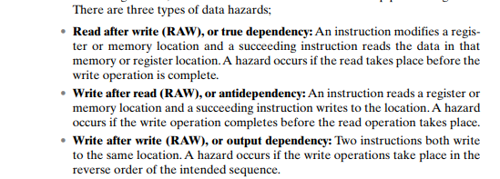
Data hazards

Slide 22

pipeline

Slide 23
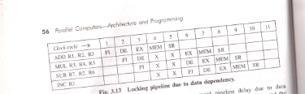
Pipeline locking

Slide 24

Data dependency
Solution
Hardware method : register forwarding Result is in buffer which is available to ALU. Hardware required to detect dependency

Slide 25

Data dependency

Slide 26
pipeline
Software method: Sequence of instructions is reordered without changing the meaning of the program

Slide 27

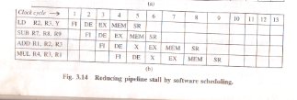
pipeline

Slide 28
A non pipelined single cycle processor operating at 100 MHz is converted into a synchro­nous pipelined processor with five stages requiring 2.5 nsec, 1.5 nsec, 2 nsec, 1.5 nsec and 2.5 nsec, respectively. The delay of the latches is 0.5 nsec. The speedup of the pipeline processor for a large number of instructions is

Slide 29
For non pipelined system time required = 2.5+1.5+2.0+1.5+2.5 =10
for pipelined system = Max(stage delay)+Max(Latch delay)
=> 2.5+0.5 = 3.0
speedup = time in non-pipelined system/time in pipelined system
= 10/3 = 3.33

Slide 30
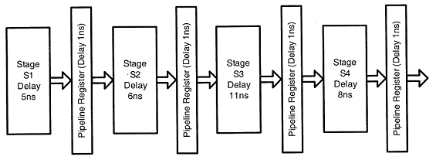
Consider an instruction pipeline with four stages (S1, S2, S3 and S4) each with combinational circuit only. The pipeline registers are required between each stage and at the end of the last stage. Delays for the stages and for the pipeline registers are as given in the figure:
What is the approximate speed up of the pipeline in steady state under ideal conditions when compared to the corresponding non-pipeline implementation?

Slide 31
So the total count will be
5+6+11+8= 30 [without pipeline]
Now, for pipeline, each stage will be of 11 n-sec (+ 1 n-sec for overhead).
and, in steady state output is produced after every pipeline cycle. Here,
in this case 11 n-sec. After adding 1n-sec overhead, We will get 12 n-sec
of constant output producing cycle.

Slide 32
A 5-stage pipelined processor has Instruction Fetch(IF),Instruction Decode(ID),Operand Fetch(OF),Perform Operation(PO)and Write Operand(WO)stages.The IF,ID,OF and WO stages take 1 clock cycle each for any instruction.The PO stage takes 1 clock cycle for ADD and SUB instructions,3 clock cycles for MUL instruction,and 6 clock cycles for DIV instruction respectively.Operand forwarding is used in the pipeline. What is the number of clock cycles needed to execute the following sequence of instructions?
Instruction Meaning of instruction
I0 :MUL R2 ,R0 ,R1 R2 ¬ R0 *R1
I1 :DIV R5 ,R3 ,R4 R5 ¬ R3/R4
I2 :ADD R2 ,R5 ,R2 R2 ¬ R5+R2
I3 :SUB R5 ,R2 ,R6 R5 ¬ R2-R6

Slide 33
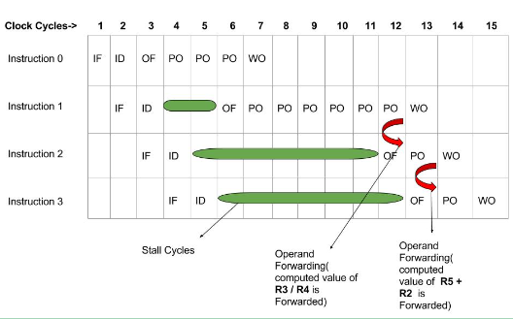

Slide 34
Efficiency = Given speed up / Max speed up = S / S_{max}
We know that, Smax = k
So, Efficiency = S / k
Throughput = Number of instructions / Total time to complete the instructions
So, Throughput = n / (k + n – 1) * Tp

Slide 35

Delay due to branch instructions
Branch instruction are known at decode stage. But branch is taken or not it knowns after Ex stage. Assume that address assignment at the end of stage 4

Slide 36
Branch Hazards
Maximum ideal speedup=5
Percentage of unconditional branches=5%
Percentage of conditional branches be 15%
Assume 80% conditional branches are taken

Slide 37
Average delay because of unconditional branches=3*0.05=0.15
Average delay due to conditional branches=3(0.15*0.8) + 2*(0.15*0.2)=0.42
Speed up with branches=5/(1+0.5+0.42)=3.18
%loss of speedup due to branches=36.4%

Slide 38
Consider an instruction pipeline with five stages without any branch prediction: Fetch Instruction (FI), Decode Instruction (DI), Fetch Operand (FO), Execute Instruction (EI) and Write Operand (WO). The stage delays for FI, DI, FO, EI and WO are 5 ns, 7 ns, 10 ns, 8 ns and 6 ns, respectively. There are intermediate storage buffers after each stage and the delay of each buffer is 1 ns. A program consisting of 12 instructions I1, I2, I3, …, I12 is executed in this pipelined processor. Instruction I4 is the only branch instruction and its branch target is I9. If the branch is taken during the execution of this program, the time (in ns) needed to complete the program is

Slide 39
Pipeline will have to be stalled till Ei stage of l4 completes,
as Ei stage will tell whether to take branch or not.
After that l4(WO) and l9(Fi) can go in parallel and later the
following instructions.
So, till l4(Ei) completes : 7 cycles * (10 + 1 ) ns = 77ns
From l4(WO) or l9(Fi) to l12(WO) : 8 cycles * (10 + 1)ns = 88ns
Total = 77 + 88 = 165 ns

Slide 40
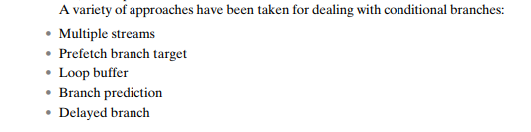
Branch hazards

Slide 41
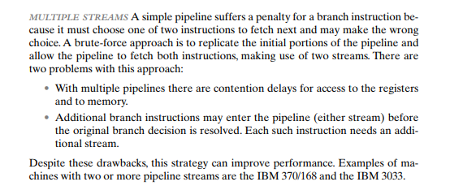

Slide 42


Slide 43
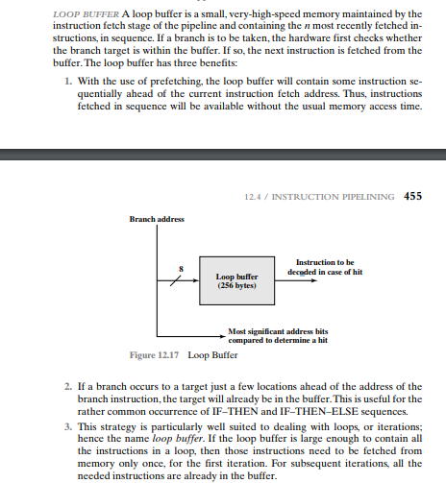

Slide 44
Branch hazards
Branch prediction buffer
Branch target buffer
BPB uses a small fast memory called Branch prediction buffer
Lower order bits of branch instruction are used as address of branch prediction buffer. It consists of Address where branch is taken and two bits count the number of times branch has been taken successfully in the immediately preceding attempts

Slide 45
At Decode state it knows , initially prediction bits are 00
Every time if branch is taken the prediction bits are incremented by 1, and if not taken are decremented by 1. if prediction bits are 11 and branch is taken it remains 11 and if not taken it is decremented to 10
Prediction bits are examine if they are 11 or 10 control jumps to branch address present in prediction buffer, otherwise next sequential instruction

Slide 46
BTB
Use at the time of instruction fetch
Address Contents prediction bits
Software method
Rearrange instructions put delay slot

